Slide 1
Tom BELLAÏCHE
Yanis DOUILI

Slide 4
64 000 deaths every year
140 deaths a day
1999 → 2015 = 560 000 deaths

Slide 5
What exactly is an opioid ?

Slide 6
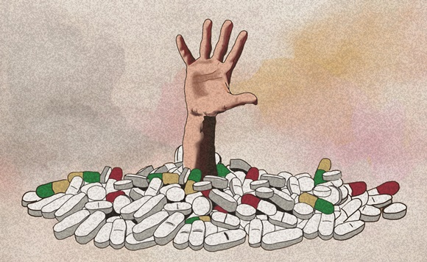
What is the opioid crisis ?
What is the crisis about ?

Slide 7
Where is the crisis most severe ?

Slide 8
Why has it gotten so much worse in recent years ?
Shouldn’t they just stop prescribing opioids ?

Slide 9
So what can be done ?

