Slide 1
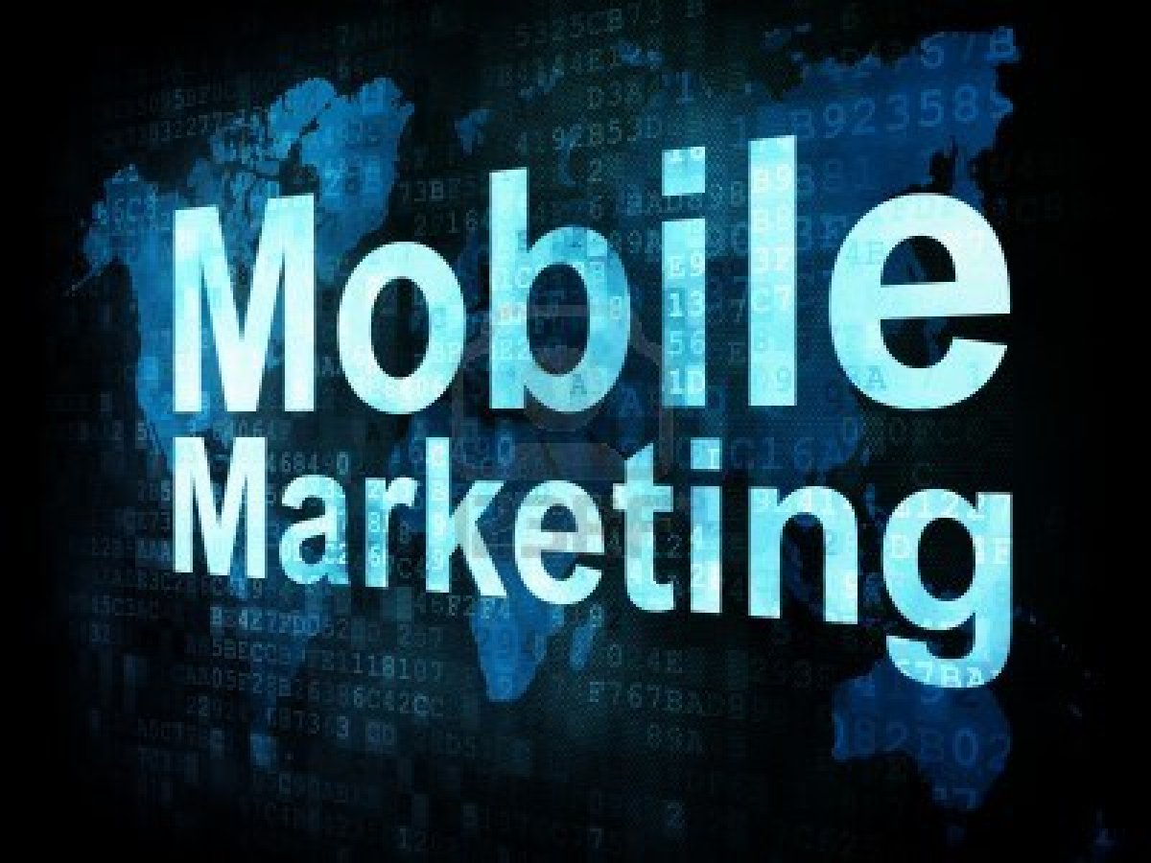
By Malek Najeh
Auna

Slide 2
Mobile marketing importance and issue
Mobile marketing means and case studies
Marketing mobile in the future

Slide 3
Definition
Mobile marketing is multi-channel online marketing technique focused at reaching a specific audience on their smart phone, tablets, or any other related devices through websites, E mail, SMS and MMS, social media or mobile applications.
Mobile marketing can provide customers with time and location sensitive, personalized information that promotes goods, services and ideas. In a more theoretical manner, academic Andreas Kaplan defines mobile marketing as "any marketing activity conducted through a ubiquitous network to which consumers are constantly connected using a personal mobile device".

Slide 4
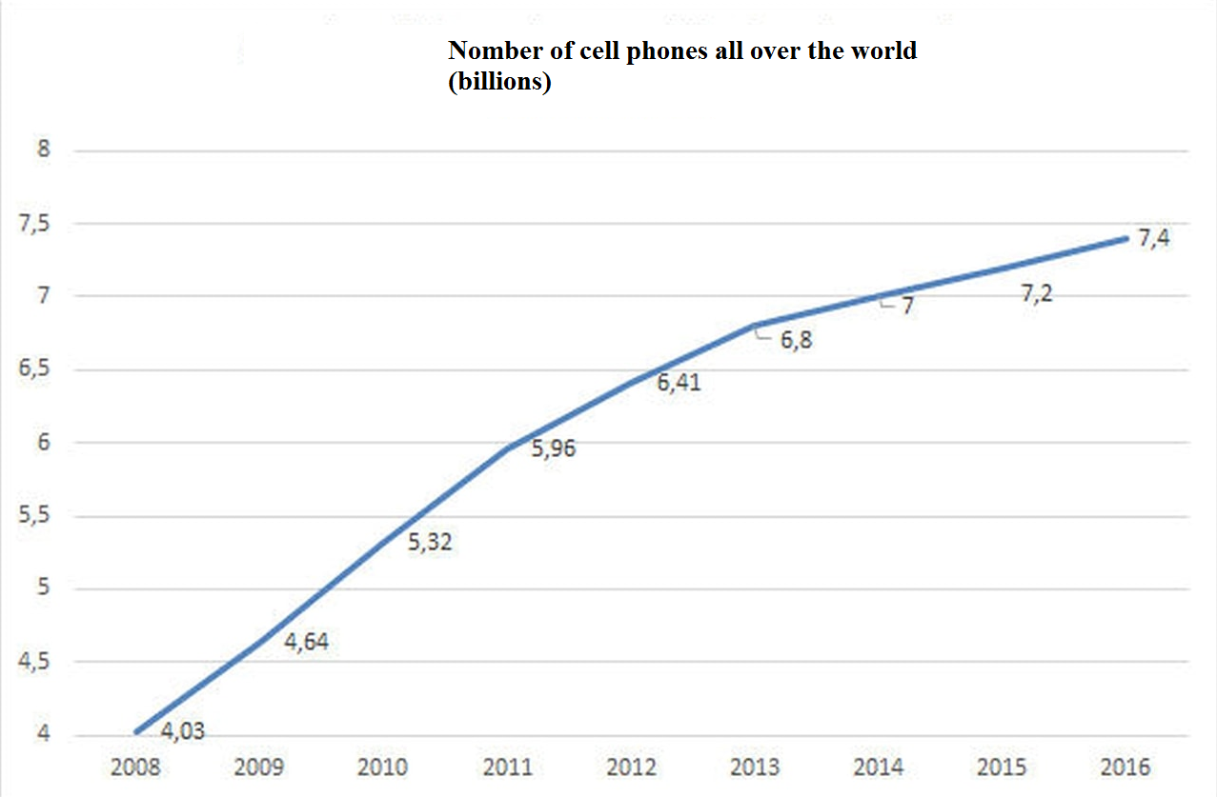

Slide 6
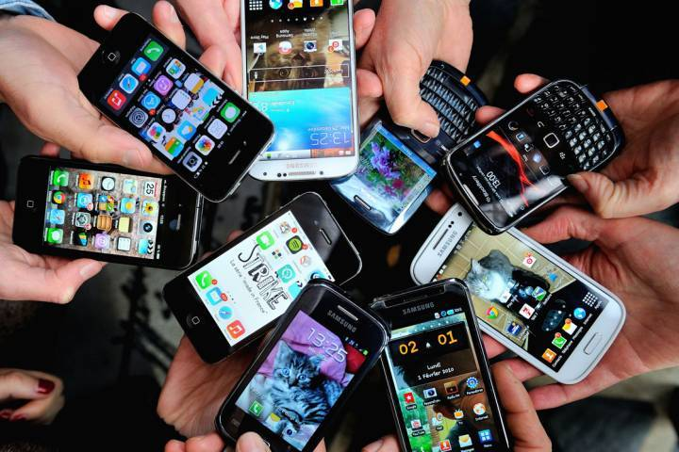
It’s expected that there will be more than 75 billion connected devices by 2020. This means there will be more devices connected and communicating by 2020 than the total number of people on this planet.

Slide 8
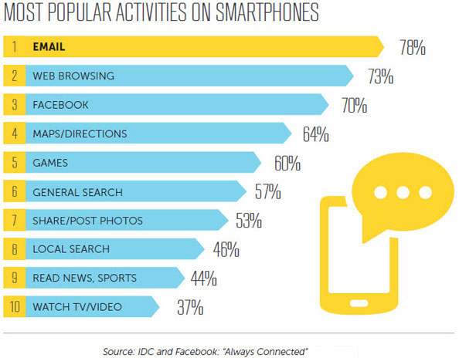

Slide 9
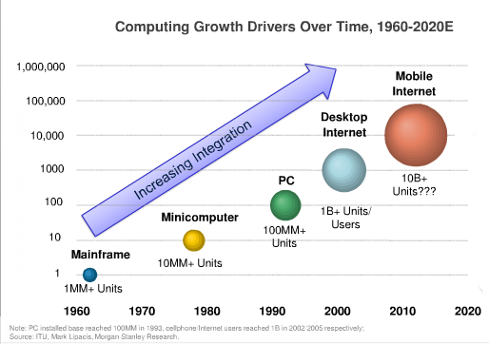

Slide 10
Global Trends Between 2011-2016
For Mobile Traffic Data
Increase 18 fold, a compound annual growth rate of 78%.
Will reach 10.8 Exabytes per month in 2016, up from 597 Petabytes per month in 2011.
Will grow 3 times faster than Global fixed IP traffic.
Global Mobile was 2% of total IP traffic in 2011, and will be 10% of total IP traffic in 2016.
Mobile data traffic in 2016 will be equivalent to 5x the volume of the entire Global Internet in 2005.

Slide 11
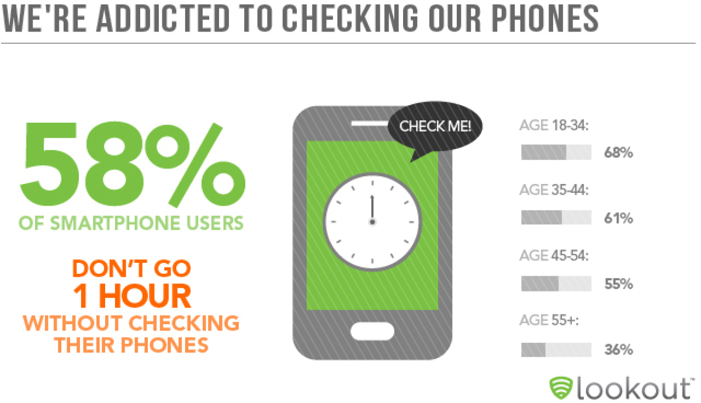

Slide 12
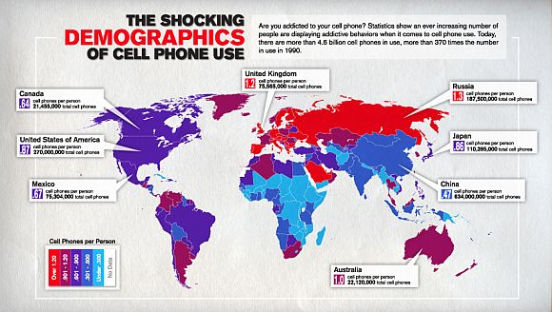

Slide 13
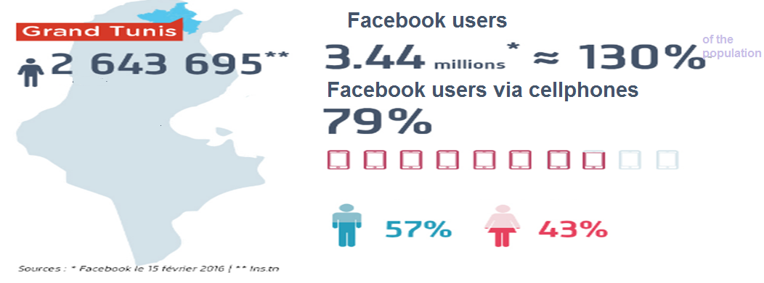
Mobile phone in tunisia
14,4 millions subscribers on the mobile phone operators (2015)
63 millions subscriber on the mobile internet
600.000 of instagram users in Tunisia ( 7th country in Africa)

Slide 14
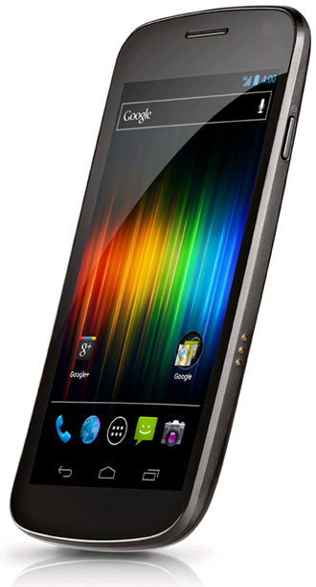
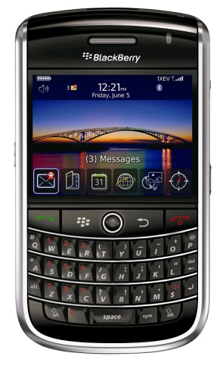
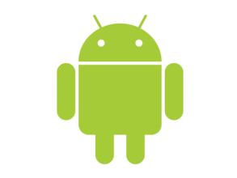
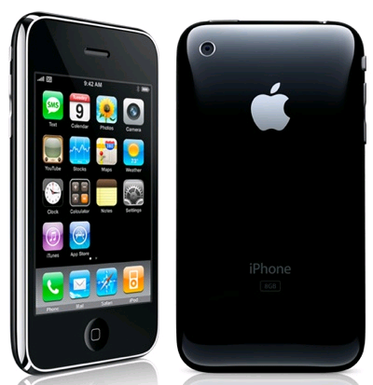
Smartphones
BlackBerry
BBM – Popular IM application available only to Blackberry
Enterprise Email System
Enhanced Security features
Limited Applications
Android - Open source software
850,000 Devices activated everyday
450,000 Applications Available
300,000,000 Android devices worldwide
Google Nexus S on Android
http://www.google.com/nexus/#/features
Apple Iphone
http://www.apple.com/iphone/features/
Siri
1080P Video Recording
What Smartphone do you have?
Notes:
Ravi
Explain different phones and operating systems very briefly to give an overview of Smartphones

Slide 15
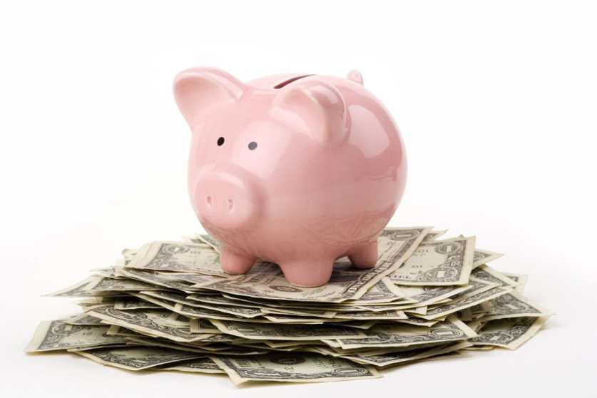
Overall by 2016, Forrester expects advertisers to spend $77 billion on interactive marketing. The consultancy broke out spending estimates in 2016 versus 2011 in these categories: * Search marketing: $33.3 billion, up 78 percent over the five-year period.
* Display advertising: $27.6 billion, up 152 percent.
* Mobile marketing: $8.2 billion, up 399 percent.
* Social media marketing: $5 billion, up 214 percent.
* Email marketing: $2.5 billion, up 63 percent

Slide 16
How can mobile marketing provide benefit?
Easy to Use: Most interactions in one or two clicks
Creates database: Consumers opt-in to receive offers
Customizable: Limited only by creativity
Instant Response: Coupons, links, and codes acted upon
Strong Delivery: Messages delivered and read in < 24 hours
Scalable: Can use several platforms, with room for growth
Cost Effective: Cost of Entry in the $$$, not the $,$$$

Slide 17
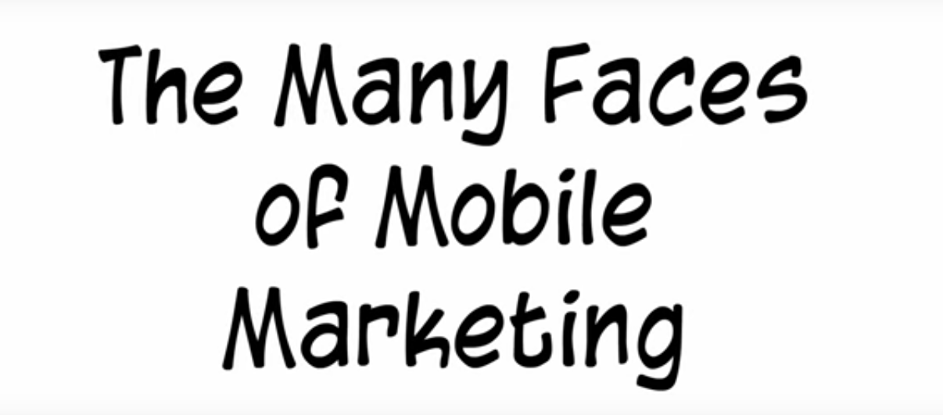

Slide 18
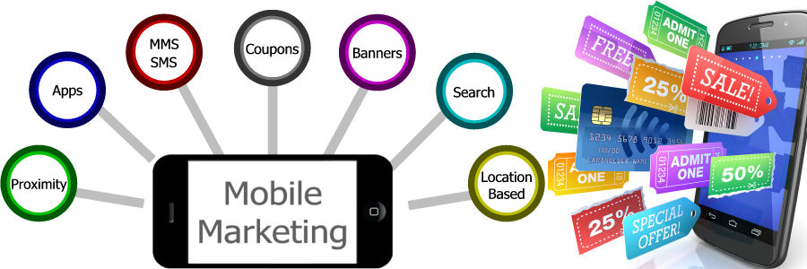
MMS
Multimedia messaging service
MOBILE APPLICATIONS
Location-based marketing
Mobile web sites/Mobile Ads

Slide 19
SMS
TEXT messages of 160 caracters sent to mobile phones
SMS marketing involves capturing a user’s phone number and sending them text offers
Two types:
Pull SMS : the Customers asked for the sms
Push SMS: the advertiser initiate the sms sending

Slide 20
SMS
How to use it??

Slide 21
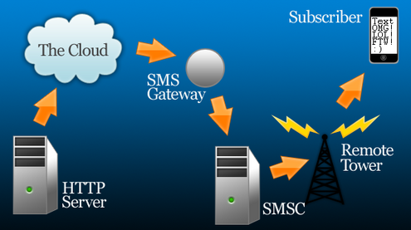
SMS
How to implement it??

Slide 22
SMS

Slide 23
SMS
38% of the customers had already buy products after reciving a marketing sms (based on a study on 13000 persons in 13 countries)
88% of the customers in France are interested by receiving advertisement sms from their favorite brands

Slide 24
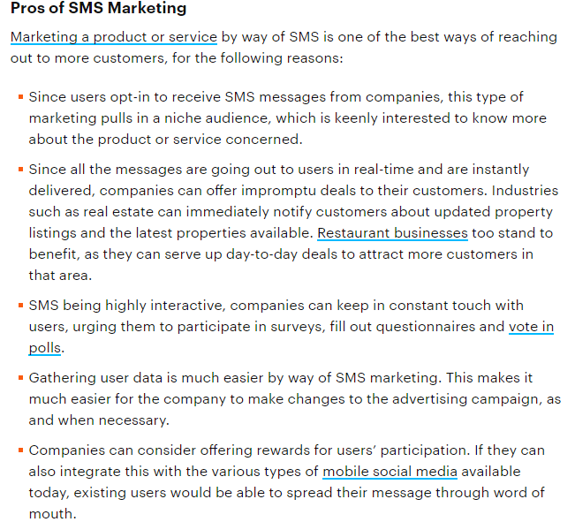
SMS

Slide 25
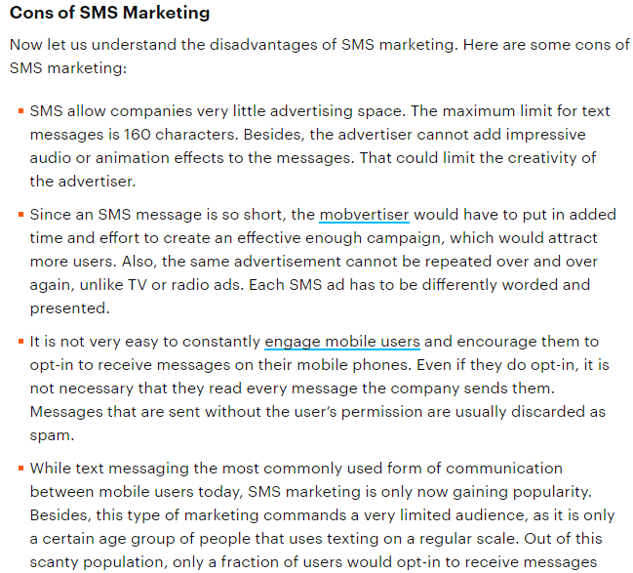
SMS

Slide 26
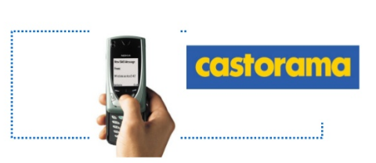
SMS
When a customers doesnt come to their stores for a trimesters, the french chain of DIY stores
Castorama send him a promotional SMS to encourage him to come
Return to the store rate :30%

Slide 27
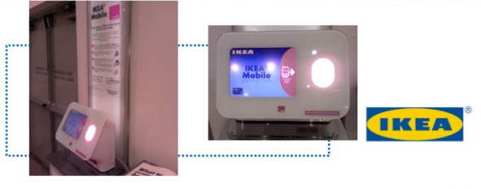
SMS
For the opening of its new store in Seattle, Ikea set up loyalty program
The costumers were asked to send ikea1 by sms so they receive an sms
with a bar code corresponding to personalized promotional offer

Slide 28
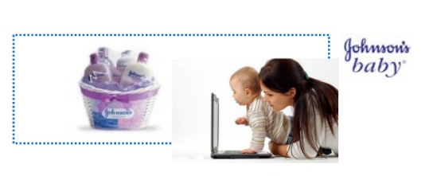
SMS
To build customers loyalty, Johnson asked pregnant women who come to the stores,
to give their delivery date
So they can support them and send them useful informations for each pregnancy stage

Slide 29
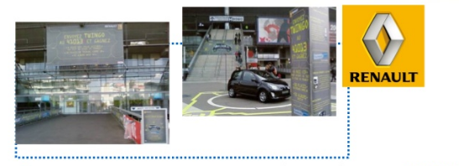
SMS
The French car firm Renault achived the product launch of the limited edition car model : twingo by nokia by seting up an SMS contest.
Un sms containing Twingo had to be sent on the number 41013
The contest was promoted by advertising billboard in the STADE DE FRANCE stadium, and 13,000 of 160,000 spectators in the stadium had participated,

Slide 30
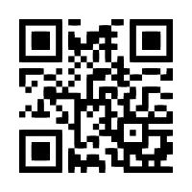
Tags/QR code
Mobile Tagging
2D Barcodes
Quick Response Barcodes

Slide 31
Tags/QR code
The QR code system was invented in 1994 in Japan.
Its purpose was to track vehicles during manufacturing;
it was designed to allow high-speed component scanning
QR codes have become common in consumer advertising. Typically, a smartphone is used as a QR code scanner, displaying the code and converting it to some useful form
QR code has become a focus of advertising strategy, since it provides a way to access a brand's website more quickly than by manually entering a URL

Slide 32
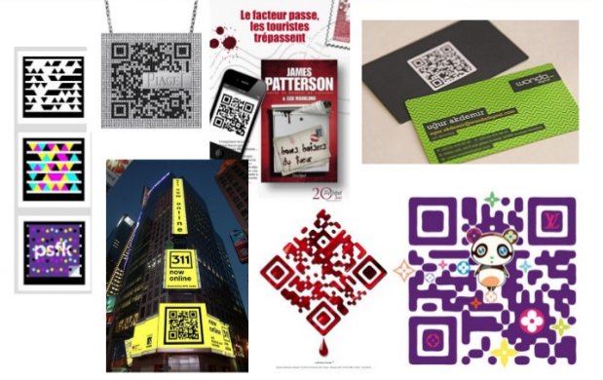
Tags/QR code
Several applications

Slide 33
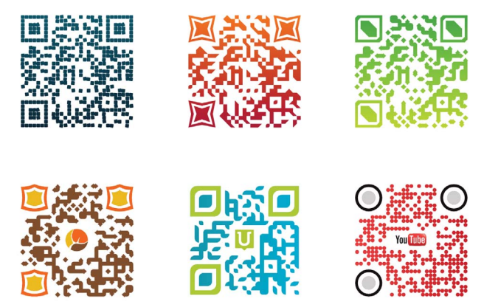
QR code: advantages
Customizable
Ease Of Use
What’s great about QR codes is that they can be added to virtually anything you can imagine, from cereal packets to advertisements on the underground.
Range Of Uses
QR codes can be used in hundreds of different ways.
Easily Trackable
The use of web analytics and unique codes for different purposes enables marketers to gain valuable insight regarding the performance of their marketing campaigns.
Playing With The Curiosity Of Mobile Users
Perhaps this is a result of QR codes being relatively new, and this effect may wear off once they become widely used by brands. But right now, mobile users couldn’t help but scan a QR code, simply to find out where it would lead them. (2016)
Extremely Cost-Effective
QR codes may seem too complicated but they have really low cost, Creating them wouldn’t put a dent in businesses’ marketing budget

Slide 34
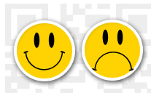
QR code: disadvantages
A QR Code Reader Is A Must
Scanning Can Take A Long Time
Lack Of Awareness
An increasing number of businesses make use of QR codes, but only a handful of the population uses them.
According to comScore, 14m US consumers use QR codes, but this only represents 6.2% of the total number of mobile users in the US. This figure also includes barcode scanning.
Real Business strategy needed
QR code campaign must be included in a business strategy to define their contents and support

Slide 35
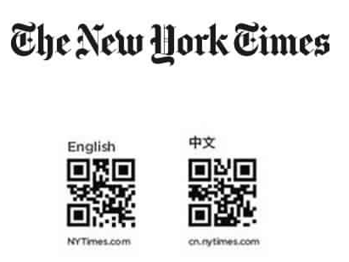
QR Code applications : Written press
New york times magazine frequently improves its editorial content
by integrating videos and offering to the readers the possibility to interact
with magazine and the journalists
In 2010 for the 10th anniversary, the magazine created a cover representing only a QR code in the innovation special issue
it gives access to 5 video illustrating innovative ideas and confirm
that the QR code was the great trend in 2010-2011

Slide 36
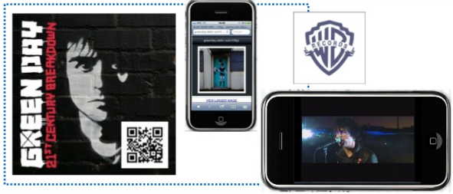
QR Code: flyer
The warner bros studio records launches a QR codes based advertising campaign for green day bands in 2009
You could see a live video of the group and the web site of the event

Slide 37
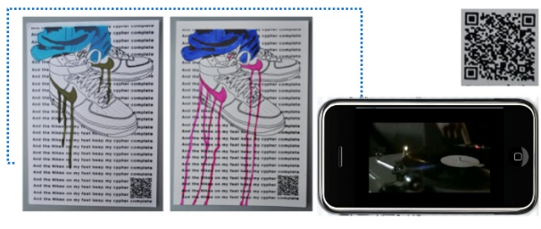
QR Code: Advertising poster
An advertising poster done by nike in 2007
The QR code redirect to a hip-hop video clip

Slide 38
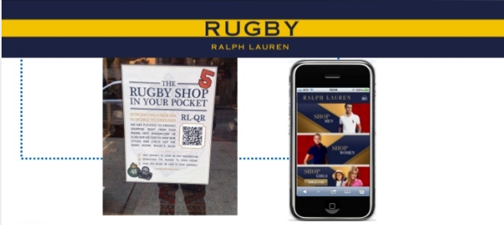
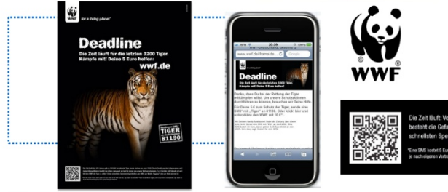
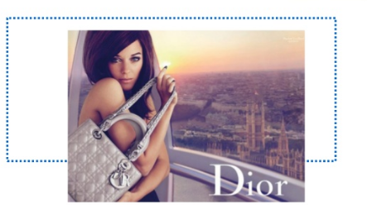
QR Code: Advertising poster

Slide 39
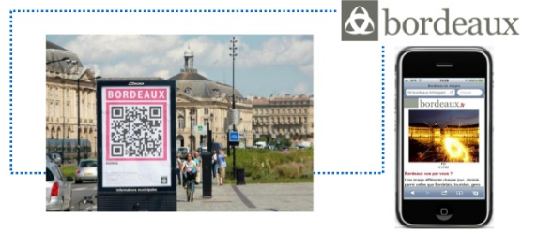
QR Code:Tourism
The QR codes offer differents informations for tourists : history of the town, monuments to visit, cultural events ..

Slide 40
QR Code applications : invitations and competitions
In 2011, during New York Fashion Week (QR) codes were omnipresent everywhere
They were on cookies doled out by Tiffany that, when scanned, revealed an invitation to a concert with Leighton Meester.
They were on a pink Barbie-themed bus, and on doll displays in stores that could be scanned for a chance to win designer clothes.
They were on postcards for a “fashion hunt” with the Madison Avenue Business Improvement District and the blog Madison Avenue Spy.
….

Slide 41
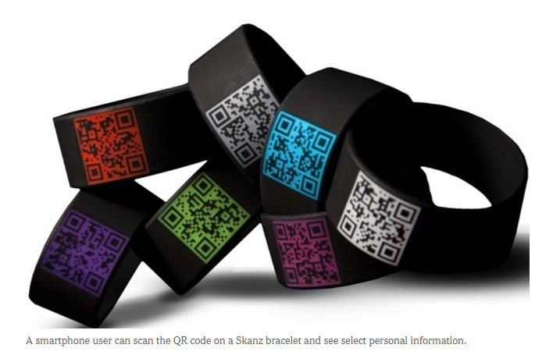
QR Code applications : invitations and competitions

Slide 42
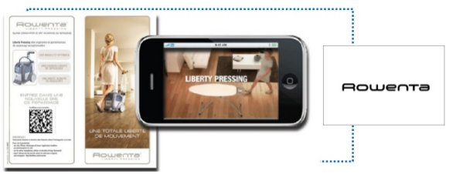
QR Code : Smart pakaging
Rowenta : an appliance brand has putted QR code on the packages of their irons
The objectives were to let the customers see the advantages of the product how it looks and how to use it without taking it out from its pachage

Slide 43
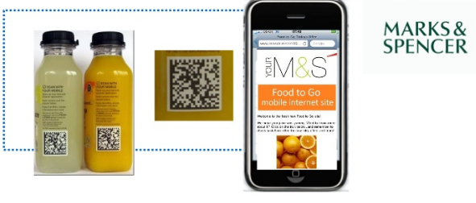
QR Code: smart packaging

Slide 44
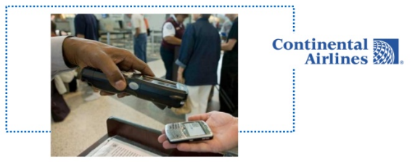
QR Code
QR codes can replace plane tickets
They are used by several compagnies

Slide 45
QR Code

Slide 46
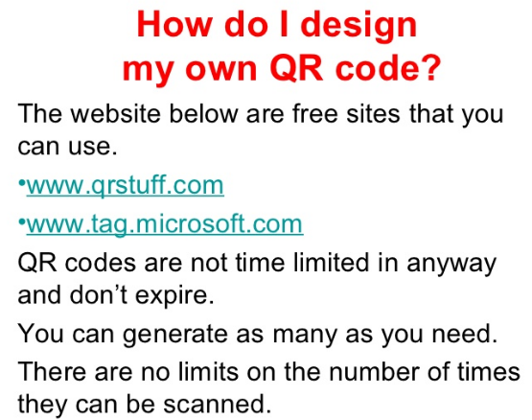
QR Code

Slide 47
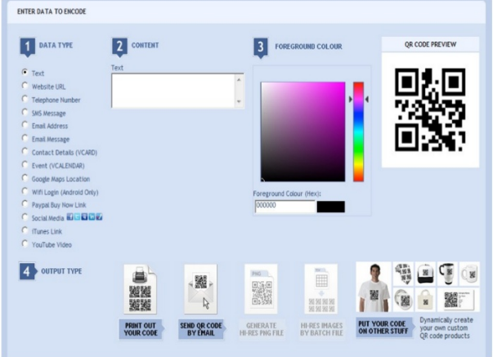
QR Code

Slide 48
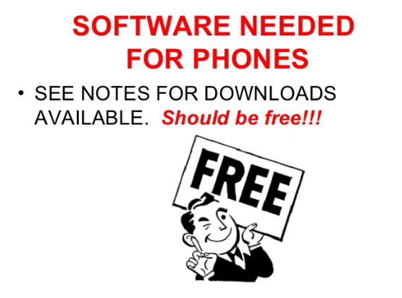
QR Code

Slide 49
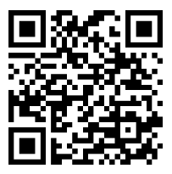
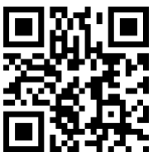
Mobile
Marketing
Try to read those tags!!

Slide 50
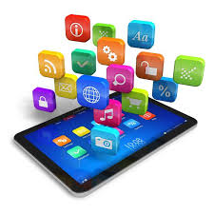
Mobile Applications
Mobile applications (also known as mobile apps) are software programs developed for mobile devices such as smartphones and tablets. They turn mobile devices into miniature powerhouses of function and fun.
Some devices come preloaded with some mobile apps courtesy of their manufacturers or the mobile service providers with which they're associated (for example, Verizon, AT&T, T-Mobile, etc.), but many more apps are available through device-specific app stores.

Slide 51
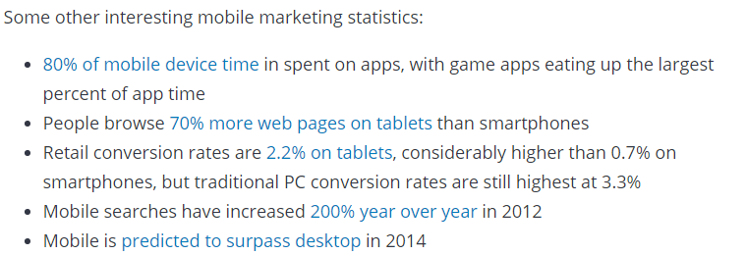
Mobile Applications

Slide 52
Mobile Applications
Mobile apps are sometimes categorized according to whether they are web-based or native apps, which are created specifically for a given platform. A third category, hybrid apps, combines elements of both native and Web apps
Many online entities have both mobile websites and mobile apps. In general, the difference lies in purpose: An app is usually smaller in scope than a mobile website, offers more interactivity, and presents more specific information in a format that's easy and intuitive to use on a mobile device
The purposes of these apps run the gamut, from utility, productivity, and navigation to entertainment, sports, fitness, and just about any others imaginable. Social media is one of the most popular fields of mobile app development and adoption. In fact, Facebook was the most widely used app in 2017 across all platforms

Slide 53
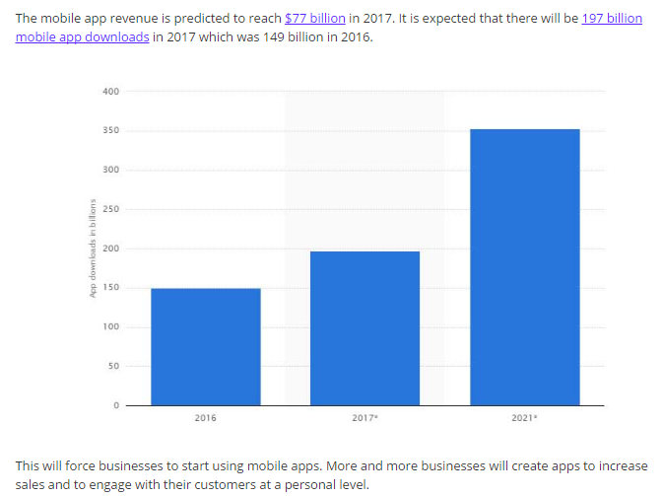
Mobile Applications

Slide 54
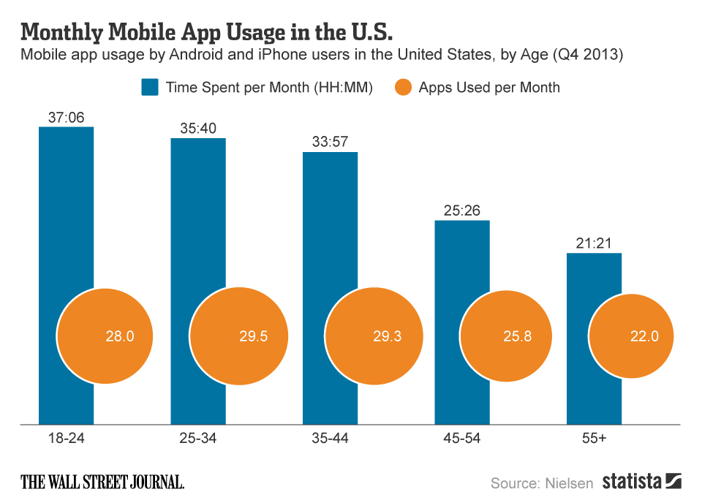
Mobile Applications

Slide 55
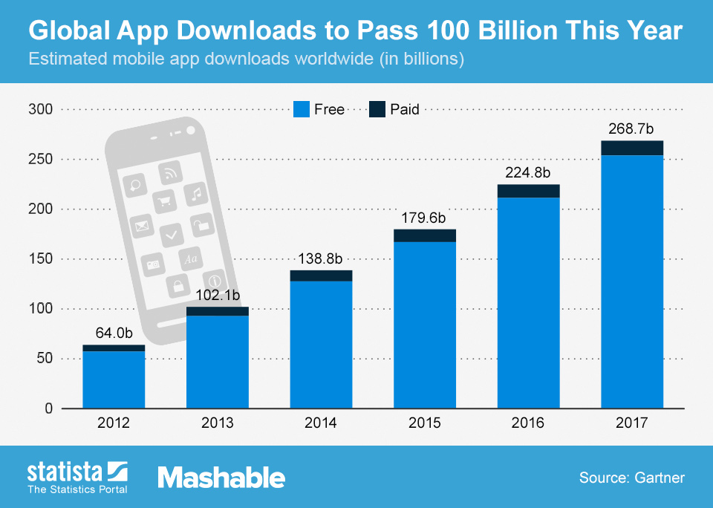
Mobile Applications

Slide 56
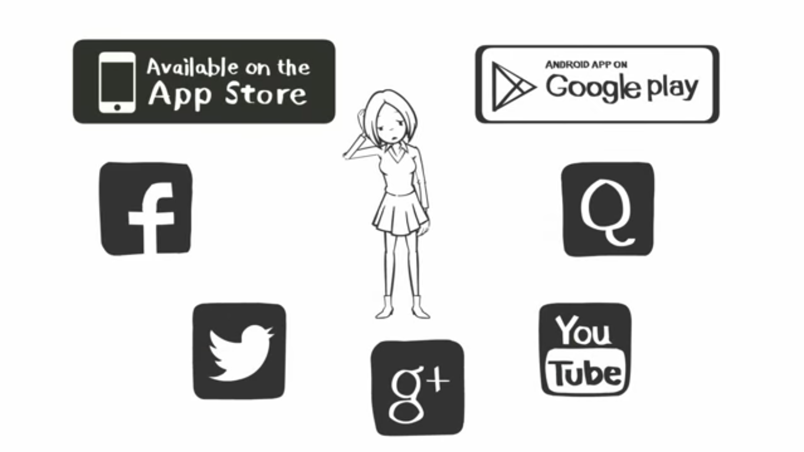

Slide 57
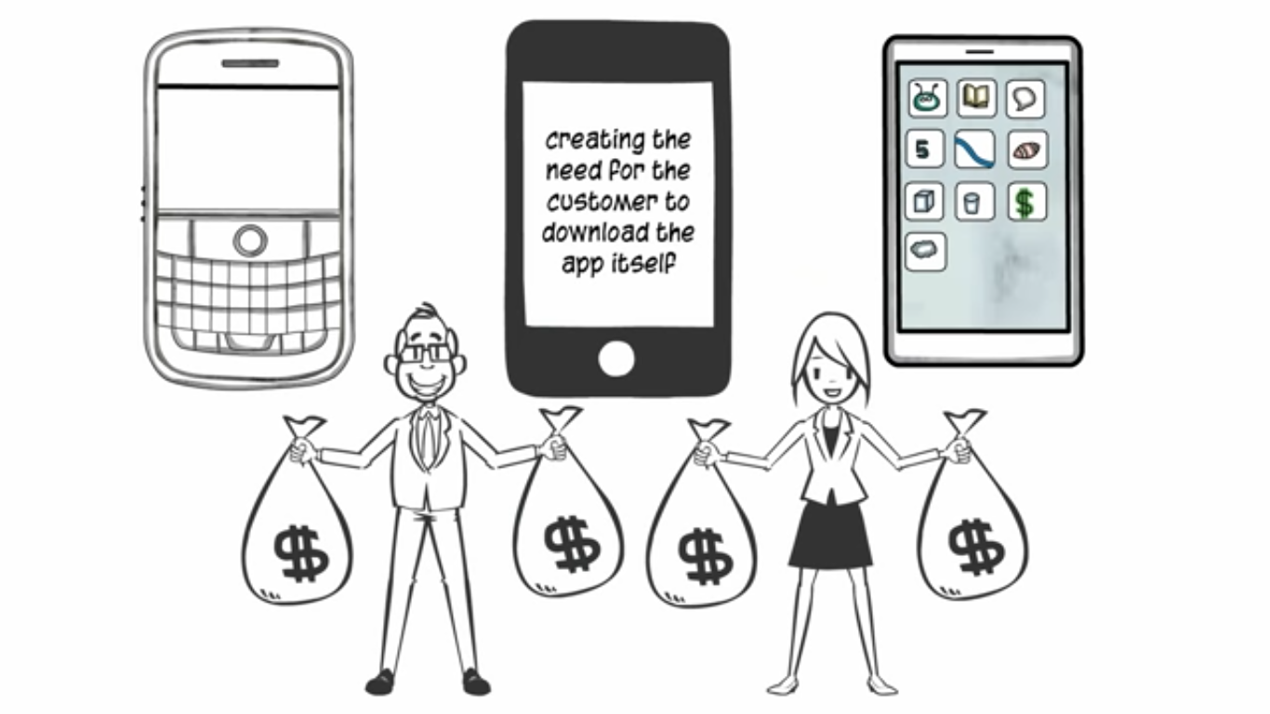

Slide 58
Research shows that only 6% of people use an app after 30 days of installing it. This happens to be a major challenge for mobile marketers

Slide 59
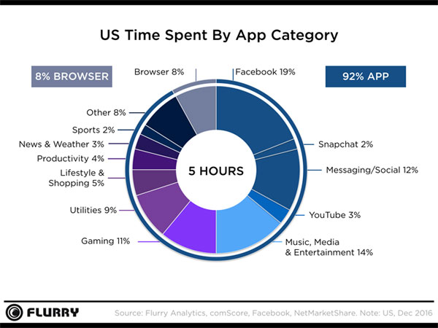

Slide 62
Mobile Marketing Trends For 2017

Slide 63
Mobile Marketing Trends For 2017

Slide 64
Mobile Marketing Trends For 2017

Slide 65
Mobile Marketing Trends For 2017

Slide 66
Mobile Marketing Trends For 2017

Slide 67
Mobile Marketing Trends For 2017

Slide 68
Mobile Marketing Trends For 2017

Slide 69
Mobile Marketing Trends For 2017

Slide 70
Mobile Marketing Strategy
Mobile Website
Mobile App
Push Alerts
(via mobile app)
Social Media

