Slide 1
Technology of
Sound Systems
Notes:
Intro

Slide 2
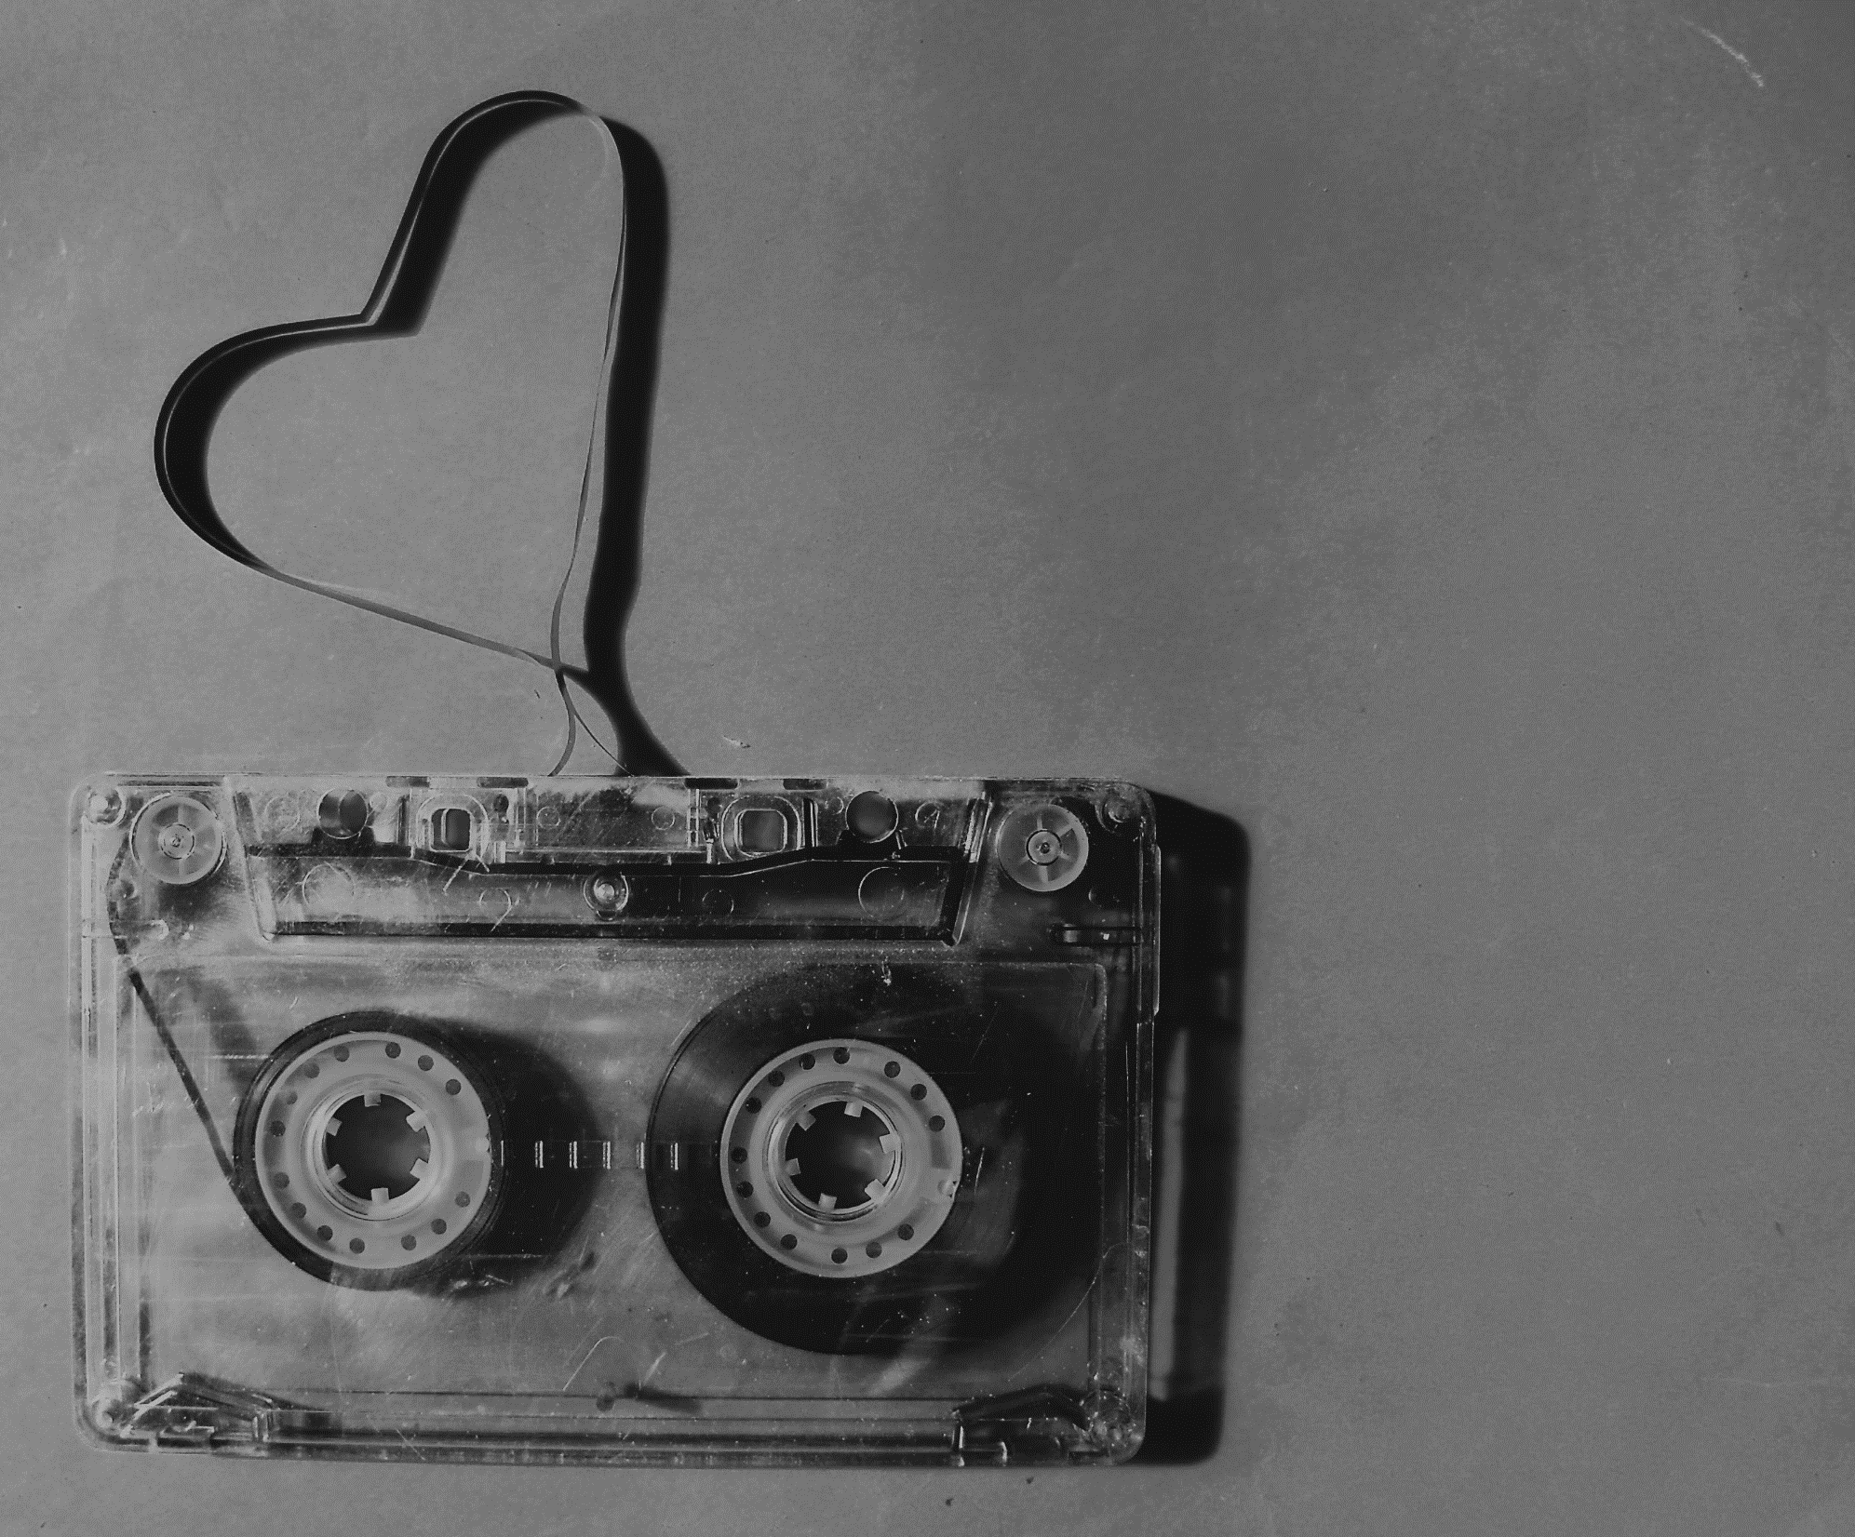
Recording sounds :
a long story …

Slide 3
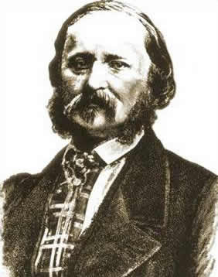
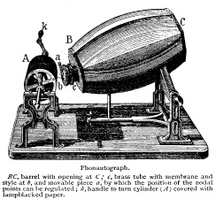
Recording sound : a long story
1857
Scott de Martinville
Phonautograph

Slide 4
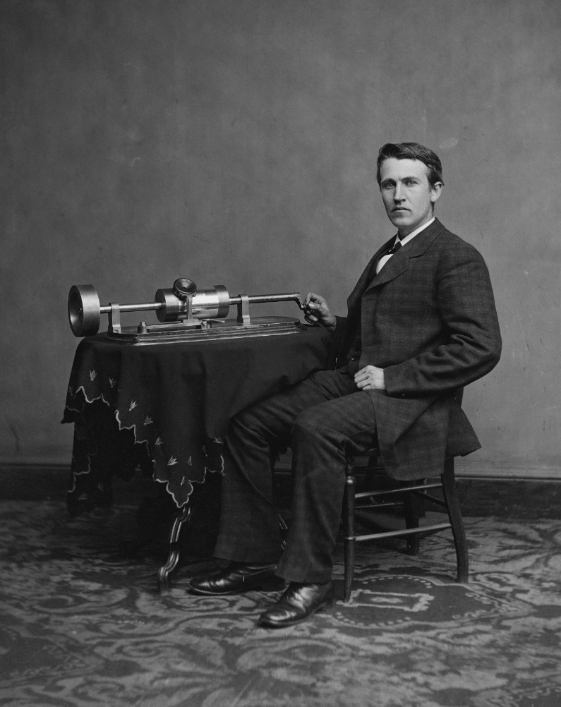
Recording sound : a long story
1857
1877
Thomas edison
Phonograph

Slide 5
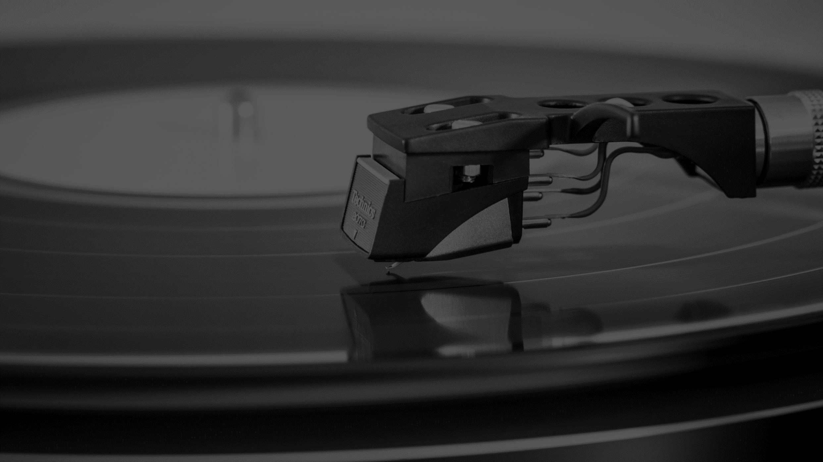
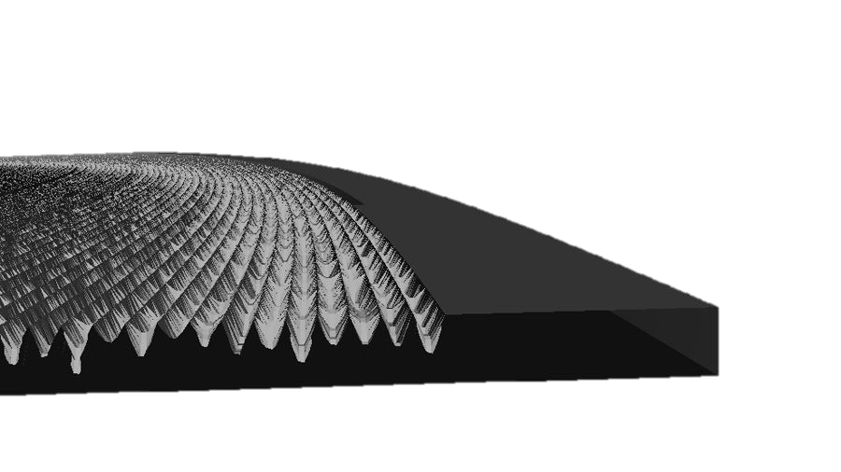
Recording sound : a long story
1857
1877
1887
1920

Slide 6
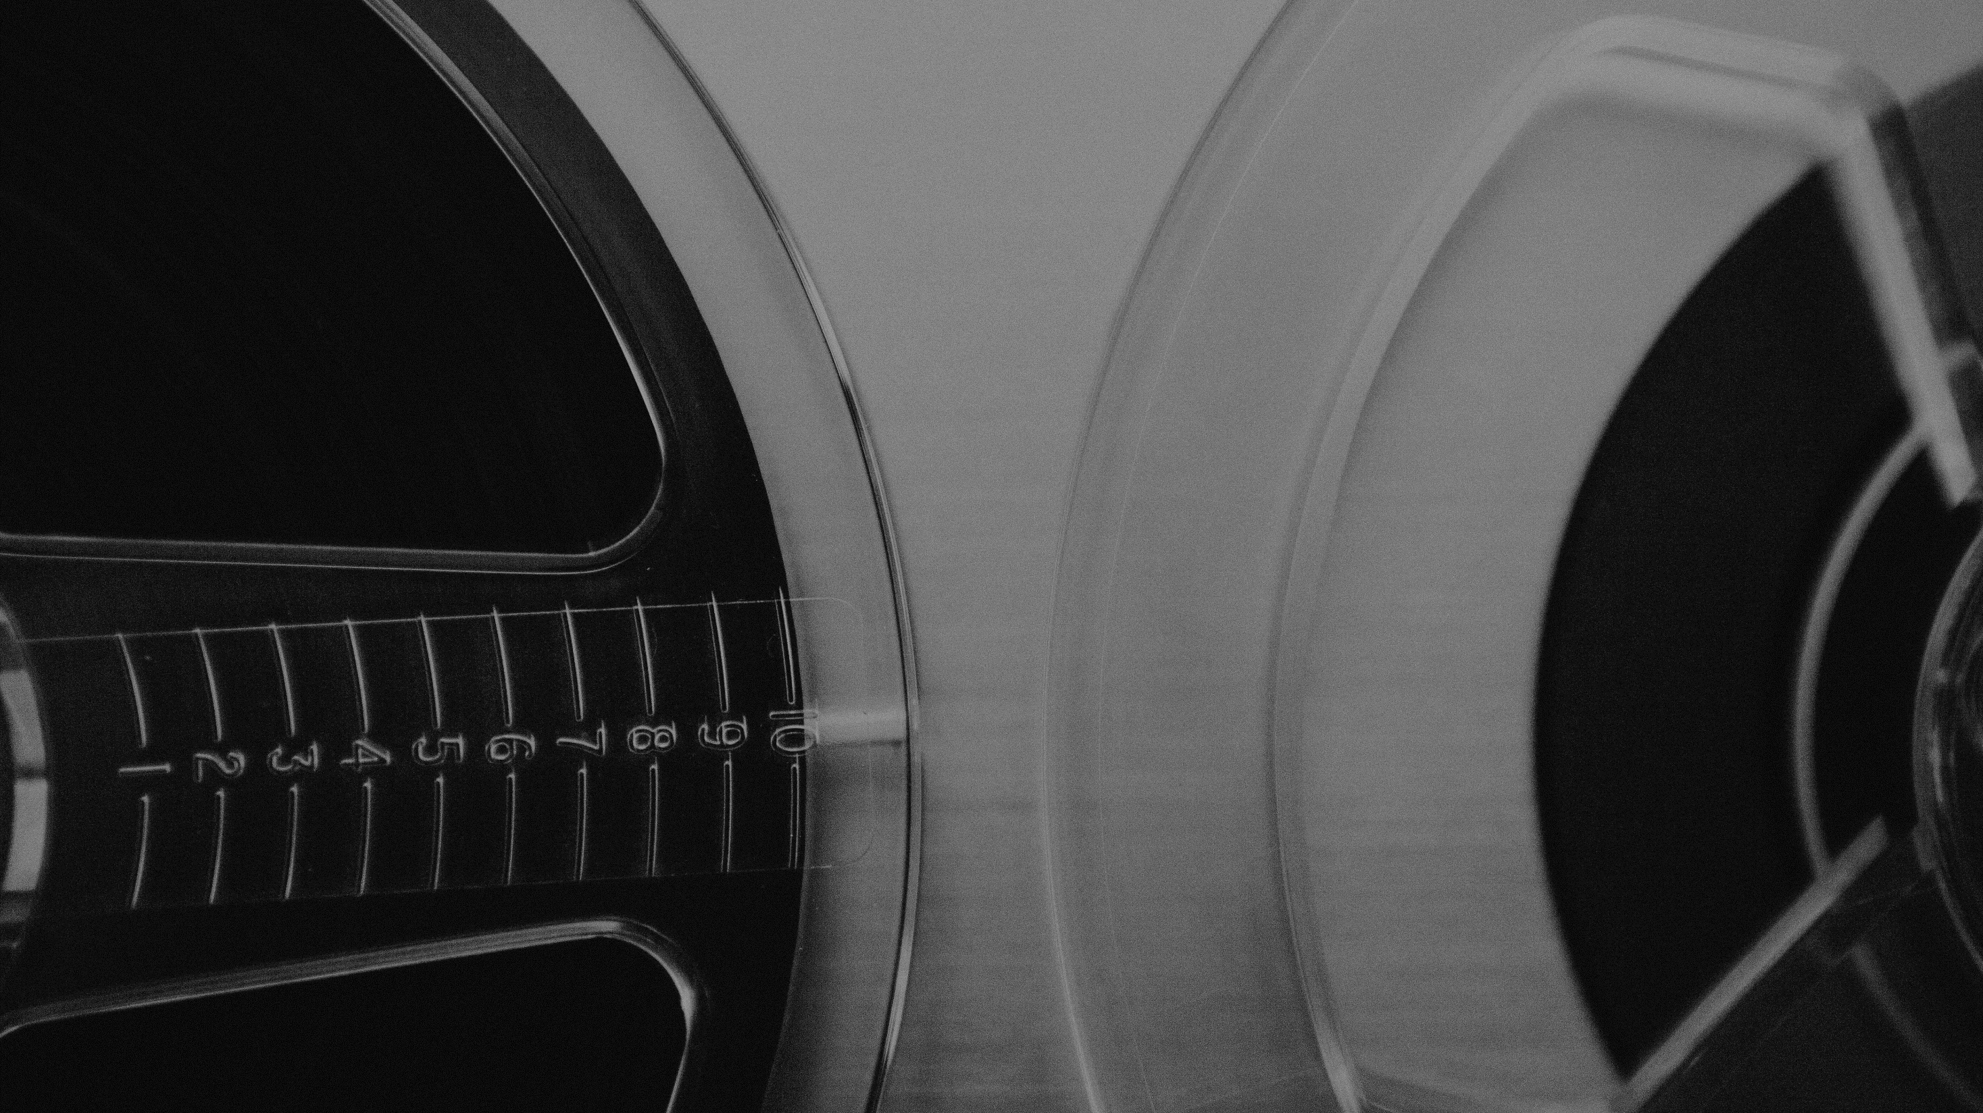
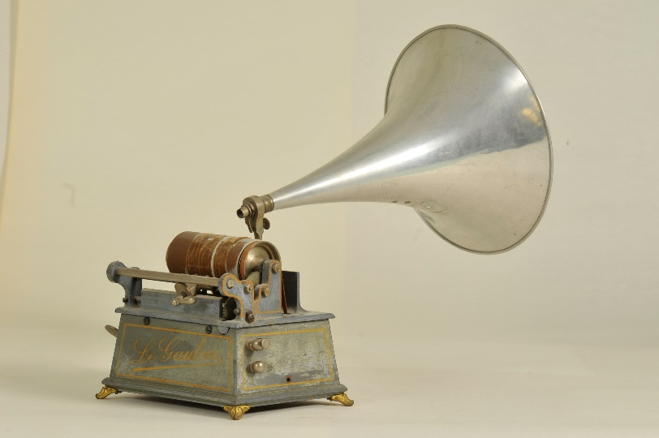
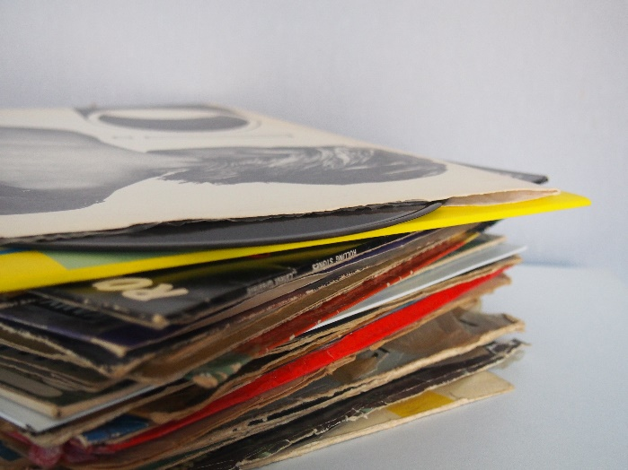
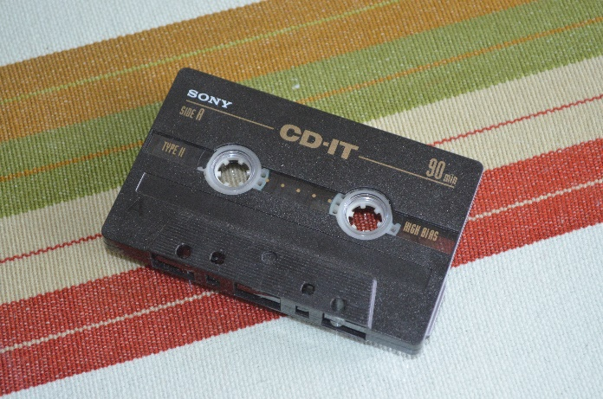
Recording sound : a long story
Phonograph
Vinyl
Cassette
1877
1920
1963

Slide 7
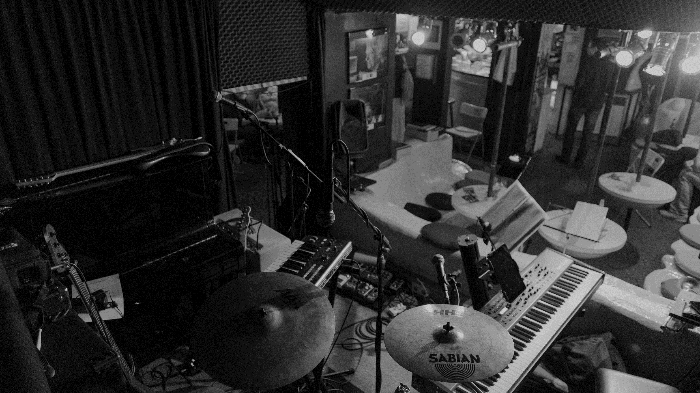
A crowd of
microphones

Slide 8
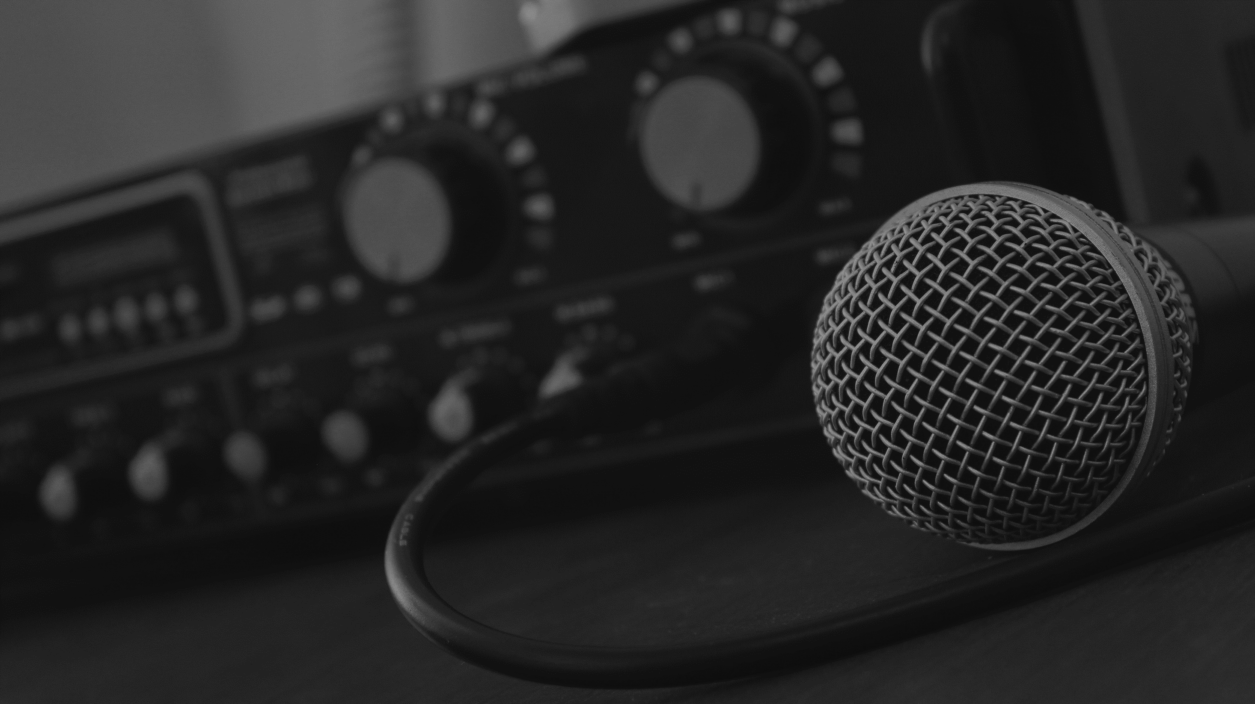
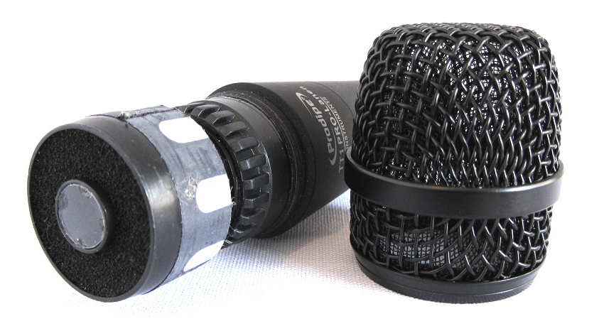
A crowd of microphones
Dynamics microphones
Magnets
Membrane
Coil
Cell of a Prodipe TT1 Lanen Instrument
Signal out

Slide 9
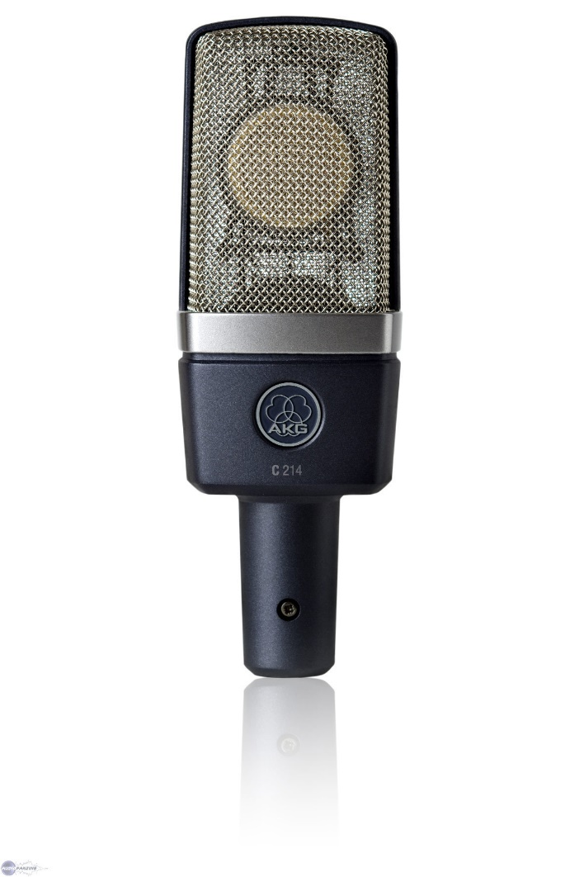
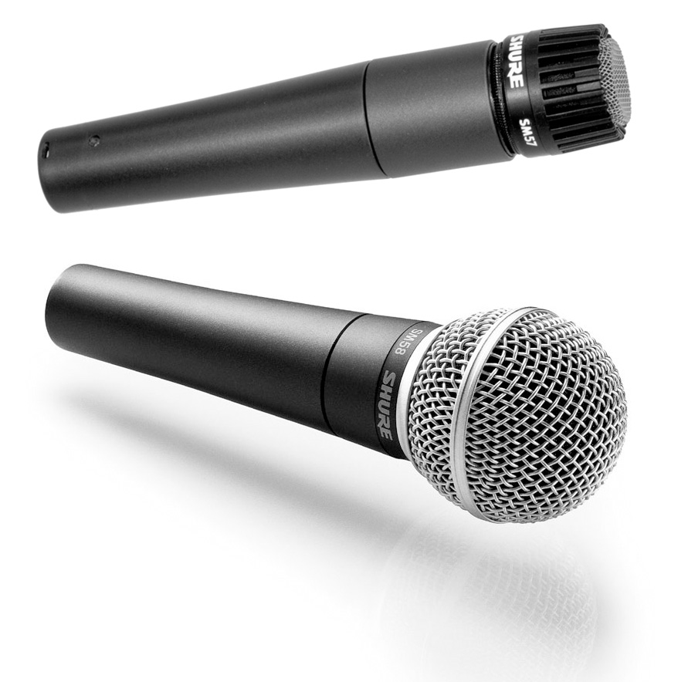
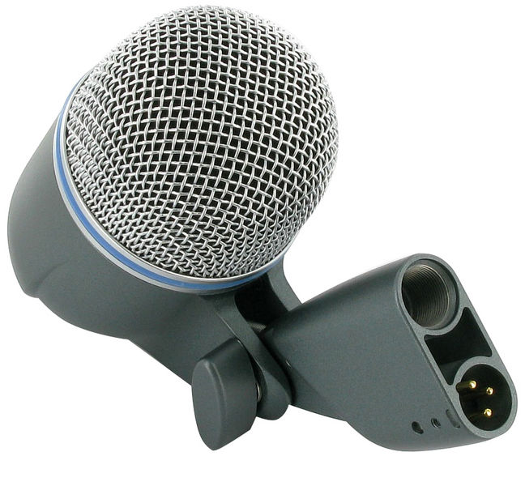
A crowd of microphones
Dynamics microphones
Shure Beta 52a for kick
AKG C214
Shure SM-57 & SM-58
~ 400 €
~ 175 €
~ 200 €
Techno a little bit different but generaly same as other

Slide 10
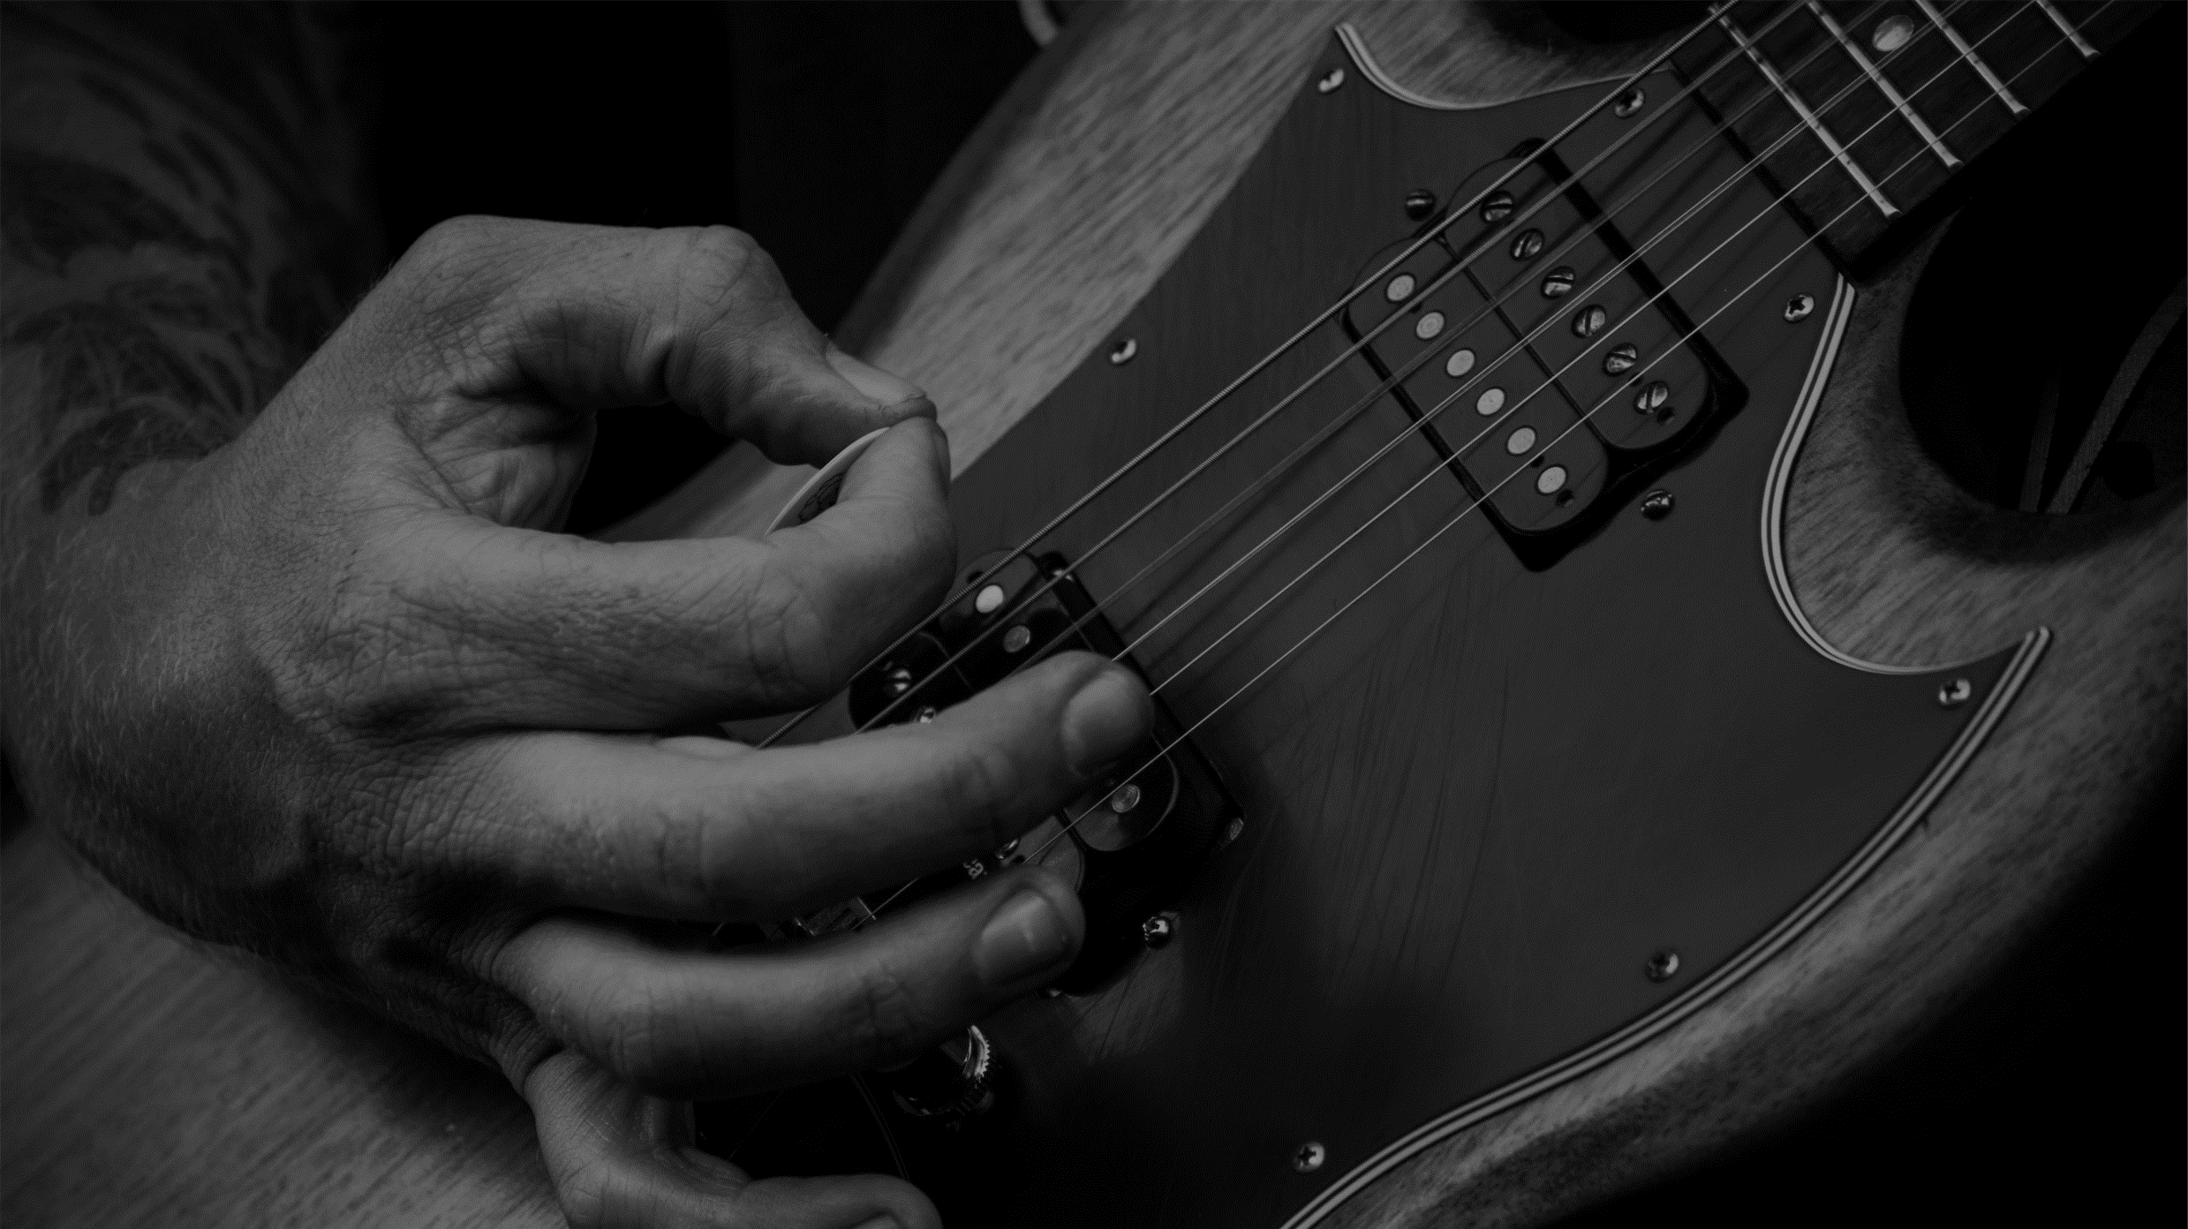
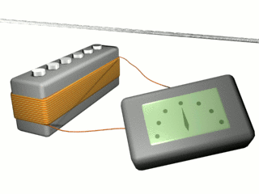
A crowd of microphones
Magnetic microphones / Electric guitars and bass
Guitar strings
Magnets
Coil
Signal out

