Slide 1
AUTOSTRADA Semnalizare
Situation au 17.10.2016

Slide 2
Summary page
BUCURESTI 3 NEW
1.a DN1A x DNCB => E81 4
1.b E81 => DN1A 20
2 SALISTE 42
3 CUNTA 59
4 LANCRAM 66
4.a dinspre Sebes 67
4.b dinspre Alba Iulia 73
4.c dinspre Sibiu 76
4.d dinspre Orastie 80
4 TURDA 84

Slide 3
Bucuresti

Slide 4
a ) DN1A x DNCB => A1 E81
Source : You Tube - Asociata Pro Infrastructura API
DNCB Centura Bucuresti DN1A – A1 13.10.2016

Slide 5
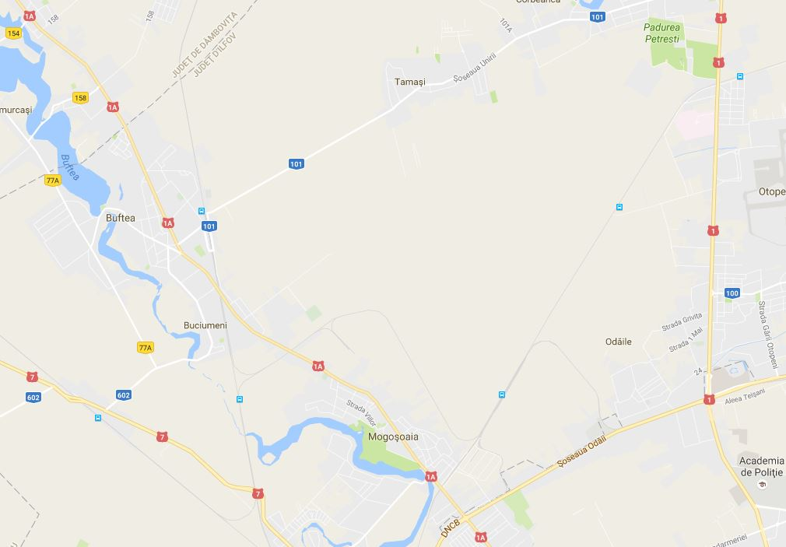
2 x 1 lane
2 x 2 lanes
2 x 1 lane
2 x 2 lanes
2 x 1 lane
Source - https://www.google.ch/maps/@44.5644841,26.0104374,13z?hl=f

Slide 6
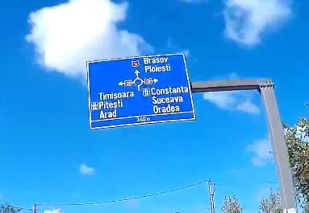
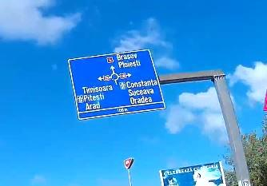
Buftea
Mogosoaia
1A
CB
CB
Pitesti
Constanza
Ploiesti
Alexandria
Giurgiu
BG
Ploiesti
Urziceni
300 m
100 m
To remain clear and quickly and easely readable, in Bucuresti, the directions on the panels must be based on limited KEY directions :
Ploiesti, Urziceni ( if necessary ) , Constanza, Giurgiu, Alexandria, Pitesti, Airports, City ( if necessary )
So, unfortunately, no or rarely place in Bucuresti intra muros for Arad, Timisoara, Brasov, Oradea, Suceava.
On the 2 panels left, there is a contradiction between Brasov via DN1A and Oradea via DNCB and A3 ;
With such a signalization, it is not surprising that I am always alone on the A3 ; it is the only place in Europe where I can profiter of 3 lanes for me alone.
Good new, Positive point : unknowed in Bucuresti, Nadlac, Bors and Co.

Slide 7
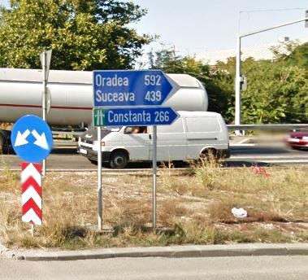
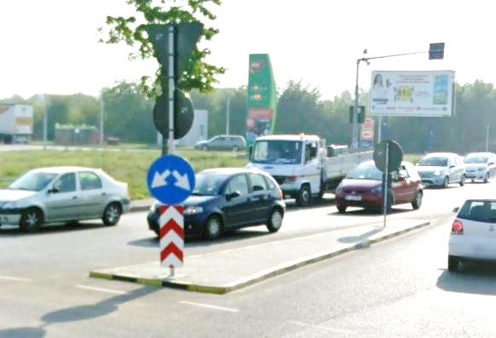
Constanza 266
Ploiesti 79
Ploiesti 55
Urziceni 64
1
2
Bucuresti
Sector 1
1A

Slide 8
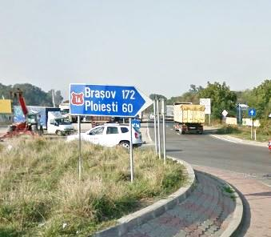
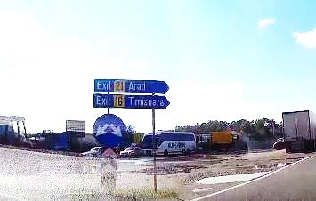
Buftea 8
Mogasoaia 2
1A
Pitesti 118
?
Alexandria 95
Giurgiu 78
Targoviste 70
6
5
7

Slide 9
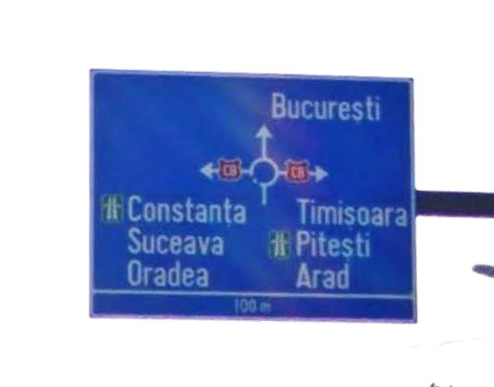
Bucuresti
1A
CB
CB
Constanza
Ploiesti
Pitesti
Arad
Ploiesti
Urziceni
Alexandria
Giurgiu
BG
100 m
Dinspre Mogosoaia

Slide 10
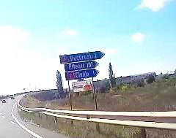
Pitesti
Alexandria
Giurgiu
6
5
BG
7
Pitesti
Targoviste
Chitila
Bucuresti
CB

Slide 11
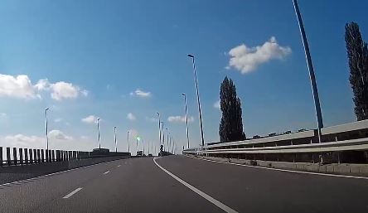
Pitesti
Alexandria
Giurgiu
Pitesti
Targoviste
Chitila
Bucuresti
Pitesti
BG
7

Slide 12
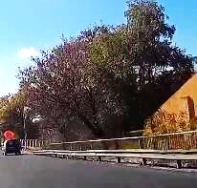
Alexandria
Giurgiu
Bucuresti Vest Sud
CB
Pitesti – Arad
BG

Slide 13
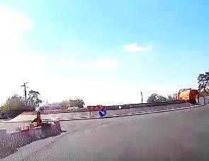
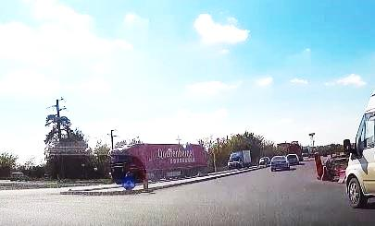
Pitesti
Alexandria
Giurgiu
6
5
BG
?
?
DNCB
Pitesti
Alexandria
Giurgiu
6
5

Slide 14
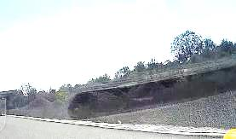
Pitesti
Arad
Alexandria
Giurgiu
BG
601A
Bucuresti Chiajna
601A
Slobozia Moara
Joita
CB
400 m
200 m

Slide 15
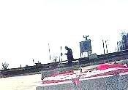
Slobozia Moara
Joita
601A
Pitesti
Bucuresti Chiajna
Alexandria
Giurgiu
6
BG
5

Slide 16
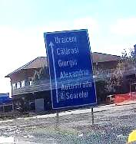
Alexandria
Giurgiu
Bucuresti Vest Sud
CB
?
Pitesti – Arad
BG

Slide 17
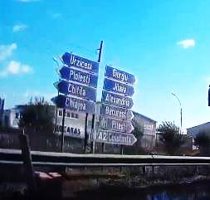
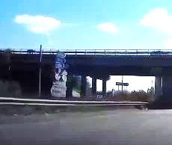
Constanza
Ploiesti
Pitesti
Arad
Ploiesti
Urziceni
Alexandria
Giurgiu
1
6
2
5
BG
Bucuresti
Bucuresti
Vest Cent
CB
Nord
CB
Vest Centru

Slide 18
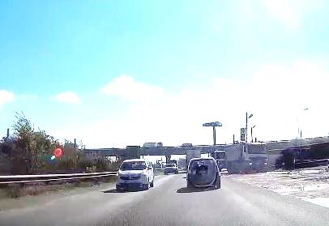
Alexandria
Giurgiu
Bucuresti Sud
BG
Sud
CB
Bucuresti
Vest Centru
Vest Centru
E81
Pitesti
Arad
Timisoara

Slide 19
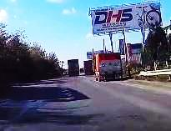
Rough road ; to repair

Slide 20
b ) E81 A1 => DN1A
DNCB x DN1A
Source : You Tube - Asociata Pro Infrastructura API
DNCB Centura Bucuresti intre A1 si DN1A ( Mogosoaia ) 13.10.2016

Slide 21
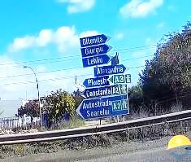
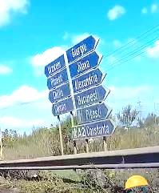
Constanza
Ploiesti
Constanza
Craiova
Ploiesti
Urziceni
Alexandria
Giurgiu
1
6
2
5
BG
Bucuresti
Bucuresti
Vest Centr
190 m1
CB
Nord
CB
Vest Centru
Currently, DNCB Nord is better to reach A3.
Distance between the 2 : +/- 200 m1

Slide 22
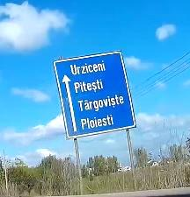
Urziceni
Ploiesti
Pitesti
Otopeni Baneasa
CB
Constanza
Ploiesti
Otopeni Baneasa

Slide 23
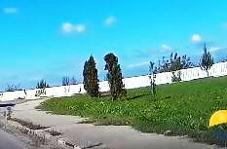
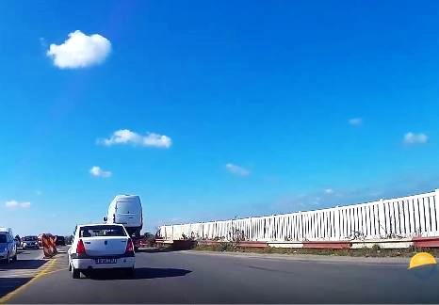
Bucuresti
Chiajna
601A
Centura Bucuresti
CB
Slobozia Moara
Joita
601A

Slide 24
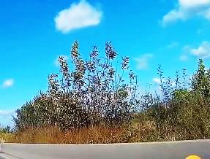
Slobozia Moara
Joita
601A
CB
Constanza
Ploiesti
Urziceni
Ploiesti
Pitesti
Otopeni Baneasa
CB

Slide 25
Urziceni
Ploiesti
Pitesti
Otopeni Baneasa
CB
Constanza
Ploiesti
Otopeni Baneasa

Slide 26
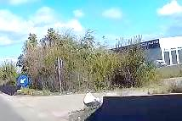
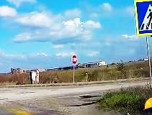
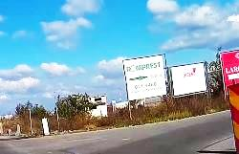
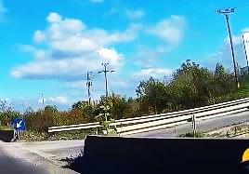
To complete
TIR thanks you
To complete
TIR thanks you
To complete
TIR thanks you
To complete
TIR thanks you

Slide 27
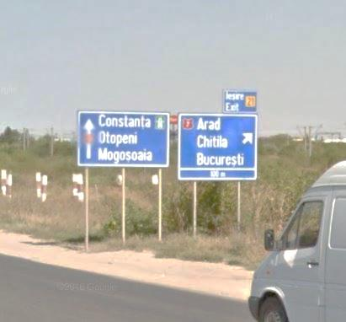
Constanza
Ploiesti
Urziceni
Ploiesti
CB
7
Pitesti
Targoviste
Chitila
Bucuresti
700 m

Slide 28
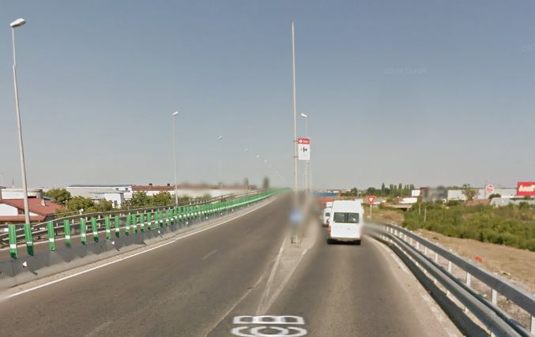
Pitesti
Urziceni
Ploiesti
Constanza
Ploiesti
Pitesti
Targoviste
Chitila
Bucuresti
7

Slide 29
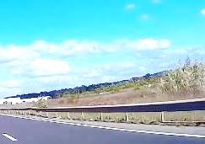
Urziceni
Ploiesti
Otopeni Baneasa
CB
Constanza
Ploiesti
Otopeni Baneasa

Slide 30
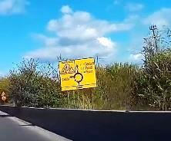
Constanza
Ploiesti
Ploiesti
Urziceni
CB
1A
1A
Buftea
Mogosoaia
Bucuresti
Sector 1
300 m

Slide 31
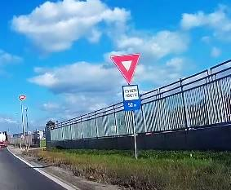
Constanza
Ploiesti
Ploiesti
Urziceni
CB
1A
1A
Buftea
Mogosoaia
Bucuresti
Sector 1
75 m

Slide 32
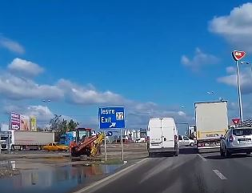
21

Slide 33
Constanza 266
Ploiesti 79
Ploiesti 55
Urziceni 64
1
2
2
Bucuresti
Sector 1
1A

Slide 34
Buftea 8
Mogasoaia 2
1A
Pitesti 118
?
Alexandria 95
Giurgiu 78
Targoviste 70
6
5
7

Slide 35
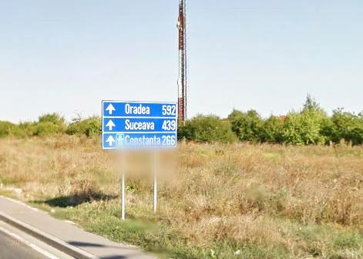
Urziceni
Ploiesti
Otopeni Baneasa
CB
Constanza
Ploiesti
Otopeni Baneasa
spre CB x DN1

Slide 36
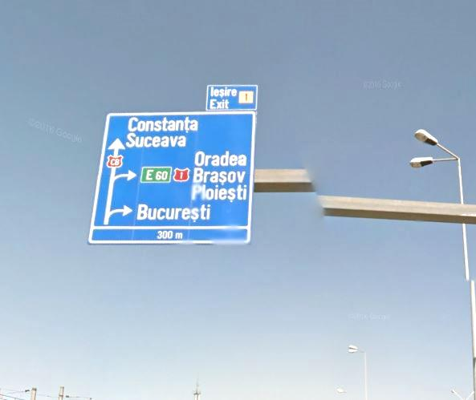
Constanza
Ploiesti
CB
Urziceni
Tunari
1
Ploiesti
Otopeni Coanda
1
Bucuresti
Surprising
Exit numbers for DNCB
NO exit numbers for highways
Baneasa
300 m

Slide 37
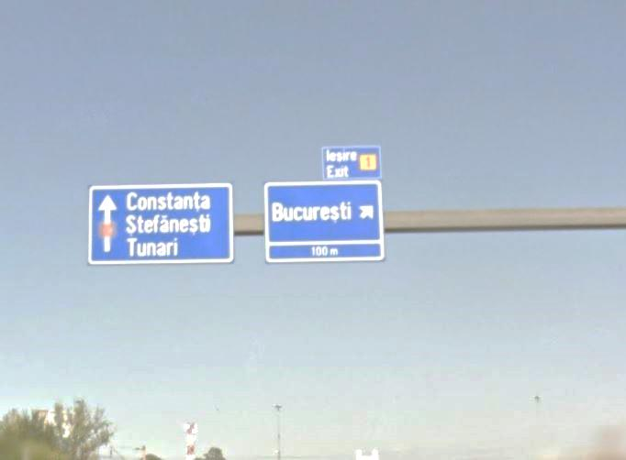
Constanza
Ploiesti
CB
Urziceni
Tunari
1
Ploiesti
Otopeni Coanda
1
Bucuresti
What’s this ?
Baneasa
100 m

Slide 38
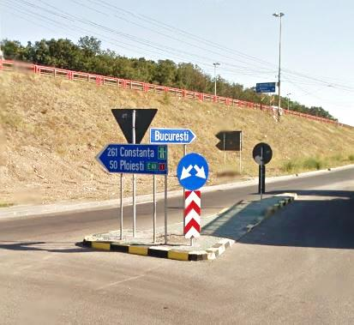
Bucuresti
1
Baneasa
Constanza
Ploiesti
Urziceni
CB
Ploiesti
Urziceni
1
Otopeni

Slide 39
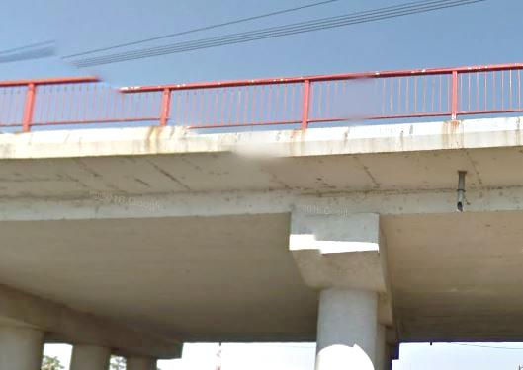
Constanza
Ploiesti
Ploiesti
Otopeni
Henri Coanda
Urziceni
Tunari

Slide 40
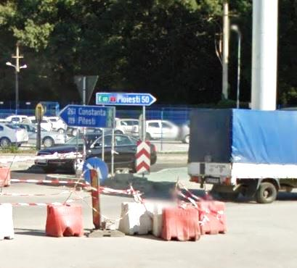
Ploiesti 50
1
Otopeni
Constanza
Ploiesti
Urziceni
CB
Pitesti

Slide 41
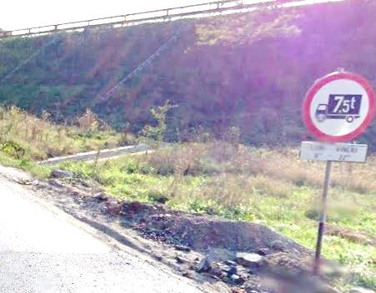
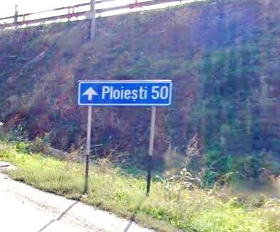
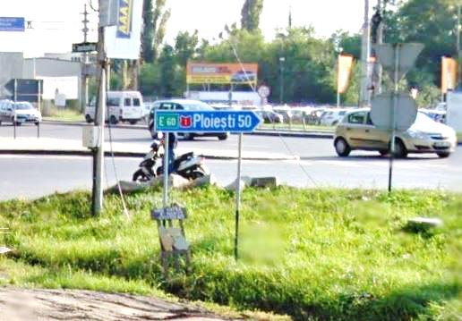
Ploiesti 50
Tunari
1
Otopeni
Ploiesti 50
Tunari
1
Otopeni

Slide 42
Saliste
Source : Forum PUM Romania A1 Autostrada Bucuresti – Nadlac
Stefan Tudor, Reply 31.007 du 10.10.2016

Slide 43
a ) dinspre Sebes

Slide 44
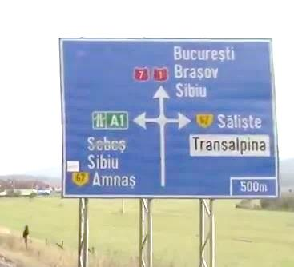
Sibiu
Christian
1
7
Bucuresti
Brasov
Sibiu
67
Saliste
E81
Transalpina
E68
Arad
Sebes
E81
E68
67
Amnas
500 m
I really don’t understand why the administration
1. strives to send the trafic to major cities like Bucuresti and Brasov via national roads,
2. almost always allocates medium towns ( or border villages ) to the highway signs and this, further, imprecisely and confused
( of course, I don’t consider Sibiu as a medium town )
After the construction of an highway, the national roads become regional roads ; all the priorities must go to the highway : numerotation E, main directions.
Please, do promote the highway ; don’t hide them .

Slide 45
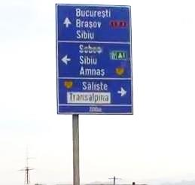
Sibiu
Christian
1
7
Bucuresti
Brasov
Sibiu
E81
E68
Arad
Sebes
E81
E68
Amnas
67
Saliste
67
Transalpina
200 m
Same remark for this big high one

Slide 46
Sibiu
Christian
1
7
67
67
Amnas
Saliste
1 km
Transalpina
200 m
500 m
Variante to 4 and 5
Smaller and big enough for a simple access

Slide 47
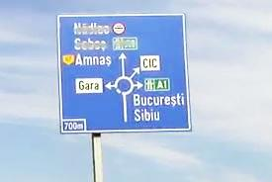
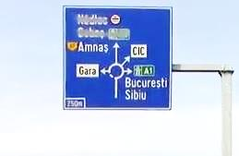
67
Amnas
Arad
Sebes
E81
E68
CIC
Gara
Bucuresti
Brasov
Sibiu
E81
E68
700 m
250 m
Here, on the 67,we recover Bucuresti
A bit late !
Imprecise and confused

Slide 48
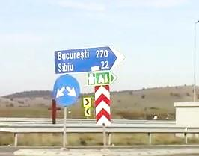
Bucuresti 270
Brasov 165
Sibiu 22
Make it beautiful and efficient

Slide 49
Arad 270
Sebes 37
Amnas 4
67
Where is Sebes ?
Where is A1
Where is the pictogramm ?
This is not very serious

Slide 50
67
Amnas
Arad
Sebes
E81
E68
250 m
You know what ; I am logical
Source : https://www.google.ch/search?q=pictogram+snoopy&client=firefox-b&tbm=isch&tbo=u&source=univ&sa=X&ved=0ahUKEwi_h9uPx9PPAhWGYZoKHUsmCLIQsAQIIA&biw=1920&bih=932#imgrc=_RB_YhPdQajRBM%3A

Slide 51
Please, add this one
Arad 270
Sebes 37
Please, secure them
Arad Sebes
Never too careful

Slide 52
b ) dinspre Sibiu

Slide 53
1
Sebes
7
67
Saliste
1 km
Transalpina
67
Amnas
500 m
Enough for a simple access
The information is complete and clear

Slide 54
1
Sebes
7
67
Saliste
1 km
Transalpina
67
Amnas
200 m
Bis repetita : Enough for a simple access
The information is complete and clear

Slide 55
1 km
Well, impossible to miss it

Slide 56
c ) dinspre Saliste

Slide 57
67
Bucuresti
Brasov
Sibiu
E81
Amnas
E68
Arad
Sebes
E81
E68
1
7
7
1
Sebes
Sibiu
Christian
67
250 m
( WelI known song but I persist ) I really don’t understand why the administration
1. strives to send the trafic to major cities like Bucuresti and Brasov via national roads,
2. almost always allocates medium towns ( or border villages ) to the highway signs and this, further, imprecisely and confused
( of course, I don’t consider Sibiu as a medium town )
After the construction of an highway, the national roads become regional roads ; all the priorities must go to the highway : numerotation E, main directions.
Please, do promote the highway ; don’t hide them .

Slide 58
Where are Sebes and Sibiu ?
Where is A1
Where is the pictogramm ?
This is not very serious
36 Sebes
1 km

Slide 59
Cunta
( no comment )
Source : Forum PUM Romania A1 Autostrada Bucuresti – Nadlac
Stefan Tudor, Reply 31.012 du 10.10.2016

Slide 61
Arad km
Sebes km

Slide 62
Sebes
1
7
Bucuresti
Brasov
Sibiu
E81
E68
nnn m

Slide 63
Bucuresti
Sibiu
Sibiu 40
Sebes 14
1
7

Slide 64
Bucuresti
Sibiu
Sibiu 40
Sebes 14
1
7

Slide 65
Bucuresti 293
Sibiu 48

Slide 66
Lancram

Slide 67
a ) dinspre SEBES

Slide 68
New informations
Arad
Orastie
Alba Iulia
Lancram
E68
1
A1
Cluj Napoca
Targu Mures
Alba Iulia
E81
A8
Bucuresti
Sibiu
E81
150 m
A1

Slide 69
Bucuresti 310
Sibiu 65
Arad 214
Orastie 54
Cluj Napoca 133
Targu Mures 145
Alba Iulia 13
New informations
Alba Iulia 12
1
Sebes 4
1
Make you an idea

Slide 70
Alba Iulia
Lancram
1
Arad
Orastie
E68
A1
Cluj Napoca
Targu Mures
Alba Iulia
E81
A8
New informations
150 m

Slide 71
E68 A1
E81 A8
Arad
Timisoara
Orastie
Cluj Napoca
Targu Mures
Alba Iulia
New panel

Slide 72
Alba Iulia 12
Lancram
1
214 Arad
54 Orastie
133 Cluj Napoca 145 Targu Mures
13 Alba Julia
New informations

Slide 73
b ) dinspre Alba Iulia

Slide 74
1
Sebes
Bucuresti
Sibiu
E68
A1
Arad
Orastie
E68
A1
Cluj Napoca
Targu Mures
Alba Iulia
E81
A8
New informations
150 m

Slide 75
Arad 214
Orastie 54
Cluj Napoca 133
Targu Mures 145
Alba Iulia 13
New informations
Bucuresti 310
Sibiu 65
Sebes 4
1
1
Sebes
Bucuresti
Sibiu
E68
A1

Slide 76
c ) iesire dinspre Sibiu

Slide 77
35
Sebes Centru
Alba Iulia
Centru
1

Slide 78
Iesire
35

Slide 79
Bucuresti
Sibiu
E68
A1
Alba Iulia
Lancram
1
Sebes
1
150 m

Slide 80
d ) iesire dinspre Orastie

Slide 81
35
Sebes Centru
Alba Iulia
Centru
1

Slide 82
Iesire
35

Slide 83
Bucuresti
Sibiu
E68
A1
Alba Iulia
Lancram
1
1
Sebes
Arad
Orastie
E68
A1
Cluj Napoca
Targu Mures
Alba Iulia
E81
A8
New informations
150 m

Slide 84
Turda

Slide 85
Alba Iulia
Teius
1
Targu Mures
Sibiu – Arad
Alba Iulia
E81
E60
Cluj Napoca
Oradea
A3
Turda : DN1 x A3

Slide 86
Targu Mures
Sibiu - Arad
Alba Iulia
Oradea
Cluj Napoca

Slide 87
Targu Mures
Brasov
Sibiu - Arad
Alba Iulia
Cluj Napoca
Oradea

Slide 88
Targu Mures
Brasov
Sibiu - Arad
Alba Iulia
Cluj Napoca
Oradea

Slide 89
E60
E81
E60
E81
Cluj Napoca
Oradea
Tg Mures
Brasov
Sibiu - Arad
Alba Iulia

Slide 90
Sources
Google Maps by Alphabet Inc, Mountain View, Ca, USA
Panneaux routiers : Ministerul Transporturilor Romania
Pictogrammes : https://fr.wikipedia.org/wiki/Comparaison_des_panneaux_de_signalisation_routi%C3%A8re_en_Europe
Note : Il n’est pas tenu compte des modifications, améliorations de toutes natures apportées aux panneaux de signalisation exposés depuis la dernière mise à jour publiée par Google Maps. Il est donc possible que certaines illustrations ne correspondent plus à la réalité actuelle, qu’elles soient dépassées ou qu’elles ne soient plus d’actualité. Je ne puis que me réjouir si les modifications intervenues ont amélioré le service aux automobilistes.

