Slide 1

AUTOSTRADA Semnalizare
Situation au 13.10.2016

Slide 2
Summary page
1 SALISTE 3 NEW
2 CUNTA 20 NEW
3 LANCRAM 27
3.a dinspre Sebes 28
3.b dinspre Alba Iulia 34
3.c dinspre Sibiu 37
3.d dinspre Orastie 41
4 TURDA 45

Slide 3
Saliste
Source : Forum PUM Romania A1 Autostrada Bucuresti – Nadlac
Stefan Tudor, Reply 31.007 du 10.10.2016

Slide 4
a ) dinspre Sebes

Slide 5
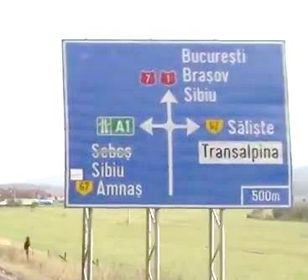
Sibiu
Christian
1
7
Bucuresti
Brasov
Sibiu
67
Saliste
E81
Transalpina
E68
Arad
Sebes
E81
E68
67
Amnas
500 m
I really don’t understand why the administration
1. strives to send the trafic to major cities like Bucuresti and Brasov via national roads,
2. almost always allocates medium towns ( or border villages ) to the highway signs and this, further, imprecisely and confused
( of course, I don’t consider Sibiu as a medium town )
After the construction of an highway, the national roads becomes regional roads ; all the priorities must go to the highway : numerotation E, main directions.
Please, do promote the highway ; don’t hide them .

Slide 6
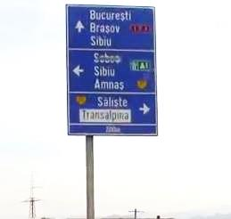
Sibiu
Christian
1
7
Bucuresti
Brasov
Sibiu
E81
E68
Arad
Sebes
E81
E68
Amnas
67
Saliste
67
Transalpina
200 m
Same remark for this big high one

Slide 7

Sibiu
Christian
1
7
67
67
Amnas
Saliste
1 km
Transalpina
200 m
500 m
Variante to 4 and 5
Smaller and big enough for a simple access

Slide 8
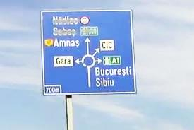
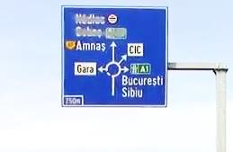
67
Amnas
Arad
Sebes
E81
E68
CIC
Gara
Bucuresti
Brasov
Sibiu
E81
E68
700 m
250 m
Here, on the 67,we recover Bucuresti
A bit late !
Imprecise and confused

Slide 9
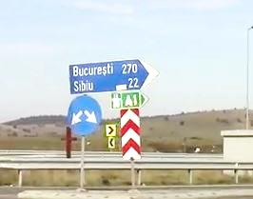
Bucuresti 270
Brasov 165
Sibiu 22
Make it beautiful and efficient

Slide 10
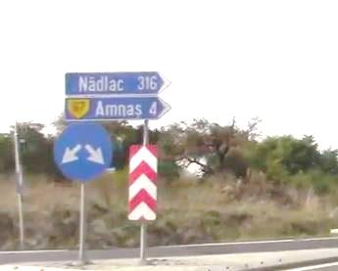

Arad 270
Sebes 37
Amnas 4
67
Where is Sebes ?
Where is A1
Where is the pictogramm ?
This is not very serious

Slide 11
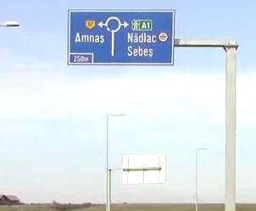

67
Amnas
Arad
Sebes
E81
E68
250 m
You know what ; I am logical
Source : https://www.google.ch/search?q=pictogram+snoopy&client=firefox-b&tbm=isch&tbo=u&source=univ&sa=X&ved=0ahUKEwi_h9uPx9PPAhWGYZoKHUsmCLIQsAQIIA&biw=1920&bih=932#imgrc=_RB_YhPdQajRBM%3A

Slide 12
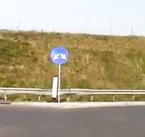
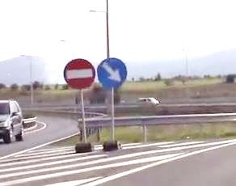
Please, add this one
Arad 270
Sebes 37
Please, secure them
Arad Sebes
Never too careful

Slide 13
b ) dinspre Sibiu

Slide 14
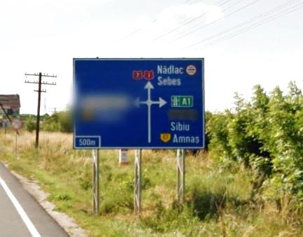
1
Sebes
7
67
Saliste
1 km
Transalpina
67
Amnas
500 m
Enough for a simple access
The information is complete and clear

Slide 15
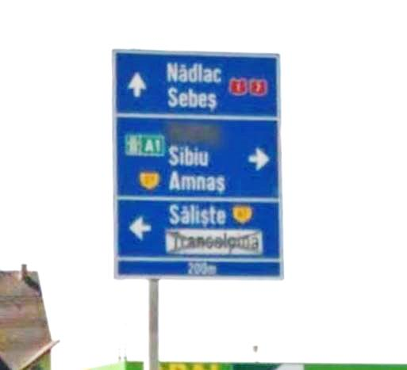
1
Sebes
7
67
Saliste
1 km
Transalpina
67
Amnas
200 m
Bis repetita : Enough for a simple access
The information is complete and clear

Slide 16
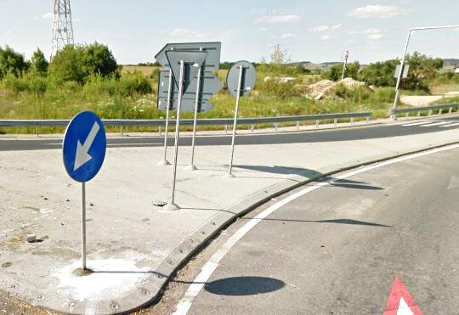
1 km
Well, impossible to miss it

Slide 17
c ) dinspre Saliste

Slide 18
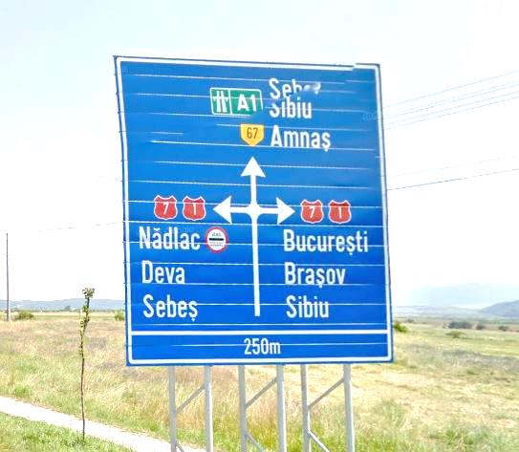
67
Bucuresti
Brasov
Sibiu
E81
Amnas
E68
Arad
Sebes
E81
E68
1
7
7
1
Sebes
Sibiu
Christian
67
250 m
( WelI known song but I persist ) I really don’t understand why the administration
1. strives to send the trafic to major cities like Bucuresti and Brasov via national roads,
2. almost always allocates medium towns ( or border villages ) to the highway signs and this, further, imprecisely and confused
( of course, I don’t consider Sibiu as a medium town )
After the construction of an highway, the national roads becomes regional roads ; all the priorities must go to the highway : numerotation E, main directions.
Please, do promote the highway ; don’t hide them .

Slide 19
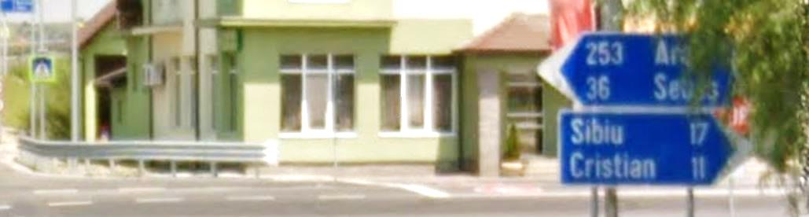
Where are Sebes ans Sibiu ?
Where is A1
Where is the pictogramm ?
This is not very serious
36 Sebes
1 km

Slide 20
Cunta
( no comment )
Source : Forum PUM Romania A1 Autostrada Bucuresti – Nadlac
Stefan Tudor, Reply 31.012 du 10.10.2016

Slide 21
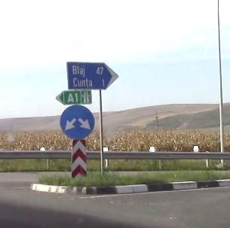

Slide 22
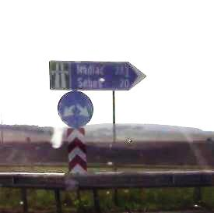
Arad km
Sebes km

Slide 23
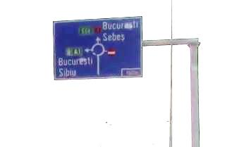

Sebes
1
7
Bucuresti
Brasov
Sibiu
E81
E68
nnn m

Slide 24
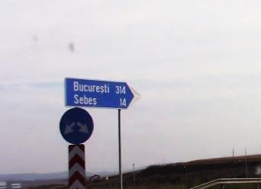
Bucuresti
Sibiu
Sibiu 40
Sebes 14
1
7

Slide 25
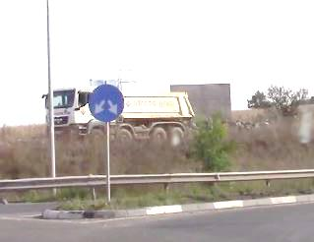
Bucuresti
Sibiu
Sibiu 40
Sebes 14
1
7

Slide 26
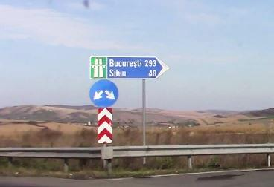
Bucuresti 293
Sibiu 48

Slide 27
Lancram

Slide 28
a ) dinspre SEBES

Slide 29
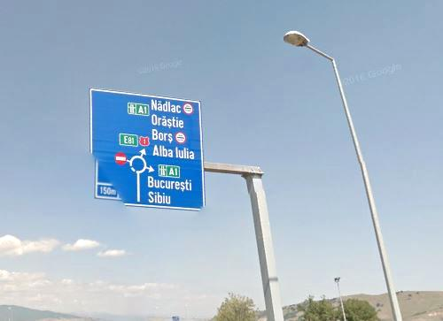

New informations
Arad
Orastie
Alba Iulia
Lancram
E68
1
A1
Cluj Napoca
Targu Mures
Alba Iulia
E81
A8
Bucuresti
Sibiu
E81
150 m
A1

Slide 30
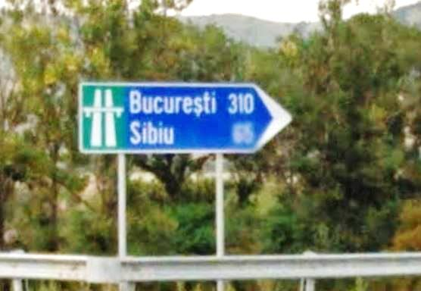
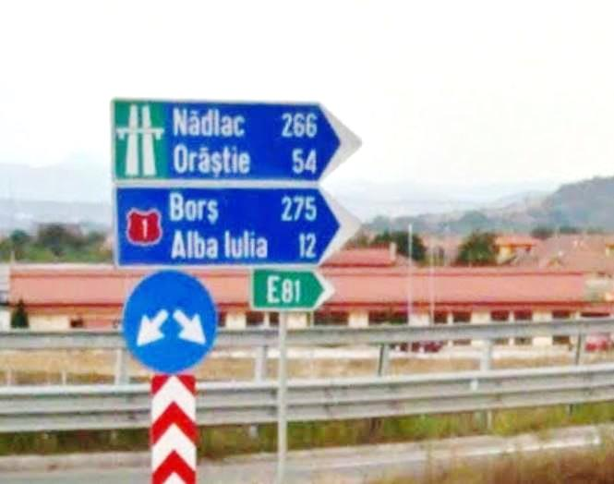
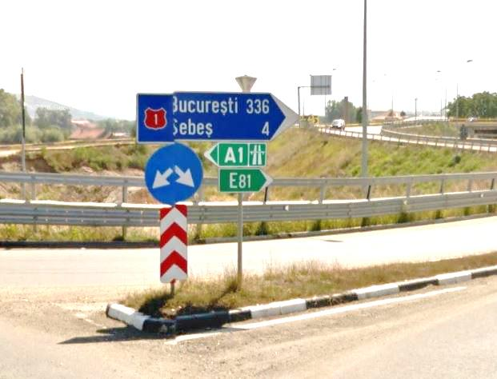
Bucuresti 310
Sibiu 65
Arad 214
Orastie 54
Cluj Napoca 133
Targu Mures 145
Alba Iulia 13
New informations
Alba Iulia 12
1
Sebes 4
1
Make you an idea

Slide 31
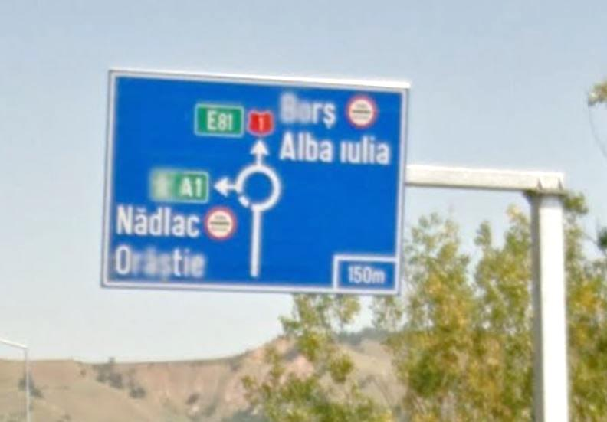
Alba Iulia
Lancram
1
Arad
Orastie
E68
A1
Cluj Napoca
Targu Mures
Alba Iulia
E81
A8
New informations
150 m

Slide 32
E68 A1
E81 A8
Arad
Timisoara
Orastie
Cluj Napoca
Targu Mures
Alba Iulia
New panel

Slide 33
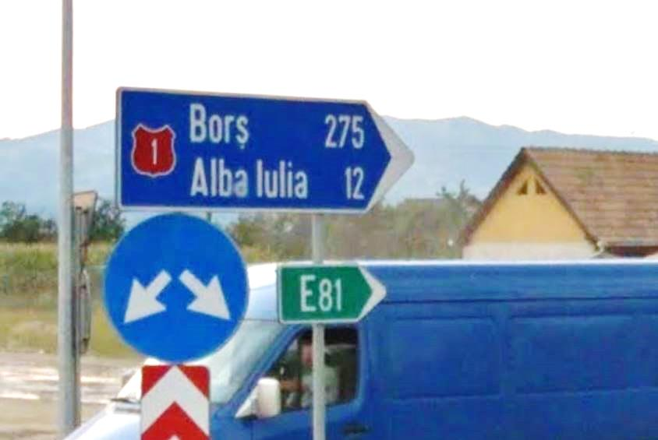
Alba Iulia 12
Lancram
1
214 Arad
54 Orastie
133 Cluj Napoca 145 Targu Mures
13 Alba Julia
New informations

Slide 34
b ) dinspre Alba Iulia

Slide 35
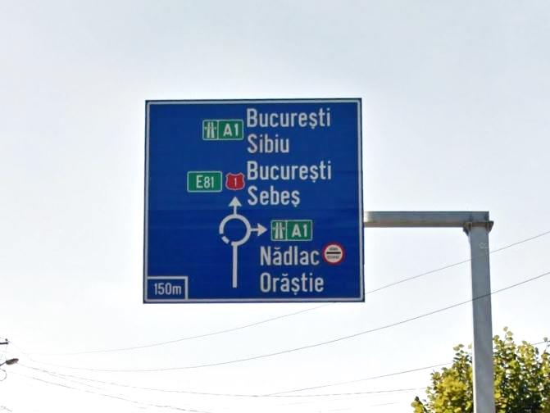
1
Sebes
Bucuresti
Sibiu
E68
A1
Arad
Orastie
E68
A1
Cluj Napoca
Targu Mures
Alba Iulia
E81
A8
New informations
150 m

Slide 36
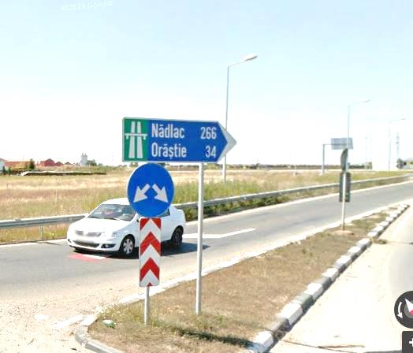
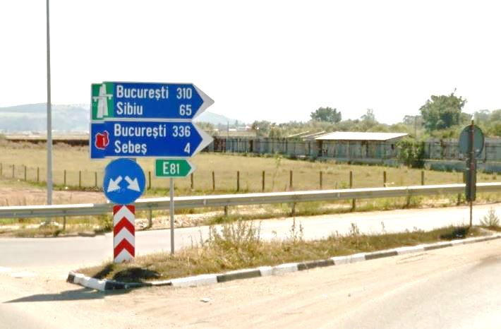
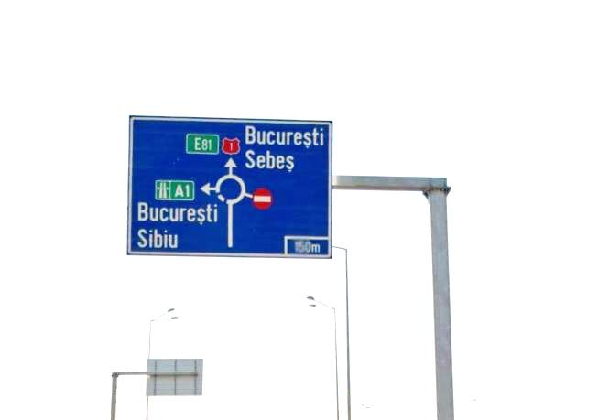
Arad 214
Orastie 54
Cluj Napoca 133
Targu Mures 145
Alba Iulia 13
New informations
Bucuresti 310
Sibiu 65
Sebes 4
1
1
Sebes
Bucuresti
Sibiu
E68
A1

Slide 37
c ) iesire dinspre Sibiu

Slide 38
35
Sebes Centru
Alba Iulia
Centru
1

Slide 39
Iesire
35

Slide 40
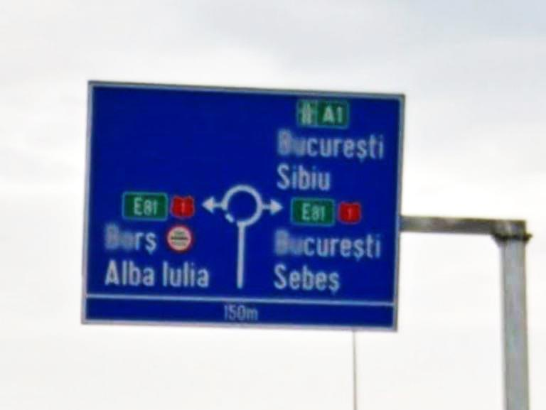
Bucuresti
Sibiu
E68
A1
Alba Iulia
Lancram
1
Sebes
1
150 m

Slide 41
d ) iesire dinspre Orastie

Slide 42
35
Sebes Centru
Alba Iulia
Centru
1

Slide 43
Iesire
35

Slide 44
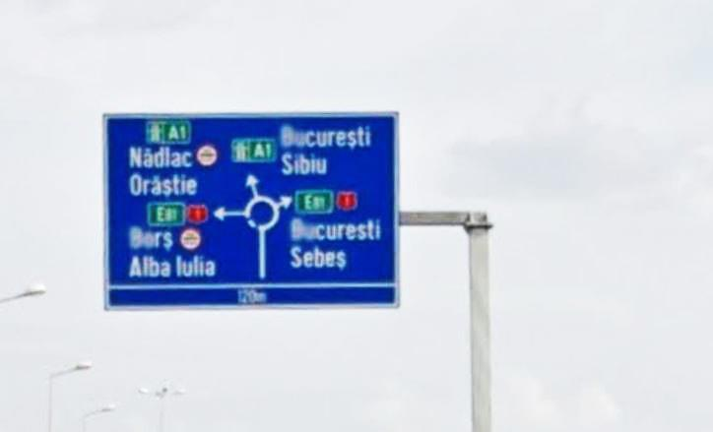
Bucuresti
Sibiu
E68
A1
Alba Iulia
Lancram
1
1
Sebes
Arad
Orastie
E68
A1
Cluj Napoca
Targu Mures
Alba Iulia
E81
A8
New informations
150 m

Slide 45
Turda

Slide 46
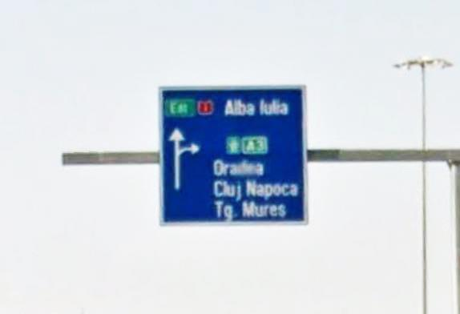
Alba Iulia
Teius
1
Targu Mures
Sibiu – Arad
Alba Iulia
E81
E60
Cluj Napoca
Oradea
A3
Turda : DN1 x A3

Slide 47
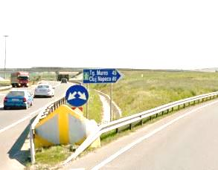

Targu Mures
Sibiu - Arad
Alba Iulia
Oradea
Cluj Napoca

Slide 48
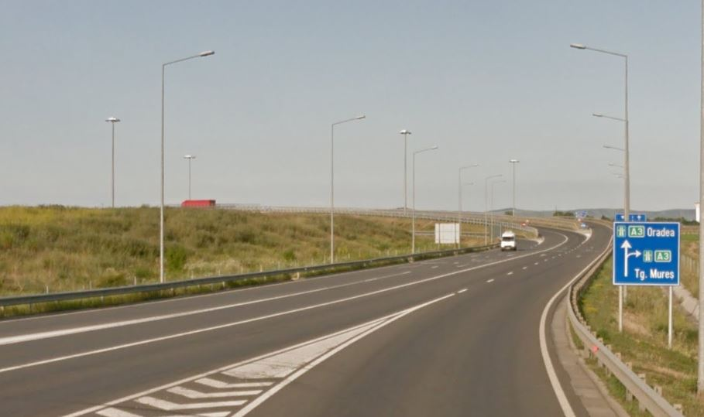
Targu Mures
Brasov
Sibiu - Arad
Alba Iulia
Cluj Napoca
Oradea

Slide 49
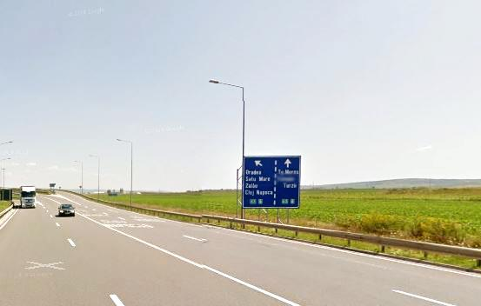
Targu Mures
Brasov
Sibiu - Arad
Alba Iulia
Cluj Napoca
Oradea

Slide 50
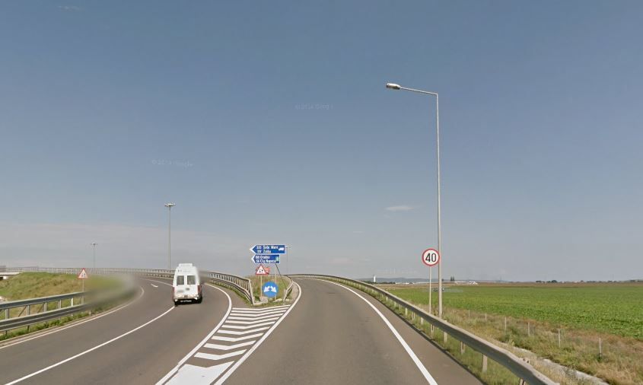
E60
E81
E60
E81
Cluj Napoca
Oradea
Tg Mures
Brasov
Sibiu - Arad
Alba Iulia

Slide 51
Sources
Google Maps by Alphabet Inc, Mountain View, Ca, USA
Panneaux routiers : Ministerul Transporturilor Romania
Pictogrammes : https://fr.wikipedia.org/wiki/Comparaison_des_panneaux_de_signalisation_routi%C3%A8re_en_Europe
Note : Il n’est pas tenu compte des modifications, améliorations de toutes natures apportées aux panneaux de signalisation exposés depuis la dernière mise à jour publiée par Google Maps. Il est donc possible que certaines illustrations ne correspondent plus à la réalité actuelle, qu’elles soient dépassées ou qu’elles ne soient plus d’actualité. Je ne puis que me réjouir si les modifications intervenues ont amélioré le service aux automobilistes.

