Slide 1
Autostrada A1
Semnalizare
Propuneri

Slide 2
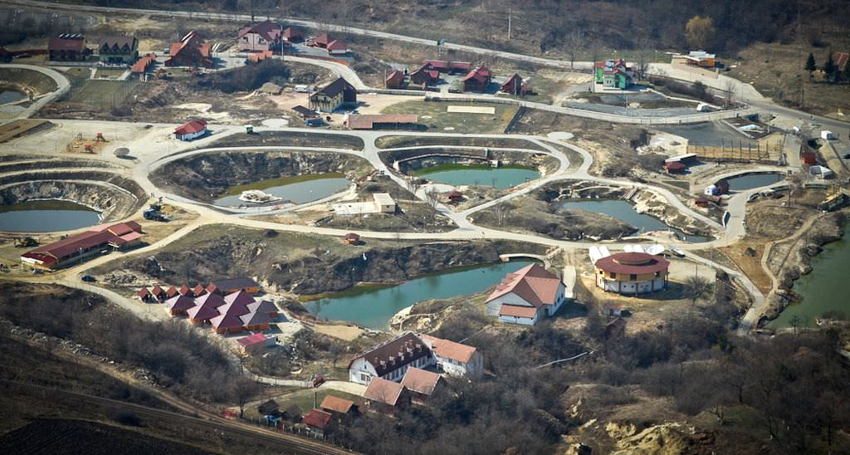
Balearic Ocna Sibiului
29

Slide 3
Sources
Ocna Sibiului : https://www.google.ch/search?q=ocna+sibiului&client=firefox-b&tbm=isch&tbo=u&source=univ&sa=X&ved=0ahUKEwj3u6uYxdzOAhXCUhQKHbPcBjkQsAQIIA&biw=1920&bih=932

