Slide 1
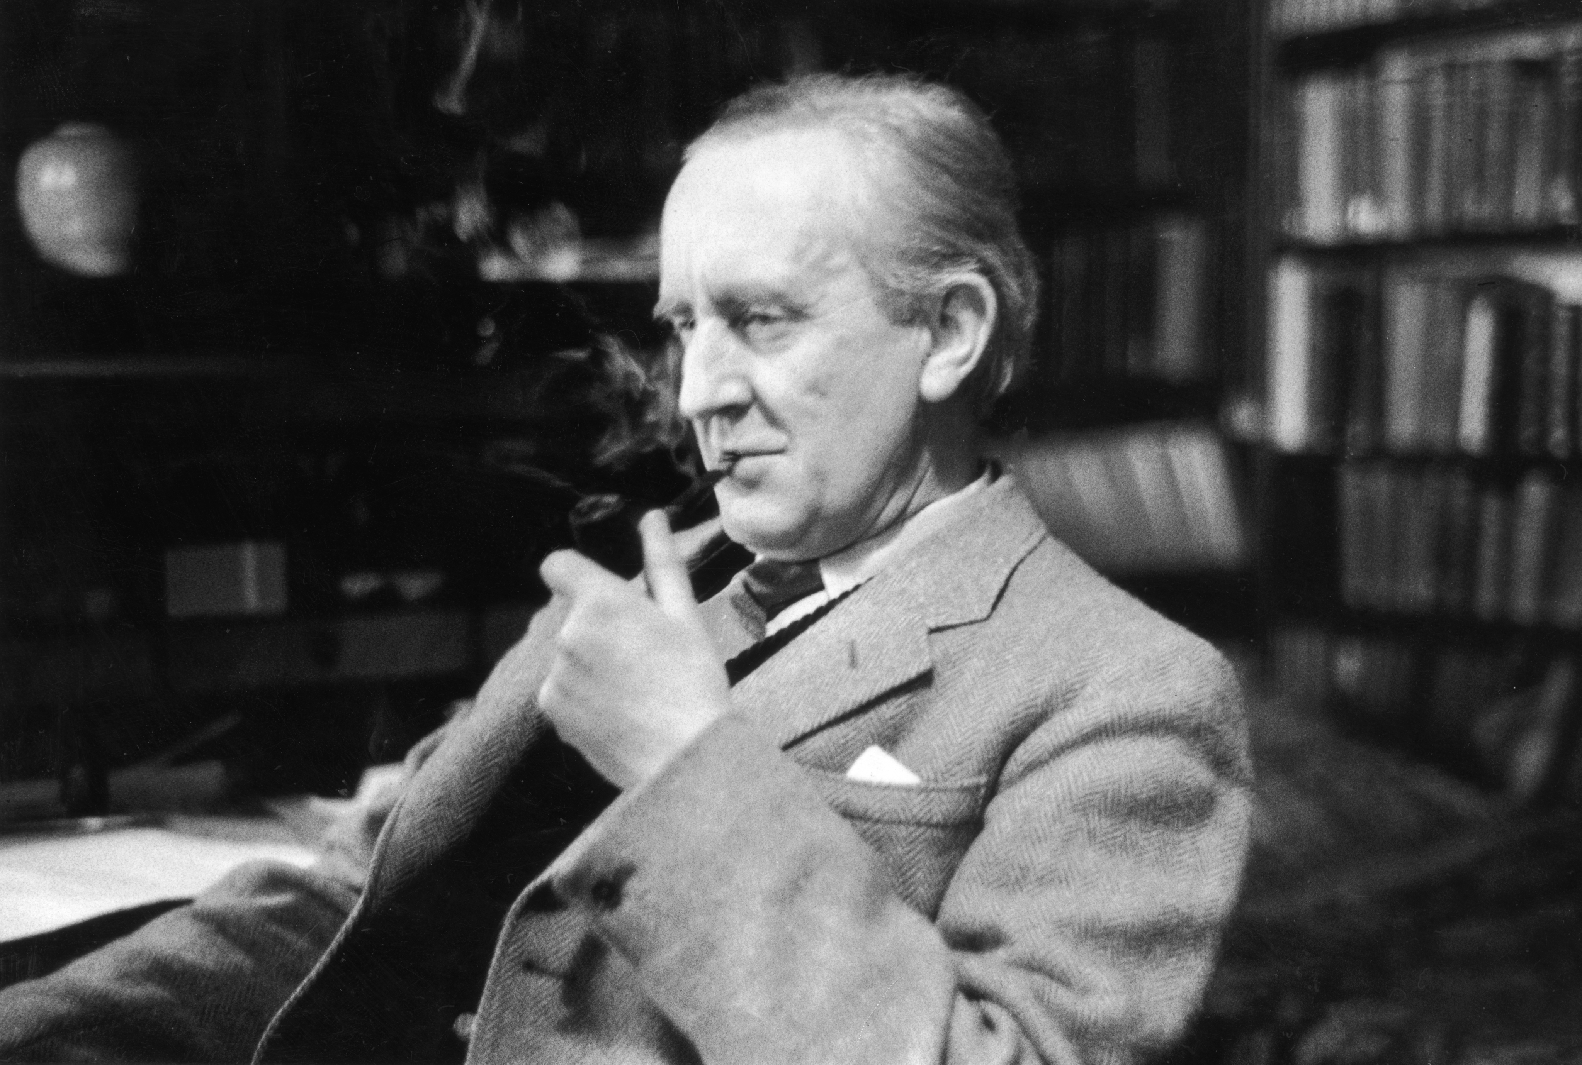
J.R.R TOLKIEN

Slide 2
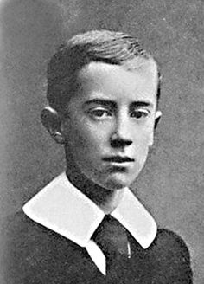
Early years
John Ronald Reuel Tolkien
Born on South Africa
Moved to England at the age of three with his mother and his brother
Lost both of his parents when he was young

Slide 3
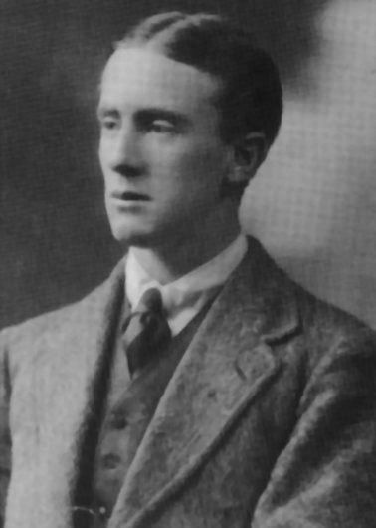
Studies
1911 : he entered to the Oxford University to study English language and literature
1915 : he completed his studies with a First, the highest achievement
After being graduated, he took his commission in the Lancashire Fusiliers and went to war

Slide 4
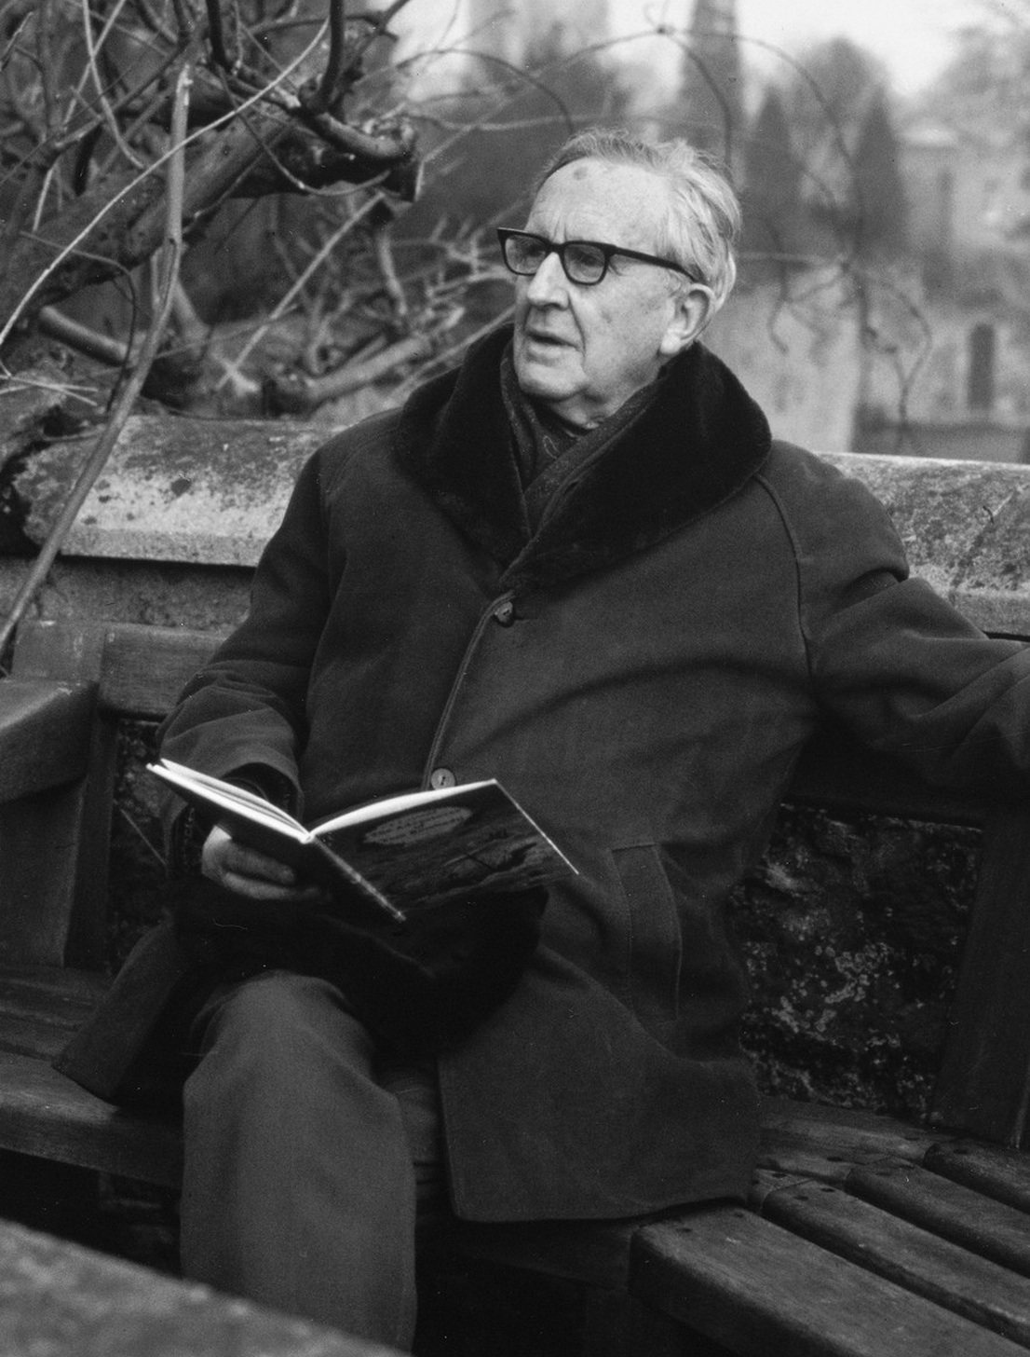
Professional career
First job : researching word origins for the Oxford English Dictionary
1920 : Reader of English Language at the University of Leeds
1924 : He was appointed Professor by the University
1925 : Professor of Anglo-Saxon at the Oxford University
1945 : Merton Professor of English Language and Literature at Oxford University

Slide 5
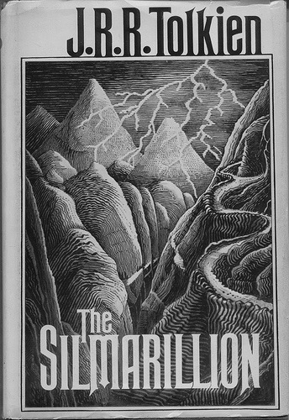
Tolkien as a writer
First, he tried his hand as poetry and published a few pieces
He started to write an ambitious collection of connected stories, poems and song about elves (the Silmarillion)
He began to tell his children many of his stories and to write more for them
Wrote the first sentence of the Hobbit on a blank page while grading exam papers during the summer holiday

Slide 6
Writing career
1937 : “The Hobbit” is published by Allen and Unwin
The book received good reviews, the publisher requested a follow up to Tolkien
17 years later, the Lord of the Rings was published in three volumes in 1954 and 1955 as “The Fellowship of the Ring”, “The Two Towers’” and “The return of the King”
Tolkien became a hero of counterculture.
He died on September 2, 1973

