Slide 1
Do wealthy candidates win elections?

Slide 2
Plan
The influence of money in campaigns
Global trends
Why is money so essential?
The limits of money’s impact.
How to gather these sums
The candidate committee
Outside money
The emocratic(?) system
Dominance of the 1(0)% : a ploutocratie
Political dynasties

Slide 3
1- The influence of money in campaigns
Global trends
Money’s effect on political outcomes
The limits of this influence

Slide 4
Global trends
Congress and presidency
House and senate (2012)
Source: https://www.opensecrets.org/bigpicture/elec_stats.php?cycle=2012
Source: https://www.opensecrets.org/bigpicture/index.php?cycle=2012

Slide 5
Money’s effect on political outcomes.
Before registration as a candidate: $ 5000
Exploratory committee
Advertising.
$1/voter = 4% probability.
Primary elections.
Democrats vs Republicans.
Notes:
References:
http://www.uspresidentialelectionnews.com/2016-presidential-primary-schedule-calendar/
http://usatoday30.usatoday.com/news/politics/2007-04-09-fundraising-presidential_N.htm

Slide 6
The limits of this influence.
2008 : McCain vs Romney, money is no guarantee.
Incumbents vs challengers.
Threshold.

Slide 7
2 – How to gather these sums
The candidate committee
Outside money

Slide 8
Candidate committee & outside money
Notes:
Reference:
https://www.opensecrets.org/pres16/index.php

Slide 9
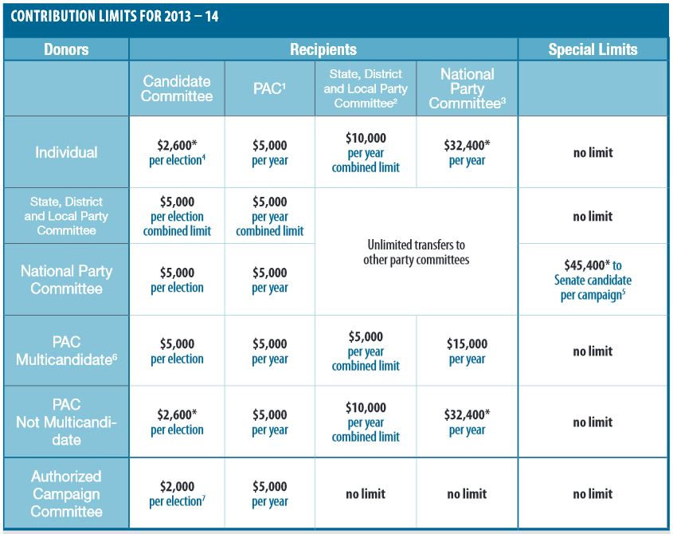
a. Candidate committee donations
Small donations ≠ big donations : the $200 threshold.
$2700 limit/election.
Donors: less than 0,44% of the population.
The role of Internet.
Notes:
Reference:
http://www.fec.gov/pdf/candgui.pdf : see chapter 4 and 10.

Slide 10
small donations
By money raised
By percentage
1: Bernie Sanders
$30,652,976
2: Ben Carson
$19,641,649
3: Hillary Clinton
$13,292,382
4: Ted Cruz
$11,070,909
5: Marco Rubio
$3,247,245
1: Bernie Sanders
74%
2: Ben Carson
63%
3: Donald Trump
48%
4: Ted Cruz
42%
5: Marco Rubio
21%
Notes:
Reference:
https://www.opensecrets.org : presentation of the different candidates.
https://www.opensecrets.org/bigpicture/donordemographics.php

Slide 11
Big donations
By money raised (Perc)
Hillary Clinton
$62,785,473 (81% : 2nd)
Jeb Bush
$23,010,370 (93% : 1st)
Ted Cruz
$15,197,051 (57% : 4th)
Ben Carson
$11692,287 (37% : 5th)
Marco Rubio
$11,346,549 (73% : 3rd)

Slide 12
Self-funding
Is Donald Trump self-fundind his campaign?

Slide 13
b. Outside money
PACs: Congressional vs Presidential elections
Leadership PACs
Super-PACs
Focus on one candidate, multi-candidates, policy.

Slide 14
3- the democratic(?) system
a. Dominance of the 1(0)% : a ploutocratie
b. Political dynasties

Slide 15
a. The dominance of the 1(0)%
Notes:
Reference:
Gilens, Martin, Affluence and Influence. Economic Inequality and Political Power in America, New York, Russell Sage Foundation & Princeton University Press, 2012 : chapter 8, “aspect of political context that might shape responsiveness”, “engagement and income”.

Slide 16
Wealth inequality
Vote maximizers
Policy maximizers
Notes:
Reference:
Gilens, Martin, Affluence and Influence. Economic Inequality and Political Power in America, New York, Russell Sage Foundation & Princeton University Press, 2012 : chapter 6 “introduction”, chapter 8
http://www2.ucsc.edu/whorulesamerica/power/wealth.html

Slide 17
b. Political dynasties
House of representatives
Senate

Slide 18
Bush & Clinton dynasties
1981-1989: R. Reagan
Vice-president: George Bush Sr.
1989-1993: George Bush Sr.
1993-2001: Bill Clinton
2001-2009: George Bush Jr.
2009-2016: Barack Obama
Secretary of State: Hillary Clinton (2009-13)
Big candidates for 2016:
Hillary Clinton and Jeb Bush
Notes:
Reference:
http://www.theguardian.com/us-news/2015/apr/24/bush-clinton-dynasties-political-elite

Slide 19
bibliography
www.opensecrets.org (/bigpicture ; /pres16 … )
Gilens, Martin, Affluence and Influence. Economic Inequality and Political Power in America, New York, Russell Sage Foundation & Princeton University Press, 2012. (chapters 6 and 8)
http://www.fec.gov/pdf/candgui.pdf
http://www.uspresidentialelectionnews.com
http://www.theguardian.com

Slide 20
Thank you
This presentation and its notes are available at

