Slide 1



Slide 2
Learning to Transform
Managing Change … really?
Juliette ROY
June 17, 2015 – Rome

Slide 3
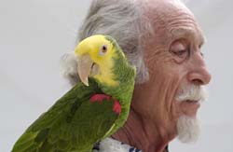
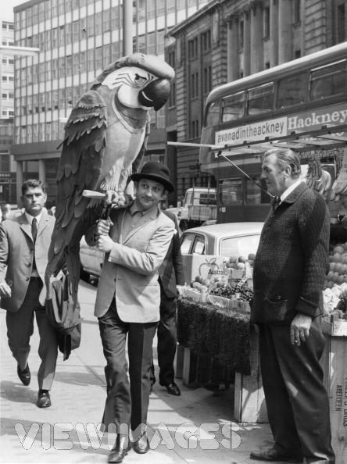

Parrots
About

Slide 4
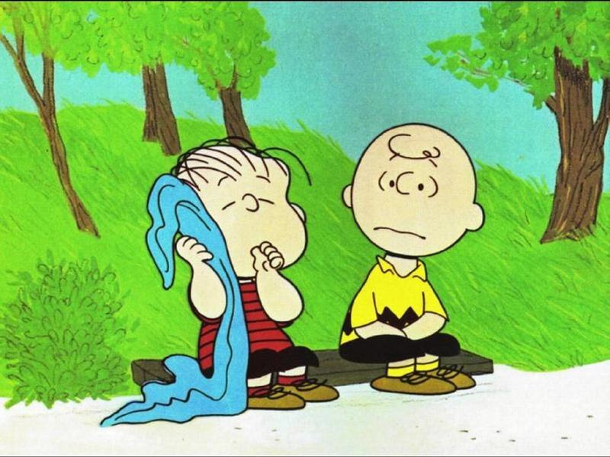
Charlie Brown and you …
about

Slide 5


Charlie Brown and you …
about

Slide 6
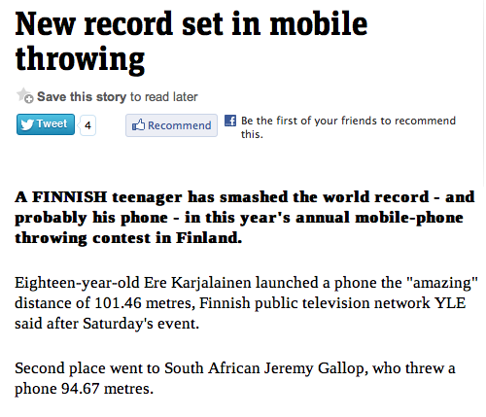
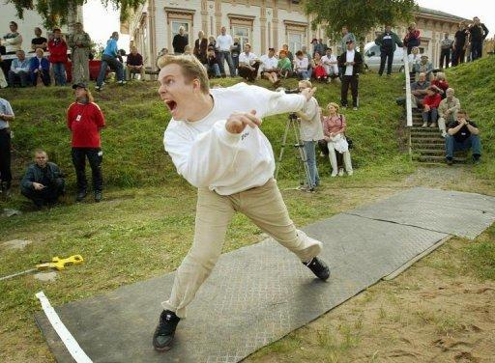

Slide 7
My best failure
Change & Innovation

Slide 8


Slide 9
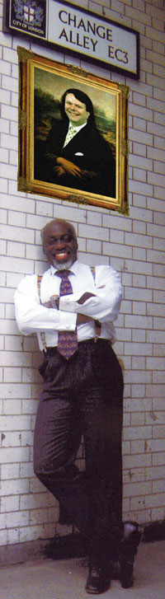
My favourite statistics

Slide 10
My favourite statistics
75%
163,011
23,618
1/300,000
80,400,000

Slide 11
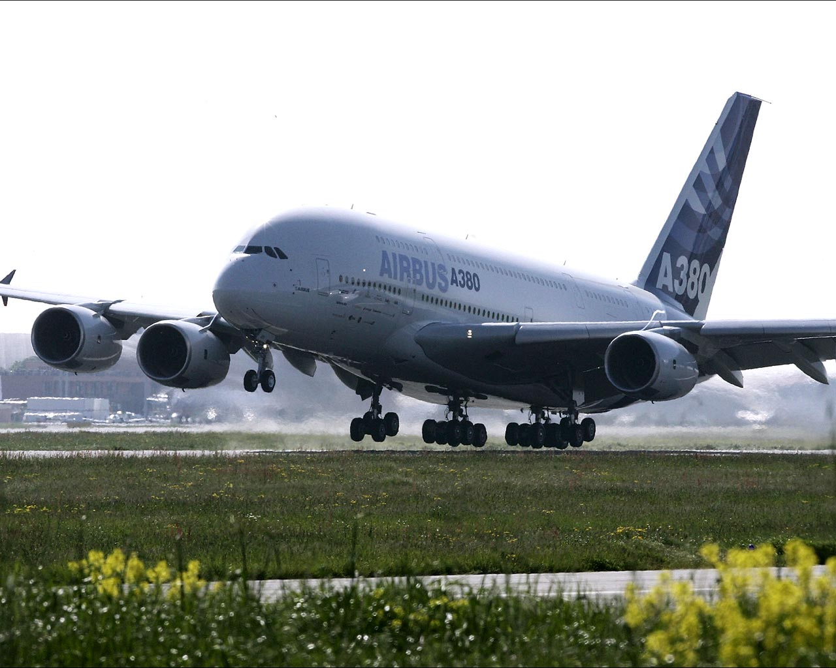
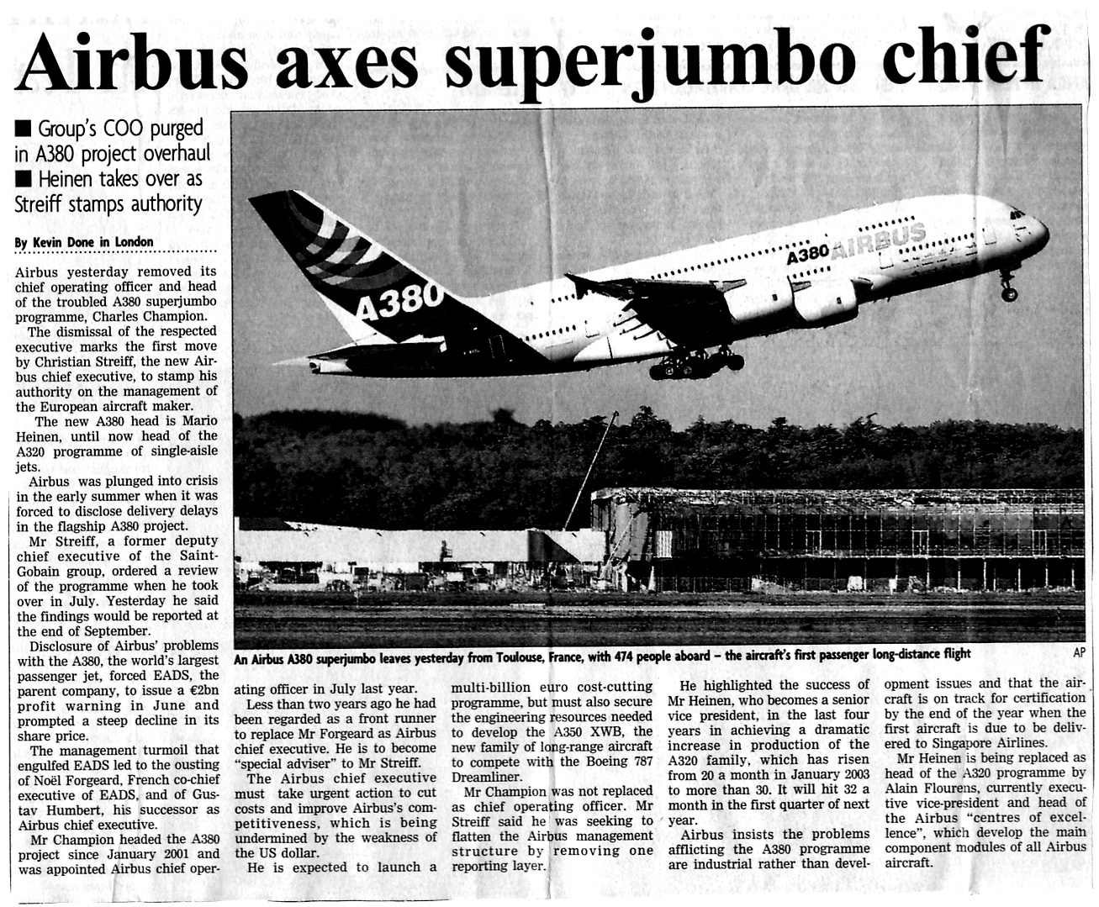

Slide 12
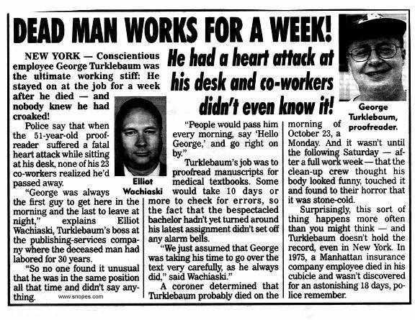
Worker found dead at desk for 5 days
Team work

Slide 13
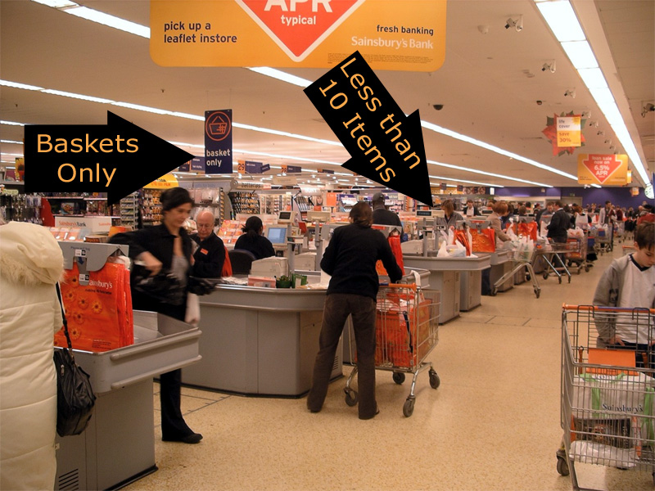
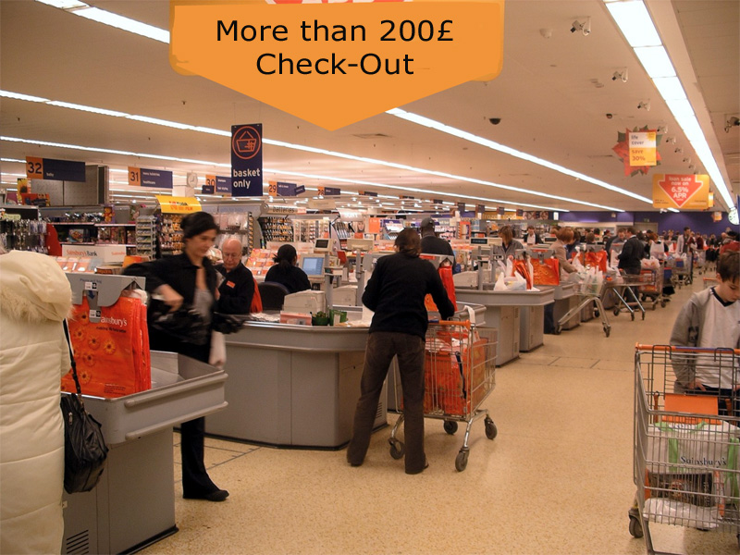
Check-Out
Super-Market

Slide 14
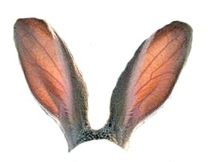
Lack of Engagement
Voice of Judgement
Fear of Failure
Lack of real Sharing
Expertise
Change Killers

Slide 15
Shift happens! …
In which context do we operate now?

Slide 16


Slide 17
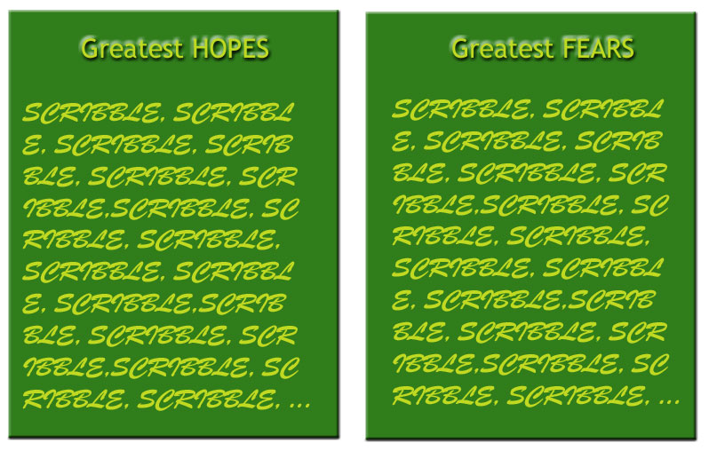
Hopes & Fears
What about you?

Slide 18
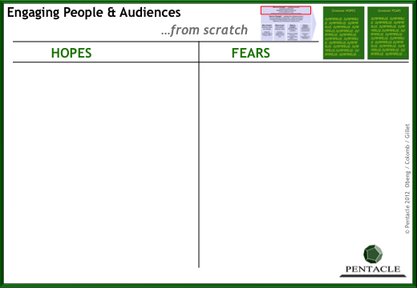
Hopes & Fears
Influencing
Inside
What about you?

Slide 19


Slide 20
Oh my God!
What the hell is happening here?

Slide 21
What’s Up Doc?
New World
Pace of Change
Old World
Change & Innovation
Rate of Learning
Time
Past
Now

Slide 22
What’s Up?
Old World
Hierarchy
Dependence
Clients
Change
Local vs Central
More-of-the-Same
Strategy
Best Practice
Management
Convincing - Directing
Efficiency
…
New World
Virtual Teams
Interdependence
Stakeholders
Alterations
Global & Virtual
Different
Strategie AND Biz Model
Innovation
Leadership
Influencing
Efficiency AND Differentiation
…
Implications

Slide 23

Recruitment @ Heineken …
NewWorld

Slide 24
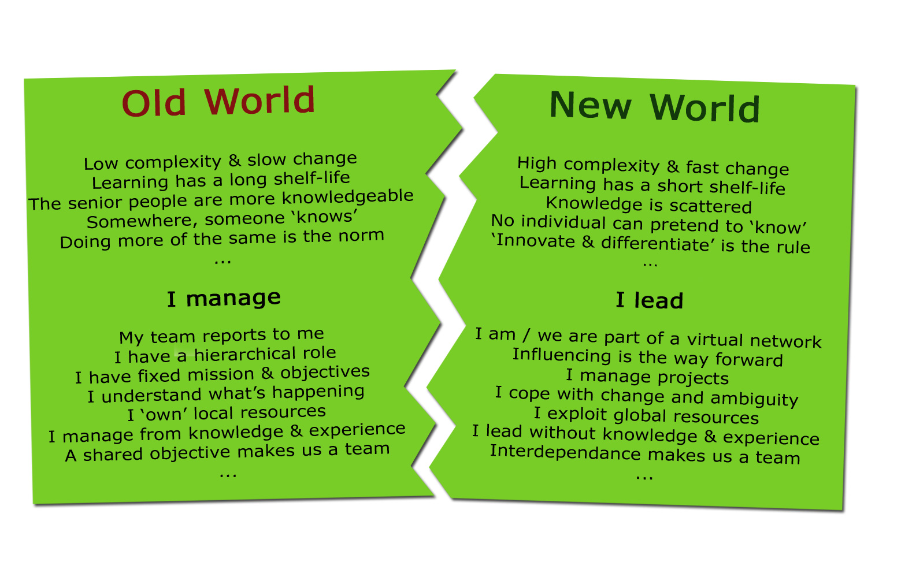
OldWorld/NewWorld
Implications

Slide 25
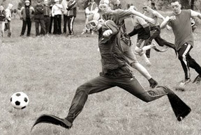
really going on in the New World?
What is

Slide 26
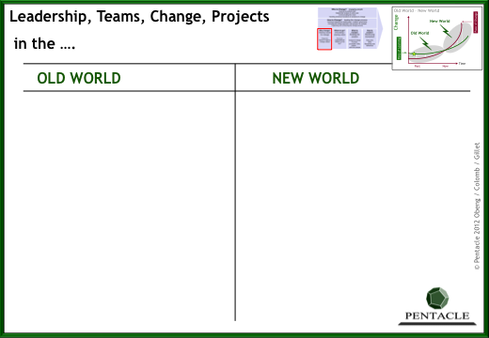
Workpad
TEAMS ?
LEADERSHIP ?
HR? STRATEGY? CUSTOMER?
ORGANIZATION ?
DECISION MAKING ?
…
Exercise

Slide 27





Slide 28
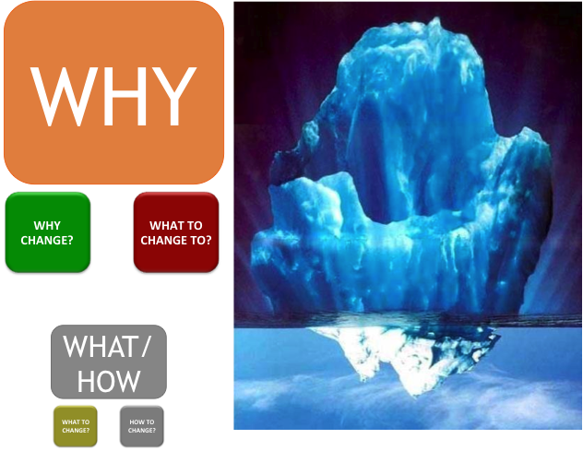
OUR LEARNINGS
WHY TO CHANGE?
WHERE TO GO?
WHO TO CHANGE?
WHAT TO CHANGE?
HOW TO CHANGE?

Slide 29
A little trick …
Change

Slide 30
Which line is the longest?
Change

Slide 31
Change

Slide 32
The Upper one is 10% Longer !!
Why did you say “same”?
Change
Knowledge = Liability

Slide 33

Psychology
Innovation
Stakeholders
Threat
Change
Hunters - Gatherers

Slide 34
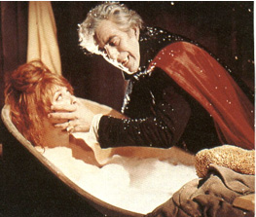
Psychology
How to Deal with Stake Holders
a Good
Stakeholders
When you have
Value Proposition

Slide 35
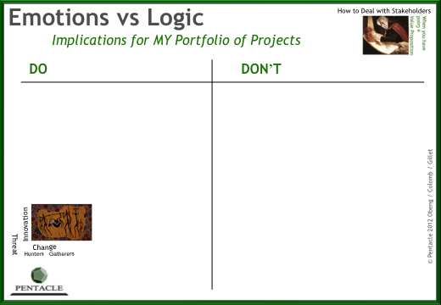
Workpads
Enhancement Tools
Influencing
Inside

Slide 36
Types
HOW
WHAT
NewWorld Change/Projects
WHAT
HOW

Slide 37


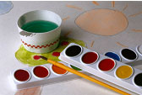

Types
QUEST
Don’t Know HOW
WHAT
PAINT
BY NUMBERS
FOG
NewWorld Change/Projects
Don’t Know WHAT
HOW
MOVIE

Slide 38





Projects …
Insights

Slide 39
MAP YOUR OWN TYPE OF PROJECTS

Slide 40
Biz Processes
Projects
QUEST
Don’t Know HOW
Know WHAT
In the New World
PAINT
BY NUMBERS
FOG
MOVIE
Don’t Know WHAT
Know HOW

Slide 41
Where do you think real Change stands?
QUEST
Don’t Know HOW
Know WHAT
PAINT
BY NUMBERS
FOG
Change Types
Don’t Know WHAT
Know HOW
MOVIE

Slide 42
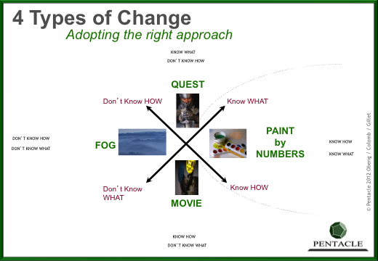
Workpads
Enhancement Tools

Slide 43

When people are engaged…

Slide 44
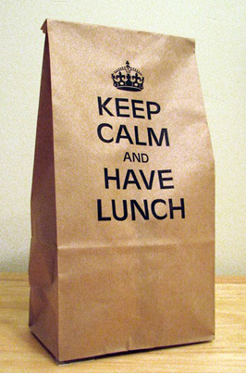

Slide 45
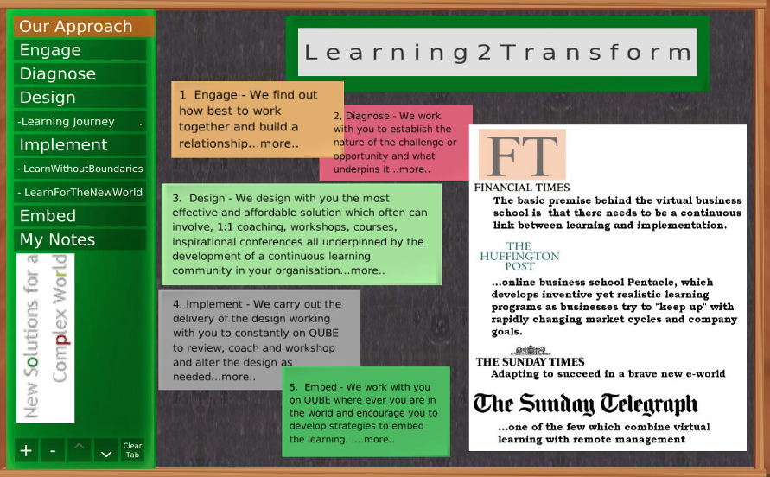
WANT TO LEARN MORE ?
… Just Register to Pentacle Courses ;-)

Slide 46
THANK YOU !
Leading in the NewWorld
Juliette ROY

