Slide 1
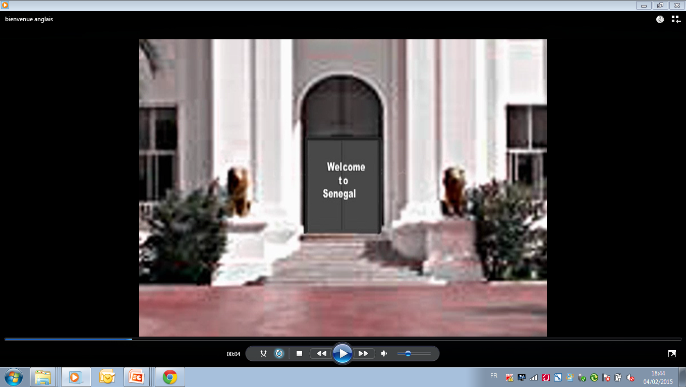

Slide 2


Why invest in Senegal
Airport sector
Tourism Opportunities

Slide 3

Africa, a land of future
Perspectives
Demographical Challenge
Population
  > China’s Population in 2020 ,
  1.5 billion in 2030
  2.1 billions in2050
75% Educated Population in 2020
$ 1.4 trillion Consuming expenses in 2020
8% growth rate in 2020

Slide 4
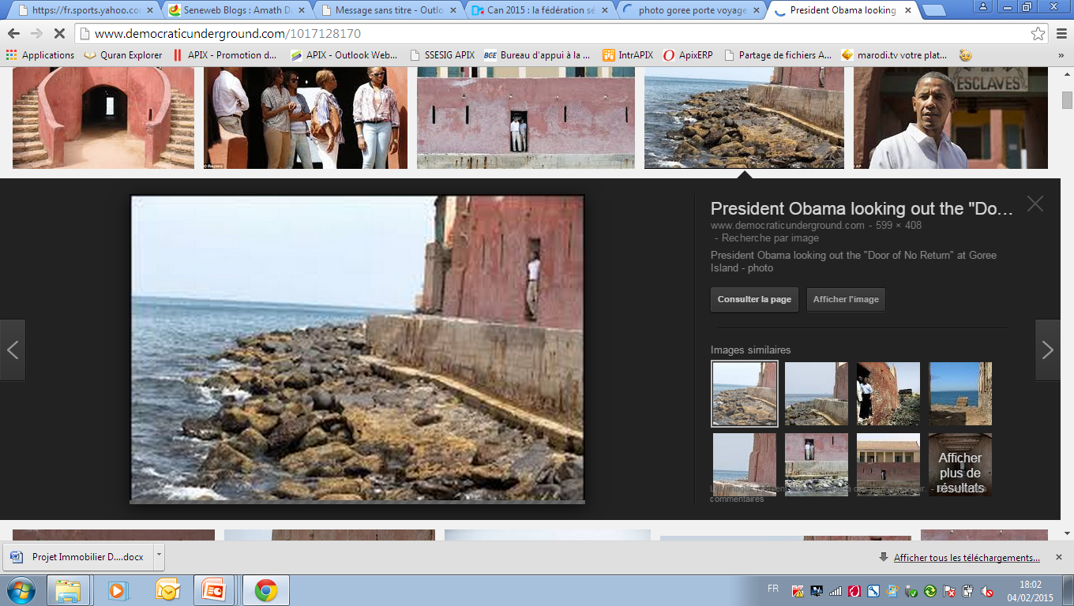
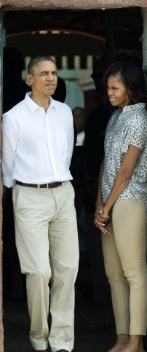

Slide 5
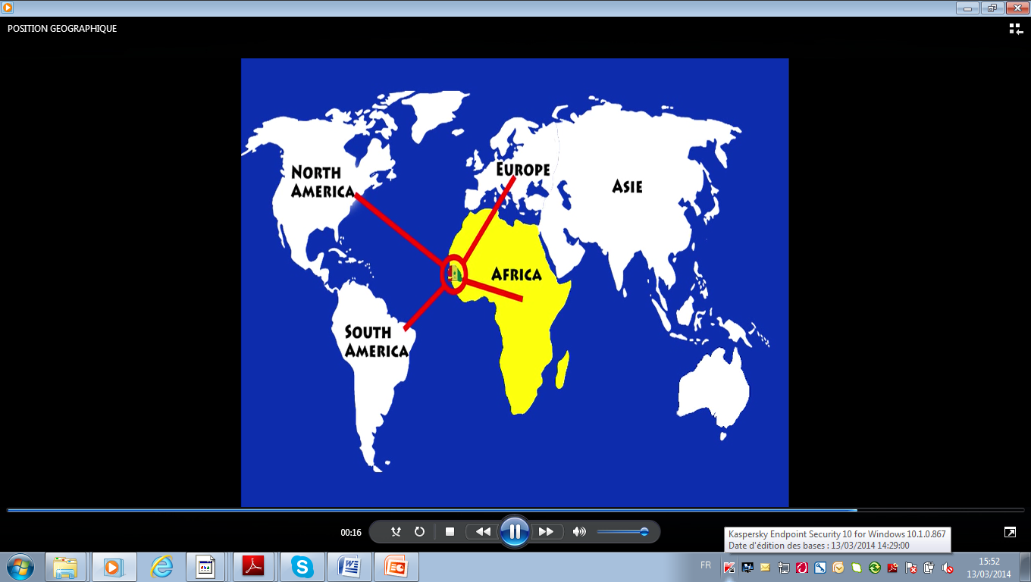
Strategic Geographical Location
GMT time zone (+0:00)
Located at the western tip of Africa
  2, 616 mi from Paris
  4,102 mi from Miami
  3, 300 mi from Sao Paulo
  4, 162 mi from Johannesburg

Slide 6
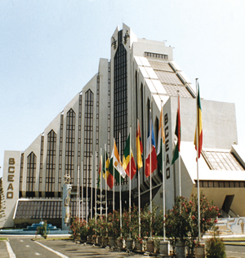
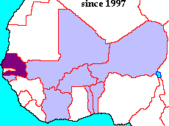
Senegal : Dynamic economy
In 2014:
  GDP per Capita: US$ 1, 040
  Growth Rate: 4,5%
Senegal within WAEMU :
  2nd GDP
  4th growth rate
  Lowest inflation rate (1,4%)
  3rd FDI recipient
Notes:
A cela s’ajoute une économie résiliente et compétitive à l’échelle sous régionale avec les classements que voici :
- 2 PIB de l’espcae UEMOA
- 4 Taux de Croissance
- Le plus taux d’inflation ( 1,4ù)
- 3 récepteur d’IDE de l’espace UEMOA

Slide 7
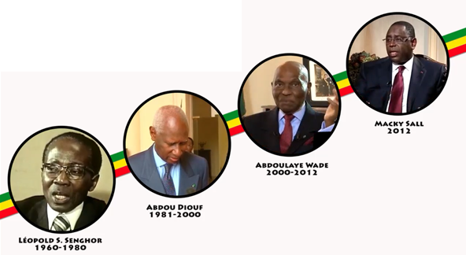
Political Stability
Notes:
Stability is a prerequiste for any Country long-term economic development and political progress.

Slide 8
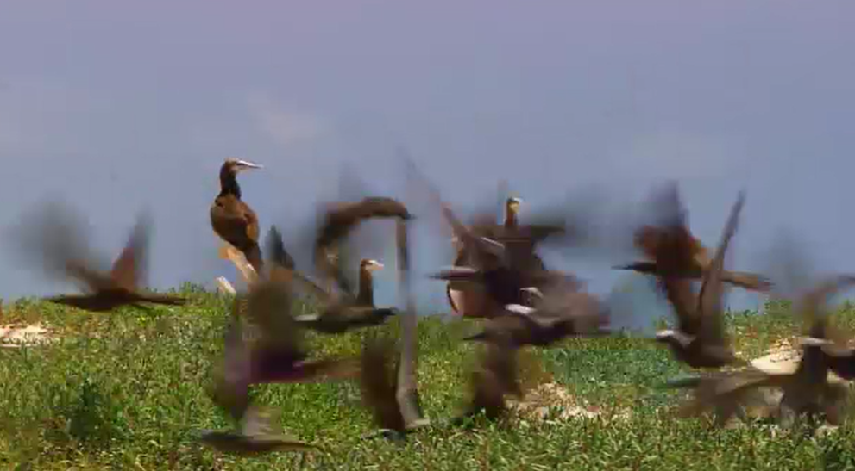
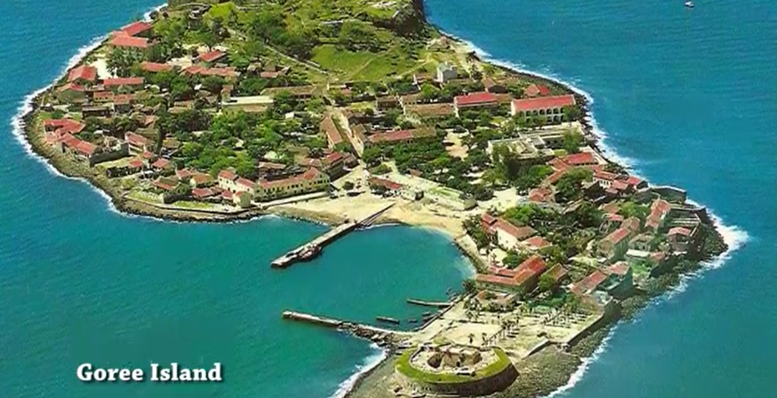
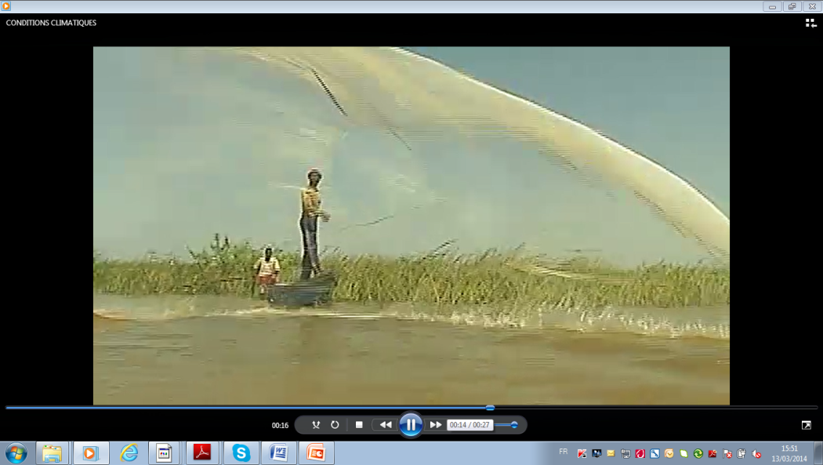
Climate Conditions
700 km of waterfront
500 km of sandy beaches
3000 hours of sunshine per year and average Temperature of 25°
Good cllimate condition for tourism
Notes:
Le Sénégal dispose d’un important potentiel touristique grâce à l’existence de sites d’une beauté exceptionnelle et sa position qui en fait l’un des pays les plus ensoleillés du globe (3 000 heures d’ensoleillement/ an)
Température modérée (25°C)
700 km de Côtes
500 km de plages
Position géographique stratégique
5 Aéroports internationaux
Environ 20 compagnies aériennes
A 5 heures des pays d’Europe
A 7 heures des Etats Unis

Slide 9
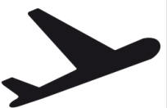
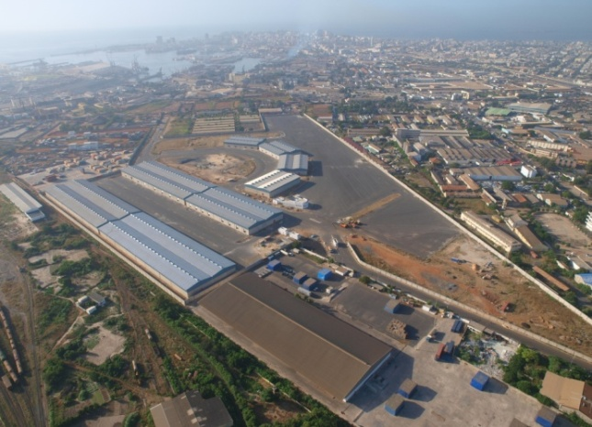
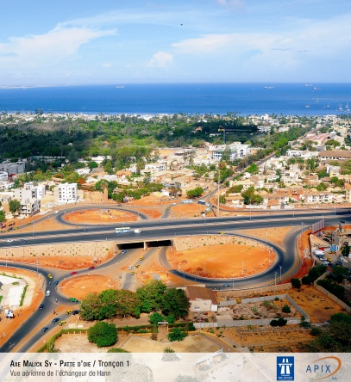

Good Access and Mobility Infrastructures
  New Airport at DIASS (45 km from Dakar) accessible via Highway and new project of express train
  Five (5) other international Airports
  Port : modern and expanding
  Roads & Train : new and upgraded Infrastructures
Telecommunication : modern and reliable network

Slide 10
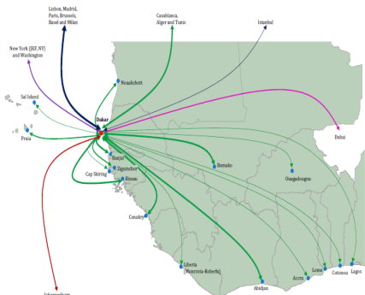
A business hub
Service and logistic Hub
Touristic and Sky Hub
Industrial Hub

Slide 11









Privilegied access to markets
Initiative TSA
SGP Canada
APE
AGOA
SGP Chine
SGP Corée
SGP Japon
WAEMU - ECOWAS
SGP Inde

Slide 12
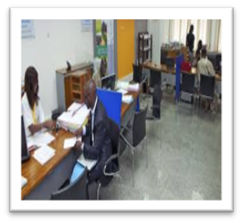



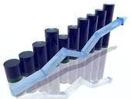

Investor services
Administrative procedures facilitation
Start a firm
1 DAY
Property transfer
50 DAYS
Commercial Law
E tax declaration
PAPERLESS
Cross border trading
10 DAYS
Building Permits
40 DAYS

Slide 13
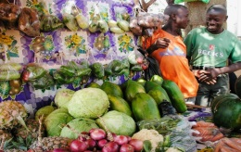
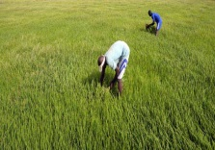




Investor services
Tax incentive
  Sectors
    All sectors that created value added
    All sectors that export
  Forms
    Exemptions
    Duty right on material and equipment of production
    VAT of agricultural materiel of production
    Suspension of VAT upon inputs , local acquisition and other woks and services

Slide 14



Investor services
Export tax incentive
  Fields
    Agriculture, Industry and Teleservices
    At least 80% of production being exported
  Forms
    Total exemption
      Duty right on material and equipment of production
      All taxes of activities (excepted taxes on consumption services)
    Reduction of income tax to 15%

Slide 15
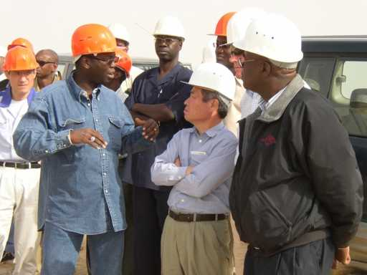
Investor services
    No discrimination between national foreign companies
    No limitation upon the number of foreign employee to hire
    Guaranty and protection of proprety rights
    Guaranty to Access to foreign currencies
    Guaranty to transfer capital and benefits
    Existing tax and on tax advantages

Slide 16

2020-2025 Infrastructures Vision
Plateforme « conteneurs »
Plateforme « céréales »
Plateforme « distribution »
Plateforme « matériaux de construction »
Podor
Plateforme « agrocommer-cialisation »
Dakar-Tamba-Kidira-Bamako – Nord
(rail): réhabilitation voie metrique existante
Saint-Louis
Dakar-Tamba-Kédougou-Bamako : nouvelle voie standard
Rail Matam – Tamba
Louga
Matam
Rail Thiès - Saint-Louis
Linguere
Pipeline
Port du futur
Diogo
Kebemer
Mboro
Mekhe
Thies
Tivaouane
Touba
Dakar
Bargny
Diourbel
A.I.B.D.
Guinguineo
Kidira
M’Bour
Fatick
Naye
Kaolack
Port minéralier de Bargny
Tambacounda
Bamako
Bignona
Kolda
Ziguinchor
Kedougou
Notes:
Railways
750 km Dakar – Bamako
50 km interurban line Dakar – Airport AIBD
Highways
247 km of toll highway to connect the center
200 km of toll highway to connect the North
120 km of toll highway to connect the east

Slide 17







NON EXHAUSTIF
2020- 2025 Energy Vision
Vers Mauritanie
Importation de 80 à 250 MW via une centrale au gaz
Taiba Ndiaye : projet éolien
(50 MW)
Nouvelles lignes (hypothèses)
Interconnexion Mauritanie
Ligne HT (225 et 90 KV)
Ligne HT 30 KV
Tobène : centrale duale fioul - gaz
(70 MW)
Centrales interconnectées
Poste HT interconnectées
Centrales régionales
Mboro :
270 MW charbon
Nouvelles centrales
(plan de production et
projets régionaux)
Port de Dakar rénové pour les produits pétroliers importés
Interconnexion
OMVS
Barrage de Felou (15 MW¹)
Mali
Barrage
de Gouina
(46 MW¹)
Sendou :
  125 MW (Nycomb)
  250 MW (Kepco)
Interconnexion
OMVG
Vers Guinée
Barrage de Kaléta
(48 MW¹)
Barrage de Sambangalou
(61 MW¹)
Centrales solaires
1 Part affectée au Sénégal

Slide 18
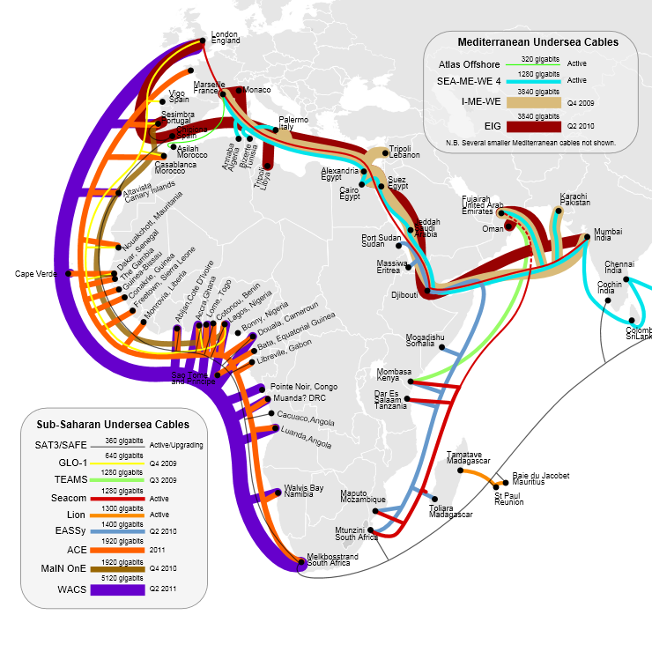
2020-2025 Numeric Vision
VSAT hub pointing to the 355.5 Intelsat
Ground optical fiber interconnecting Mali, Mauritania and Senegal
  3000 kilometers loop of optics fiber
18,4 Gb/s of International Internet bandwidth
National IP network and leased lines from 64 Kbps to 2 Mbps

Slide 19

Agoa Opportunities
AS.1
DEVELOPMENT of SENEGAL EXPORTATIONS under AGOA
Enhancement of exportation capacity in US market
Sensibilisation about AGOA and information about opportunities in US market
Promotion of «From Senegal» in US market
Facilitation of trade exchange
4 STRATEGIC AXES
9 projects
AS.4
AS.2
AS.3

Slide 20
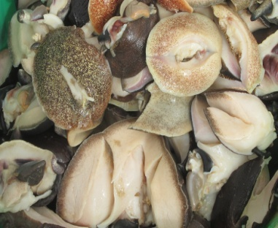
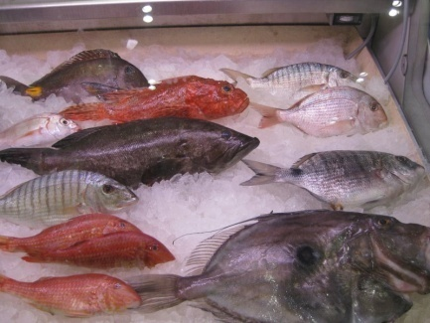
Agoa Opportunities
Fishery and Aquaculture - Potential
148 000 tons of production exported (2011)
  91% non transformed.
Markets: Europeans, Russian, Asian, Arabic
Products : Fish and Seafood
Notes:
Produits congelés
Produits frais
Mollusques et crustacés
Conserves et farine de poisson
Nouvelles espèces (les chinchards, les barbures (thiekeme), les ceintures, les sardinelles)
Produits séchés et fumés
Produits aquacoles

Slide 21
Agoa Opportunities
Agro - Potential
4 million ha of arable land
  385 ha per 1000 inhabitants (SN)
  86 ha per 1000 inhabitants (World Average)
20 to 30%
35 billion m³ of water ressources
  4 billion m³ undergroung water ressources
350 000 ha irrigated land in the north
  150 000 ha pre developed

Slide 22

Agoa Opportunities
Agro – Export or high value added
sectors
67 568 tons of horticulture products , 50% of national target
Market : Europe et Amérique
  Products :Cherry tomatoes (10 000t), green beans (8 000 t), Sweet corn( 8 000t), etc.
750 000 tons Rice production, 60% of national target
Market: local and sub regional
Product: Riz Paddy

Slide 23
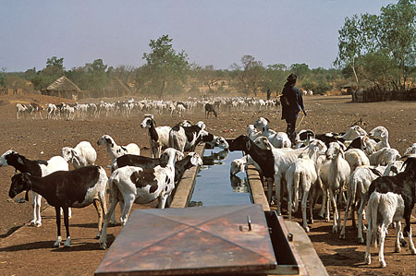

Agoa Opportunities
Livestock – Leather and Skin Sector
  Markets : Chine (Hong Kong), Portugal, EAU, Brésil, Niger, Inde, Turkey
  Products : Cattle, Shaved or without hair Sheep, non tanned, other skin …

Slide 24
Why invest in Senegal
Airport sector
Tourism Opportunities

Slide 25




Senegal serves as the regional headquarter of major aviation organizations
Aviation Capital

Slide 26

Monitoring capacity
Existence of an authority for monitoring aeronautical activities according to the ICAO & FAA 's recommendations.
Regularly audited by ICAO, TSA & WAEMU
In terms of safety, level of compliance :
  83% of monitoring system
  62% of continuous surveillance system

Slide 27
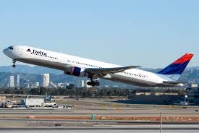
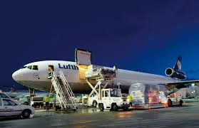
Dakar AIRPORT connections
32 companies serve Dakar
  27 regular
  02 charters
  03 cargo
58 bilateral agreements signed
  32 in open sky
  29 within Yamoussoukro declaration for liberalization of traffic in Africa,
  03 agreements with USA, Kuwait and UAE.

Slide 28
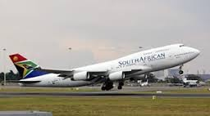
Dakar AIRPORT connections with USA
02 major Airlines:
  DELTA : 04 frequencies,
  SAA: 12 frequencies
  LAST POINT OF DEPARTURE TO USA
The establishment of a connection from Miami to Dakar could help :
  to reach a touristic market composed by afro americans living in the south of USA
  and impulse opportunies within AGOA agreements in terms of commercial exchange (Cargo Village within DISEZ closed to AIBD)

Slide 29
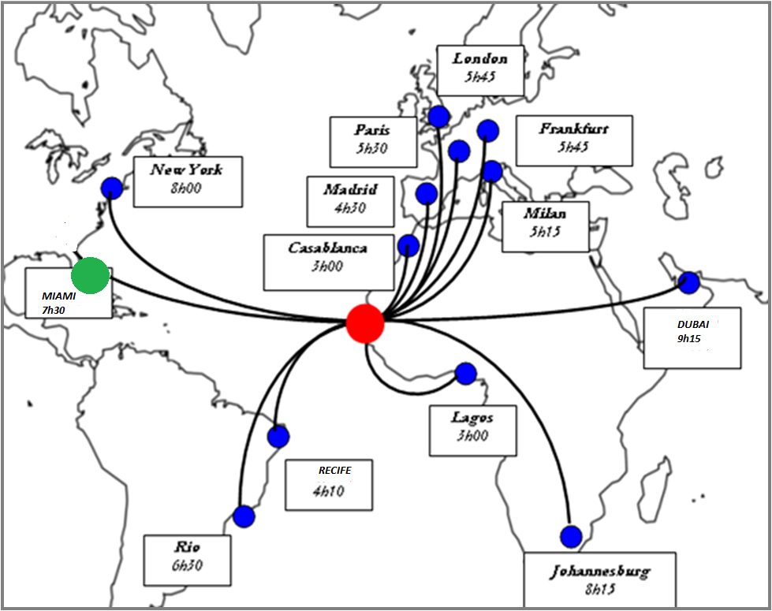
Worldwide connected……
Strategic Position :
Between Europe and America
Between the Middle East and America
Between Europe and the south of Africa
SENEGAL: JUST A FEW HOURS FROM THE REST OF THE WORLD

Slide 30
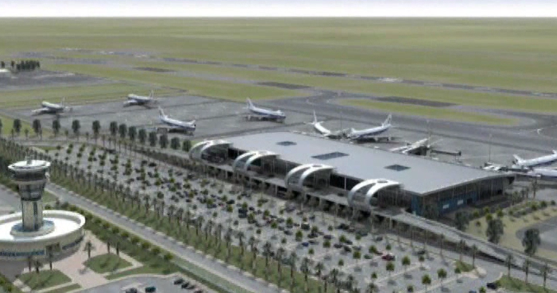
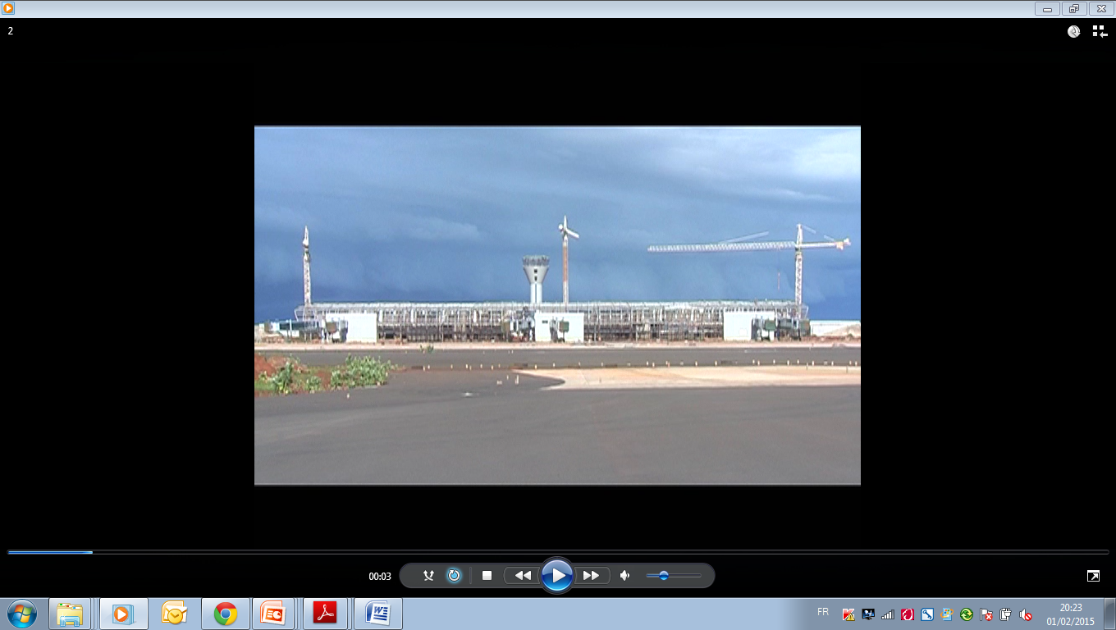
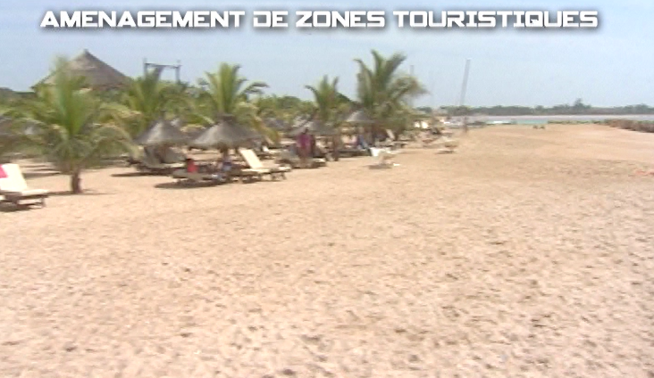
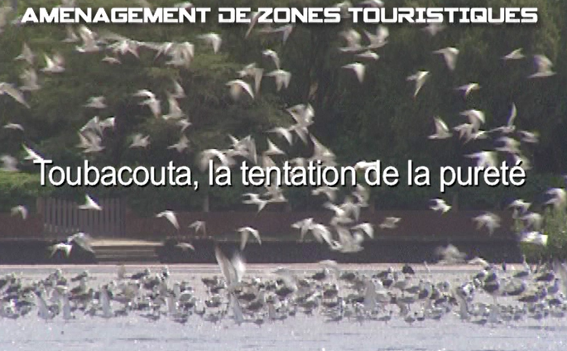
A Sky hub….. with a new modern airport and new touristic zones
From….
….To...
Passenger Capacity of 1,8 million
Potential of business tourism, medical tourism , seaside tourism and other type of tourism
Passengers Capacity of 6 millions by 2025
1 Airport with the largest capacity of the subregion
More than 5 airports and airfields fully rehabilitated all over the country
Reference Maintenance Platform
Over 3 new tourist sites fitted out

Slide 31
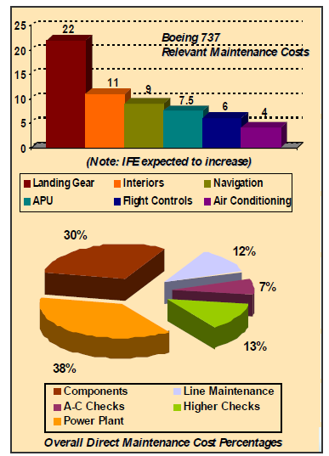
MRO in Africa: Industry profile, global trends and potential competitors
Africa weighs for 4,5 % of the global market in air transport MRO which is about 2 billion USD
Globalization has triggered the creation of strategic partnership between low labor cost service providers and higher ones
Most of the airlines in West Africa use narrow-body aircraft. However the second generation Boeing 737 is the most used one for passengers.
There is not an MRO Center in west Africa.

Slide 32
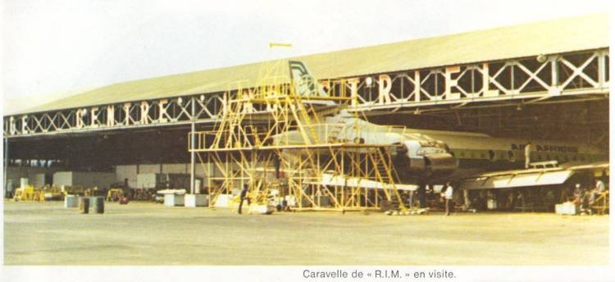
MRO in Senegal: Diagnosis and Realization options
The main objective behind the construction of the new airport is to make of Dakar a hub by betting on its historic role to be a point of transit for intercontinental flights.
To accomplish that goal realizing a MRO center that offers efficient and competitive services is a must.
Also concentrate on intercontinental aeronautical activities including but not limited to technical stops
Realization options: A PPP is foreseen.

Slide 33
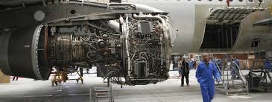
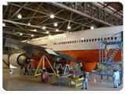
MRO in Senegal: Assessment of future demand
There are about 38 destinations in Africa being reached from Dakar, also direct flights to Europe, North America and South America (Cargo) are carried,
About 12 leading airlines come to Dakar , out of which you can list Delta, South African Airways, Air France, Iberia, TAP, Lufthansa.
For that reason we propose a modular way to start the activities step by step by having:
    Stopovers/Technical stops including Check A&B,
    Aircraft on ground maintenance et not planned,
    Heavy Maintenance check C & D,
    Interior and external works on aircraft,
    Aircraft maintenance logistics .

Slide 34
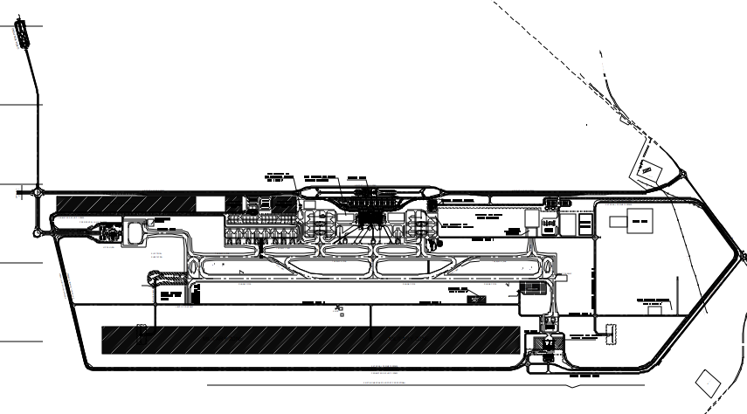
MRO Localization in AIBD
Presidential Aircraft
Hangar
VVIP
Handling
Assigned official lodgings
Fuel Farm
Hotel
General
Aviation
Aircraft
Maintenance
Administrative
Buildings
Catering

Slide 35
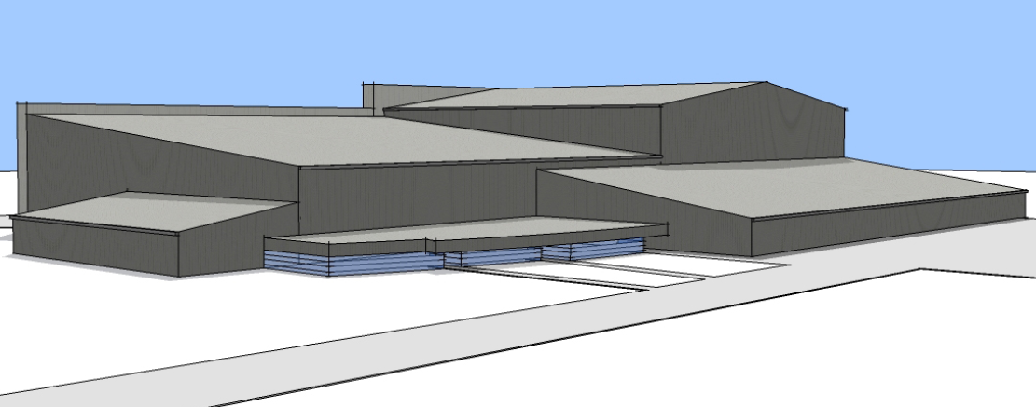
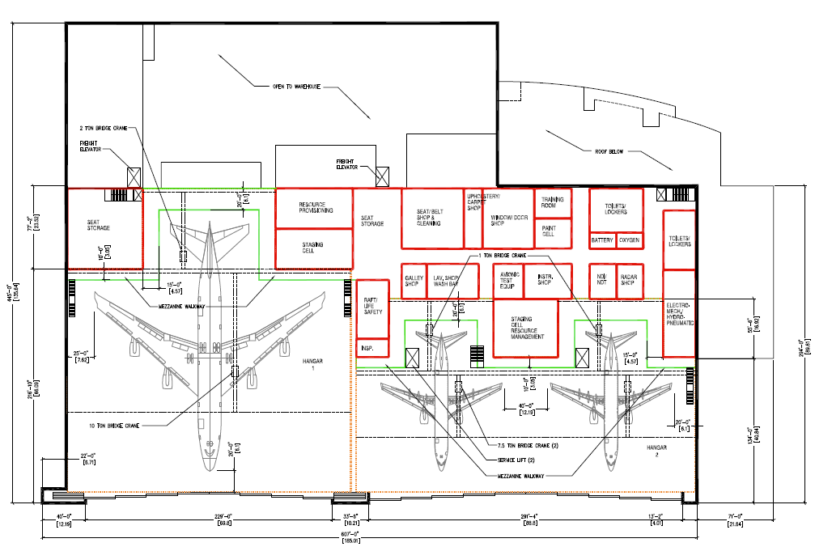
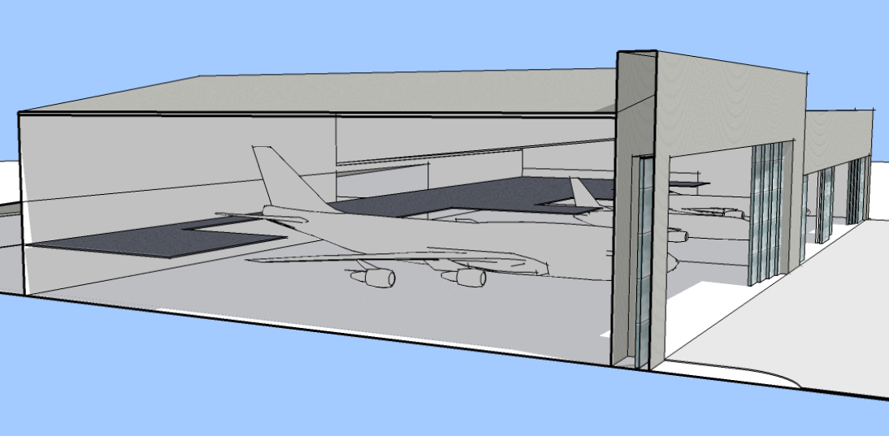
MRO Sizing, Option & Financial estimates
Option to realize it thru BOT: PPP
Preliminary and detailed project studies already completed
Selected option 1 code E aircraft (B 747) & option 2 code C aircraft (A 320) (30700m² hangar)
Adequate aircraft stands
A total cost about 58 millions USD

Slide 36


Financial Analysis
With the option retained of having 1 code E and 2 code C aircraft and to offer a great quality of service we can foresee:
  Revenues for 467 000 hours at 7 Billions CFA
  Materials revenue from 3 to 7 Billions CFA according to tasks
  External vendors revenue from 7 to 10 billions CFA
Required allocated yearly revenues are to be at about 2,6 Billions CFA to cover capital obligations for the hangar and the supporting facilities

Slide 37
Conclusions and Recommendations
An MRO service at the new airport should be based on the following strategic points:
  Obtain a maximum of profit with a minimum of expenses by building at first:
      A light maintenance hangar with its shops
      A multifunctional logistic center
      Aircraft stands for rapid cleaning and connected to shops
  Have a good technical and commercial partner
  Progressively move the initial capacity to more important operations with heavier carriers
  Develop the center in global way including activities in the SEZ.
To succeed in developing the MRO and other aeronautical activities it is essential to build synergies between them.

Slide 38
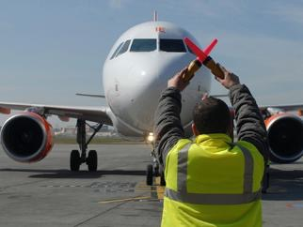
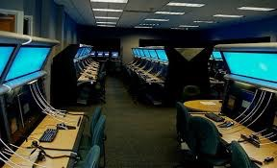
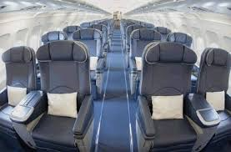
AIBD: MRO connected Projects
Training Institute for Aviation
Location site already identified
Training for Air Traffic Controllers, pilots, aircraft maintenance agents, ground handling, safety and rescue certification and cabin crew
Need to find a strong partner for the financing

Slide 39
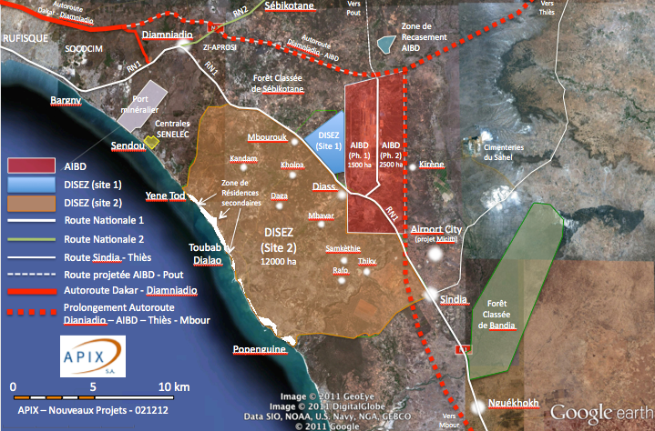

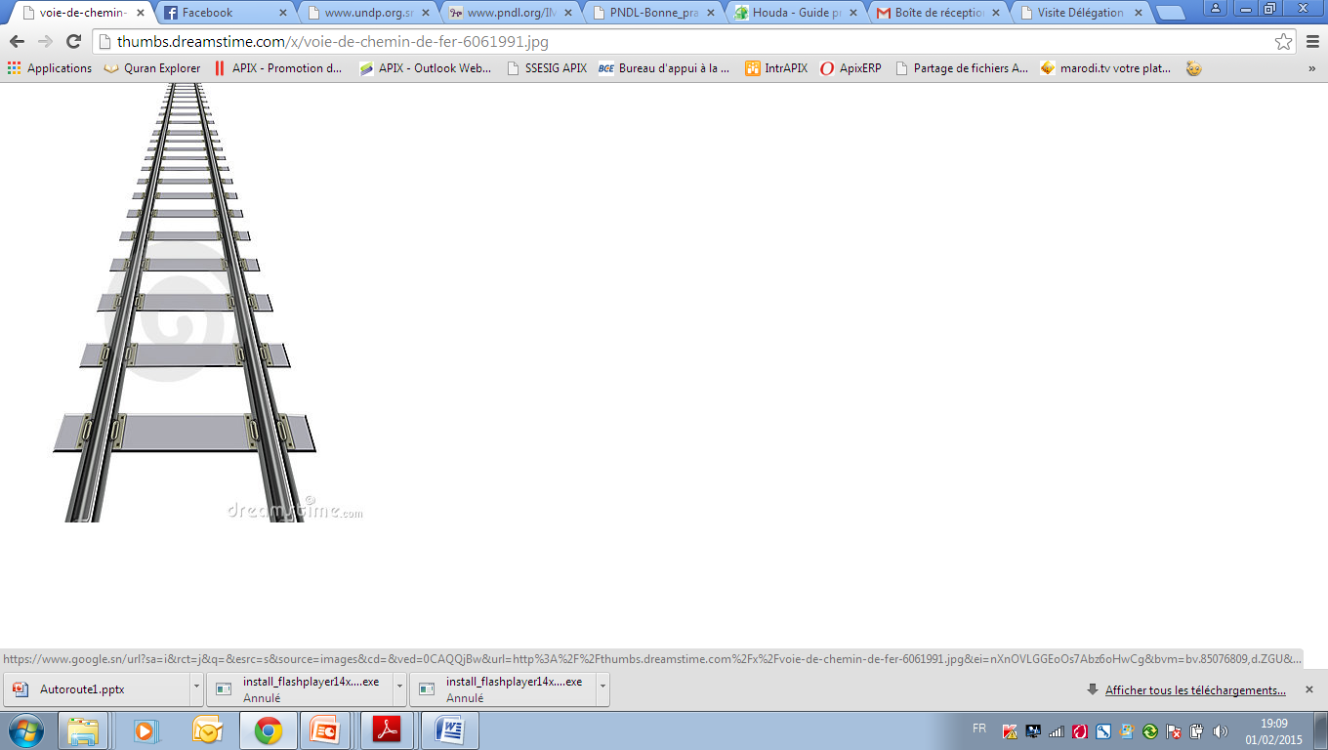

Localization of AIBD Airport & Platform of Maintenance
  New Airport at DIASS (45 km from Dakar) accessible via Highway and new project of express train

Slide 40
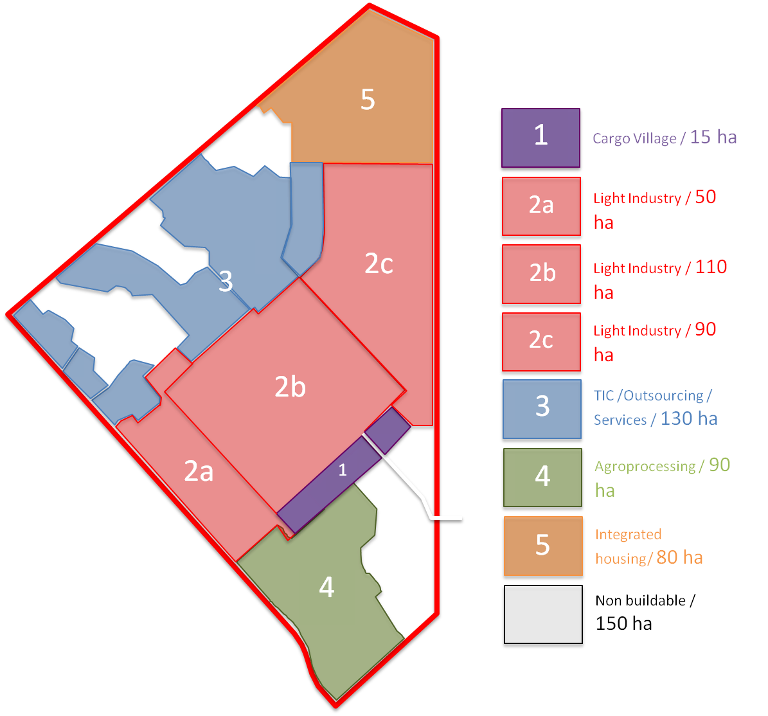
MRO connected project
DISEZ : Development plan of 718 ha
Sector 1 : Cargo Village SEZ
  Surface : 15 ha
  product types: serviced plots and prebuilt warehouses
Sector 2 : Light Industry (non-dedicated)
  Surface : 3 zones of 50 + 110 + 90 ha = 250 ha
  Product types: offices, serviced land, prebuilt warehouses, industrial development
Sector 3 : TIC – Services – Outsourcing
  Surface : 130 ha
  Product types : offices, serviced lands, prebuilt warehouses
Sector 4 : Agroprocessing – Agribusiness
  Surface : 90 ha
  Product types : office, light industrial platforms processing local agricultural products
Sector 5 : Integrated Housing– Facilities – Tourism
  Surface : 80 ha
  Product types : houses, residential buildings, hotels, restaurants, shopping malls, offices (business city or other dedicated vocation)

Slide 41
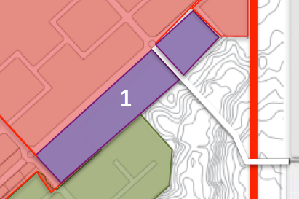
MRO connected project
DISEZ : Cargo Village
Description
Studied area: 2,25 ha
Extendable up to 15 Ha
Product types : Serviced lands for the freight forwarders and turnkey warehouses solutions, public buildings, customs-bonded access road
Current status
Delivery : 2015
Preparation works study achieved
Warehouse’s architectural study achieved

Slide 42
Senegal Airlines
Senegal Airlines was created in 2009 and started operations in 2011 with two A320s. 35% State older and 65% private shear olders.
Key facts regarding the launch of the company and the beginning of operations
June 25, 2009
  Creation of the company
June 25, 2009
  Release of the initial capital of the company
January 26, 2010
  Capital increase
2010
  Initial Business plan elaborated by TASC Aviation, an Airbus subsidiary (100%)
May 2010
  Recruitment of the CEO and beginning of the project implementation with the support of TASC Aviation
June 15, 2010
  Obtainment of the ICAO code (SGG)
December 6, 2010
  Obtainment of the AOC
December 9, 2010
  Obtainment of the IATA code (DN)
January 19, 2011
  Reception of two A320s and start of operations on the West African network (Bamako, Banjul, Conakry, Nouakchott, Niamey, Ouagadougou)
May 31, 2011
  Switch of the President of the Board
August 6, 2011
  Signing of an ACMI contract to operate an ATR42 on domestic (ZIG/CSK) and neighboring (RAI/BJL/OXB/NKC) destinations
August 13, 2011
  Reception of the third A320 and start of operations on the Central African network (Abidjan, Cotonou, Douala, Libreville)
March 21, 2012
  Signing of an ACMI contract replacing the ATR42 by the ATR72

Slide 43
Senegal Airlines operates short and medium haul flights in one local axis and three regional axes
Senegal Airlines
Senegal Airlines network by axis [2014]
Local
A
Local axis (/DASH 8Q-400)
Nouakchott (Mauritania)
Regional
Praia
(Cape Verde)
B
Abidjan axis (A320)
Ziguinchor (Sénégal)
Dakar (Sénégal)
Bamako (Mali)
C
Bamako axis (A320)
Banjul (The Gambia)
Niamey (Niger)
D
Conakry axis (CRJ& A320)
Cap Skirring
(Sénégal)
Bissau
(Guinea-Bissau)
Ouagadougou (Burkina Faso)
Cotonou
(Benin)
Conakry (Guinea)
Long haul
Douala (Cameroon)
No flights operated currently
Abidjan
(Ivory Coast)
Libreville
(Gabon)

Slide 44
Senegal Airlines
In terms of intra-African traffic on the routes it deserves, Senegal Airlines is the second largest company among its direct competitors in 2012
Main competitors of Senegal Airlines
MIDT¹⁾ INTRA-AFRICAN TRAFFIC OF MAIN AIRLINES OPERATING THE LINES WHERE SENEGAL AIRLINES IS ACTIVE [thousands of PAX ; 2012]
Kenya Airways
Sénégal Airlines
Arik Air
(Nigeria)
Royal Air Maroc
Asky
(Togo)
TACV
(Cape Verde)
Ethiopian Airlines
Air Burkina
Mauritania Airlines
Air Mali²⁾
Air Nigeria
Air Côte d’Ivoire
Gambia Bird
Companies based in West Africa
Companies launched in 2012
1) Traffic figures coming exclusively from Amadeus bookings
2) Air Mali activities suspended for 9 months

Slide 45
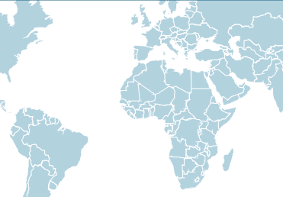
Senegal Airlines
Senegal Airlines may open 9 long haul lines operated directly or through partnerships, Paris being the main opportunity
Selected routes for direct operations or partnerships
  9 lines to be open including 1 to be operated directly (Paris) and 8 under a code share agreement in a first step¹⁾ (Miami, Madrid, Barcelona, London, Sao Paulo, New York, Washington, Johannesburg, Istanbul)
  Ensuring continuity of and enhancing the ongoing partnerships (Emirates to Dubai, Brussels Airlines to Brussels)
  Monetization of flows on 1 destination (Tunis – Tunisair)
London
Bruxelles
New York¹⁾
Paris
Milan¹⁾
Washington¹⁾
Madrid¹⁾
Barcelona¹⁾
Istanbul
Tunis
Beyrouth
Miami
Casablanca
ME
DAKAR
Addis Abeba
Nairobi
To be open directly or through partnerships (code-share / JV)
Brazil
Partnership (code-share / JV)
Flow monetization
Johannesburg
1) Direct operations possible in the long run: Milan, Barcelona, Madrid, New York, Washington

Slide 46
Opportunities with Senegal Airlines
In connection with a joint venture between the two entities, the technical industrial maintenance center could stepwise reactivated in order to cover firstly the airline as well as third party players with regards to light maintenance, develop small shops and further into a maintenance center for the region and beyond..
Maintenance Center
Training Center
Possibility to set and develop a regional training center that could cover various needs of airline industry in terms of safety and security, maintenance, flight operation and other mandatory trainings.
Opportunity to develop Miami-Dakar gateway, will be able to extend its area of activities towards high profit non-core business units such as Ground handling services, catering and some other activities linked to the airline core business
Availability of a huge cargo area which will be allocated by the new airport authorities
Potentiality to build up a cargo dispatch hub due to strategical airport position open to international freight flows
Regional Cargo
Airport activities services

Slide 47
Why invest in Senegal
Airport sector
Tourism Opportunities

Slide 48
Touristic products
Seaside Tourism
Congress and Events Tourism
Potential: Discovery Tourism and Ecotourism

Slide 49
Perspectives
Targeted objective: 1,5 million tourists by the year 2016
Accommodation capacity multiplied by two
Building of 3 high standard seaside stations :
      ✓ Pointe Sarène
      ✓ Mbodiene
      ✓ Joal Finio

Slide 50
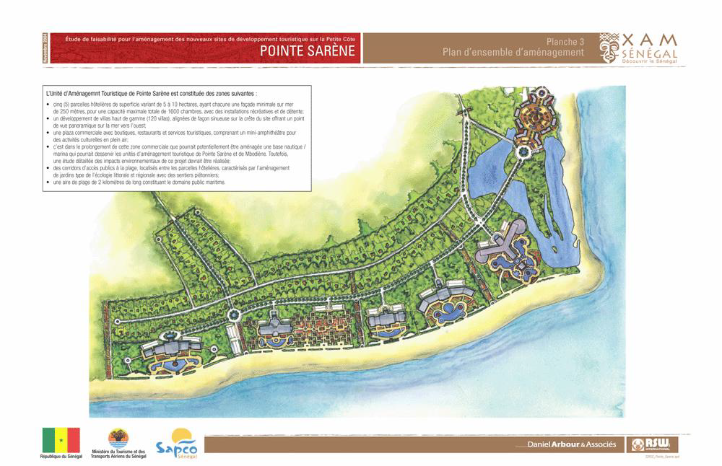
Pointe Sarène
75 ha of available land
5 hotels: 250 to 500 rooms
1 600 rooms
leisure and recreational facilities
120 high standard villas
1 commercial plaza (center)
corridors
1.2 miles of beach

Slide 51
Pointe Sarène
The Pointe Sarène Touristic unit is comprised of the following areas:
five (5) hotels plots varying from 5 to lo 17 hectares of land, each hotel having a minimal sea front of 250 meters for a total maximal capacity of 1600 rooms with leisure and recreational facilities.
High standard mansions (120) all along the summit of an area which gives a panoramic view of the sea to the western side;
A commercial plaza with shops , restaurants and touristic services with a small hall for outdoor cultural activities;
At the end of the commercial area a nautical base / marina could potentially be erected which could service Pointe Sarène and Mbodiene
General public access corridors to the beach between hotel plots surrounded by seaside and regional type ecological gardens that can be accessed through foot lanes;
A 1.2 miles long beach as waterfront

Slide 52
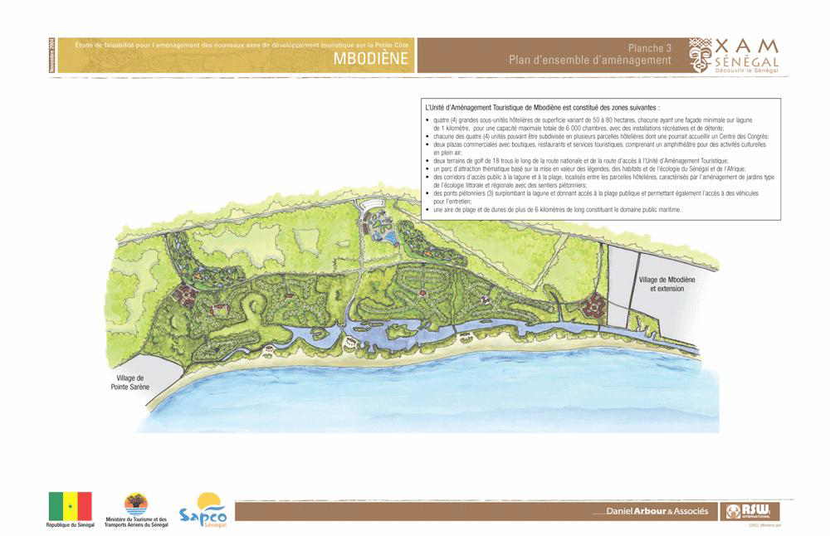
Mbodiene
300 ha of available land
20 hotels: 250 to 500 rooms
6 000 rooms
Leisure facilities
2 commercials plazas with shops and restaurants
touristical services and a major outdoor hall
1 18-holes golf course
General Public Access Corridors
foot bridges

Slide 53
Mbodiene
The Mbodiene Touristic unit is comprised of the following areas:
four (4) major 50 to 80 hectares hotel sub-units with a minimal sea front line of 1 kilometer on the lagoon, with a maximal total capacity of 6.000 rooms with leisure and recreational facilities;
Each of the four (4) sub-units can be divided into many hotel plots one of which can host a congress center;
Two commercial plazas (centers) with shops, restaurants and touristical services Including one large hall for outdoor cultural activities;
Two 18 holes golf course along the main road and the access lane to the touristical area Construction Unit;
A thematic park of attraction that will valorise our legends, habitats as well as the ecology of Senegal and the African Continent
Corridors for people to access the lagoon and the beach located in between the hotel plots surrounded by seaside and regional type ecological gardens that can be accessed through foot lanes
Foot bridges (3) over the lagoon with direct access to the beach; the bridges can also be crossed by vehicles for maintenance.
A beach and sand dunes area covering more than 6 kilometers and which constitutes the state seafront area.

Slide 54
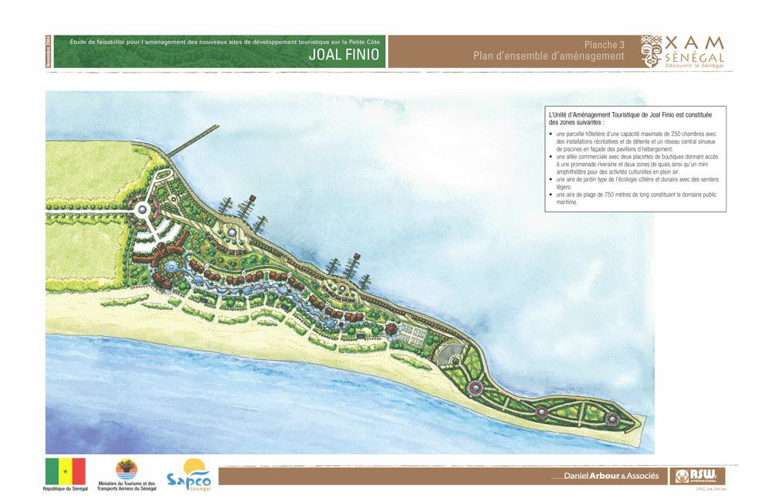
Joal - Finio
15 ha of available land
1 hotel complex
250 rooms
Recreational facilities
commercial lane with 2 shops areas
1 coastal and sand dune type garden area
one 750 m beach area
1 hall

Slide 55
Joal - Finio
The Touristic Development Unit is comprises of the following areas:
A hotel plot with a maximal capacity of 250 rooms and recreational facilities, a central network of scattered swimming pools facing accommodation pavilions ;
1 commercial lane of shops with access to the river walkway and two quay areas as well a mini-hall for outdoor cultural activities ;
1 costal and sand-dune type garden area with small lanes ;
One 750 meters beach that constitutes the state seafront area ;

Slide 56


SENEGAL, A bridge to the Futur

