Slide 1


Slide 2

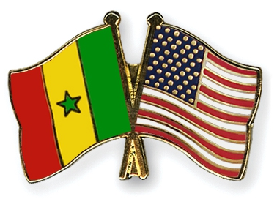
Why invest in Senegal
Airport sector
Tourism Opportunities

Slide 3
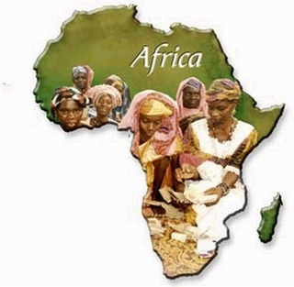
Africa, a land of future
Perspectives
Demographical Challenge
Population
  > China’s Population in 2020 ,
  1.5 billion in 2030
  2.1 billions in2050
75% Educated Population in 2020
$ 1.4 trillion Consuming expenses in 2020
8% growth rate in 2020

Slide 4
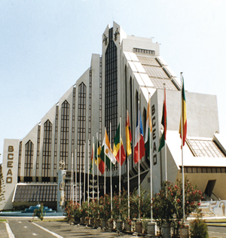
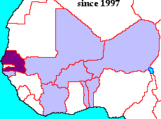
Dynamic Economy
In 2013:
  GDP per Capita: US$ 1, 040
  Growth Rate: 3,8 %
Competitive Country
Senegal within WAEMU :
  2nd GDP
  4th growth rate
  Lowest inflation rate (1,4%)
  3rd FDI recipient
Notes:
A cela s’ajoute une économie résiliente et compétitive à l’échelle sous régionale avec les classements que voici :
- 2 PIB de l’espcae UEMOA
- 4 Taux de Croissance
- Le plus taux d’inflation ( 1,4ù)
- 3 récepteur d’IDE de l’espace UEMOA

Slide 5
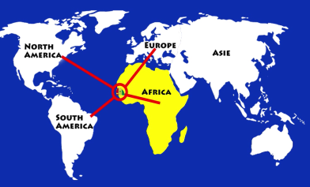
Strategic Geographical Location
Located at the western tip of Africa
  2, 616 mi from Paris
  4,102 mi from Miami
  3, 300 mi from Sao Paulo
  4, 162 mi from Johannesburg
GMT time zone (+0:00)

Slide 6
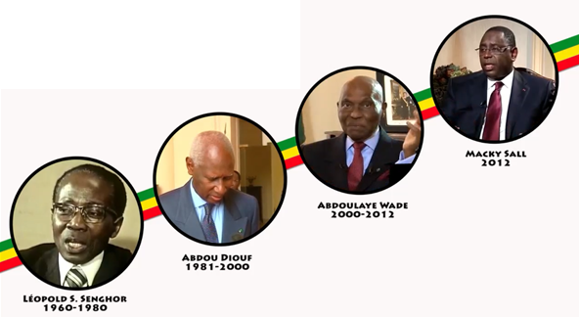
Why Investing in Senegal
Political Stability & Strong governance System
Notes:
Stability is a prerequiste for any Country long-term economic development and political progress.

Slide 7
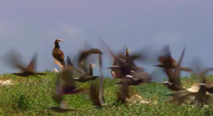
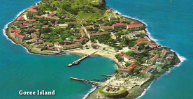
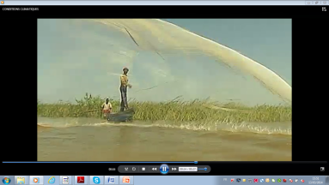
Climate Conditions
700 km of waterfront
500 km of sandy beaches
3000 hours of sunshine Medium and Mild Temperature of 25°
Micro climate in favour of health tourism and Counter season agriculture
Notes:
Le Sénégal dispose d’un important potentiel touristique grâce à l’existence de sites d’une beauté exceptionnelle et sa position qui en fait l’un des pays les plus ensoleillés du globe (3 000 heures d’ensoleillement/ an)
Température modérée (25°C)
700 km de Côtes
500 km de plages
Position géographique stratégique
5 Aéroports internationaux
Environ 20 compagnies aériennes
A 5 heures des pays d’Europe
A 7 heures des Etats Unis

Slide 8
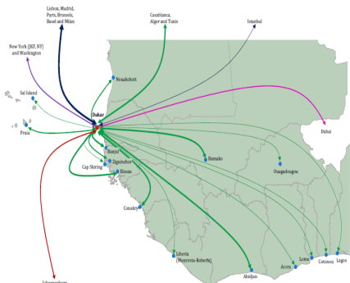
Senegal Positioning
Service and logistic Hub
Touristic and Sky Hub
Industrial Hub

Slide 9
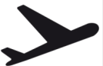

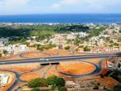

Good Access and Mobility Infrastructures
  New Airport at DIASS (45 km from Dakar) accessible via Highway and new project of express train
  Five (5) other international Airports
  Port : modern and expanding
  Roads & Train : new and upgraded Infrastructures
Telecommunication : modern and reliable network

Slide 10









Privilegied access to markets
Initiative TSA
SGP Canada
APE
AGOA
SGP Chine
SGP Corée
SGP Japon
UEMOA - CEDEAO
SGP Inde

Slide 11
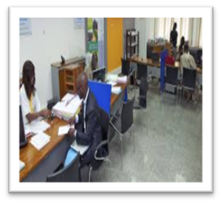



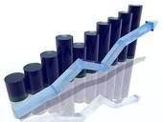

Investors’ services
Administrative procedures’ facilitation
Starting a firm
1 DAY
Proprety transfer
50 DAYS
Commercial Law
E tax declaration
PAPERLESS
Cross border trading
10 DAYS
Building Permits
40 DAYS

Slide 12
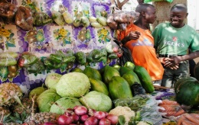
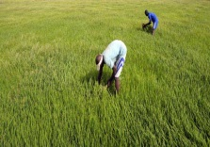
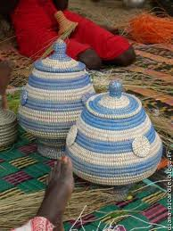



Investors’ services
Tax incentive
  Sectors
    All sectors that created value added
    All sectors that export
  Forms
    Exemptions
    Duty right on material and equipment of production
    VAT of agricultural materiel of production
    Suspension of VAT upon inputs , local acquisiton and other works and services

Slide 13



Investors’ services
Export tax incentive
  Fields
    Agriculture, Industry and Teleservices
    At least 80% of production being exported
  Forms
    Total exemption
      Duty right on material and equipment of production
      All taxes of activities (excepted taxes on consumption services)
    Reduction of income tax to 15%

Slide 14
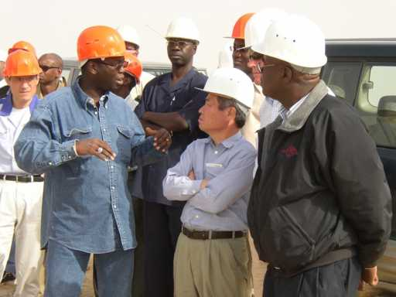
Investors’ services
    No discrimination between national foreign companies
    No limitation upon the number of foreign employees to hire
    Guaranty and protection of property rights
    Guaranty to Access to foreign currencies
    Guaranty to transfer capital and benefits
    Existing tax and on tax advantages

Slide 15

2020-2025 Infrastructures Vision
Plateforme « conteneurs »
Plateforme « céréales »
Plateforme « distribution »
Plateforme « matériaux de construction »
Podor
Plateforme « agrocommer-cialisation »
Dakar-Tamba-Kidira-Bamako – Nord
(rail): réhabilitation voie metrique existante
750 km of rail line to the Mali
Railways
Saint-Louis
Dakar-Tamba-Kédougou-Bamako : nouvelle voie standard
Rail Matam – Tamba
50 km of inter urban rail line in Dakar region
Louga
Matam
Rail Thiès - Saint-Louis
Linguere
Pipeline
Port du futur
Diogo
Kebemer
Mboro
Mekhe
Thies
Tivaouane
Touba
Dakar
Bargny
Diourbel
A.I.B.D.
Guinguineo
Kidira
M’Bour
Fatick
Naye
Kaolack
247 km of toll highway to connect the center
Port minéralier de Bargny
Highways
Tambacounda
Bamako
200 km of toll highway to connect the North (access to Europe)
Bignona
Kolda
120 km of toll highway to connect the East
Ziguinchor
Kedougou

Slide 16







NON EXHAUSTIF
2020- 2025 Energy Vision
Vers Mauritanie
Importation de 80 à 250 MW via une centrale au gaz
Taiba Ndiaye : projet éolien
(50 MW)
Nouvelles lignes (hypothèses)
Interconnexion Mauritanie
Ligne HT (225 et 90 KV)
Ligne HT 30 KV
Tobène : centrale duale fioul - gaz
(70 MW)
Centrales interconnectées
Poste HT interconnectées
Centrales régionales
Mboro :
270 MW charbon
Nouvelles centrales
(plan de production et
projets régionaux)
Port de Dakar rénové pour les produits pétroliers importés
Interconnexion
OMVS
Barrage de Felou (15 MW¹)
Mali
Barrage
de Gouina
(46 MW¹)
Sendou :
  125 MW (Nycomb)
  250 MW (Kepco)
Interconnexion
OMVG
Vers Guinée
Barrage de Kaléta
(48 MW¹)
Barrage de Sambangalou
(61 MW¹)
Centrales solaires
1 Part affectée au Sénégal

Slide 17
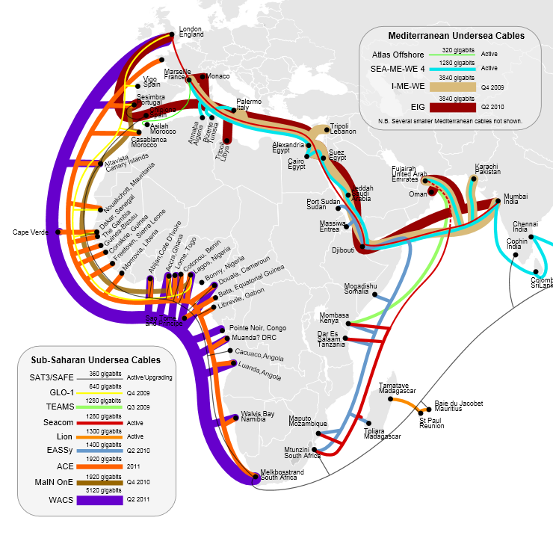
2020-2025 Numeric Infrastructure Vision
VSAT hub pointing to the 355.5 Intelsat
Ground optical fiber interconnecting Mali, Mauritania and Senegal
  3000 kilometers loop of optics fiber
18,4 Gb/s of International Internet bandwidth
National IP network and leased lines from 64 Kbps to 2 Mbps

Slide 18

Agoa Opportunities
AS.1
DEVELOPMENT of SENEGAL EXPORTATIONS under AGOA
Enhancement of exportation capacity in US market
Sensibilisation about AGOA and information about opportunities in US market
Promotion of «From Senegal» in US market
Facilitation of trade exchange
4 STRATEGIC AXES
9 projects
AS.4
AS.2
AS.3

Slide 19
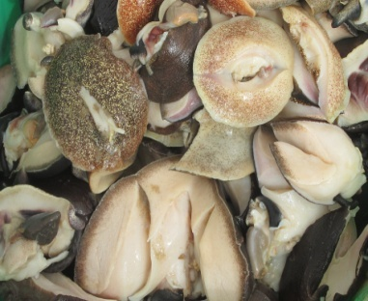
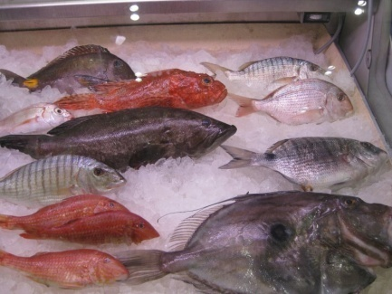
Agoa Opportunities
Fishery and Aquaculture - Potential
148 000 tons of production exported (2011)
  91% unprocessed.
Markets: Europeans, Russian, Asian, Arabic
Products : Fish and Seafood
Notes:
Produits congelés
Produits frais
Mollusques et crustacés
Conserves et farine de poisson
Nouvelles espèces (les chinchards, les barbures (thiekeme), les ceintures, les sardinelles)
Produits séchés et fumés
Produits aquacoles

Slide 20
Agoa Opportunities
Agro - Potential
4 million ha of arable land
  385 ha per 1000 inhabitants (SN)
  86 ha per 1000 inhabitants (World Average)
20 to 30%
35 billion m³ of water resources
  4 billion m³ underground water resources
350 000 ha irrigated land in the north
  150 000 ha pre developed

Slide 21
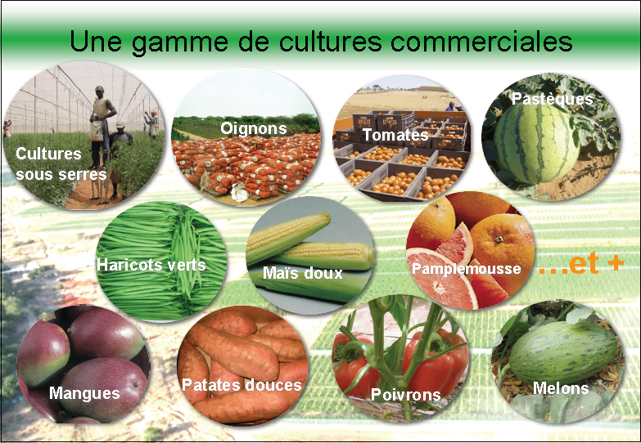
Agoa Opportunities
Agro – Export or high value added
sectors
67 568 tons of horticulture products , 50% of national target
Market : Europe and America
  Products :Cherry tomatoes (10 000t), green beans (8 000 t), Sweet corn( 8 000t), etc.
750 000 tons Rice production, 60% of national target
Market: local and sub regional
Product: Paddy rice

Slide 22
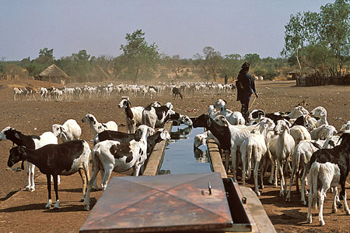
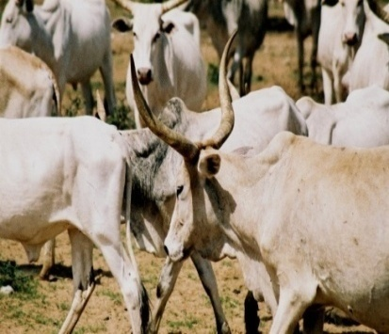
Agoa Opportunities
Livestock – Leather and Skin Sector
  Markets : China (Hong Kong), Portugal, UAE, Brasil, Niger, India, Turkey
  Products : Cattle, Shaved or without hair Sheep, non tanned, other skin …

