Slide 1
MUD’S SYMBOLS

Slide 3
SNAKES’ AND BIRDS’ SIGNIFICATION IN THE MOVIE
« God created snakes for us to be afraid »
Mud has a snake running up his arm to remind him of the time he almost died of a snake bite. Snakes symbolize Evil.
Sometimes, birds eat snakes. Bird means hope in that film.
Birds are personnified by Juniper and snakes are personnified by Mud.
It means that Juniper “eat” and control Mud.
When Mud sees birds’ flight, it makes him think to Juniper.

Slide 4
SNAKES’ AND BIRDS’ SIGNIFICATION IN THE BIBLE
In the bible, the snake used to be the symbol of knowledge and freedom.
Cursed by God, the snake actually represent Evil, poison and temptation.
The snake has a bad meaning in Bible. For some tribes in Africa, the snake means fertility and food.

Slide 5
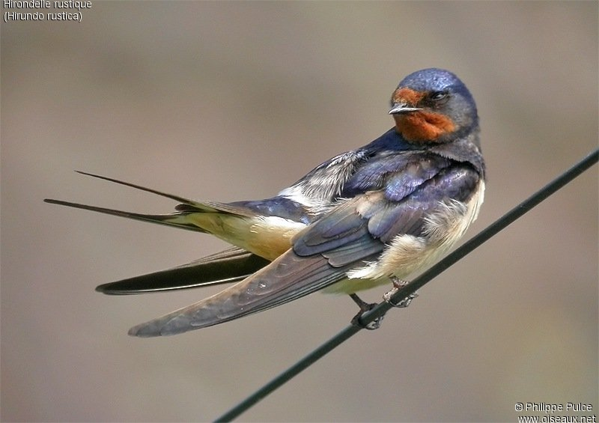
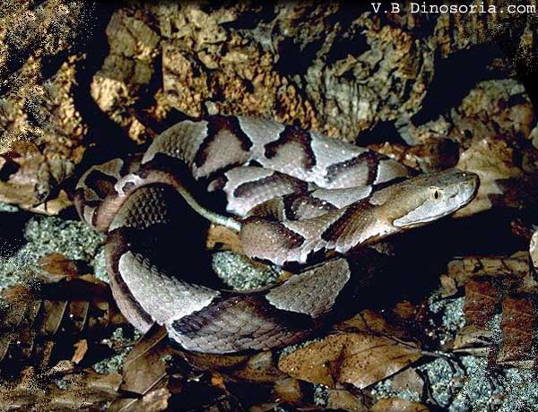

Slide 6
FIRE’S MEANING IN BIBLE
The fire has many signification in real life and in the holy bible.
The fire means purification and exaltation of the senses. The fire is one of the four elements.
The fire also means Evil sometimes and Destruction. The fire is so pure that it’s one of the most important element of life and spirituality.

Slide 7
FIRES’ MEANING IN MUD
There are many types of fires in Mud.
Once, Mud makes a joy-fire because he thinks that Juniper will come and travel with him.
Mud is really superstitious and fires mean a lot of different things for him.

Slide 8
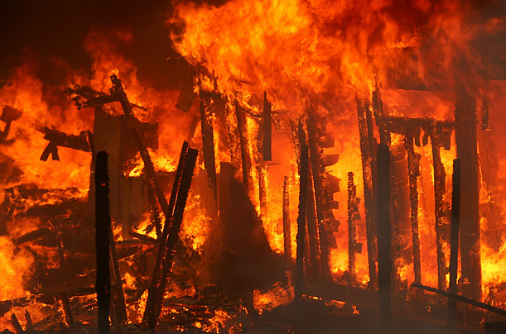

Slide 9
TATOOES
The fact is that Juniper has birds on her arm.
Mud has a snake to remember that if he’s bitten another time, he will die because he already has been bite.
Some birds eat snakes. It is a way to show that Juniper is « eating » Mud.
She has the power on Mud. She’s ruining his life.
Mud is living for Juniper.

Slide 10
THANKS FOR WATCHING

