Slide 1









Slide 2


What is Creatibi?
Being completely honnest, we don’t know what Creatibi is, but what we know, which is very clear, is what we don’t want to be. Creatibi doesn’t pretend to be an event where someones comes, goes up on the platform and tell us about his life or sells us his last book. You can call it meeting, congregation, assembly, the name doesn’t matter, what matters is the content. And the content, we will choose it between us, because everyone has something interesting to tell…
But it doesn’t mean there won’t be surprises…
Creatibi seeks to promote the creation of inspiring conversations, the generation of new nexus, the personal growth, always under one premise: the more you offer, the more you will receive in exchange. Come to the white island and dare to know us, dare to know yourself...

Slide 3


Why Creatibi?
"Creatibi, Ibiza Creativity Week" is set up with the goal of creating a place where creativity understood in the widest sense would be the nexus to join together multidisciplinary professionals willing to know each other, to interact. A place to inspire and connect anybody who understands creativity as the motor of the world: nexus of union, of cooperation, of participation, and of opening opportunities.
Creatibi, a dream-like place to meet people to share, to get along with each other and to learn jointly. A space out of our day-to-day, where we can afford once again thinking outside the box.

Slide 4


Why Ibiza?
Yes, we admit it, we love partying in Ibiza more than a fat kid loves cake, but there is a thing we like even more, it’s to be able to rack our brains surrounded by beaches and idyllic landscapes that inspire tranquility and good vibes! Surrounded by this environment, ideas arise easily! And if not, remember that the poets (no, we are not talking about David Guetta) always found inspiration in atypical sites! We won’t be different!
Why is it so cheap?
We have a lot of expectations for this project and the only thing we want is that all the crazy people like us come to kick up a big fuss. Come on, our big challenge was to obtain an affordable price for the pocketbook of everyone who wants to come to shake his neurons! Moreover, this isn’t our business (in spite of having worked like sickos to keep the project going) we don’t have a lucrative goal, we just want to cover the costs, that’s why we tell you for which things we set aside the money euro by euro.

Slide 5
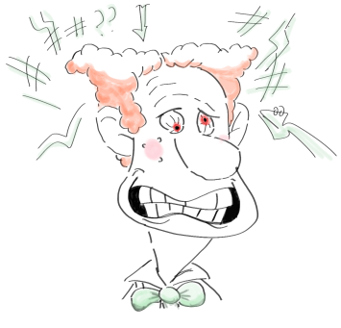
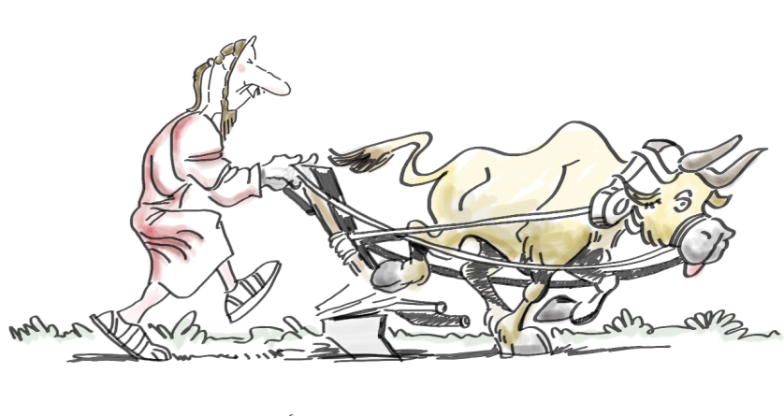
Why does it last five days and not three like it was planned in the old version?
Because in Creatibi, we want you to take the most out of our meetup! If we do three intensive days using our brain, what we’ll get will be an important mental exhaustion! Saturation is not good! That’s why, and because we think that throwing away the opportunity to enjoy the magical spots this paradise offers is a mortal sin, we decided to combine both aspects! Moreover, this will allow us to know better the other crazy people and who knows what can appear from these relationships…When nuts gather…
What would be an example of a typical day of the program?
This point has to be clearly understood: the fact that we are completely mad doesn’t mean that we are lazy! So don’t think we’ll get up at 12 to begin the talks at 3 in the afternoon! It’s not our philosophy! We want productivity, fresh minds and available to be squeezed as much as possible! Each attendee’s implication is what will make this meeting very nice! A typical day will have a schedule similar to a typical day of work, even though we are sure that with all the exciting subjects we’ll talk about… We’ll know when the talks begin…but not when they finish!

Slide 6


What are the main goals of the meeting?
In the end, what matters aren’t the years of life, but the life of the years! That’s why we want to do our small part to make this life great! Something unforgettable for each one of us, helping us to break the routine, to make our minds more flexible, to know other points of view, to learn from each other about everything, to enjoy!
What did motivate you to invest work, time and money on this project, if like you say you don’t obtain profit?
Passion moves mountains (or was it love?), well, it doesn’t matter, the thing is that we love what we do, for us it’s not work, it’s pleasure! Earning some money wouldn’t be bad (and more in these days, we are all broke) but fortunately, not everything in this life happens for economic reasons! And this is an example! We wanted to keep this project going, with or without money, with or without profit, that’s why the only thing important to us is that people enjoy like youngsters!

Slide 7

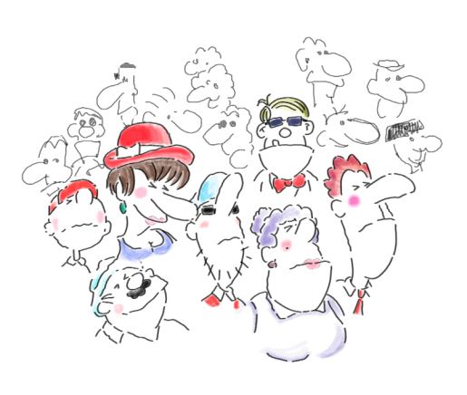
What is your target?
We summarize it to you in a few words:
Are you a crazy person willing to shake you neurons?
Do you think that things can be done in another way?
Do you want to enjoy like a youngster?
Yes? You are our target!
Why only 80 people?
We don’t want a big meeting for 100 attendees! We consider that 80 is the perfect number so that each one of the attendees can get involved 100% to the project, know the others and facilitate new contacts. We use to say that the more the merrier, but we think we are the exception that proves the rule. Creatibi is measured by its quality, not quantity.

Slide 8


Isn’t it risky to let Creatibi’s success in the attendees’ hands?
Due to Creatibi’s nature, this project wouldn’t have any sense without the involvement of each one of the 80 crazy people! The lack of leaders and norms will be useful to make the people free to share their opinions, being conscious that all of them have the same valor! As we are sure of the extreme motivation of each one of you, this philosophy doesn’t seem risky at all!
How did the idea rise up?
This project is born with the necessity for a group of crazy people to create a space to escape from our day-to-day! Going out from the cave and mix up with others is always positive (moreover and Ibiza…puf). We wanted to build a meeting place, a site in which being able to think with tranquility, to listen to you and to the others.

Slide 9

Why all these changes? New philosophy, new dates, bigger length, transparency…
While we were making progress in the project, we realized that little by little we were keeping away from our initial philosophy, that in an unconscious way we were changing into an event more, a thing that we wanted to avoid no matter what! That’s why we decided to take the rudder and correct the direction 180 degrees, because our purpose was very different. Now, Creatibi can be defined as a meeting, a meetup of anticonformist crazy people who want to learn about themselves and the others.
About the dates, do you know the saying “make haste slowly”? Well, this is exactly the same; we didn’t want to do more things only to comply with a schedule, we wanted to do it as things have to be done, good! That’s why we decided to move it to the first week of October (coinciding with the closing of the Ibiza summer, it’s pure causality…)
We decided to extend the length of the stay too, to be able to alternate the talks with the discovery of this island with so many surprises.
The decision to impose transparency as a key principal of Creatibi is precisely motivated for the lack of it in the actual society, we think we have to give an example. In Creatibi, we gather people thinking that things can be done in a different way, and because not….we had to give an example!

Slide 10
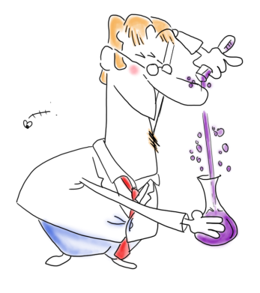

Do you think about carrying out an annual edition of Creatibi, or is it going to be a punctual meeting?
The answer to this question, we’ll give it to you the second week of October… If Creatibi is a success (that we hope it will be), we will make an effort so that it won’t stay a punctual thing. If not, we’ll have learned a lot of things organizing this pilot test and it will be a good experience to learn about our mistakes.
Which capacities will Creatibi help to develop?
If you think Creatibi won’t have any effect on your life, you swing (and a lot)! In fact, we organize all this to open your mind and for you to acquire new capacities and abilities! Which ones? You’ll learn to refute ideas, to accept critics, to see things with another point of view, to put yourself in another’s brain, cognitive flexibility, to know you better, to open yourself to the others, to improve your relational capacity… Do I continue?

Slide 11
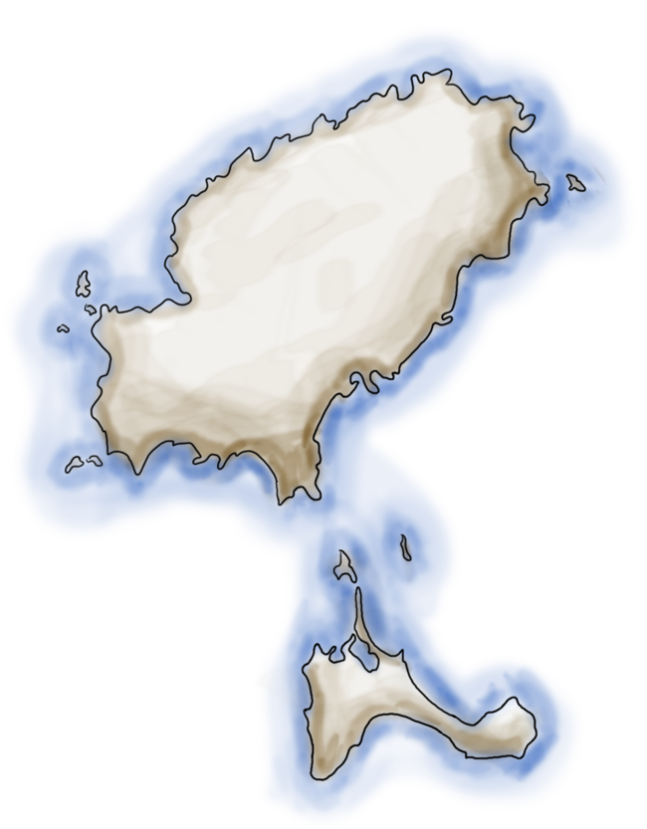
The island
Ibiza is one of the most famous islands in the world, thanks to its climate (more tan 300 sunny days a year), its partys and paradisiacal landscapes. It’s a part of the Baleares Islands and has 135 000 inhabitants, the capital is Ibiza.
At the end of the 60s and during the 70s, the island of Ibiza lived a turistical expansión which permitted an economic development higher tan expected.
Nowadays, Ibiza is a reference in term of destination for young people in the whole world thanks to its night life. The island offers too a large number of beaches for those who are looking for tranquility.

Slide 12

Tickets
Creatibi’s organization has set up the goal of providing the maximum facilities possible to all the crazy people who fancy coming to shake their neurons, that’s why, if you want, you can avoid you luggage… Yes, yes, as you can hear (sure, we know that in this case it is “what you are reading”, but we are rebels and we prefer like that, so what’s going on?)… Well, about what we were talking about…
Creatibi’s ticket for the entire week costs 100€…But…drum roll…
Creatibi’s ticket + 3 personalized Creatibi’s special edition t-shirts (one for each day of the meet up) with your name: 120€ (incredible, right? This way, all the nuts we will be able to call us with our own name!).

Slide 13
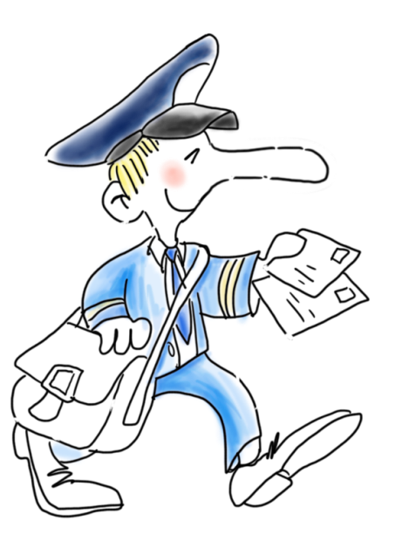
How and when will I receive my t-shirts ?
Te response to this question is: it depends!
¿ On what? If we find a courier service firm which does us a favor and wants to be our sponsor, we will send you by post the ticket and the personalized t-shirts (if you chose this option) and all the information you need about the event.
If we don’t have a sponsor, to save money and to be able to maintain the promised price, we will give you the t-shirts in your own hands when you arrive in Ibiza, with all the information sent by e-mail.

Slide 14

Luggage
As we told you before, if you chose the option of the 3 t-shirts… You almost don’t need any luggage ! But because we know you’ll bring a few things, here are our recommendations :
Summer cloth, we know Creatibi celebrates the end of summer, better said the beginning of atumn, but we are confident that the sun will be there with us! A swimsuit and a towel are highly recommended.
2. A tanning lotion, to take care of your skin.
3. Some cloth that keeps warm
4. Some food
5. This Manual! (that can help you a lot)
6. Your brain (yes, you can find it!)
7. Your good humour (even if we know that you always have it with you!)

Slide 15
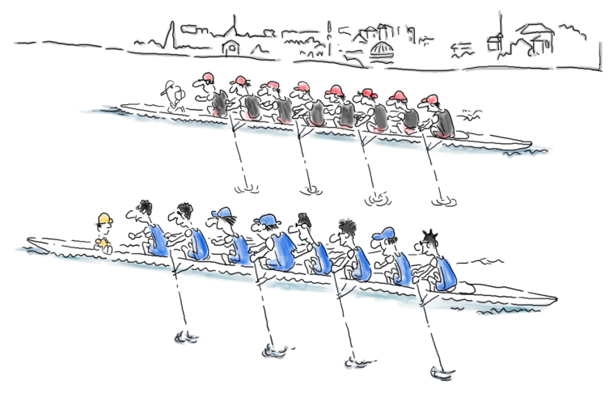
Transportation
It’s possible to arrive in Ibiza by air or by sea.
The plane is the quickest and cheapest solution. Barcelona, Madrid, Alicante, Mallorca and Valencia airports are those which are connected directly to Ibiza airport with the following companies : Ryanair, Iberia, Vueling, Air Europa, Air Nostrum and Air Berlin.
Arriving by boat will take more time, but this way has its advantages if you don’t have a busy planning. In that case, you’ll be able to enjoy fantastic landscapes and enjoy your first party on the boat ! Moreover, there is a swimming pool… Boats to Ibiza come from Valencia, Barcelone and Mallorca. We recommend you Balearia and Trasmediterranea companies.
Once arrived in the White island, it’s posible to rent a car o take the bus which will take you to any point of the island.

Slide 16
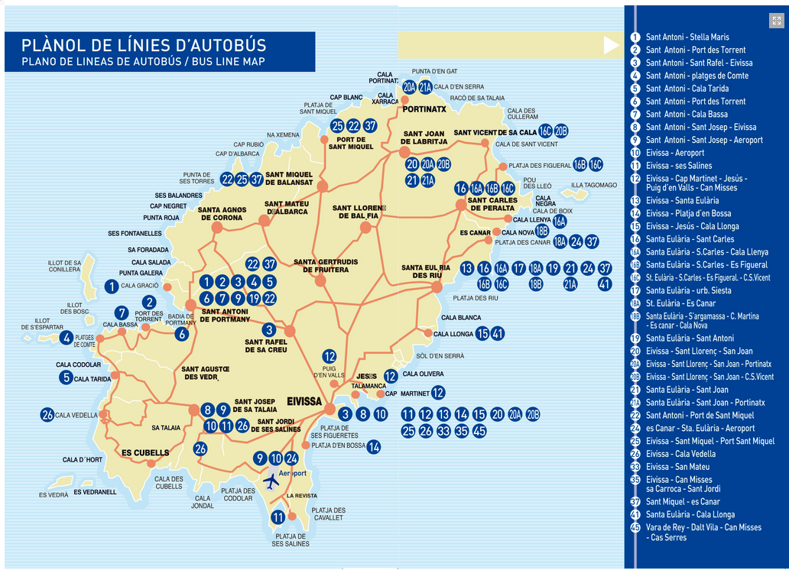
As you can see, there are 34 autobus lines in the island. The main places of beginning are San Antonio, Santa Eulalia and Eivissa. The prices go from 1,85€ to 3,20€.

Slide 17

Accomodation
If you don’t want to worry about looking for a place to sleep, we offer ourselves to take charge of the reservation of your accommodation. Of course, everyone is free to do it himself. We receive no commission at all to do that (carrying on with the transparency policy).
We suggest you the Hotel THB Los Molinos ****, which is located 500m from the stop “Eivissa”, 8km to the airport. That’s why we recommend you to take line 10 until the end and then walk until the hotel.
Buses come every 15-30 minutes.
There are different options which vary depending on the type of the room and the stay number of days. Following different options already include the ticket’s price for Creatibi + the three awesome t-shirts that we are working on.

Slide 18
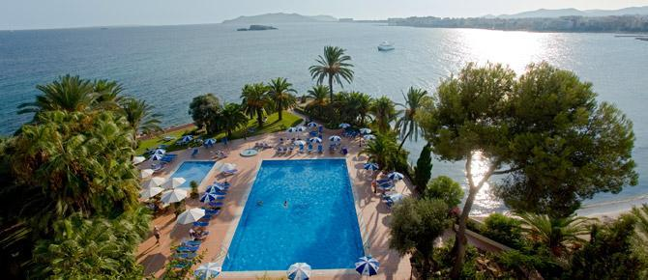

Alojamiento
The address of the hotel is :
THB Los Molinos Class
C/ Ramón Muntaner, 60
07800, Ibiza
+34 971 302 250

Slide 19

Option 1: 4 Nights, 30th September, 1st, 2nd, 3rd October
Individual : 330 €
Double : 430€
Option 2: 5 nights, 29th, 30th September, 1st, 2nd, 3rd October
Individual: 435€
Double: 560€
Option 3: 6 nights, 30th September, 1st, 2nd, 3rd, 4th, 5th October
Individual: 480€
Double: 630€
Option 4: 7 nights, 29th September, 1st, 2nd, 3rd, 4th, 5th October
Individual: 585€
Double: 760€
Each option includes accommodation and breakfast.

Slide 20
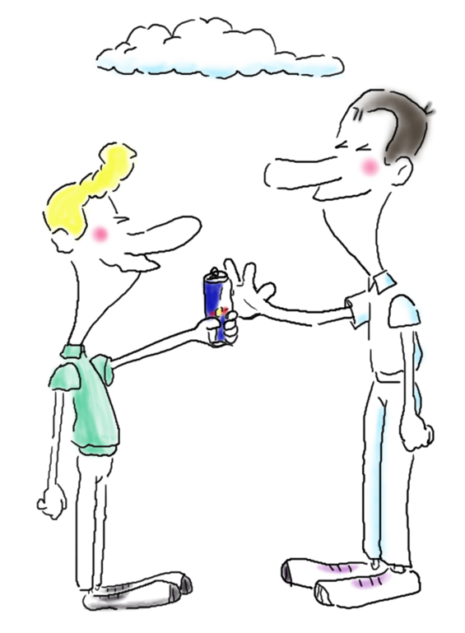
For your personal cash, the better solution would be to share a double room, if you come with another person, perfect! If you come alone but if you don’t matter about sharing a room, tell us and very gladly we will deal with suiting the rooms with other crazy people who are also ok. Moreover, it will be a way to contribute to Creatibi philosophy, it deals with SHARING (ideas, opinions, points of view… and why not a room?)
For sure, the ones who subscribe to share a room and let the room distribution in our hands, you have to consider the possibility that we don’t achieve to find you another attendee (because you are an odd number, bla bla bla…), the price difference between the individual room and the double, you will have to pay it yourself.

Slide 21

Program Creatibi
Yes, we already know that the term creativity is very wide and can cover many areas of knowledge! Because it is logical, you will be more interested in some than others. That's why we want you to tell us which subjects make your neurons crazier and keep shaking! Because Creatibi, we make it between all of us and for all of us!
We will encompass all your contributions under three more general labels, so that at the beginning of the event, you will decide in which debate you prefer to join.

Slide 22
Program Creatibi
Light meet up: a space to inspire and dazzle, where to soak up experiences and reflections. Important moments, inflexion points in life, creativity as the catalyst for change.
Water meet up: how to work creativity efficiently, through working processes, tools and models employed in day-to-day work.
Soil meet up: place where to know creativity in a real form to generate/solve problems. Creativity in a solid state, a space to know examples and good practices carried out.

Slide 23
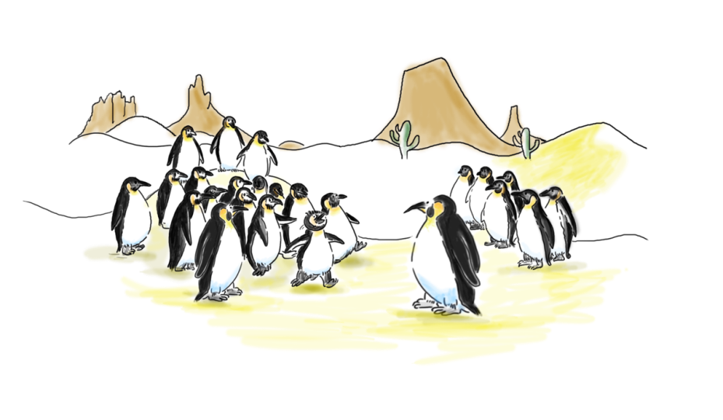
Program Creatibi
Creatibi deals with sharing; therefore we will find spaces where to know the others while going into detail about what we like. In short, it's an Open Space in which productive conversations are generated, and where the only norm is "The Rule of the Two feet". If you feel that this debate isn't enriching you or that you aren't contributing to the conversation, you stand up and you move to another parallel talk! That easy!
Remember, everything depends on the attendees' energy and implication, that is to say on you. That's why we know it is going to work!
Passion Session
Another important part of Creatibi is the Passion Session. We all have one or some passions in our life, and we want you to share it with us. Stand up and tell us in 5 minutes what we are losing. And this is only the beginning…
Remember, everything depends on the attendees' energy and implication, that is to say on you. That's why we know it is going to work!

Slide 24
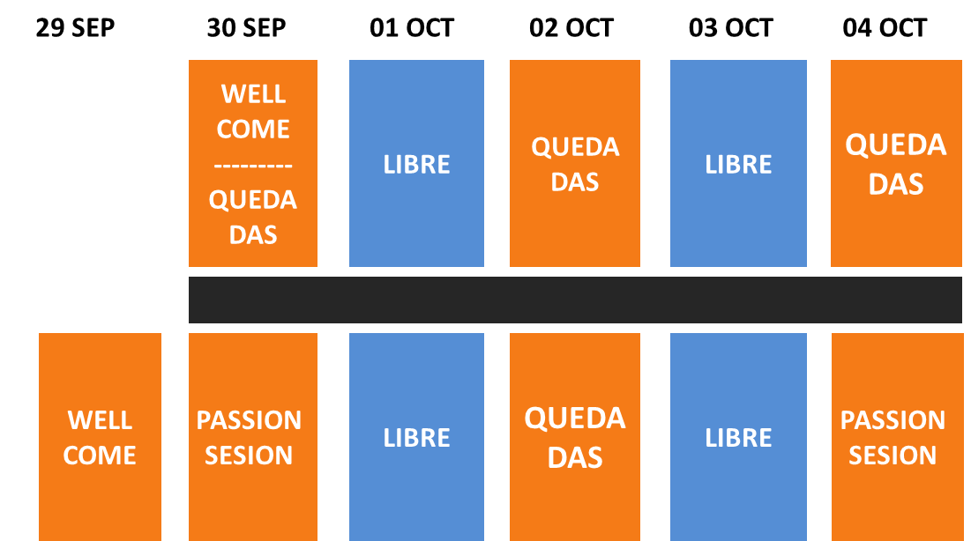
Program Creatibi
Los horarios de las quedadas creativas serán comunicados los días previos a Creatibi.

Slide 25
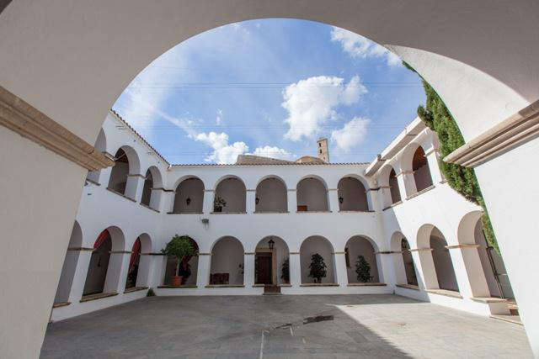
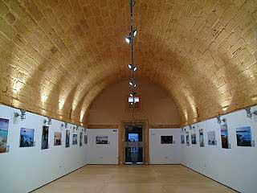
The place
The event will take place in the beautiful Convento de los P.P. Dominicos y el Antiguo Polvorín de Ibiza, Dalt Vila, an old borrough of Ibiza

Slide 26
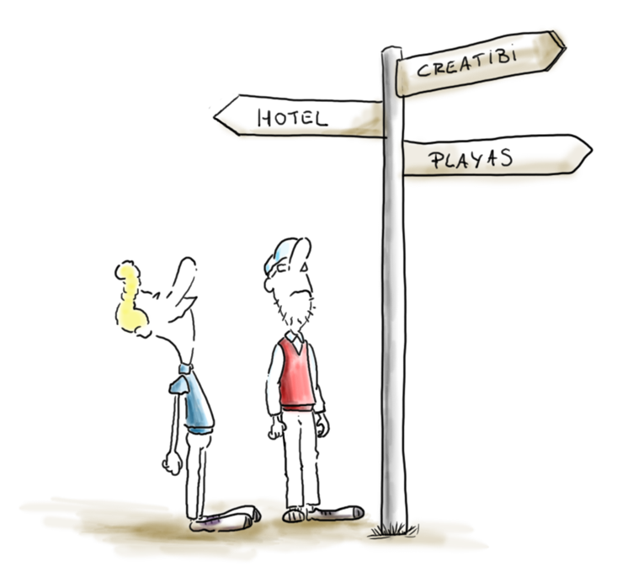
The place
The address of the event is this one :
Plaça d'Espanya, 1
07800 Eivissa,
Islas Baleares
And this is the phone number if you need it 971 39 75 00.
We will propose you different activities to do in your free time. If you want to do them on your own, here are our suggestions:

Slide 27

Beaches
Ibiza has an impressive number of beaches, here are the more famous :
La playa d’en Bossa, y Las Salinas in the south
La Cala Talamaca close to the city of Ibiza
Cala Llonga and as playas de Santa Eulalia at the east
Las playas de San Juan at the north: Cala Xarraca, Cala de Sant Vincent, Portinatx, etc.
Las playas de San Antonio at the west, the more frecuented of the island: Cala Salada y Cala Saladeta, Cala Gracioneta o Cala Tarida.
At the southwest, some places are also incredible like Cala d’Hort, with incredible landscapes.

Slide 28
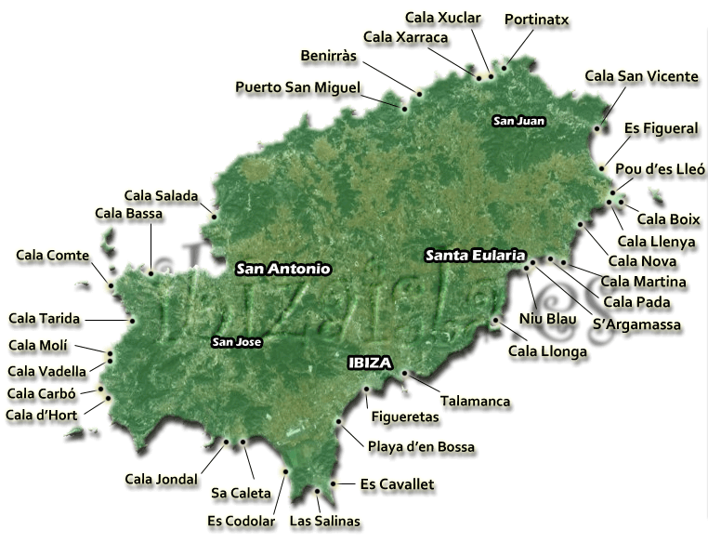
Beaches

Slide 29
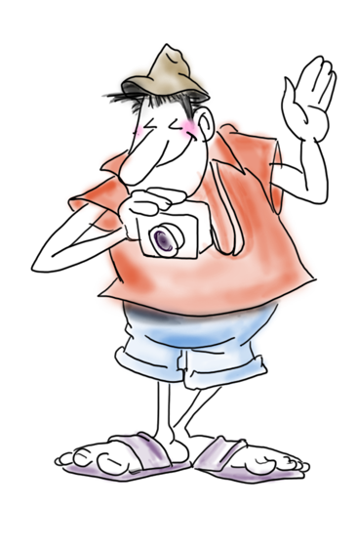
Visits
Ibiza, the capital of the island, as a lot of things to offer. After visiting the Museo Monográfico del Puig de Molins, you can go to the barrio de la Penya. The historical center D’Alt Vila deserves to be visited before seeing the antigua Catedral. To conclud, we recommend the museo arqueológico.
You can’t lose some fantastic churches like San Josep.
In the north, you have to see Cueva de Can Marçà, an impressive 100 000 year-old place.

Slide 30

Gastronomy
Ibiza is known for the variety of its vegetables and fishes. Here are some typical food you can try :
Bullit de Peix: Typical fishes
La burrida de ratjada :
La langosta ibicenca with its squids
El guisat de marisc with fishes and shellfishes.
Ibiza is also known for its wine. Why wouldn’t you take a glass?

Slide 31

Sports
After using a lot your brain, maybe you will want to relax by doing sports… Here are some that you can practice on the island :
Water sports: windsurf, sailing
Cycling, with special roads
Air sports: paragliding, parasailing
Diving for any level
Hiking with fantastic views

Slide 32






Organiza
Patrocina

