Slide 1
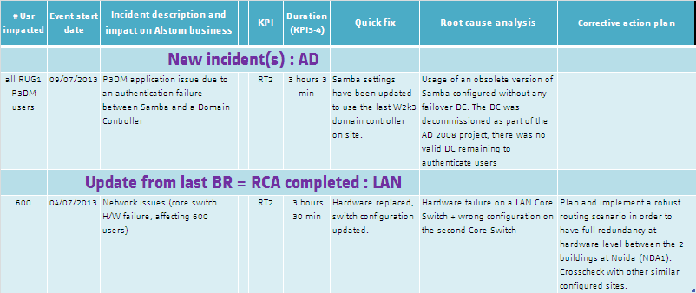
6 - Workplace & Telecom Update 1/2
Major incidents impacting critical sites / 1st July– 15th August
Comments:
Power outages & Network incidents impacts other services (Security, Telephony…).

Slide 2
6 - Workplace & Telecom Update 2/2
Major achievements / 1st July– 15th August
Comments:
3YP has dedicated reporting

