Slide 1
SARL EL FETH
FABRICATION DU MOBILIER DE BUREAUX

Slide 2
CONTACT
Usine: Zone Industrielle Sidi Abed 2 Tessala El Merdja Birtouta
Mob: 0555 00 90 51
Show Room 01: 53,Rue Louis Rouget Château Neuf El Biar
Tel/Fax: 021 92 97 32/33
Mob: 0555 00 90 47
Show Room 02: 137B Abdi Mouloud Birtouta
Tel/Fax: 021 44 42 93 / 021 44 49 74
Mob: 0555 00 90 52
Show Room 03: Résidence les Rosiers B^{t} E N° 57 Boufarik
Mob: 0555 00 90 53

Slide 3
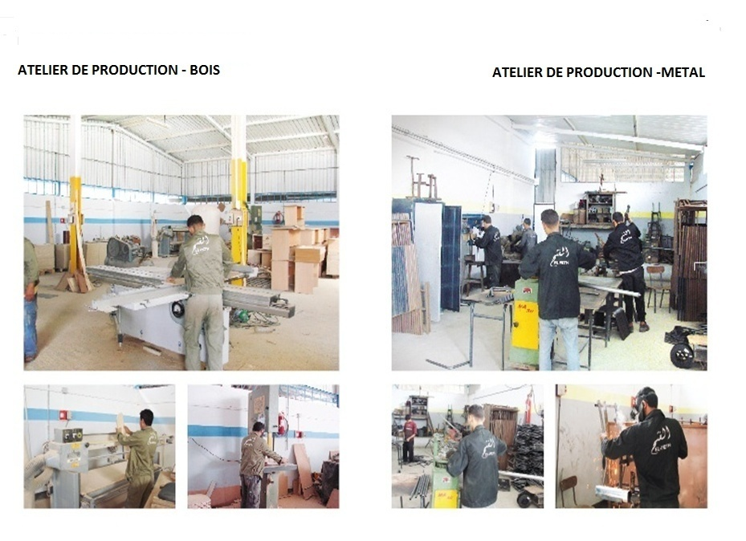

Slide 4
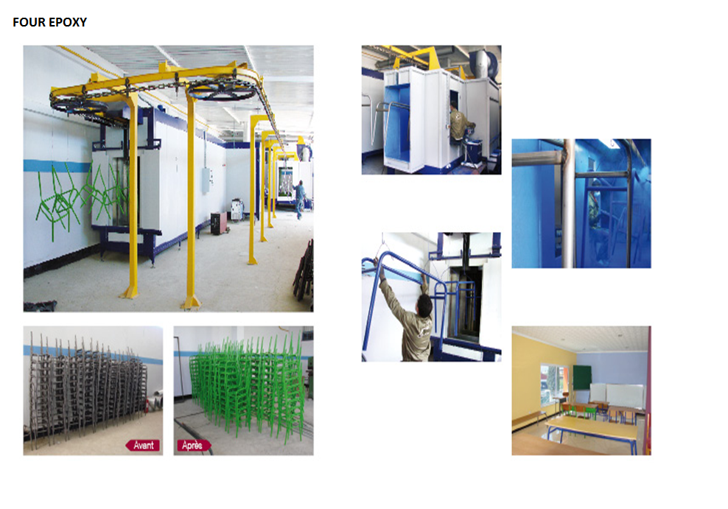

Slide 5
MOBILIER METALLIQUE

Slide 6
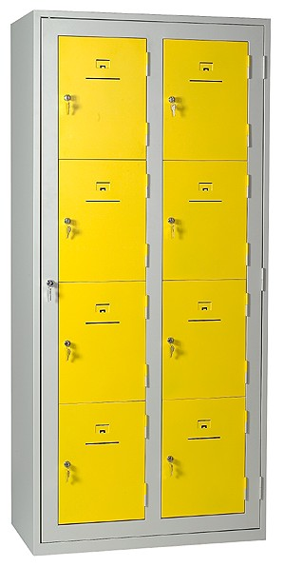
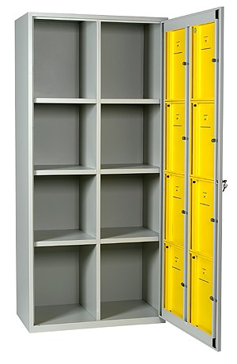
REF/ MM 100

Slide 7
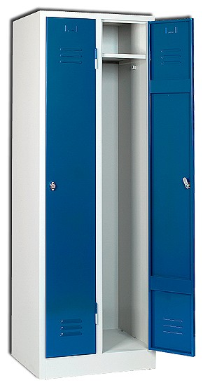
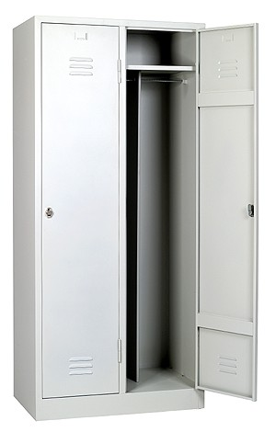
REF/ MM 101

Slide 8
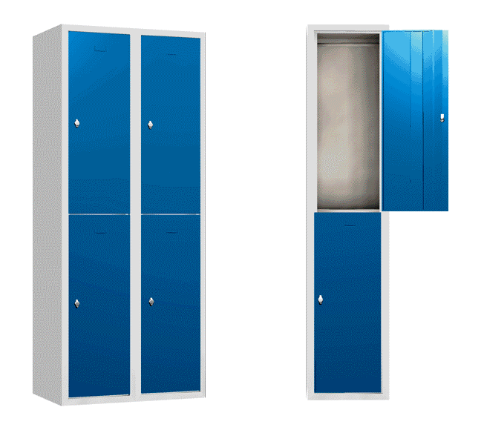
REF/ MM 102
A
B

Slide 9
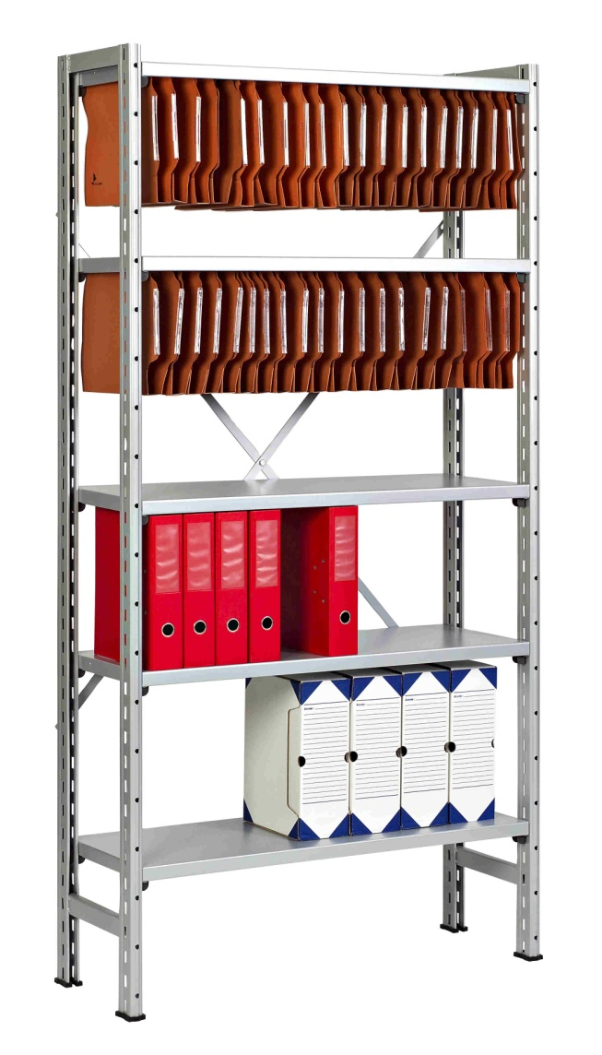
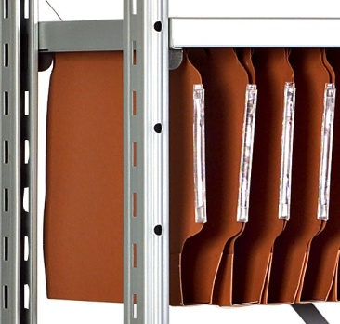
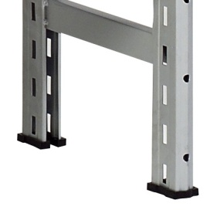
REF/ MM 103

Slide 10
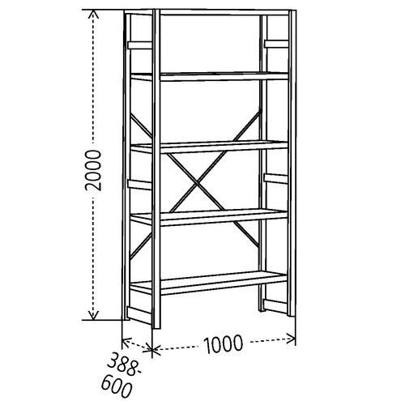
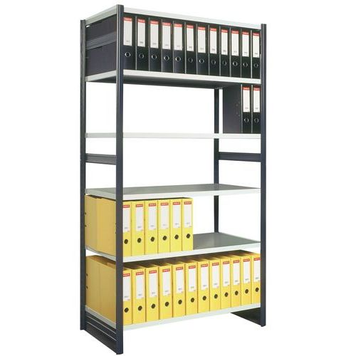
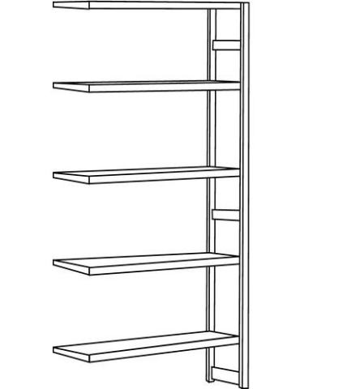
REF/ MM 104

Slide 11
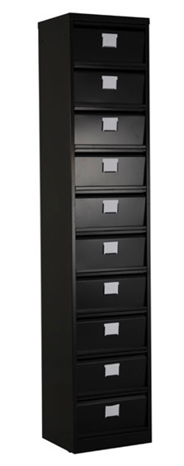
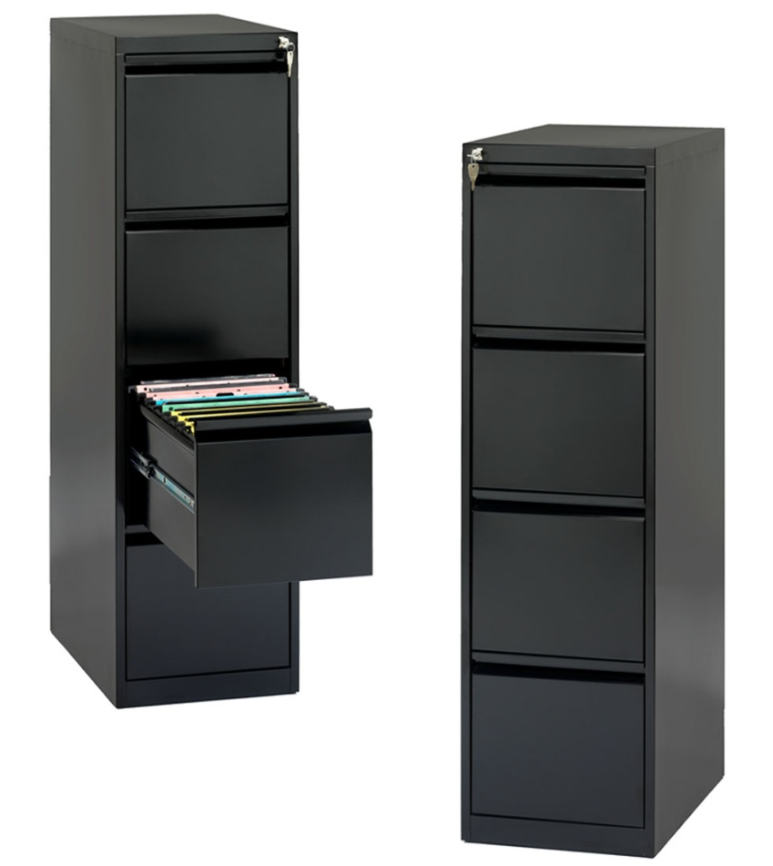
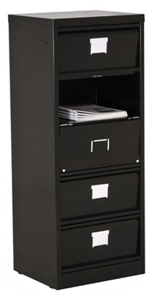
REF/ MM 105
REF/ MM 105
A
C
B

Slide 12
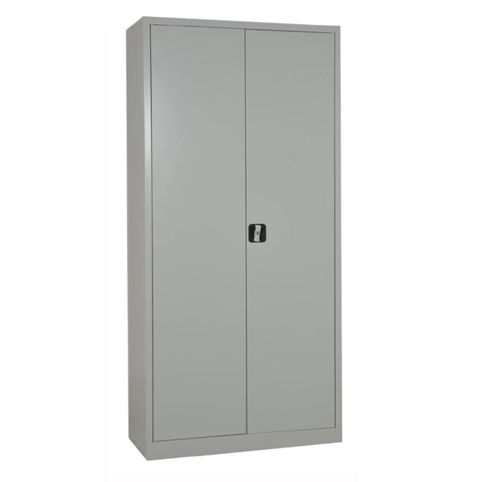
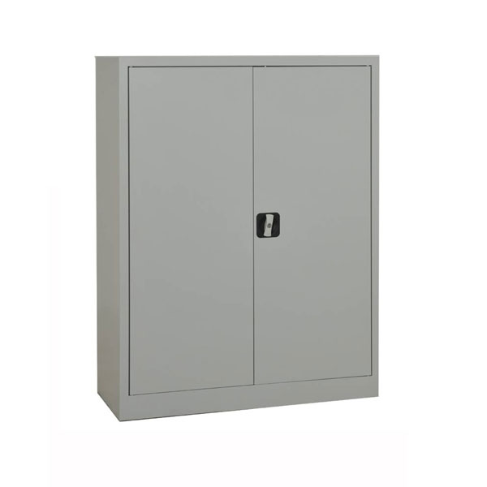
REF/ MM 106
A
B

Slide 13
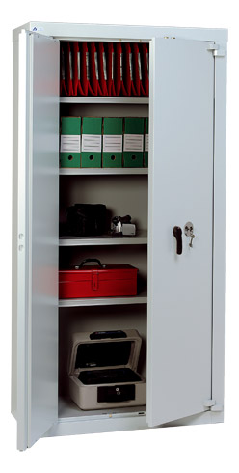
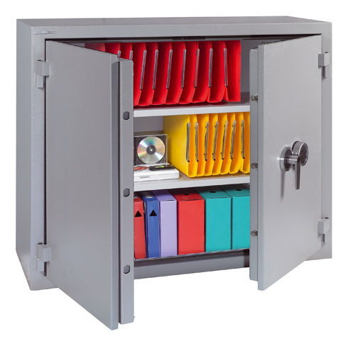
REF/ MM 107
A
B

Slide 14
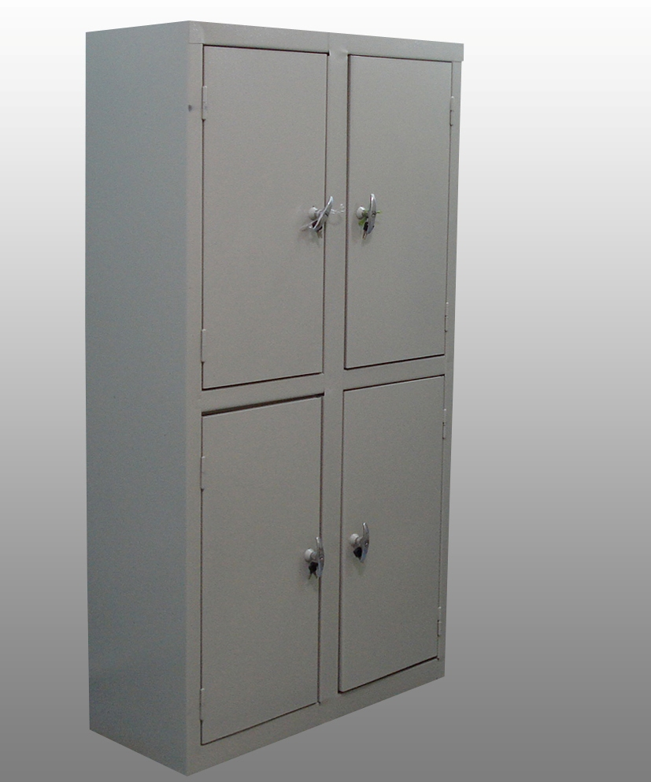
REF/ MM 108

Slide 15
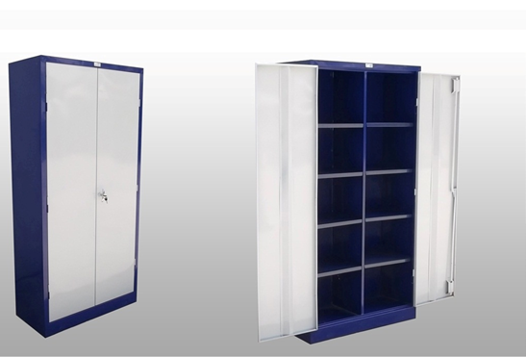
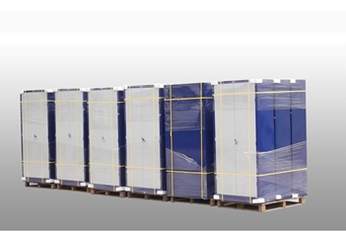
REF/ MM 109

Slide 16
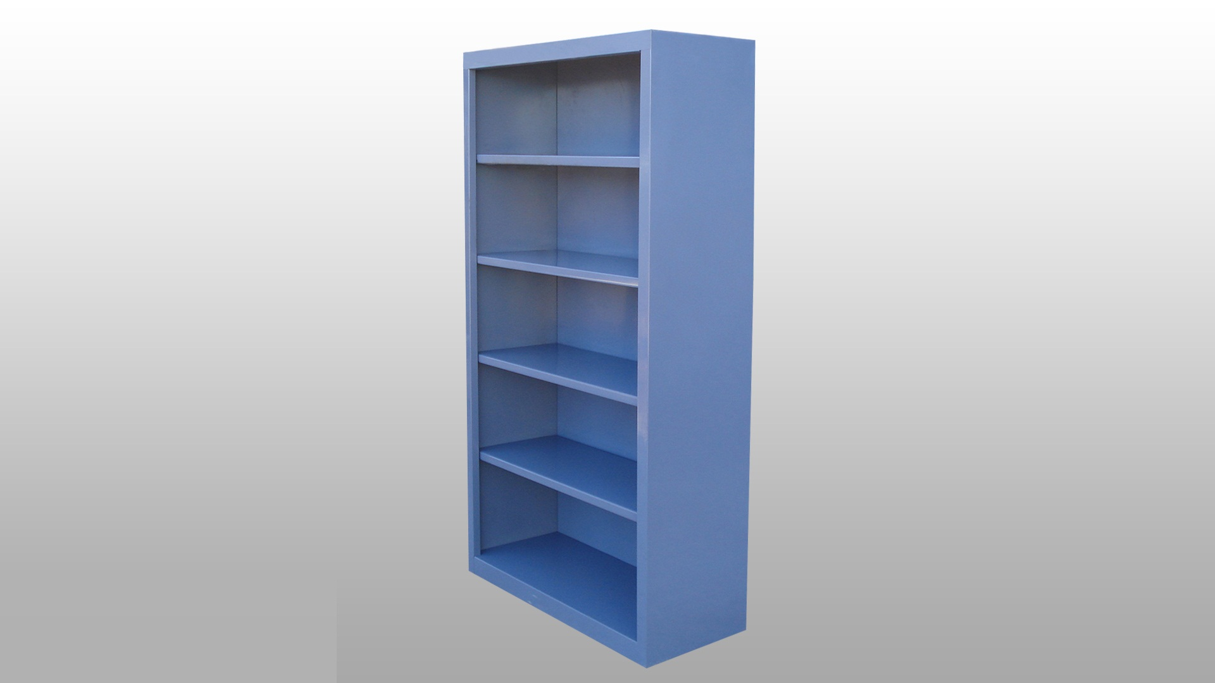
REF/ MM 110

Slide 17
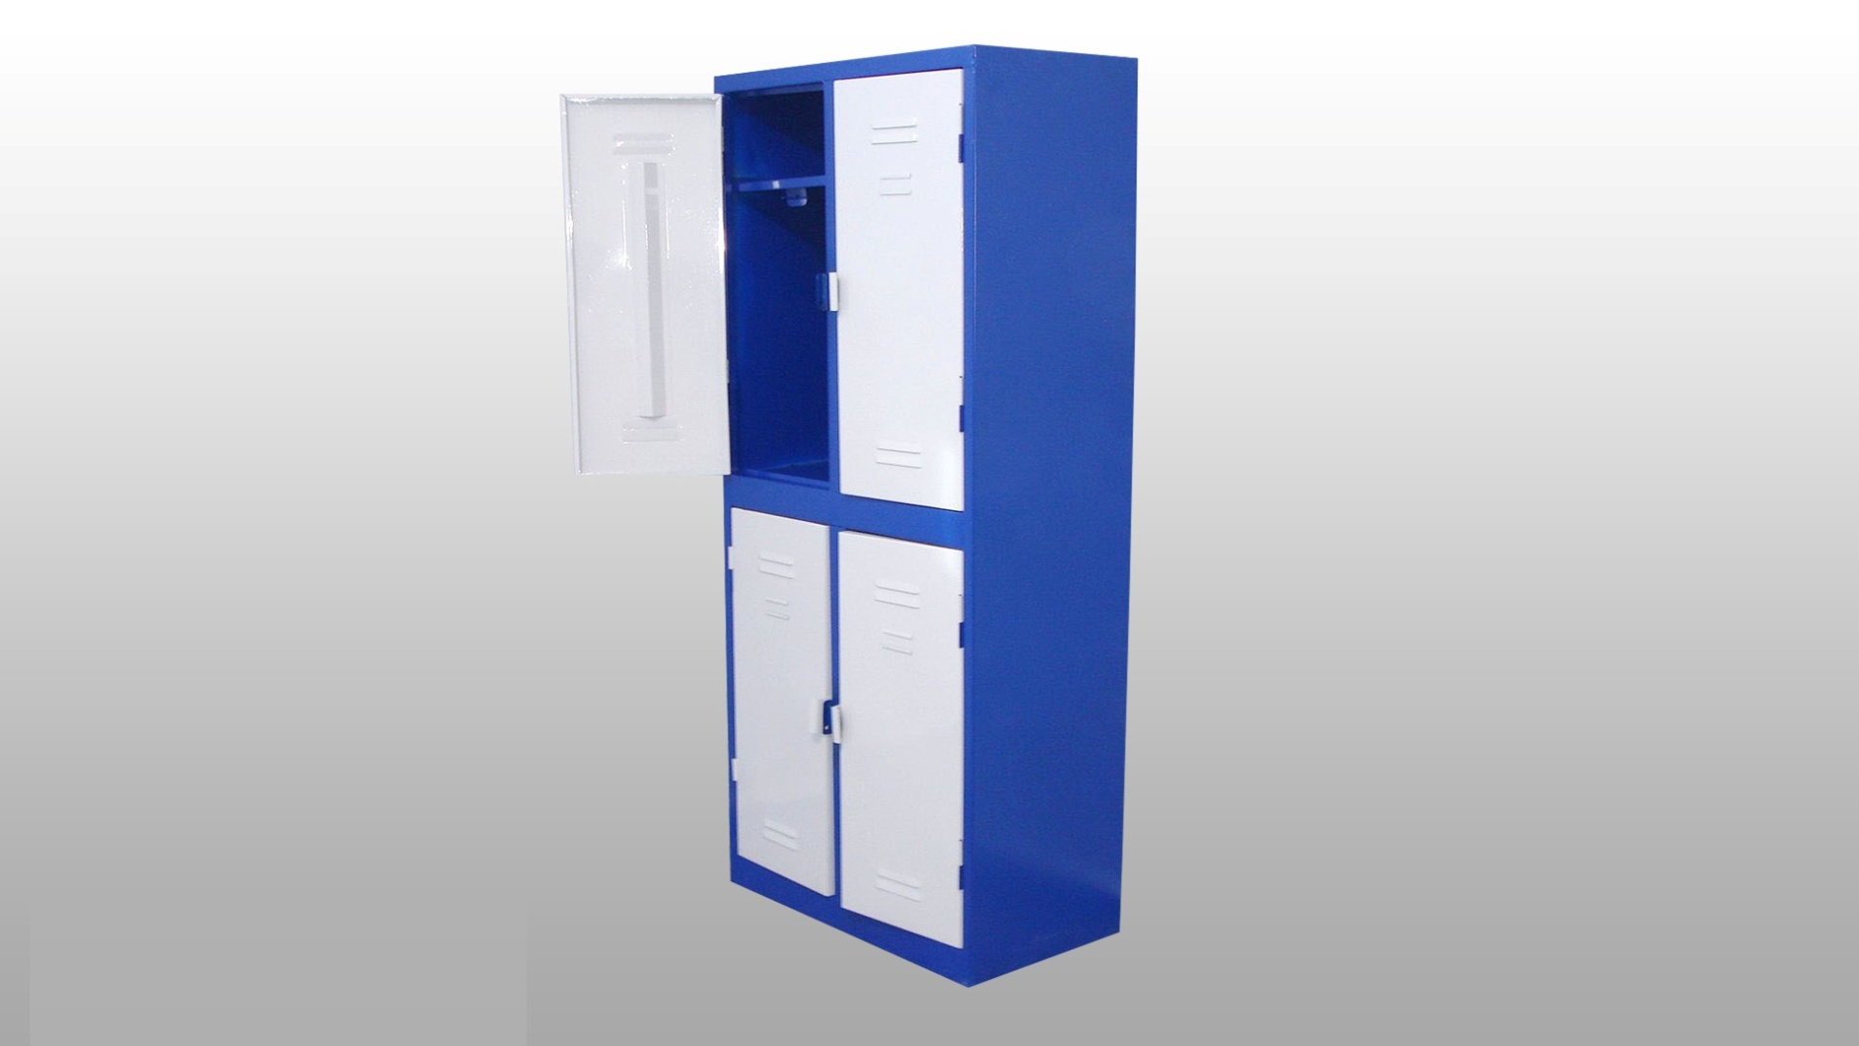
REF/ MM 111

Slide 18
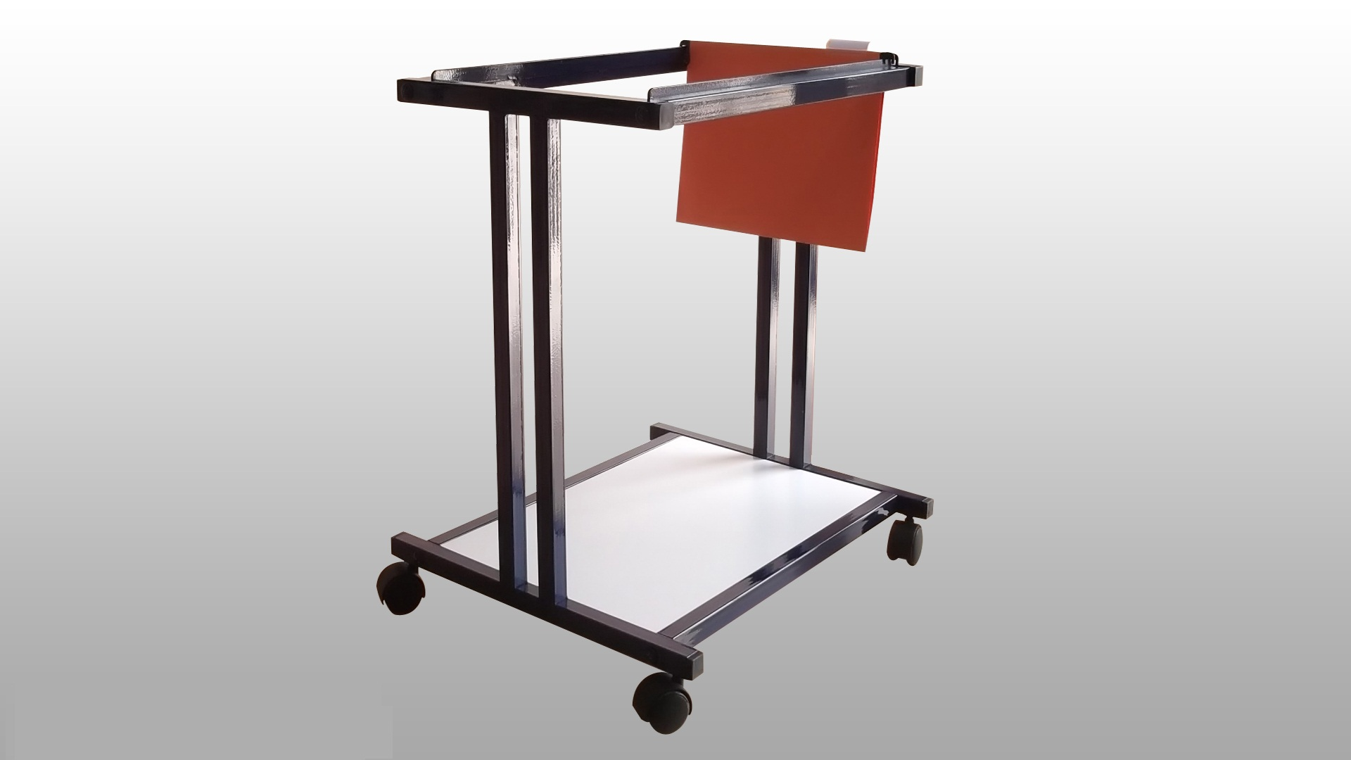
REF/ MM 112

Slide 19
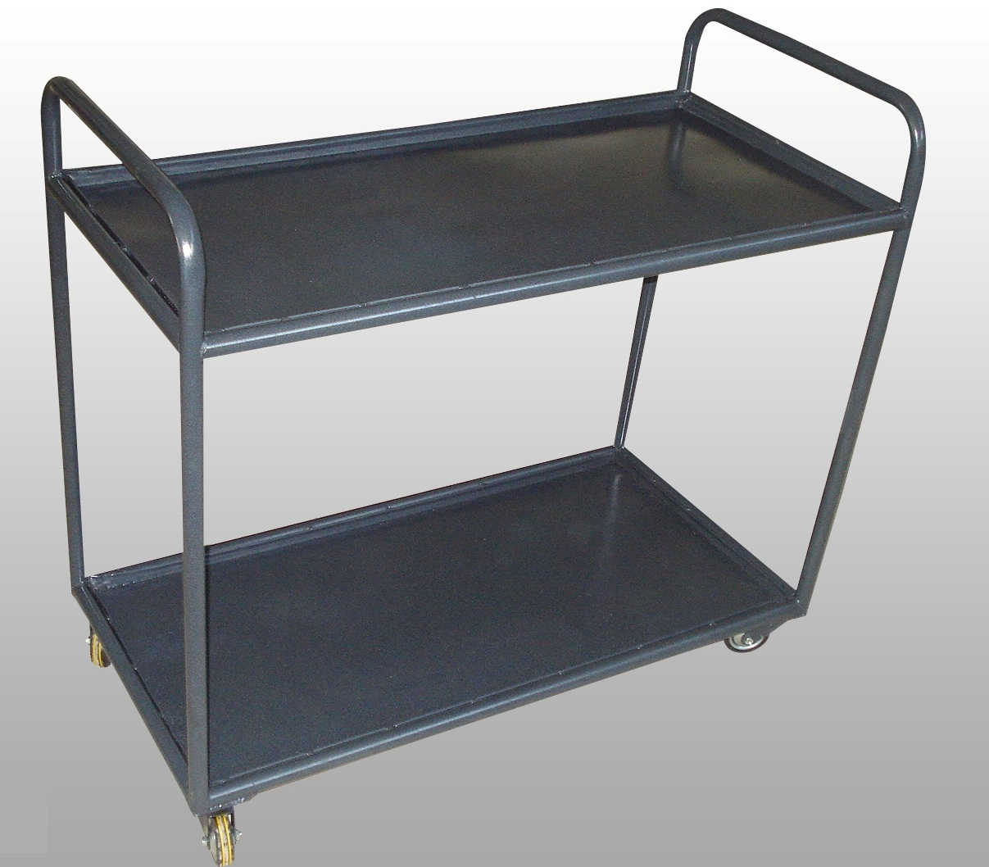
REF/ MM 113

Slide 20
MOBILIER POUR CRECHE

Slide 21
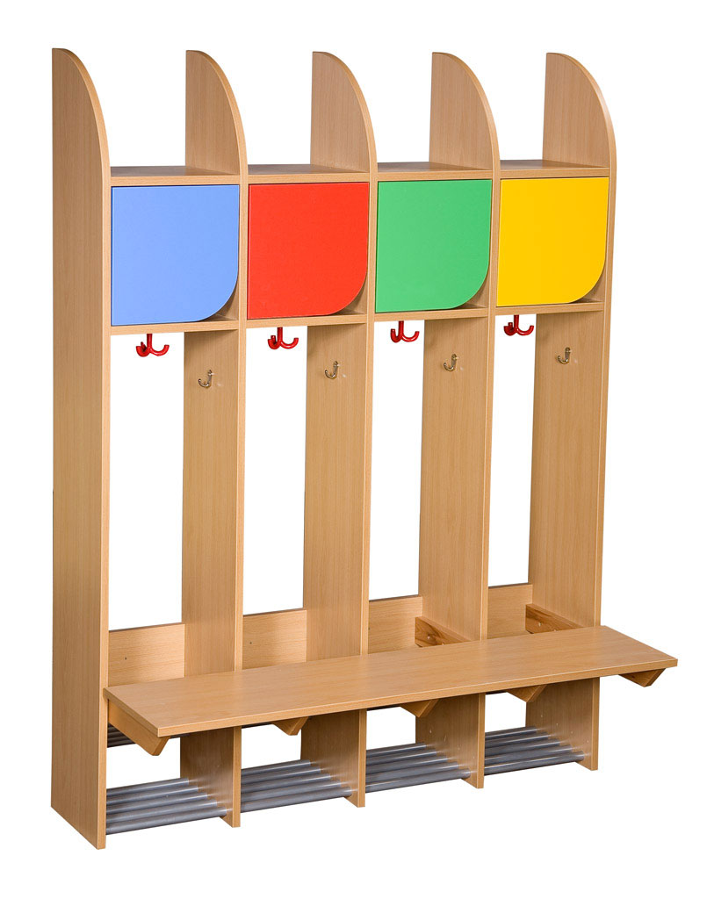
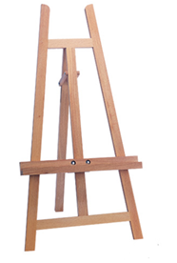
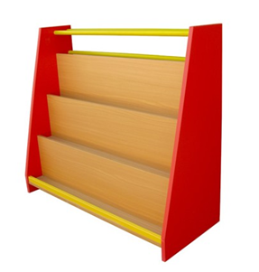
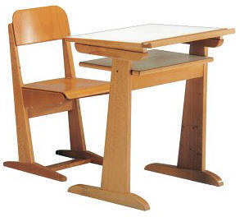
REF/ MC 200
A
B
C
D

Slide 22
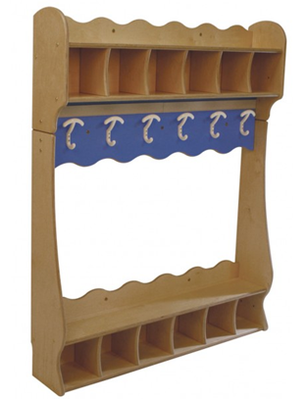
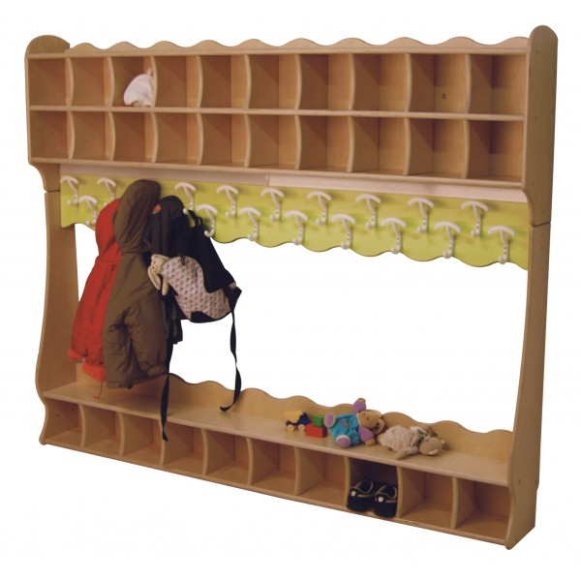
REF/ MC 200/01
A
B
C

Slide 23
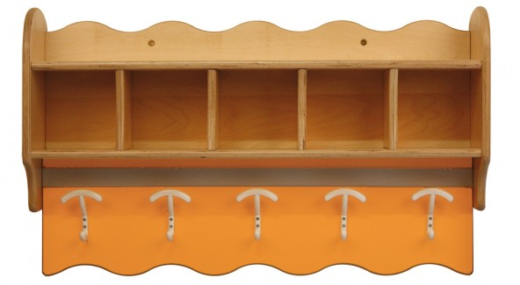
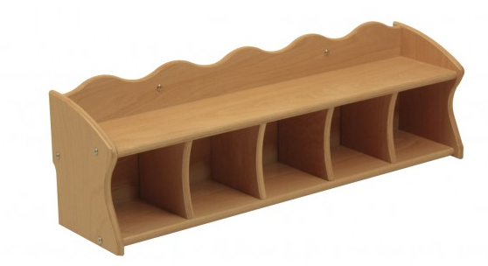
REF/ MC 200/02
A
B

Slide 24
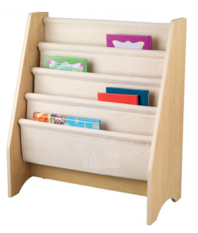
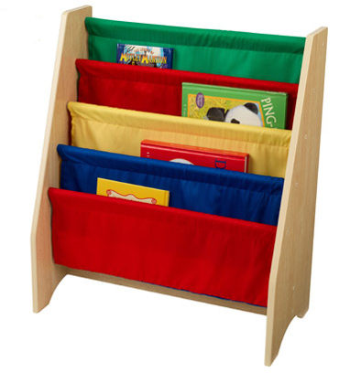
REF/ MC 200/03
A
B

Slide 25
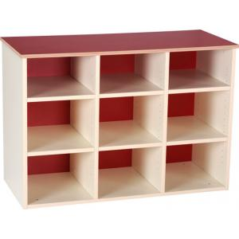
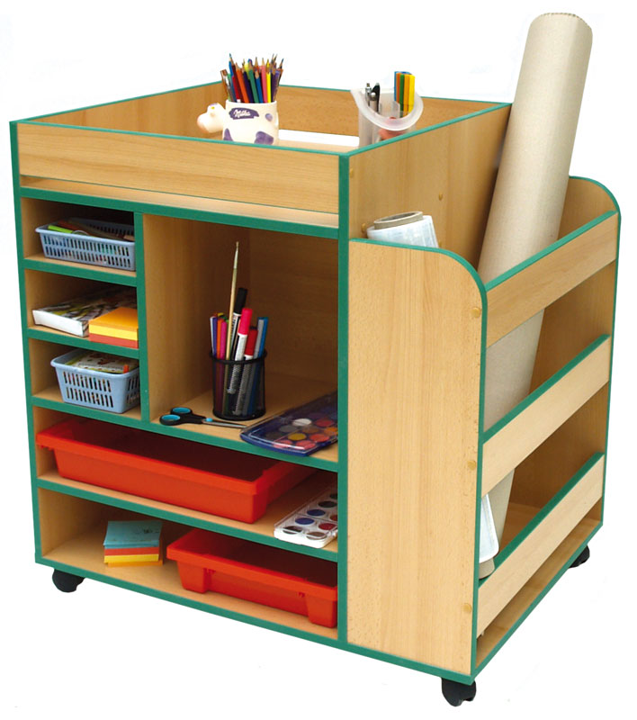
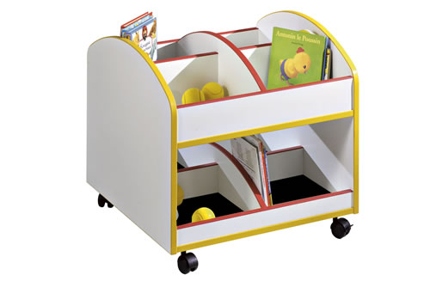
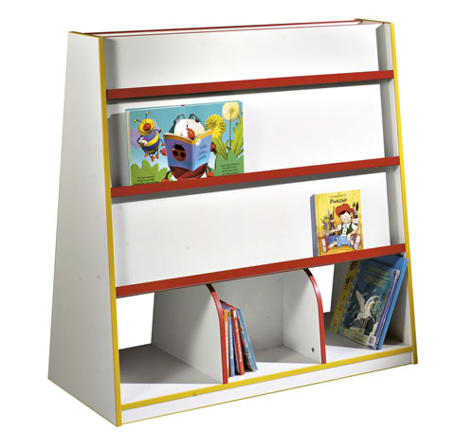
REF/ MC 201
A
B
C
D

Slide 26
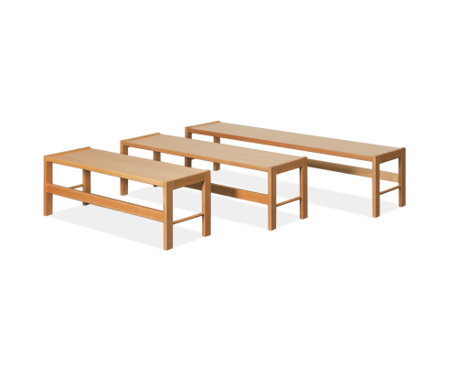
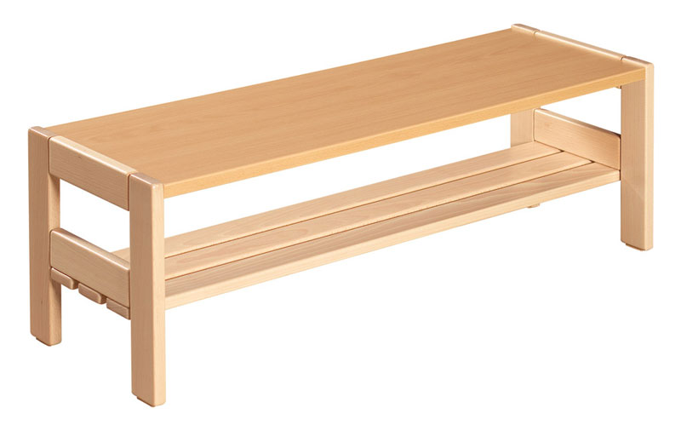
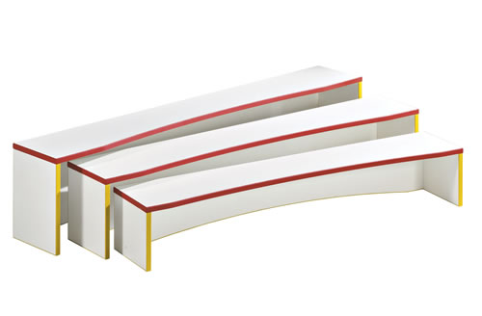
REF/ MC 202
A
B
C

Slide 27
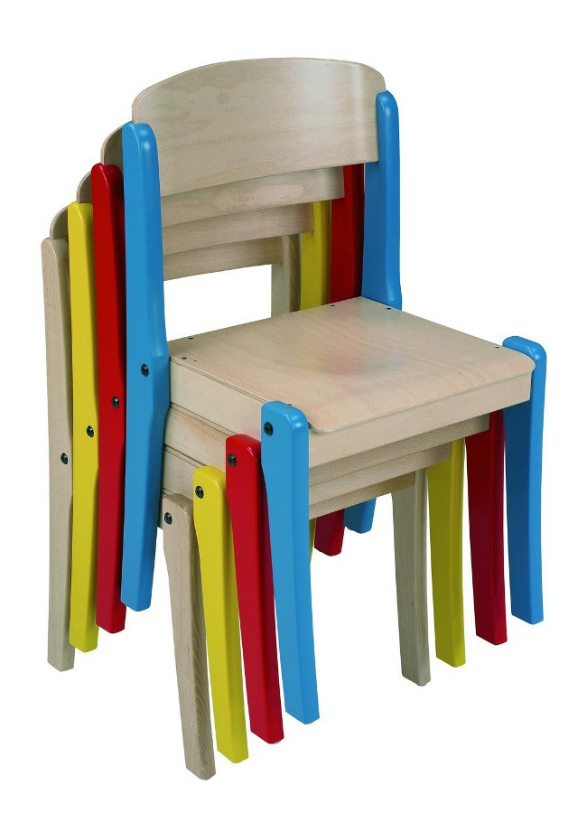
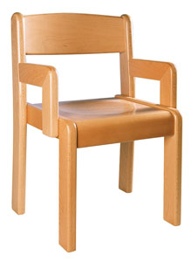
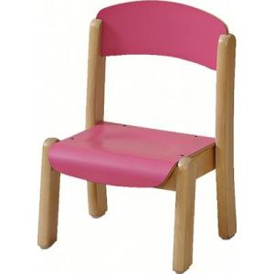
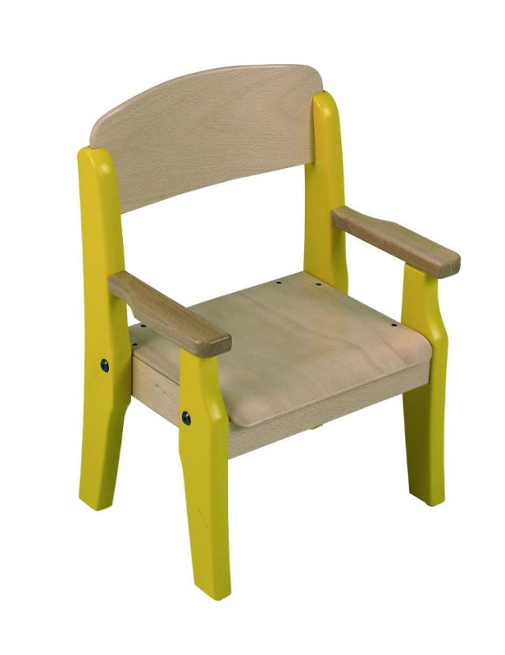
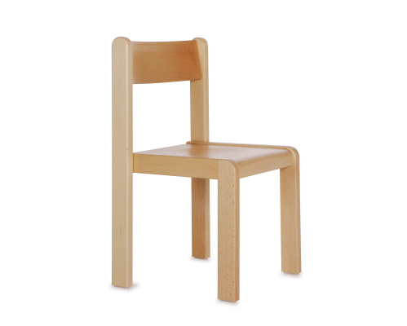
REF/ MC 203
A
B
C
D
E

Slide 28
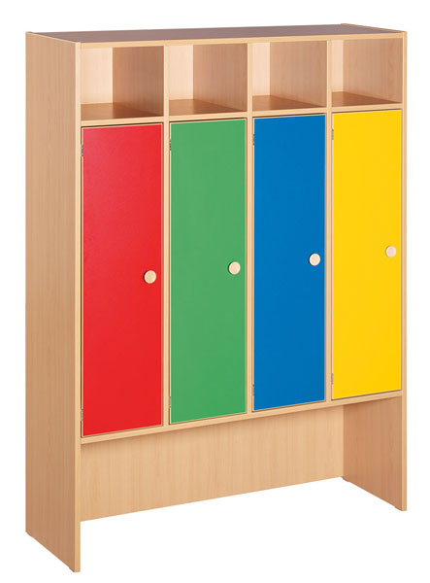


REF/ MC 204
A
B
C

Slide 29


REF/ MC 204/01
A
B

Slide 30



REF/ MC 205
A
B
C

Slide 31





REF/ MC 206
A
B
C
C1
C2

Slide 32


REF/ MC 207
A
B

Slide 33


REF/ MC 208
A
B

Slide 34




REF/ MC 209
A
A
B
B
C

Slide 35



REF/ MC 209/01
A
B

Slide 36


REF/ MC 210
A
A
B
B
C
C

Slide 37

REF/ MC 211
REF/ MC 211

Slide 38


REF/ MC 211
REF/ MC 211/01
TISSU ET BARRE NON INCLUS
A
B

Slide 39

REF/ MC 212

Slide 40



REF/ MC 213

Slide 41

REF/ MC 214
A
B
C

Slide 42


REF/ MC 215
A
B

Slide 43

REF/ MC 216
A
B

Slide 44

REF/ MC 217

Slide 45





REF/ MC 218

Slide 46

REF/ MC 219

Slide 47

REF/ MC 220

Slide 48

REF/ MC 220
REF/ MC 221

Slide 49



REF/ MC 221/01
A
B

Slide 50


REF/ MC 221/02
A
B

Slide 51

REF/ MC 222
A
C
B

Slide 52

REF/ MC 223

Slide 53

REF/ MC 224

Slide 54




REF/ MC 225
A
B
C
D

Slide 55

REF/ MC 226

Slide 56




REF/ MC 227
A
B
B
C
D

Slide 57


REF/ MC 228
A
B

Slide 58




REF/ MC 229
A
B
D
C

Slide 59


REF/ MC 230

Slide 60


REF/ MC 231
A
B

Slide 61



REF/ MC 232
A
B
C

Slide 62




REF/ MC 233
A
B
C
D

Slide 63



REF/ MC 234
A
B
C

Slide 64



REF/ MC 235
A
B
C

Slide 65




REF/ MC 236
A
B
C
D

Slide 66




REF/ MC 237
B
A
D
C

Slide 67



REF/ MC 238
A
B
C

Slide 68



REF/ MC 239
A
B
C

Slide 69
MOBILIER SCOLAIRE

Slide 70




REF/ MS 300

Slide 71






REF/ MS 301
A
B

Slide 72


REF/ MS 302
A
B

Slide 73



REF/ MS 303
A
B

Slide 74




REF/ MS 304
C
A
B

Slide 75







REF/ MS 305
A
B
C

Slide 76




REF/ MS 306
A
B

Slide 77



REF/ MS 307
A
C
B

Slide 78


REF/ MS 308
B
A

Slide 79



REF/ MS 309
A
B
C

Slide 80


REF/ MS 310
A
B

Slide 81



REF/ MS 311
A
B

Slide 82



REF/ MS 312

Slide 83

REF/ MS 313

Slide 84

REF/ MS 314

Slide 85

REF/ MS 315

Slide 86

REF/ MS 316

Slide 87

REF/ MS 317
A
B

Slide 88

REF/ MS 318

Slide 89

REF/ MS 319

Slide 90

REF/ MS 320

Slide 91

REF/ MS 321

Slide 92

REF/ MS 322

Slide 93

REF/ MS 323

Slide 94

REF/ MS 324

Slide 95

REF/ MS 325

Slide 96

REF/ MS 326

Slide 97

REF/ MS 327

Slide 98

REF/ MS 328

Slide 99

REF/ MS 329

Slide 100

REF/ MS 330

Slide 101

REF/ MS 331

Slide 102


REF/ MS 332

Slide 103

REF/ MS 333
A
B
C

Slide 104

REF/ MS 334

Slide 105



REF/ MS 335
A
B

Slide 106

REF/ MS 336
A
B

Slide 107

REF/ MS 337

Slide 108

REF/ MS 338

Slide 109

REF/ MS 339

Slide 110

REF/ MS 340

Slide 111

REF/ MS 341

Slide 112

REF/ MS 342

Slide 113
MOBILIER D’HEBERGEMENT

Slide 114


REF/ MH 400
A
B

Slide 115





REF/ MH401
B
A

Slide 116



REF/MH402
A
B
C

Slide 117

REF/MH403
REF/MH403

Slide 118

REF/MH404
REF/MH404

Slide 119



REF/MH405
C
A
B
D

Slide 120


REF/MH406
A
B

Slide 121

REF/MH407

Slide 122

REF/MH408

Slide 123

REF/MH409

Slide 124

REF/MH410

Slide 125

REF/MH411

Slide 126

REF/MH412

Slide 127

REF/MH413

Slide 128

REF/MH414

Slide 129

REF/MH415

Slide 130

REF/MH416

Slide 131

REF/MH417
A
B

Slide 132
TABLE DE REUNION

Slide 133

REF/TR 500
A
B

Slide 134


REF/ TR 501
A
B

Slide 135



REF/ TR 502
A1
A2
A

Slide 136


REF / TR 503
A
B

Slide 137


REF / TR 504
A
B

Slide 138


REF / TR 505
A
B

Slide 139

REF / TR 506

Slide 140


REF / TR 507

Slide 141
ARMOIRE

Slide 142



REF/ AR 600
A
C
B

Slide 143



REF/ AR 601
A
B
C

Slide 144


REF/ AR 602
A
B

Slide 145


REF/ AR 603
A
B

Slide 146

REF/ AR 604

Slide 147

REF/ AR 605

Slide 148

REF/ AR 606

Slide 149

REF/ AR 607

Slide 150

REF/ AR 608

Slide 151

REF/ AR 609

Slide 152

REF/ AR 610

Slide 153

REF/ AR 611

Slide 154

REF/ AR 612
A
B

Slide 155
WORK STATION

Slide 156



REF/ WS 700

Slide 157

REF/ WS 701

Slide 158

REF/ WS 702
REF/ WS 702

Slide 159

REF/ WS 703

Slide 160

REF/ WS 704

Slide 161
BUREAUX

Slide 162



REF/ BR 800

Slide 163

REF/ BR 801

Slide 164


REF/ BR 802

Slide 165


REF/ BR 803
A
B

Slide 166







REF/ 804
A
B
E
D
F
C
G

Slide 167

REF/BR805

Slide 168

REF/BR 806

Slide 169

REF/BR 807

Slide 170

REF/BR 808

Slide 171

REF/BR 809

Slide 172

REF/BR 810

Slide 173

REF/BR 811

Slide 174

REF/BR 812

Slide 175

REF/BR 813

Slide 176

REF/BR 814
A
B

Slide 177

REF/BR 815

Slide 178

REF/BR 816

Slide 179

REF/BR 817

Slide 180

REF/BR 818

Slide 181

REF/BR 819

Slide 182

REF/BR 820
A
B
C

Slide 183

REF/BR 821

Slide 184

REF/BR 823
REF/BR 822

Slide 185

REF/BR 823

Slide 186

REF/BRTD 824

Slide 187

REF/BRTD 825

Slide 188

REF/BRTD 826

Slide 189

REF/BRTD 827

Slide 190

REF/BRTM 828

Slide 191

REF/BRTM 829

Slide 192

REF/BRTM 830

Slide 193
AMENAGEMENT

Slide 194

REF/ AM 900

Slide 195

REF/ AM 901

Slide 196



REF/ AM 902
A
B

Slide 197


REF/ AM 903
A
D
B
C

Slide 198



REF/ AM 904
A
B
C

Slide 199
CHAISERIE

Slide 200

REF/ CH 1000

Slide 201




REF/ CH 1001

Slide 202




REF/ CH 1002

Slide 203



REF/ CH 1003

Slide 204



REF/ CH 1004
A
B
C

Slide 205

REF/ CH 1005

Slide 206

REF/ CH 1006

Slide 207

REF/ CH 1007

Slide 208

REF/ CH 1008

Slide 209

REF/ CH 1009

Slide 210

REF/ CH 1010

Slide 211

REF/ CH 1011

Slide 212

REF/ CH 1012

Slide 213

REF/ CH 1013

Slide 214

REF/ CH 1014

Slide 215
COMPTOIR

Slide 216




REF/ CT 2000

Slide 217


REF/ CT 2001

Slide 218

REF/ CT 2002
REF/ CT 2002

Slide 219

REF/ CT 2003

Slide 220


REF/ CT 2004
REF/ CT 2004

Slide 221
REFECTOIRE

Slide 222


REF/ RF 3000
REF/ RF 3000
A
B

Slide 223


REF/ RF 3001
A
B

Slide 224



REF/ RF 3002
A
B

Slide 225

REF/ RF 3003

Slide 226

REF/ RF 3004

Slide 227

REF/ RF 3005

Slide 228

REF/ RF 3006

Slide 229

REF/ RF 3007

Slide 230

REF/ RF 3008

Slide 231

REF/ RF 3009

Slide 232

REF/ RF 3010

Slide 233

REF/ RF 3011

Slide 234

REF/ RF 3012

Slide 235

REF/ RF 3013

Slide 236

REF/ RF 3014

Slide 237

REF/ RF 3015

Slide 238

REF/ RF 3016

Slide 239

REF/ RF 3017

Slide 240
DIVERS

Slide 241




REF/ DV 3000
REF/ DV 4000
A
B

Slide 242



REF/ DV 4001
A
B
C

Slide 243


REF/ DV 4002
A
B

Slide 244



REF/ DV 4003
A
B
C

Slide 245

REF/ DV 4004

