Slide 1

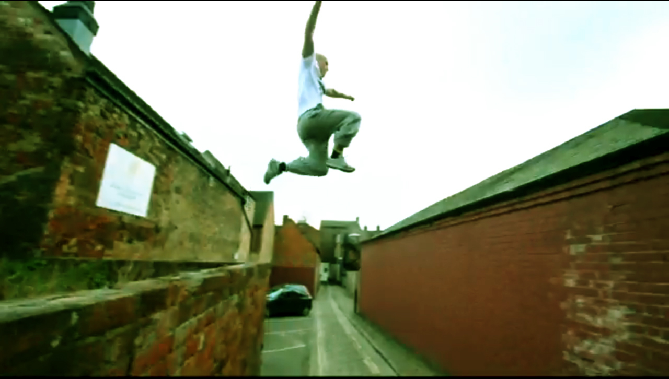

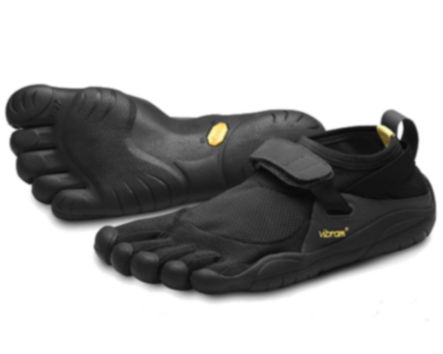



Latest Viral Video
FiveFingers
E-Marketing Campaign

Slide 2
Latest Viral Video
E-Marketing strategy
E-Marketing Strategy
Based on 2 IRL events that will interact with internet and mobile technology
Main
Website
Mobile App
Social Media
Our IRL events will be a sticker race and a sticker war in paris

Slide 3

Latest Viral Video
Stickers concept
Stickers
Modality
• Stickers will allow every Parkour players/team to represent themselfs in Paris streets.
• They are customable so that every team can creates it own logo online that will be associated to a unic QR code.
• Every Player would have to register his Bio online and link it to his own or group QR code.
• Every player registered will get a credit of 30 stickers a month, sent home allowing only one mail adress per player.
• Player can get extra stickers if they buy a pair of Vibram, using their product code they can unlock an extra 20 stickers a month.

Slide 4

Latest Viral Video
E-Marketing strategy
Mention légale
Logo de groupe
QR code
Logo vibram
W
C
M

Slide 5
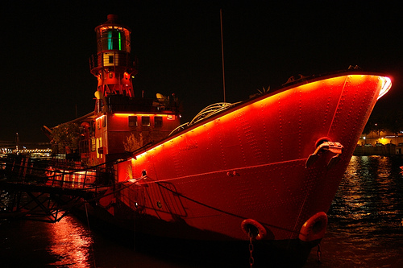

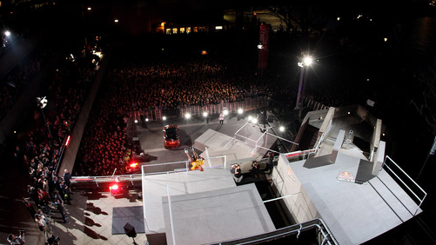
Latest Viral Video
IRL Events
Peniche Party
We aim to organize an event in Paris.
What we aim to do is to organize a promotion evening on a “Peniche” wearing Vibram’s colors and logo.
We plan to invite Free runners and journalist, during the evening we want to present the product, worn by Walters and to introduce people to our “Stickers concept”
We want to get people like bloggers, journalist and influent free runners, talking about the product and concept
Social network will end the communication process, and start a teasing week introducing the begining of the Walter’s sticker race, and then the sticker war.

Slide 6
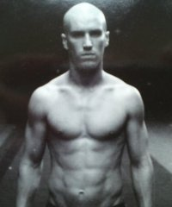
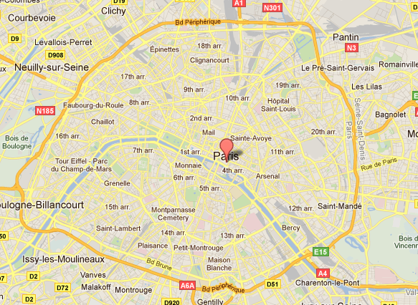
Latest Viral Video
IRL: Sticker Race
Damien Walters Endorsement
Walters will stick 20 stickers in Paris
Localisation registered on the App
Players will chase the sticker through geolocalisation
The first ten players to scan every of the 20 stickers will win a pair of Vibram « Walters » 5 fingers.
The event will last for a week.
DamienWalters

Slide 7
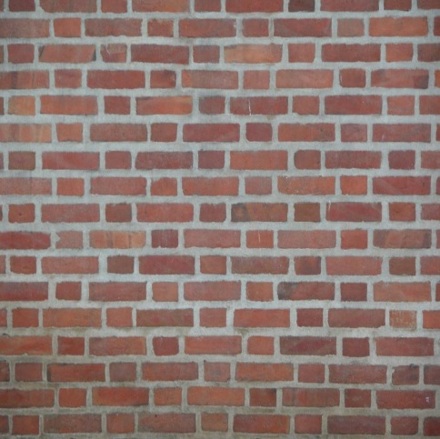


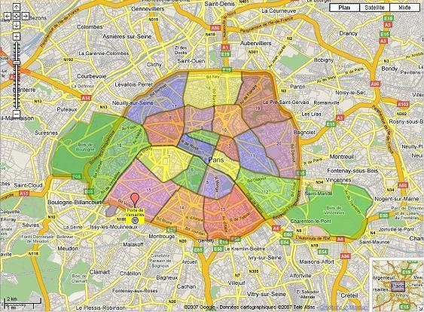






Latest Viral Video
IRL : STICKERS WAR
Stickers War
3 months IRL eventPlayers (free runners) can create teams or be a team on their own
Teams will have to previously register on the website with facebook connect.
They will have to stick a maximum of sticker in paris, and scan their QR code for geolocalisation
The team with the highest number of stickers in a district own it
A sticker « toying » option will be in the App
The team with the highest number of districts after 3 month win a Pair of Vibram Walters for every members (limited to 10 pairs).

Slide 8
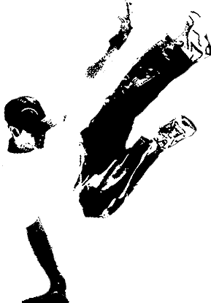
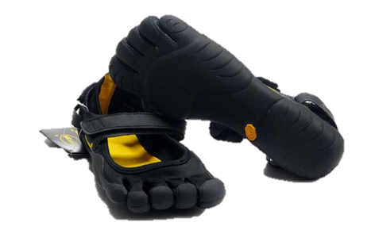
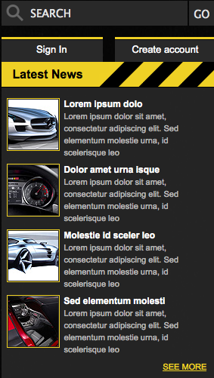
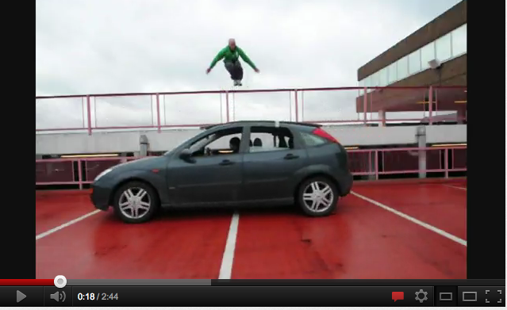

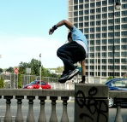
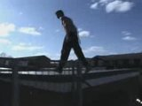
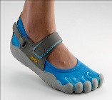
Latest Viral Video
Sponsored by
STICKERS
TOURNAMENTS
CONTACT US
See all
Pierrow1988: I tried Vibram for the first time today practicing parkour, they are really the next best thing to going barefoot
Arnou09: Next tournament in 2 weeks, hope you are all getting ready.
Guigui200: New stickers on the grand boulevard street.
Rajeu87: Does anyone know how to I download the stickers? Can’t seem to login

Slide 9
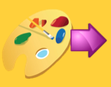

Latest Viral Video
Sponsored by
STICKERS
TOURNAMENTS
CONTACT US
You can download a standard sticker by clicking on the image
Or Create and purchase your own custom stickers. High-quality, removable, vinyl stickers, decals and labels
Get started with our artwork, or upload your own logo or image - it's easy. You're guaranteed to love it.
YOUR
Design
here
See all
FOLLOW US
Pierrow1988: I tried Vibram for the first time today practicing parkour, they are really the next best thing to going barefoot
Arnou09: Next tournament in 2 weeks, hope you are all getting ready.
Guigui200: New stickers on the grand boulevard street.
Rajeu87: Does anyone know how to I download the stickers? Can’t seem to login

Slide 10
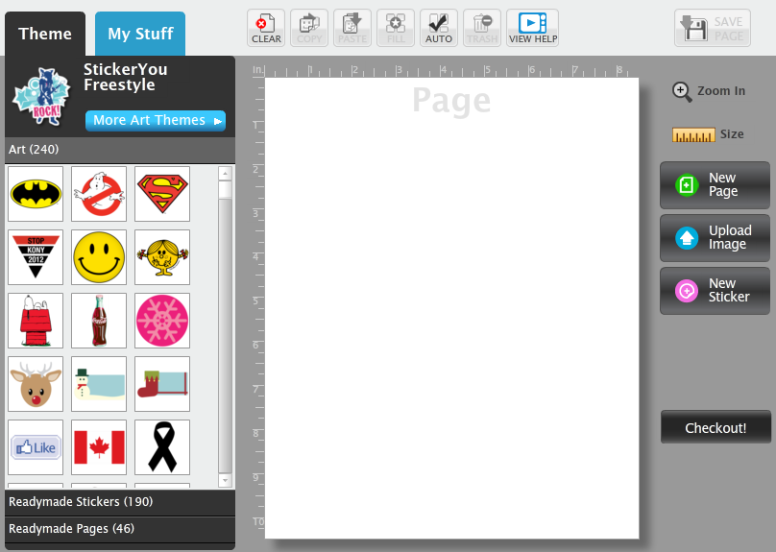
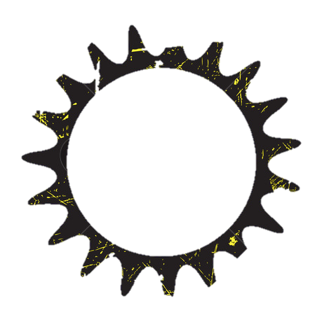
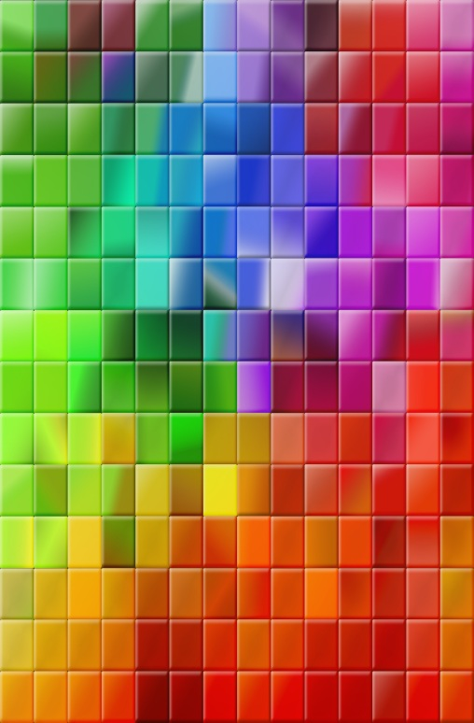
Latest Viral Video
Sponsored by
STICKERS
TOURNAMENTS
CONTACT US
See all
Pierrow1988: I tried Vibram for the first time today practicing parkour, they are really the next best thing to going barefoot
Arnou09: Next tournament in 2 weeks, hope you are all getting ready.
Guigui200: New stickers on the grand boulevard street.
Rajeu87: Does anyone know how to I download the stickers? Can’t seem to login

Slide 11

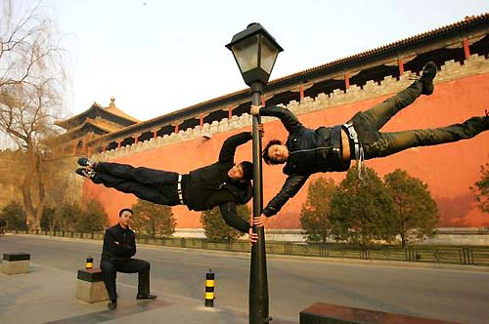
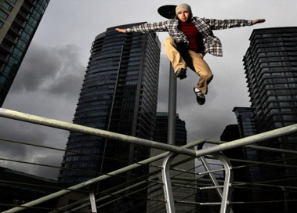
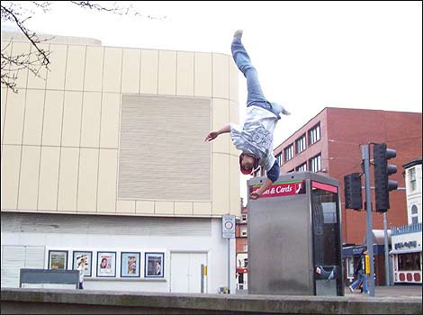

Latest Viral Video
Sponsored by
STICKERS
TOURNAMENTS
CONTACT US
last tournament pictures
Ranking
1. Damien Walters
2. Rogerz
3. Guigz
4. Nono
See all
Pierrow1988: I tried Vibram for the first time today practicing parkour, they are really the next best thing to going barefoot
Arnou09: Next tournament in 2 weeks, hope you are all getting ready.
Guigui200: New stickers on the grand boulevard street.
Rajeu87: Does anyone know how to I download the stickers? Can’t seem to login

Slide 12
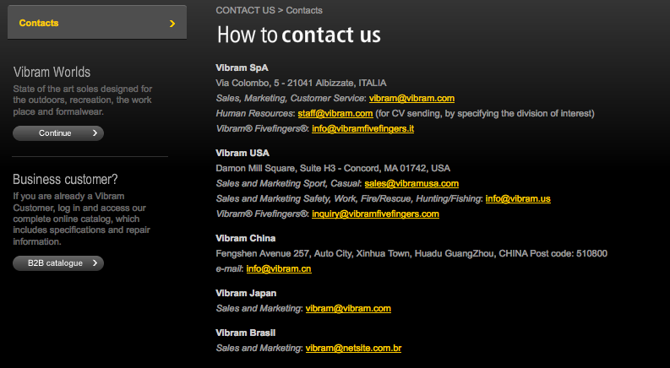
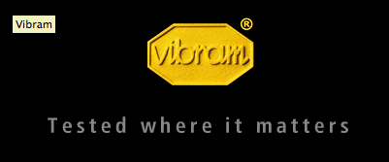
Sponsored by
STICKERS
TOURNAMENTS
CONTACT US

Slide 13
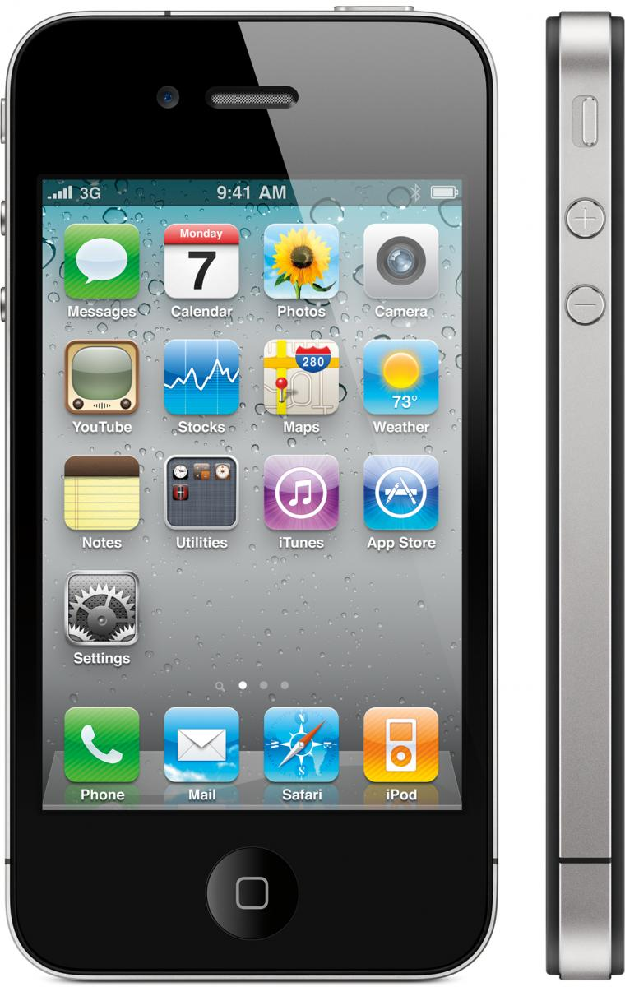

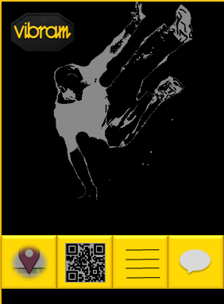

Latest Viral Video
Mobile Application
Home Page
4 functions:
• Tournament Map
• Scan and geolocalize the QR Code sticker
• Ranking
• Take and send pictures/videos
Parkour Five Fingers

Slide 14
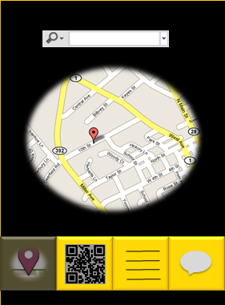
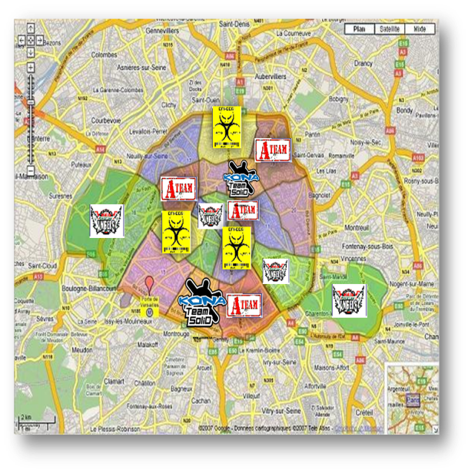

Latest Viral Video
Mobile Application
Tournament Map
• Locate the “Walters” stickers
• Find the stickers already placed in the city to find territory to reconquer

Slide 15
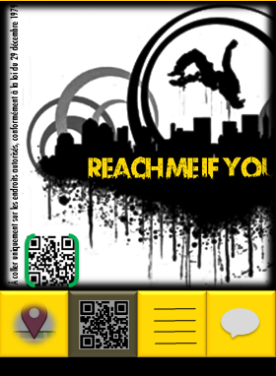
Latest Viral Video
Mobile Application
Scan & Geo-Localize
QR Code Stickers
• Scan the QR Code of the sticker you’ve just put in place, and send info to website.
• Scan other stickers and learn about the owner or the team:
Who is he?
How many sticker he put?
Where are the others stickers?
Date of action

Slide 16
Latest Viral Video
Mobile Application
Ranking
Photos/Videos
• This function allows to see the ranking of the best players in real time and see his place among the practitioners
• Send photos and videos to add content to the campaign website
1 Damien Walters
2 Rogerz
3 Nono
4 Pedro
5 Guigz

Slide 17


Latest Viral Video
Parkour Community
Federation de
ParKour
December 2011
Affiliated Associations

Slide 18
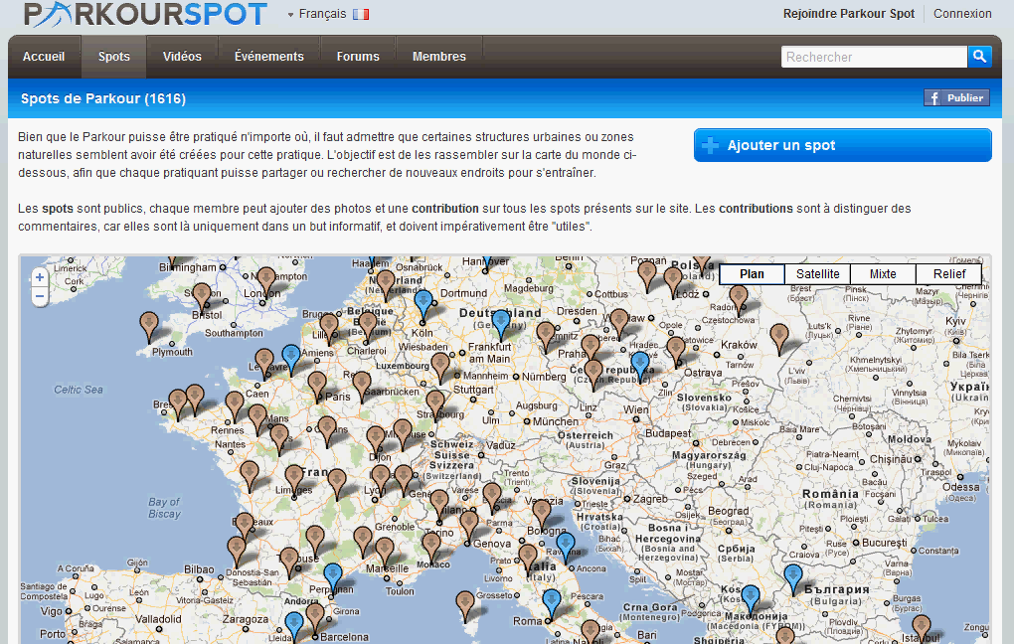






Latest Viral Video
Parkour Community
Forum
Schools

Slide 19










Latest Viral Video
Strategy
Channel
Mobile App
Stickers
Website
Parkour
Community
U
G
C
Sticker Contest Community
Users
Content

Slide 20
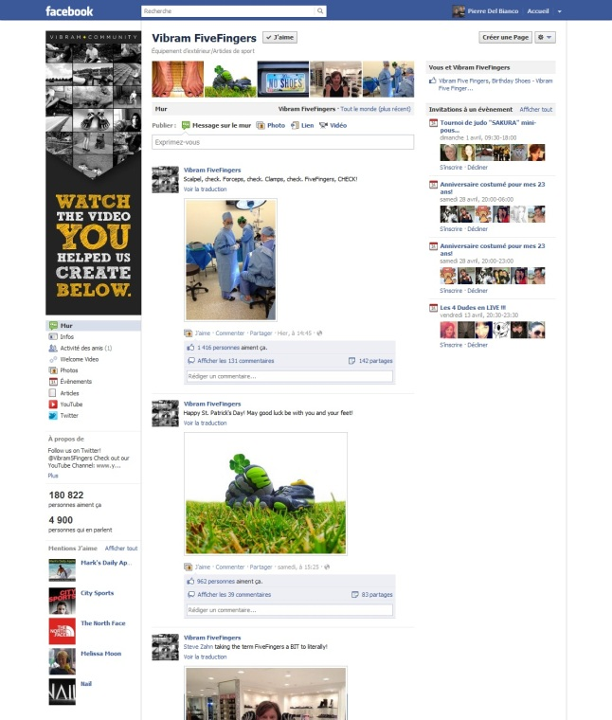
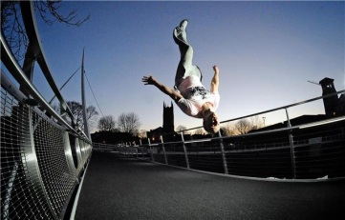



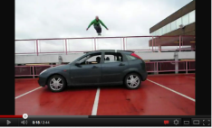
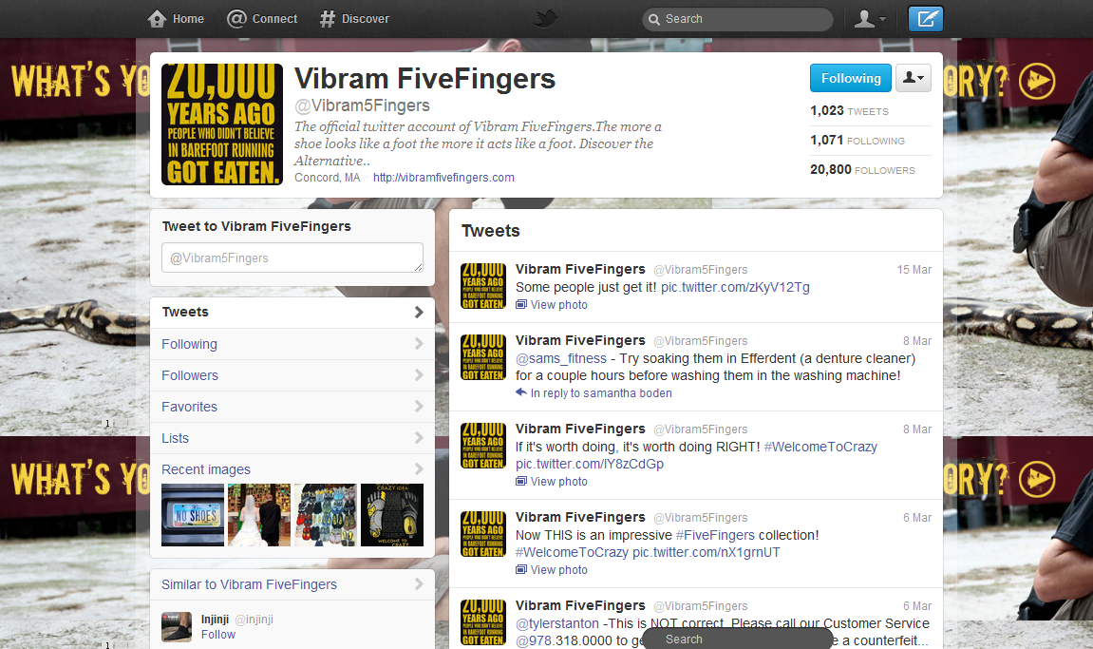


Latest Viral Video
Examples

Slide 21
Latest Viral Video
Thank you for your attention

