Slide 1
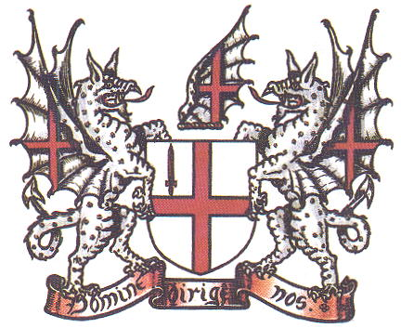
London
Source : Wikimedia Commons images

Slide 2
Camden Town

Slide 3
Camden Town

Slide 4
Camden Town
« What’s Camden Town ? »

Slide 5
Camden Town
« What’s Camden Town ? »

Slide 6
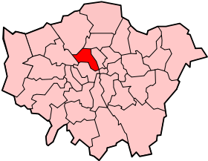
Camden Town
CAMDEN
Notes:
Camden Town is a neighborhood of the center of the famous district Camden. Camden Town is the former stables of the Queen. What’s the most famous in Camden Town is undoubtedly « Camden Lock Market » where there's mainly young Punks and Goths.

Slide 7
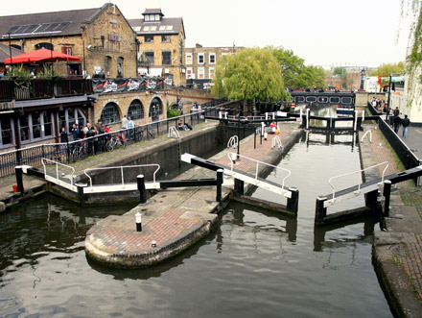
Camden Town
CAMDEN
Cut into
16 parts
Camden Town
Notes:
Camden Town is a neighborhood of the center of the famous district Camden. Camden Town is the former stables of the Queen. What’s the most famous in Camden Town is undoubtedly « Camden Lock Market » where there's mainly young Punks and Goths.

Slide 8
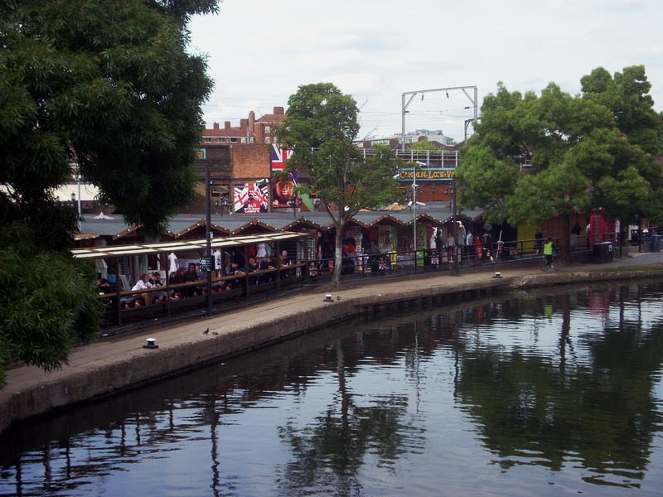
Camden Town
CAMDEN
Cut into
16 parts
Camden Town
All markets grouped
Camden Market
Notes:
Camden Town is a neighborhood of the center of the famous district Camden. Camden Town is the former stables of the Queen. What’s the most famous in Camden Town is undoubtedly « Camden Lock Market » where there's mainly young Punks and Goths.

Slide 9
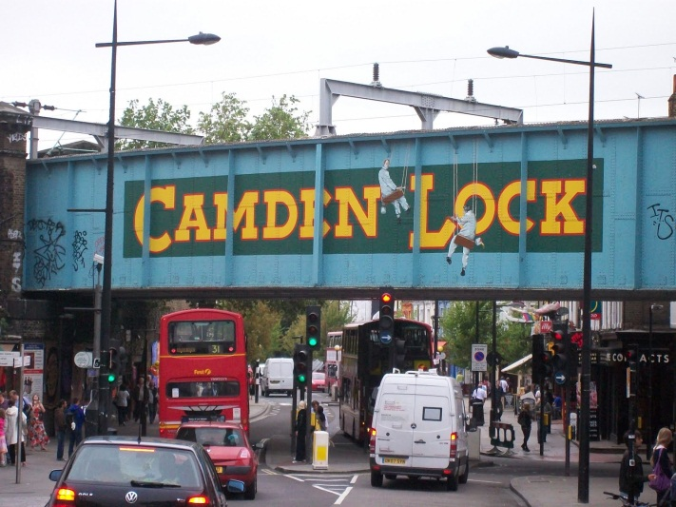
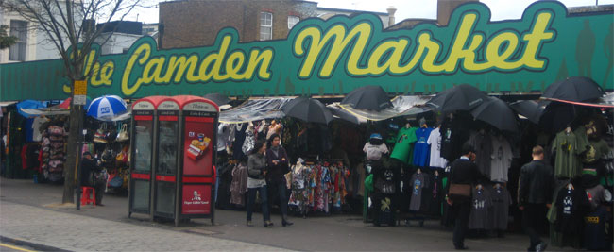
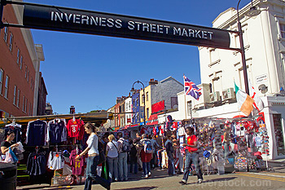
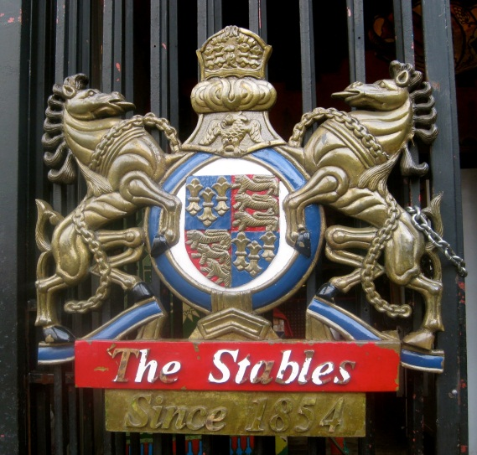
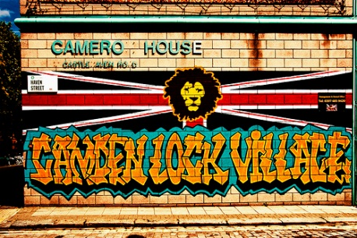
Camden Town
CAMDEN
Cut into
16 parts
Camden Town
All markets grouped
Camden Market
These markets are
Camden Lock Market
Inverness Street Market
Stables Market
Camden Lock Village
Buck Street Market
Notes:
Camden Town is a neighborhood of the center of the famous district Camden. Camden Town is the former stables of the Queen. What’s the most famous in Camden Town is undoubtedly « Camden Lock Market » where there's mainly young Punks and Goths.

Slide 10
Camden Town
CAMDEN
Cut into
16 parts
Camden Town
All markets grouped
Camden Market
These markets are
Camden Lock Market
Inverness Street Market
Stables Market
Camden Lock Village
Buck Street Market
Notes:
Camden Town is a neighborhood of the center of the famous district Camden. Camden Town is the former stables of the Queen. What’s the most famous in Camden Town is undoubtedly « Camden Lock Market » where there's mainly young Punks and Goths.

Slide 11
Camden Town
« Where’s Camden Town ? »

Slide 12
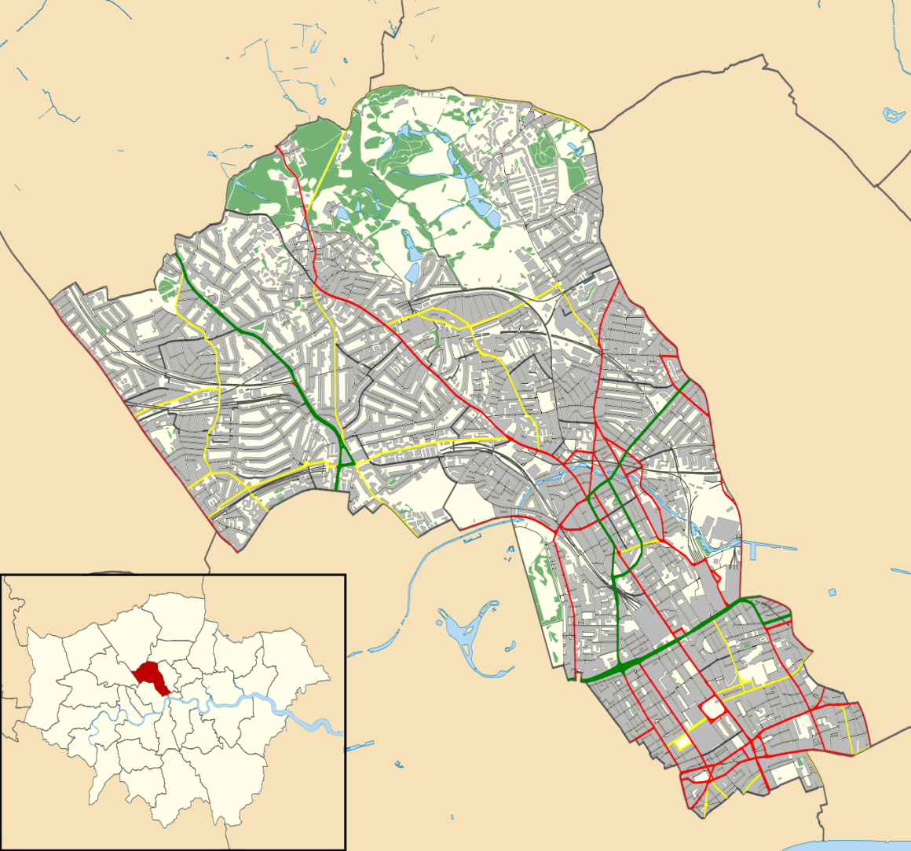
Camden Town
Camden

Slide 13
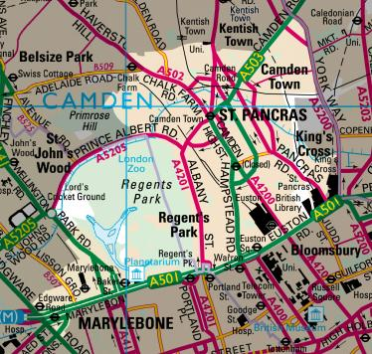
Camden Town
Camden Town

Slide 14
Camden Town
« A little bit of History of Camden Town … »

Slide 15
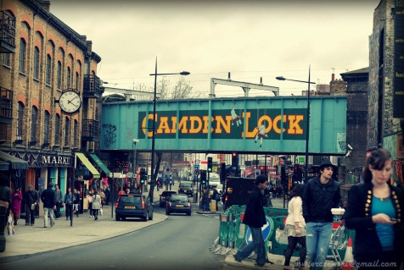
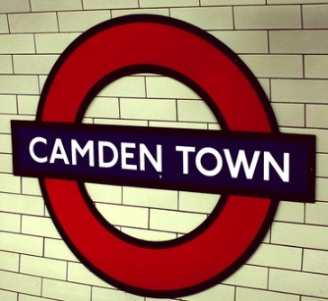
Camden Town
1854 : Creation of The Stables of The Queen
1907 : Opening of the Underground Station of Camden Town
Today : Very famous neighborhood, undoubtedly for a long, long, time …

Slide 16
Camden Town
« More about Camden Town … »

Slide 17
Camden Town
Famous Personalities in Camden Town
Beryl Bainbridge
Alan Benett
Oliver Heaviside
Walter Sickert
Dylan Thomas
Amy Winehouse

Slide 18
Camden Town
Some Pictures of the neighborhood …

Slide 19
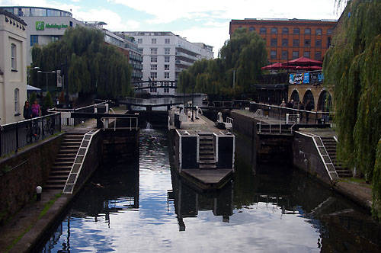
Camden Town
Regent’s Canal

Slide 20
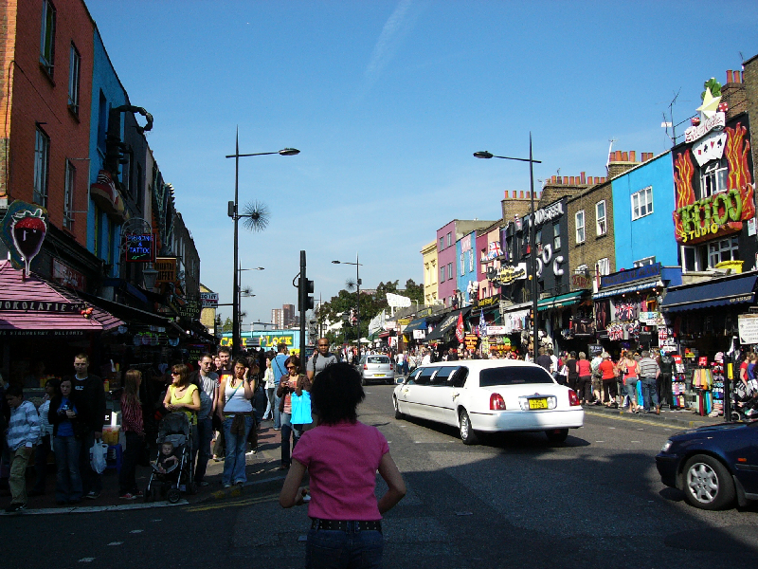
Camden Town
Camden Street

Slide 21
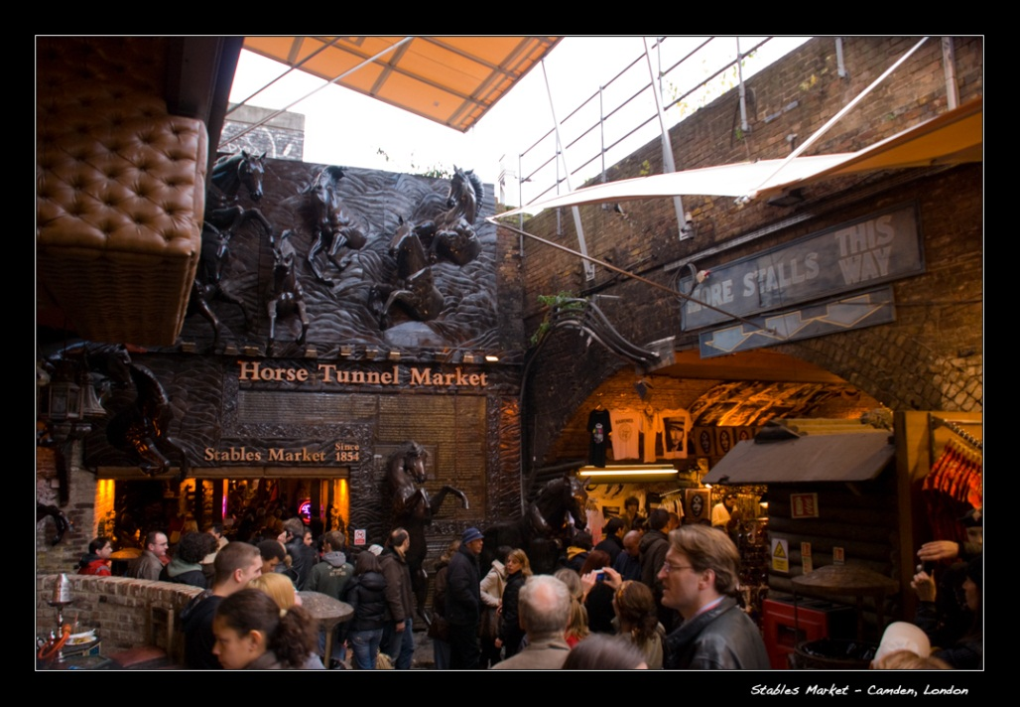
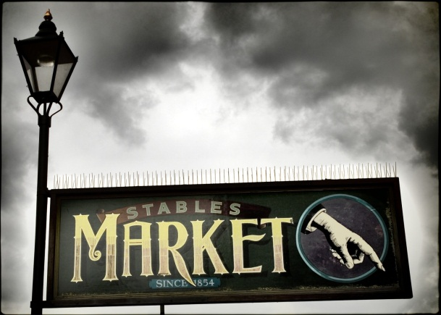
Camden Town
The stables

Slide 22
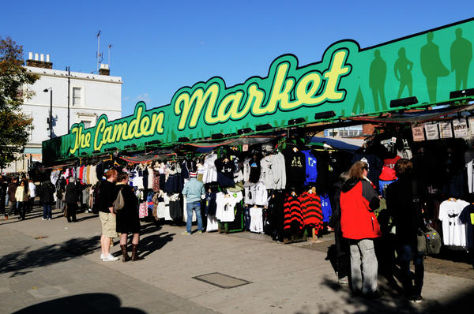
Camden Town
Buck Street market

Slide 23
Thanks for having dedicated your time and your attention for us …
but are you sure you have listened carefully ? We’ll see that !

