Slide 1

THE CONTROVERSIAL BUSINESS OF FOIE GRAS
Thursday 18th of December
Clément CHADUC
Julie RUSSON
Notes:
Good morning every body. For the next twenty minuts or so Julie and I, Clément, have chosen to introduce you a very unusual topic.
We called our presentation “The controversial business of Foie Gras”.
If you have some questions, remarks or comments, we will answer at the end of the presentation.
Now, I let Julie introduce our subject.

Slide 2
INTRODUCTION
Who will eat any foie gras for Christmas and New Year holidays ?
Notes:
luxury food made with the liver of a duck or goose that has been specially fattened, called force feeding
Phrase intro ➔ Christmas and NY hollidays

Slide 3
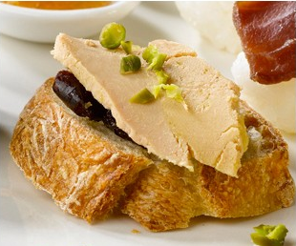
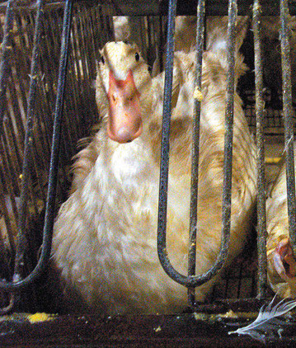
INTRODUCTION
What do you imagine when I say “Foie Gras” ?
Notes:
I have a second question for you : “What do you imagine when I say “Foie Gras” ?
Do you think first the luxury food or rather the problem of force feeding ?
Please, rise your hand if you have this kind of picture in mind.
Now, rise you hand if you have rather that kind of picture in mind.
Thank you for your participation.
Now I can introduce you the schedule of our work.

Slide 4
SCHEDULE
I- Foie Gras is a long tradition in French gastronomy...
II- … but the way to produce it can be debated...
III- … that is why some people denounce the system...
IV- … and the legislations are evolving.
Notes:
Basically, we have divided our presentation into four parts.
In the first part, we will talk about the long tradition of Foie Gras and its place in french cooking.
Then, in the second part, we will look at the way to produce it and all the problems it generates.
In the third part, we will focus on the associations which denounce the way to produce Foie Gras.
And, in the final part we will consider the countries where the legislations have evolved.
To start, in the first part we have chosen to show you the evolution of Foie Gras, its place in the economy and in the gastronomy.

Slide 5
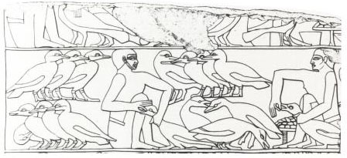
I- Foie Gras is a long tradition in French gastronomy...
1.1- Brief history
2500 BC (Egyptians)
361 BC (Romans)
16th century (France)
Notes:
Thousand = mille
Hundred = cent (je n’ai pas ri et tu peux mettre tout ce que tu veux comme notes)
(Légende) An Egyptian fresco showing the force-feeding of geese
- Back at least to ancient Egypt (roasted and humidified grains)
- Roman Empire (dried figs)
- France (corn)
French law: cultural and gastronomic heritage

Slide 6
I- Foie Gras is a long tradition in French gastronomy...
1.2- Key figures
30.000 tons
75 %
2 billion euros
150.000 persons
south-west of France
36 million euros
19.800 tons
308 g
Notes:
you're in point concerning the Foie gras ?
Annual global production
The French production in the global production (is the largest producer followed by Hungary)
Turnover of the sector in France
The number of employees in France
First producing region of the world
The value of exports of foie gras in France slightly lower due to the crisis
The amount of foie gras consumed in France each year
The average amount consumed each year by household in France

Slide 7
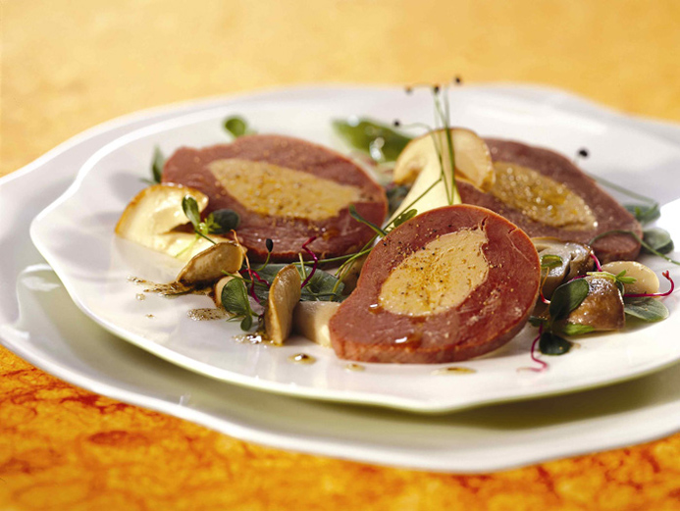
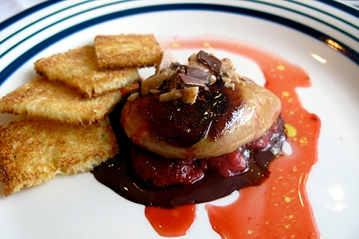
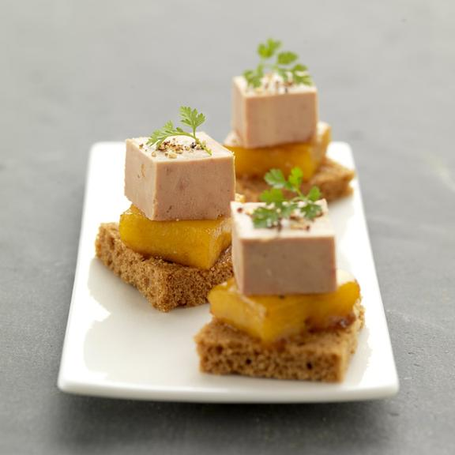
I- Foie Gras is a long tradition in French gastronomy...
1.3- How do you prefer it ?
as entree ?
as side dish ?
as desert ?

Slide 8
SCHEDULE
I- Foie Gras is a long tradition in French gastronomy...
II- … but the way to produce it can be debated...
III- … that is why some people denounce the system...
IV- … and the legislations are evolving.
Notes:
So, we have seen that Foie Gras is very important in our economy and gastronomy. Now we will pass at the second part of our presentation. We will focus on the manufacturing steps of production of Foie Gras.
Julie will begin by introducing you the process.

Slide 9
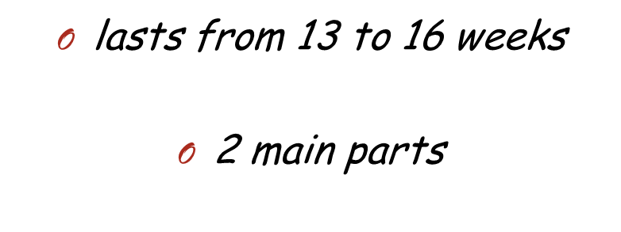
II- … but the way to produce it can be debated...
Breeding
Force feeding
Notes:
Increase liver size

Slide 10
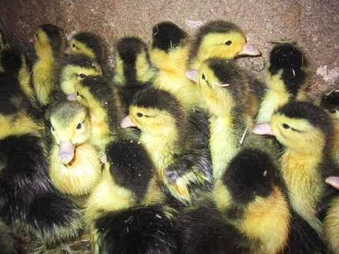
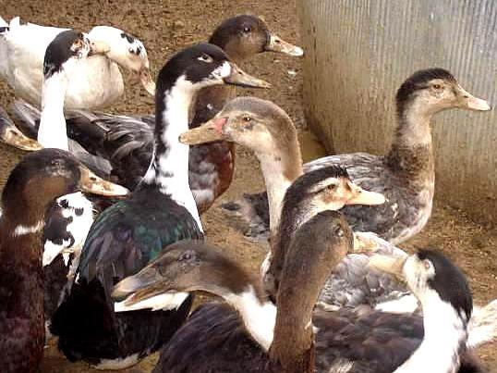
II- … but the way to produce it can be debated...
Notes:
Here, you have some mule ducks aged about a week.
And here it is the same ducks ten weeks later.
As you can imagine, between these two stages, there are some steps.

Slide 11
II- … but the way to produce it can be debated...
Start up
Growth
Preparation
Sexing
Notes:
First of all the “Start up”. The animals are between one day and one month. They live in a heated room. They eat between thirty and hundred grams of cereals or granules per day.
Then, during the following month, the ducks change of enclosure : they have large outdoor runs. They also change diet : now they eat up to three hundred grams of flours.
Generally these two steps do not take place in the exploitation producer of Foie Gras but from a breeder.
The third step called “preparation” comprises preparing the ducks for the gavage (which is the next step). During one month, little by little the daily rations are increased to accustom the ducks.

Slide 12
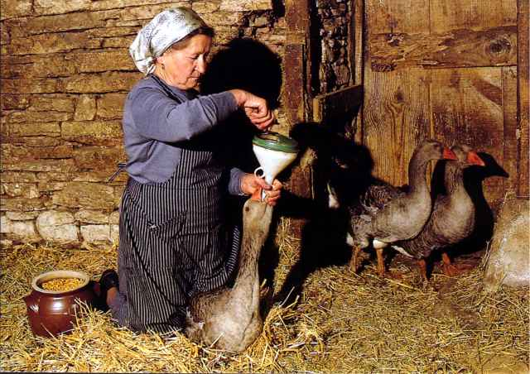
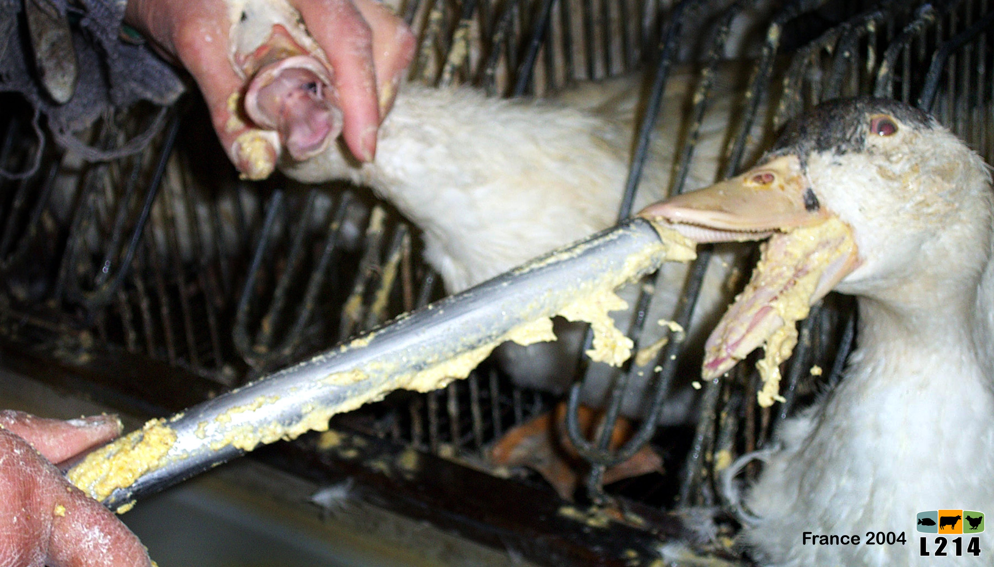
II- … but the way to produce it can be debated...
Foie gras
Rillette
Duck gizzard
SLAUGHTER
Breast
Fritons
…
Force feeding
Notes:
After the step of preparation, comes the step of gavage. It lasts between one and two weeks. The aim is to fatten the animals by giving them more and more food (generally corn).
When the duck is ready, it is killed and eighty per cent of it is used for human consummation. Here you have a non exhaustive list of products which come from ducks fat.

Slide 13
SCHEDULE
I- Foie Gras is a long tradition in French gastronomy...
II- … but the way to produce it can be debated...
III- … that is why some people denounce the system...
IV- … and the legislations are evolving.
Notes:
We have seen in the previous part that the way to produce Foie Gras can be criticized. Even if the Foie Gras industry is powerful, some associations don’t hesitate to lead some actions or campaigns against Foie Gras.
In the third part we will introduce you these associations, their arguments and their actions.

Slide 14
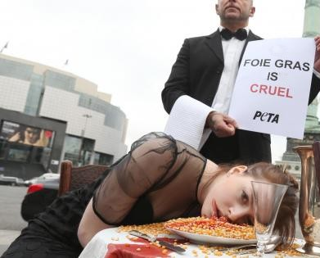




III- … that is why some people denounce the system...
3.1- Many associations
Notes:
PETA, SPA, L214, GAIA
Peta campaign : staging of a woman "as a force-fed goose" by PETA in Paris

Slide 15
III- … that is why some people denounce the system...
3.2- Different points of view
- self feeding
- ducks are greedy
- liver not sick
- classic mortality
- short time
- force feeding is not uncomfortable
Notes:
Arguments in favor of force feeding :
- Self feeding when they migrate
- Duck greedy / accustomed very well to force feeding
- Not sick : feeding stopped => liver recover normal size
- Mortality during force feeding (2 to 5%) = in classic breeding
- Not last a long time
- Scientifically, not prove it is source of discomfort

Slide 16

III- … that is why some people denounce the system...
3.2- Different points of view
- self feeding
Are you kidding ?
- ducks are greedy
- liver not sick
- classic mortality
- short time
- force feeding is not uncomfortable
Notes:
These arguments are swept by the associations for Animal Health and Welfare.
Today the ducks aren’t migrators! Moreover after undergoing gavage they can’t move normally so imagine if they have to migrate!
It’s wrong to say that a duck can accustomed very well to force feeding : if force feeding is stopped, the ducks refuse to eat during two weeks.

Slide 17
III- … that is why some people denounce the system...
3.2- Different points of view
- self feeding
Are you kidding ?
- ducks are greedy
- liver not sick
- classic mortality
- short time
- force feeding is not uncomfortable
Notes:
It is not because you can be cured that you are not sick ! The worst is, if the gavage lasts a few days more, the duck will simply die.
Ok the mortality is the same like in the other breeding but this value don’t consider all the ducks killed during sexing.

Slide 18
III- … that is why some people denounce the system...
3.2- Different points of view
- self feeding
Are you kidding ?
- ducks are greedy
- liver not sick
- classic mortality
- short time
- force feeding is not uncomfortable
Notes:
Kill an animal after have suffer it is worse : it is called barbarity. And do you know why gavage lasts only two weeks ? It’s just because after that short time the animals risk to die.
The associations don’t believe this scientific study. This survey was paid by Foie Gras lobby so it can’t be objective.
Moreover they explain that force feeding is nor moral nor legal. Some European laws ban gavage without naming it but saying " No animal must be fed or watered causing him damages or suffering unuseful."
Does foie gras is useful ? It can not be replaced ?

Slide 19
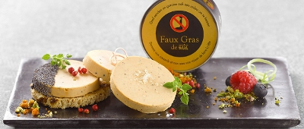
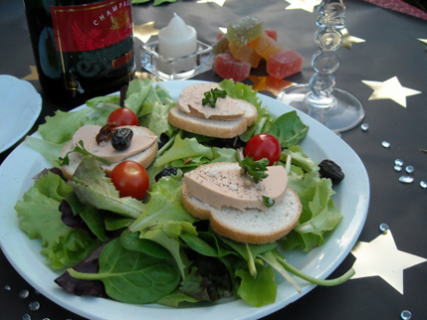
III- … that is why some people denounce the system...
3.3- Alternative products

Slide 20
III- … that is why some people denounce the system...
3.3- Alternative products
DIETARY
ECONOMIC
But what about the taste ?
Notes:
In dietary “Faux Gras” is better than true Foie Gras. It is twice less caloric, and contains four times less fat.
In economic, “Faux Gras” is also a good choice : it is ten times less expensive than Foie Gras.
But what about the taste ?
I look on the internet to have the opinion of the gourmets and I was very surprised. No one was satisfy by the “Faux Gras” : they just consider it as a bad pâté ! I also found an article where they wonder if this product is not simply a scam : it has exactly the same taste and the same composition that an other product called “vegetal pâté” but it is three times more expensive.
Moreover it contains palm oils : when you buy some “Faux Gras” you protect the ducks but you destruct the ecosystems. Logical isn't ?

Slide 21
SCHEDULE
I- Foie Gras is a long tradition in French gastronomy...
II- … but the way to produce it can be debated...
III- … that is why some people denounce the system...
IV- … and the legislations are evolving.

Slide 22
IV- … and the legislations are evolving.
4.1- The California case
1st of July 2012
Notes:
Force feeding & Selling foie gras were forbidden on the 1st of July 2012.
Whereas America’s appetite for foie gras is increasing, the California State Senate introduced bills to ban the production and sale of foie gras in California

Slide 23
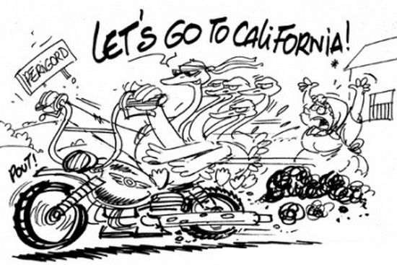
IV- … and the legislations are evolving.
4.1- The California case
1st of July 2012
Notes:
Yet a company have decided to build a factory on the California – Nevada border. On the same way there is the of the apparition of a black market (like in the twenty’s during the alcohol prohibition).
This decision was very mediated in France, but in fact it is too early to measure the consequences on the foie gras industry in France. The experts think it will no change anything for french producers : in fact the American market represents a tiny part of France exports of foie gras.
["It's a treat for chefs to get to cook for people to enjoy foie gras. And it's an art, not everyone knows how to cook foie gras properly, and it's unfortunate for the consumer to have it taken away," said Nyesha Arrington, head chef at the Wilshire restaurant in Santa Monica, LA, South California.]

Slide 24
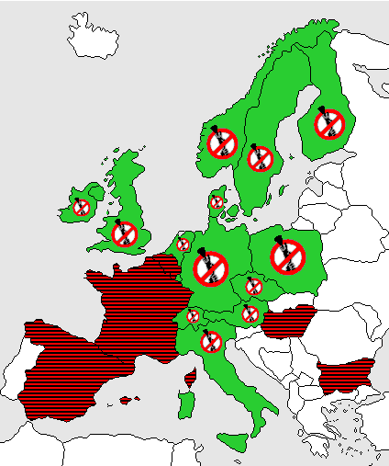
IV- … and the legislations are evolving.
4.2- And in the others countries ?
Notes:
Foie gras selling is not forbidden but force fedding is forbidden.
Laws are written differently in different countries, but all prohibit the feeding in order to make Foie Gras
In a lot of european countries' law : Forbidden to force feeding an animal unless his health require it : Germany, Austria, Denmark...
In other countries, the law target geese and ducks (and not all animals) : Italy.
And in some countries, laws are more vague and are interpreted as the prohibition of force feeding : Sweden, Irelande.

Slide 25
CONCLUSION
Who will eat any foie gras for Christmas and New Year holidays ?
Who will prefer foie gras – alternatives ?
Notes:
As we tried to show you during our presentation, the industry of Foie Gras abuses during force feeding whenever nor the consumer nor the producers are ready to forget Foie Gras even if the laws are more and more strict.
Thank you very much for you attention.
Don’t hesitate to ask questions if something was not clear.
Well, I have some questions for you.

