Slide 1
THE CONTROVERSIAL BUSINESS OF FOIE GRAS
Thursday 18th of December
Clément CHADUC
Julie RUSSON

Slide 2
INTRODUCTION
Who will eat any foie gras for Christmas and New Year holidays ?
Notes:
luxury food made with the liver of a duck or goose that has been specially fattened.
Phrase intro

Slide 3
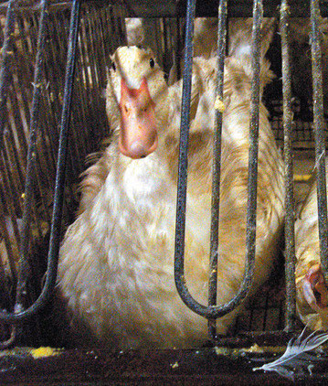
INTRODUCTION
What do you imagine when I say “Foie Gras” ?

Slide 4
SCHEDULE
I- Foie Gras is a long tradition in French gastronomy...
II- … but the way to produce it can be debated...
III- … that is why some people denounce the system...
IV- … and the legislations are evolving.

Slide 5
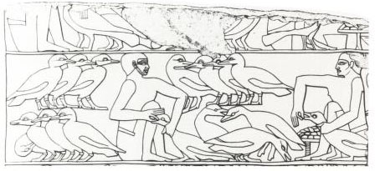
I- Foie Gras is a long tradition in French gastronomy...
1.1- Brief history
2500 BC (Egyptians)
361 BC (Romans)
16th century (France)
Notes:
Thousand = mille
Hundred = cent (je n’ai pas ri et tu peux mettre tout ce que tu veux comme notes)
(Légende) An Egyptian fresco showing the force-feeding of geese
- Back at least to ancient Egypt (roasted and humidified grains)
- Roman Empire (dried figs)
- France (corn)
French law: cultural and gastronomic heritage

Slide 6
I- Foie Gras is a long tradition in French gastronomy...
1.2- Key figures
30.000 tons
75 %
2 billion euros
150.000 persons
south-west of France
36 million euros
19.800 tons
308 g
Notes:
you're in point concerning the Foie gras ?
Annual global production
From the French production in the global production (is the largest producer followed by Hungary)
Turnover of the sector in France
The number of employees in France
First producing region of the world
The value of exports of foie gras in France slightly lower due to the crisis
The amount of foie gras consumed in France each year
The average amount consumed each year by household in France

Slide 7
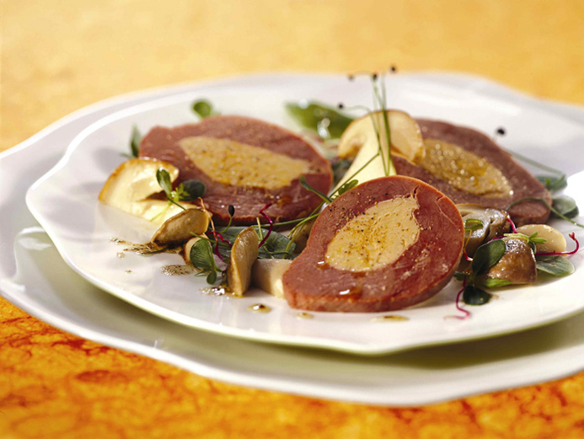
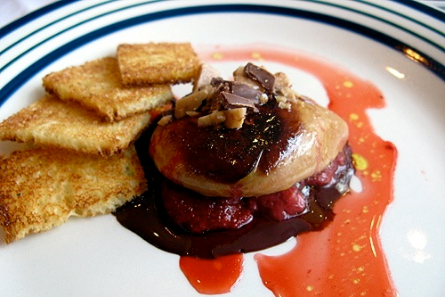
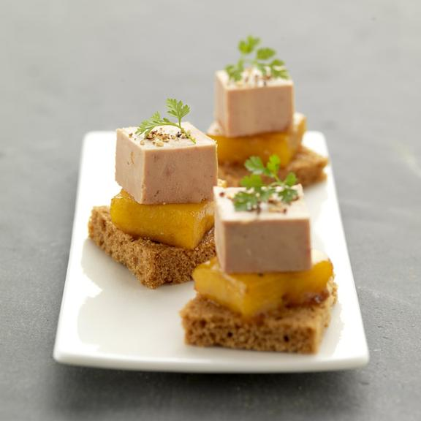
I- Foie Gras is a long tradition in French gastronomy...
1.3- How do you prefer it ?
as entrée ?
as side dish ?
as desert ?

Slide 8
SCHEDULE
I- Foie Gras is a long tradition in French gastronomy...
II- … but the way to produce it can be debated...
III- … that is why some people denounce the system...
IV- … and the legislations are evolving.

Slide 9
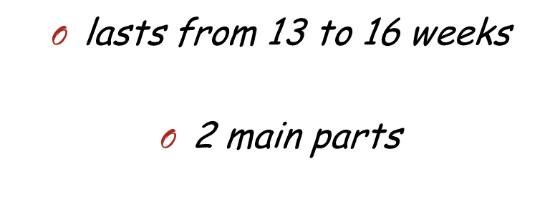
II- … but the way to produce it can be debated...
Breeding
Force feeding

Slide 10
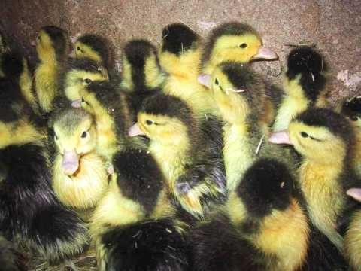
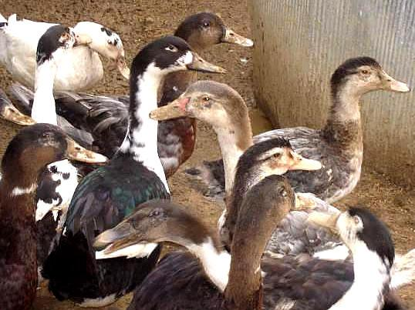
II- … but the way to produce it can be debated...
Start up
Growth
Preparation
Sexing

Slide 11
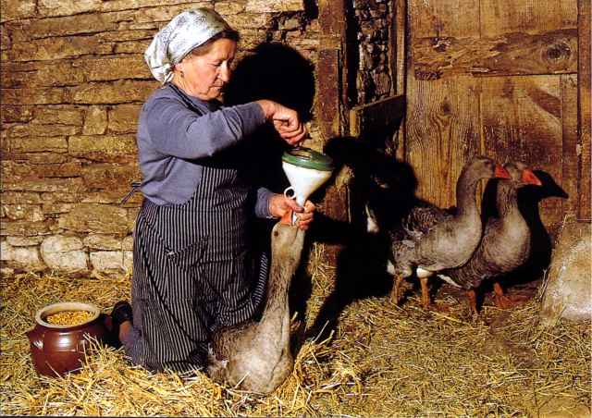
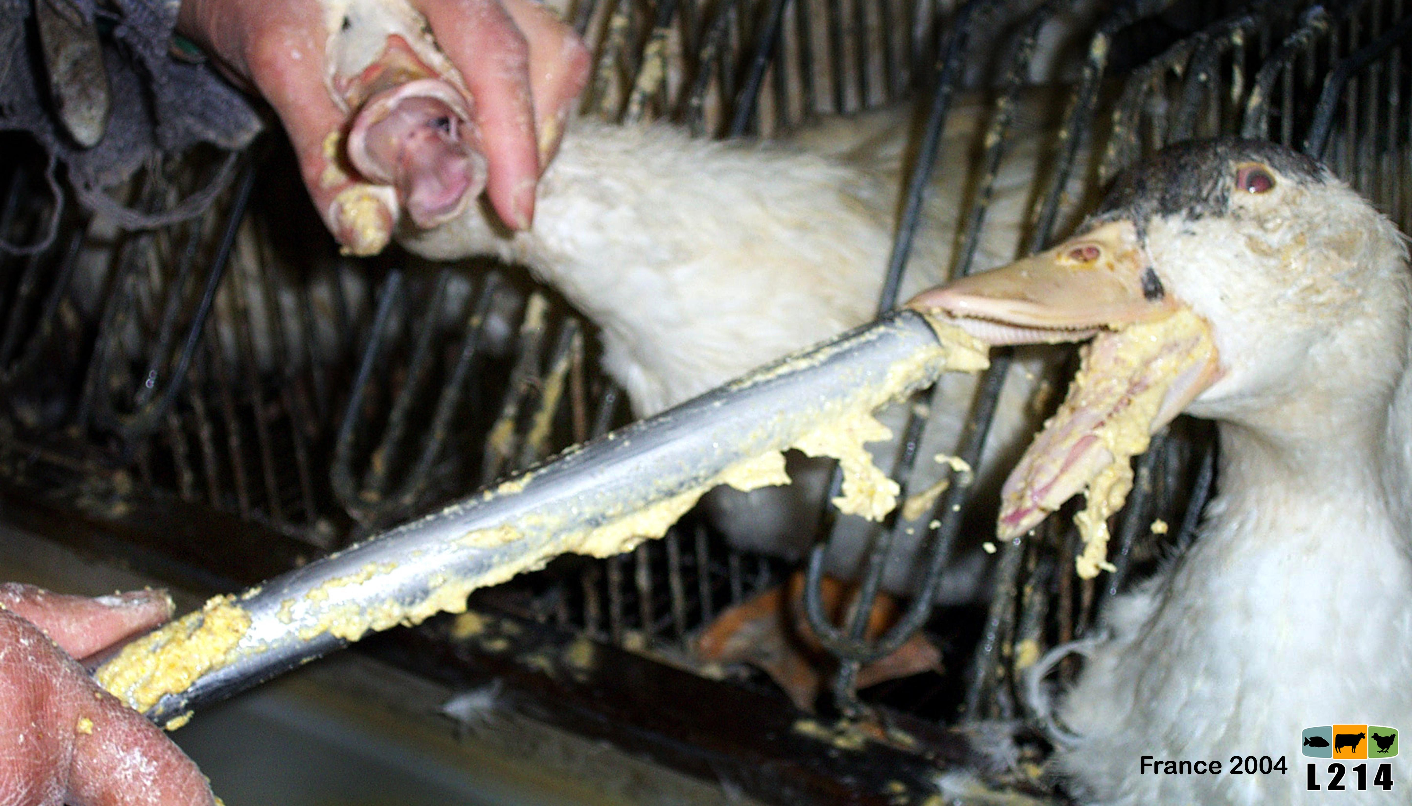
II- … but the way to produce it can be debated...
Foie gras
Rillette
Duck gizzard
SLAUGHTER
Breast
Fritons
…
Force feeding

Slide 12
SCHEDULE
I- Foie Gras is a long tradition in French gastronomy...
II- … but the way to produce it can be debated...
III- … that is why some people denounce the system...
IV- … and the legislations are evolving.

Slide 13
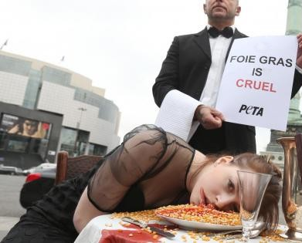
III- … that is why some people denounce the system...
3.1- Many associations
Notes:
PETA, SPA, L214, GAIA
Peta campaign : staging of a woman "as a force-fed goose" by PETA in Paris

Slide 14
III- … that is why some people denounce the system...
3.2- Different points of view
- self feeding
- ducks are greedy
- liver not sick
- classic mortality
- short time
- force feeding is not uncomfortable for geese and ducks
Notes:
Arguments in favor of force feeding :
- self feeding when they migrate
- Duck greedy / accustomed very well to force feeding
- Not sick : feeding stopped => liver recover normal size
- Mortality during force feeding (2 to 5%) = in classic breeding
- Not last a long time
- Scientifically, not prove it is source of discomfort

Slide 15
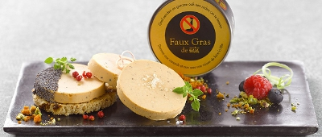
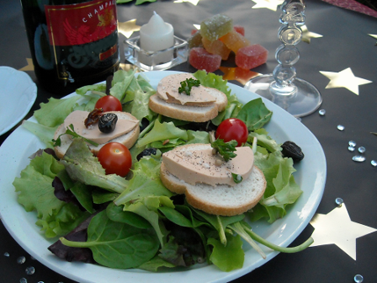
III- … that is why some people denounce the system...
3.3- Alternative products
Notes:
vegetable terrines :
Tartex nature, Pural nature, Tartex Chardonay côte d'or (bio shops and distance selling)
Bjorg Chardonnay (Supermarkets).
3 euros for 250 grams.
Made with truffle and champagne.

Slide 16
SCHEDULE
I- Foie Gras is a long tradition in French gastronomy...
II- … but the way to produce it can be debated...
III- … that is why some people denounce the system...
IV- … and the legislations are evolving.

Slide 17
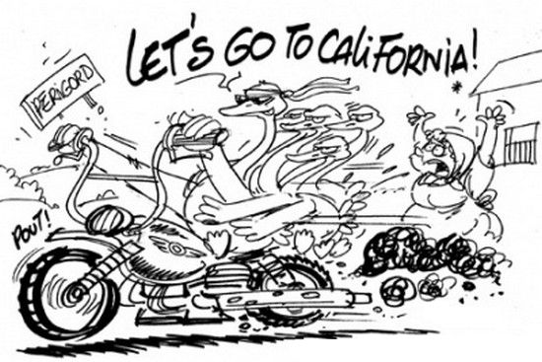
IV- … and the legislations are evolving.
4.1- The California case
Notes:
Force feeding & Selling forbidden 1st of July
Whereas America’s appetite for foie gras is increasing, the California State Senate introduced bills to ban the production and sale of foie gras in California
["It's a treat for chefs to get to cook for people to enjoy foie gras. And it's an art, not everyone knows how to cook foie gras properly, and it's unfortunate for the consumer to have it taken away," said Nyesha Arrington, head chef at the Wilshire restaurant in Santa Monica, LA, South California.]

Slide 18
IV- … and the legislations are evolving.
4.2- And in the others countries ?
Notes:
Foie gras selling is not forbidden but force fedding is forbidden.
Laws are written differently in different countries, but all prohibit the feeding in order to make Foie Gras
In a lot of european countries' law : Forbidden to force feeding an animal unless his health require it : Allemagne, Autriche, Danemark ...
In other countries, the law target geese and ducks (and not all animals) : Italie.
And in some countries, laws are more vague and are interpreted as the prohibition of force feeding : Suède, Irlande.

Slide 19
CONCLUSION
Who will eat any foie gras for Christmas and New Year holidays ?
Who will prefer foie gras – alternatives ?
Notes:
Thank you very much for you attention.
Don’t hesitate to ask questions if something was not clear.
Well, I have some questions for you.

