Slide 1
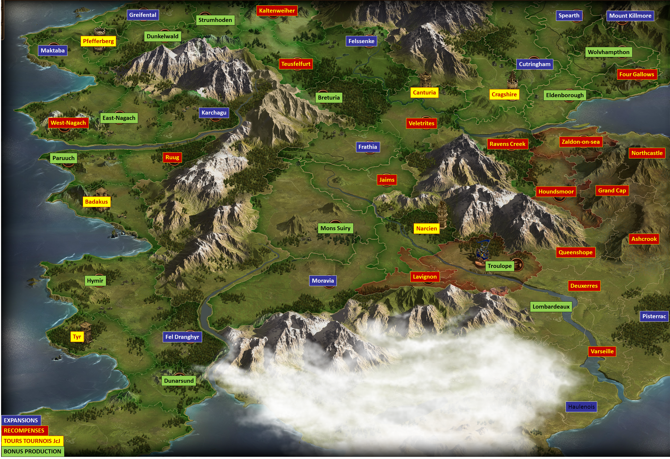

Slide 2
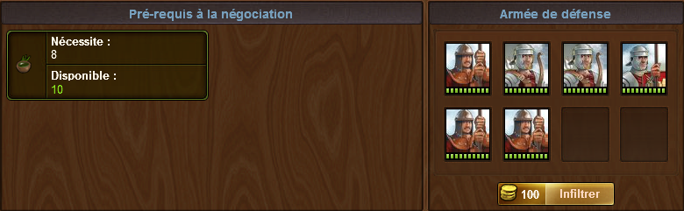
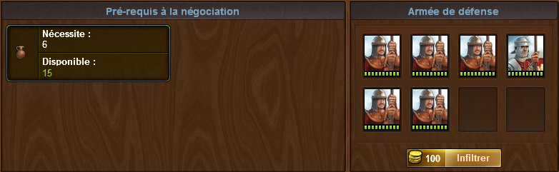
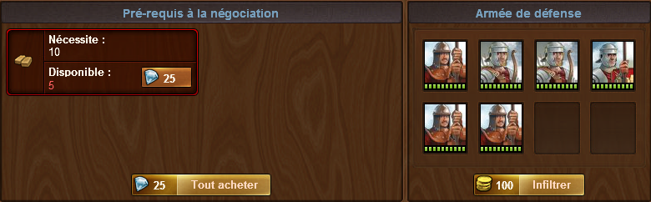
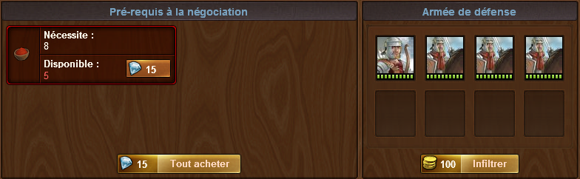
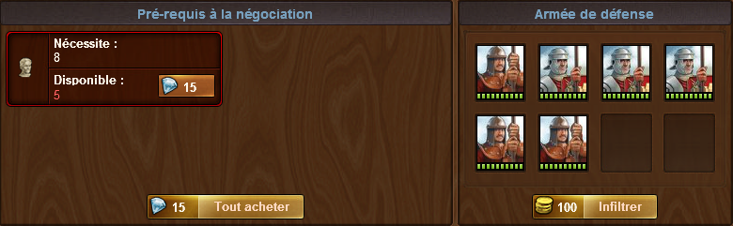
BADAKUS

Slide 3
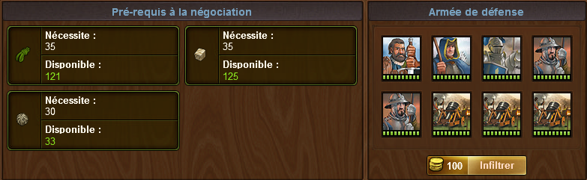
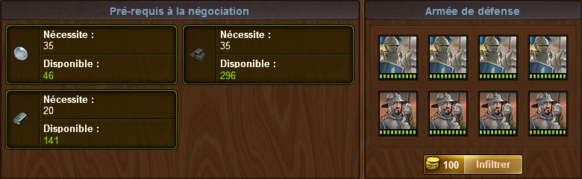
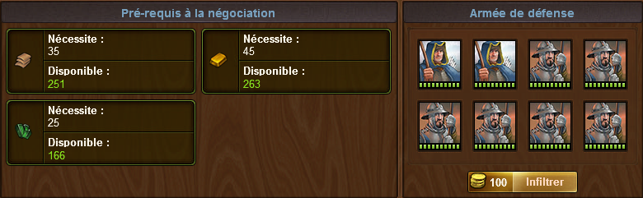
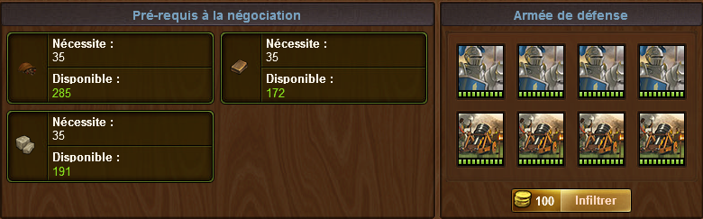
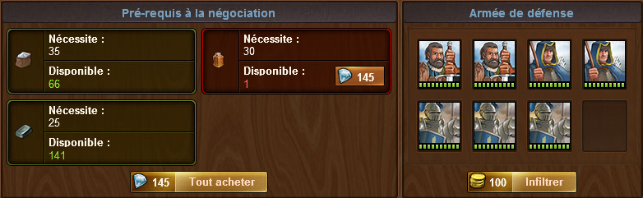
CUTRINGHAM

Slide 4
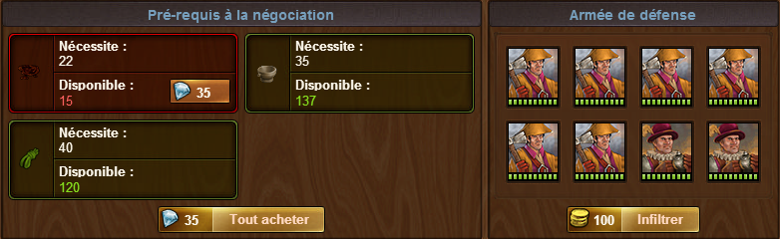
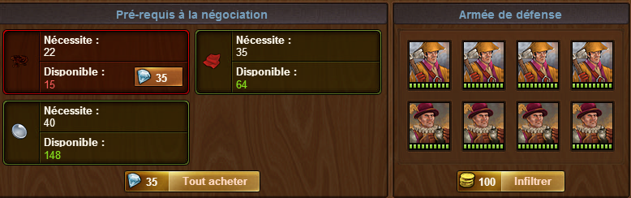
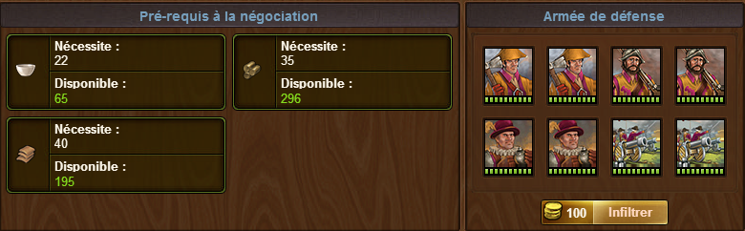
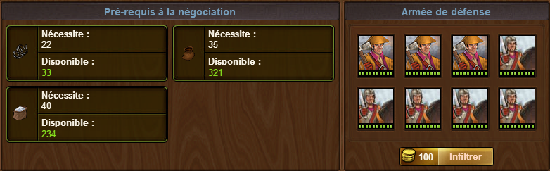
DEUXERRES

Slide 5
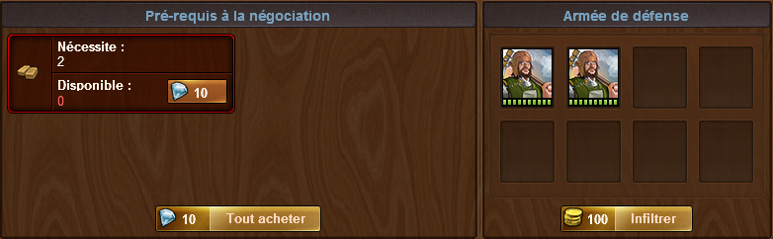
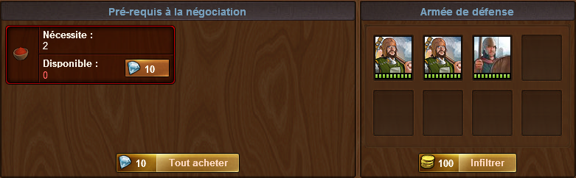
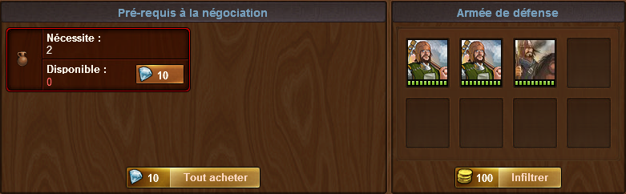
Dunarsund

Slide 6
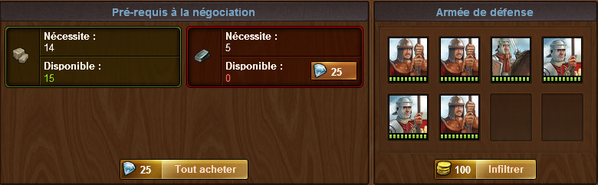
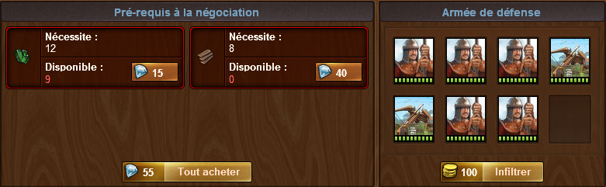
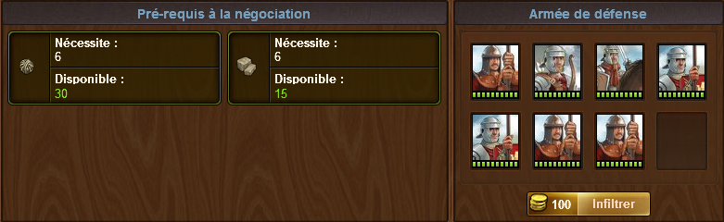
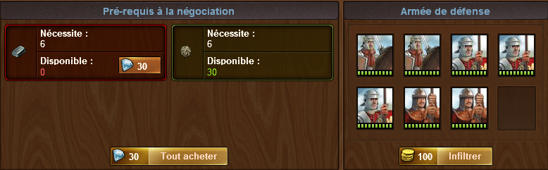
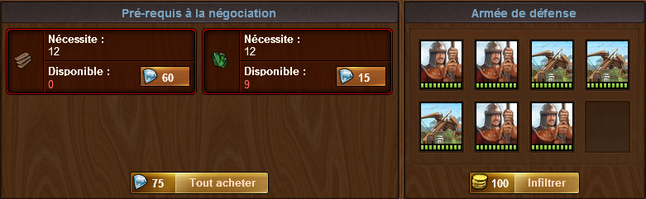
East-Nagach

Slide 7
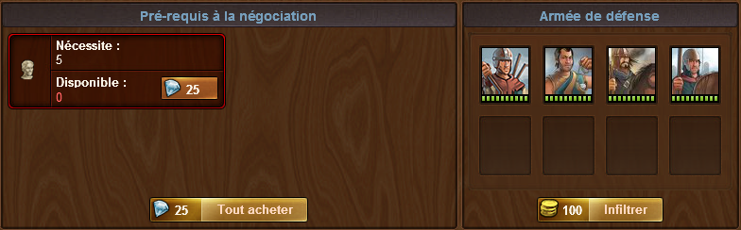
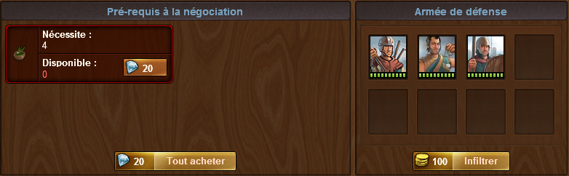
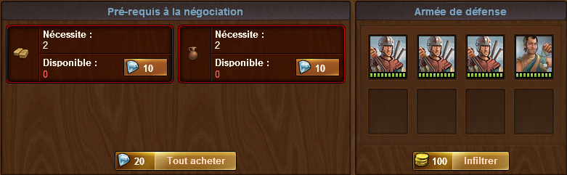
Fel Dranghyr

Slide 8
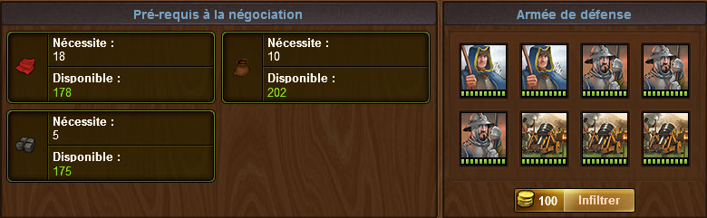
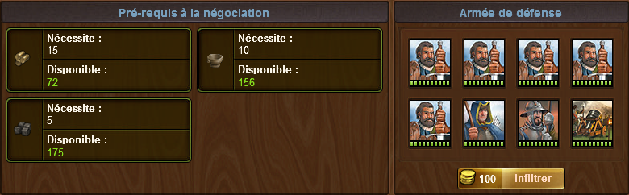
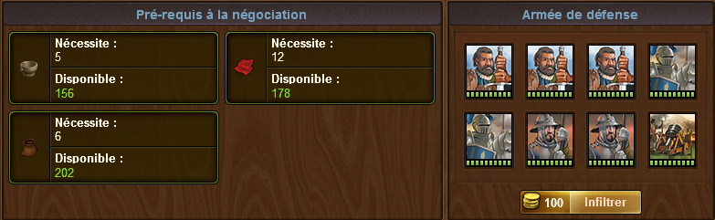
Four Gallows

Slide 9
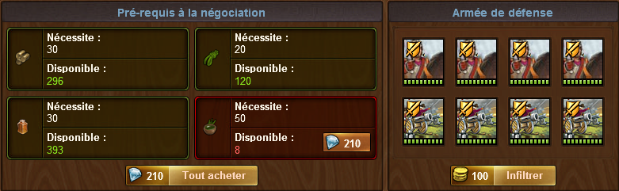
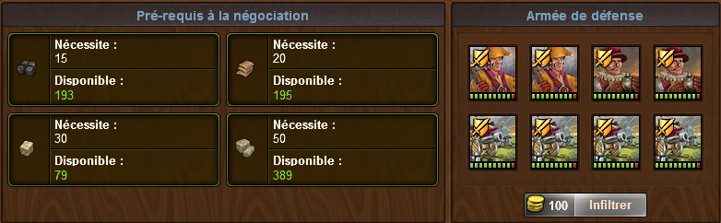
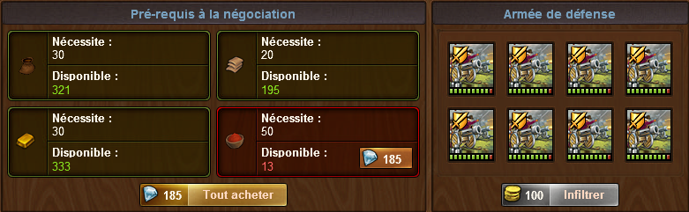
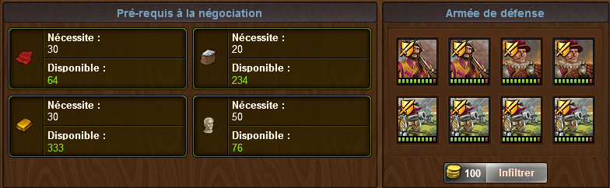
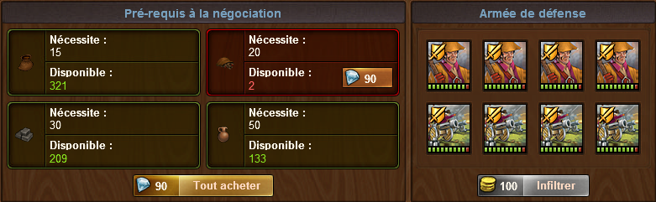
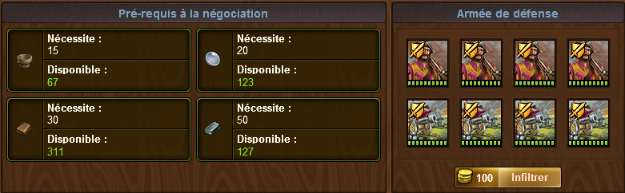
Grand Cap

Slide 10
Houndsmoor

Slide 11
Hymir

Slide 12
Lavignon

Slide 13
Lombardeaux

Slide 14
Mount Killmore

Slide 15
Narcien

Slide 16
Paruuch

Slide 17
Queenshope

Slide 18
Ruug

Slide 19
Spearth

Slide 20
Troulope

Slide 21
Tyr

Slide 22
Varseille

Slide 23
Velerites

Slide 24
Zaldon-on-sea

Slide 25
Ashcrook

Slide 26
Breturia

Slide 27
Centuria

Slide 28
Cragshire

Slide 29
Dunkerlwald

Slide 30
Eldenborough

Slide 31
Felssenke

Slide 32
Frathia

Slide 33
Greifental

Slide 34
Jaims

Slide 35
Kaltenweiher

Slide 36
Karchagu

Slide 37
Maktaba

Slide 38
Mons Suiry

Slide 39
Moravia

Slide 40
Northcastle

Slide 41
Pfefferberg

Slide 42
Pisterrac

Slide 43
Raven Creek

Slide 44
Strumhoden

Slide 45
Teusfelfurt

Slide 46
West-Nagach

Slide 47
Wolvhampthon

Slide 48
Haulenois

