Slide 1
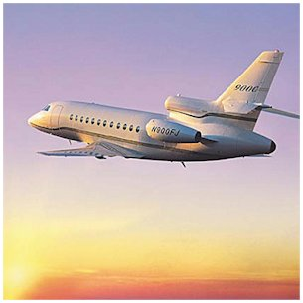
Travel in South America
We shall leave France in plane to south america where we shall arrive at the airport of Rio Of Jainero .
We shall leave from February 8th till February 12th.

Slide 2
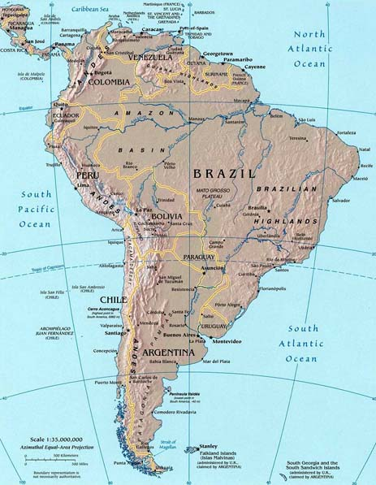

Slide 3
Brazil
This day; it’s the beginning of the carnival.
We shall go to sleep in the hotel :
“Porto Bay Rio Internacional Hotel “.
First morning we shall go to see the carnival in the street.
The afternoon, we shall go on foot on the hill of Corcovado
where is located “Christ the Redeemer”.

Slide 4
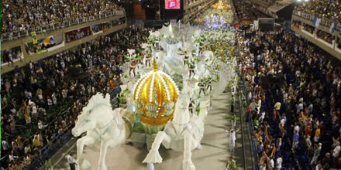
The Saturday , we go all day long participate in the Rio carnival, see in the street this show. We think that it will be amazing. In noon we shall eat in one restore with specialties Brazilian. The night, we shall go in Argentina in plane.

Slide 5
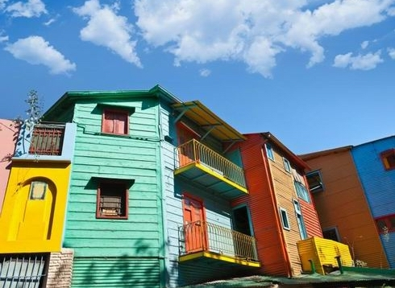
The Sunday , we shall arrive at the airport of Buenos Aires. In the morning we shall go to San Telmo, every Sunday morning there low there are antique dealers and orchestras of streets. In noon, we shall go to eat in the “Parque Tres de Febrero”. In the afternoon, we shall walk in the city to visit streets, places... In the night , we shall sleep in “Fierro Hotel Buenos Aires” .
Argentina

Slide 6
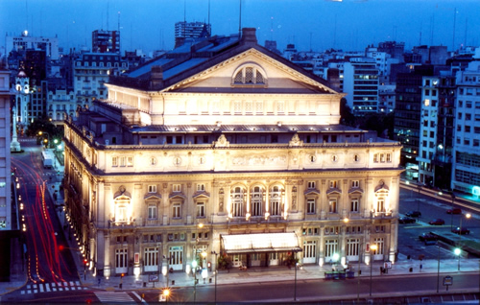
In the morning, we shall take a course of tango in a dancing school of Buenos Aires. In the afternoon, In the afternoon shall visit the Theater Colón. In the evening, we shall take off from Buenos Aires to go to Santiago to Chile.

Slide 7
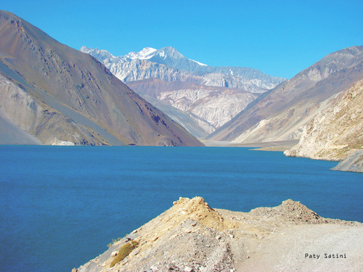
Chile
All day long we shall go to make a hike in horse with a guide on “Cajon Del Maipo”. In the night we shall sleep, in a camp which is on “Cajon Del Maipo”. In the morning, we shall return in Santiago and in the noon, we shall eat in “Mercado Central”. At 1:00 pm, we shall leave for Valparaiso who is on the coast; we have for 2 hours 26 of car. We shall visit the city and the port we shall sleep in the hotel Acontraluz and the next day at 10 am our plane will wait for us to return to France.
Zainab and Lise

