Slide 1
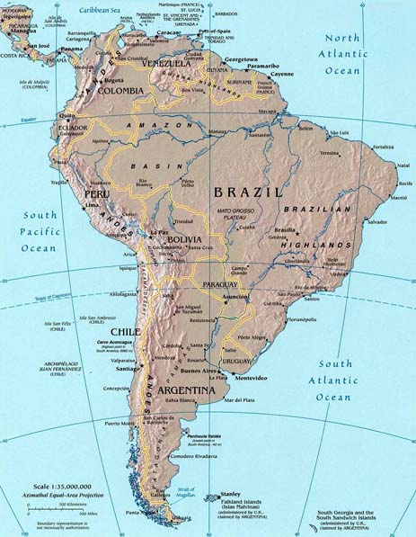
Travel in South America
Lise and Zainab

Slide 2
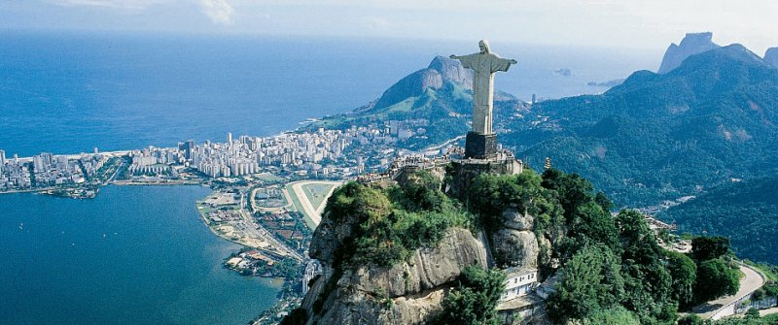

Brazil
We leave France in plane to Brazil where we arrive
at the airport of Rio Of Jainero .

