Slide 1
Squirrel sports
A new vision of sport!

Slide 2
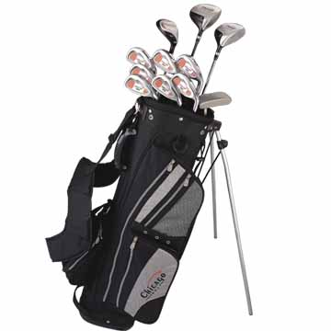
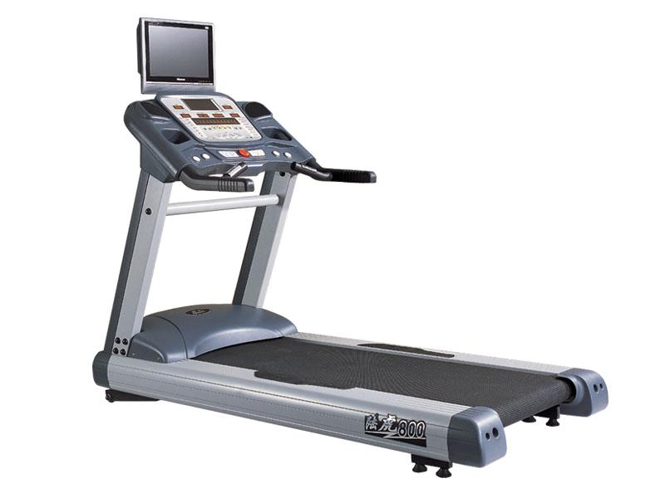
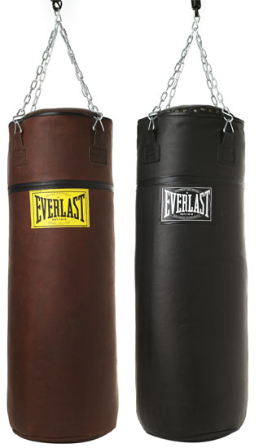
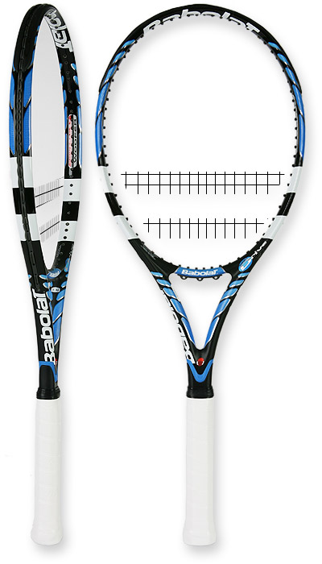
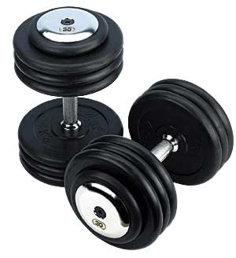
Nature and objectives of the business:
We sell
Golf clubs
Treadmills
Dumbbells
Punching bags
tennis racquets

Slide 3
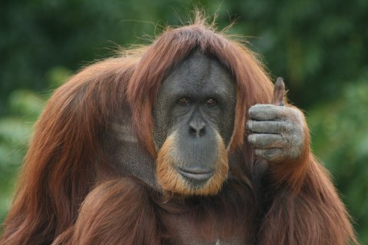
What make us so different?
We care a lot about animal cause, so we decided
TO WORK WITH THEM

Slide 4
All our products are tested and certified by professional squirrels

Slide 5
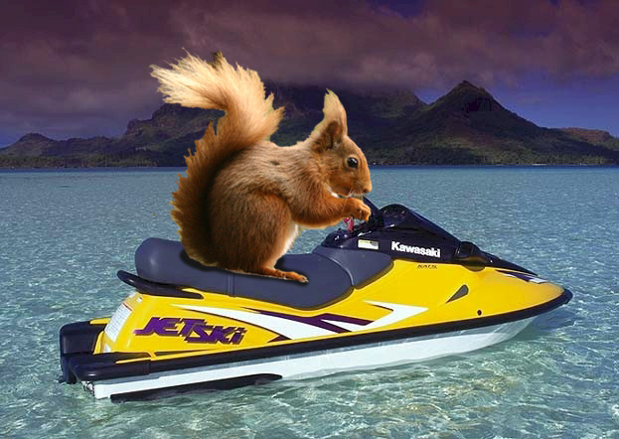
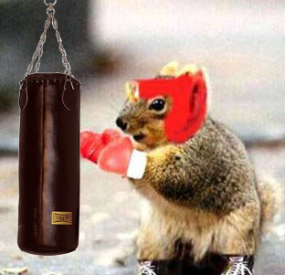
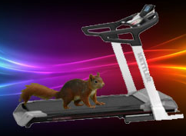
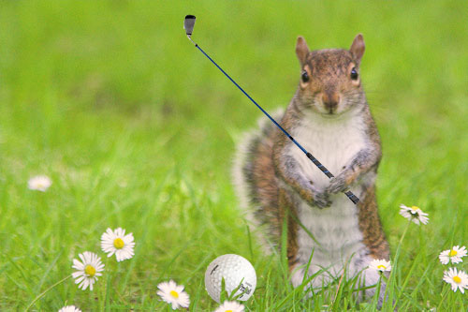

Slide 6
COMPANY ORGANIZATION

Slide 7
Direction
Chuck Norris
Communication
Té Oh ti zhié
Commercial
Jessica Salvadoria Dalia
Research and development
Ferdinand von Zillerguilht
Joy Division
MArgaRINE Thatcher

Slide 8
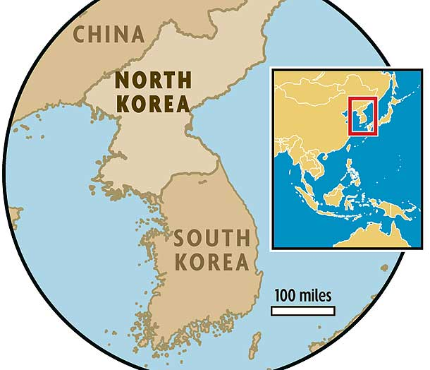
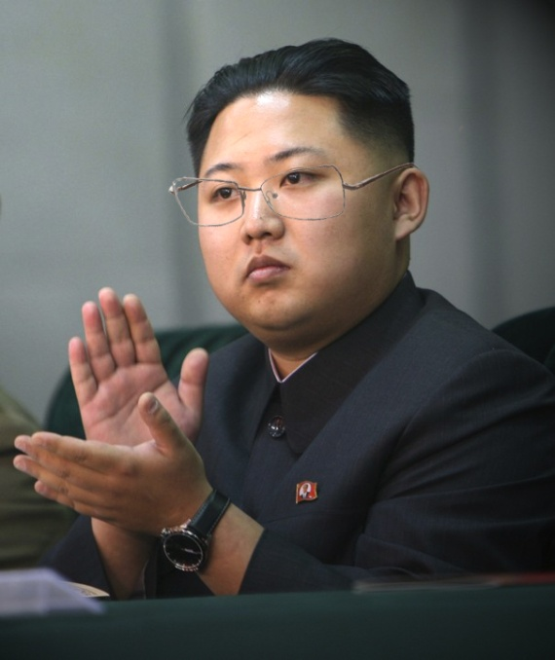
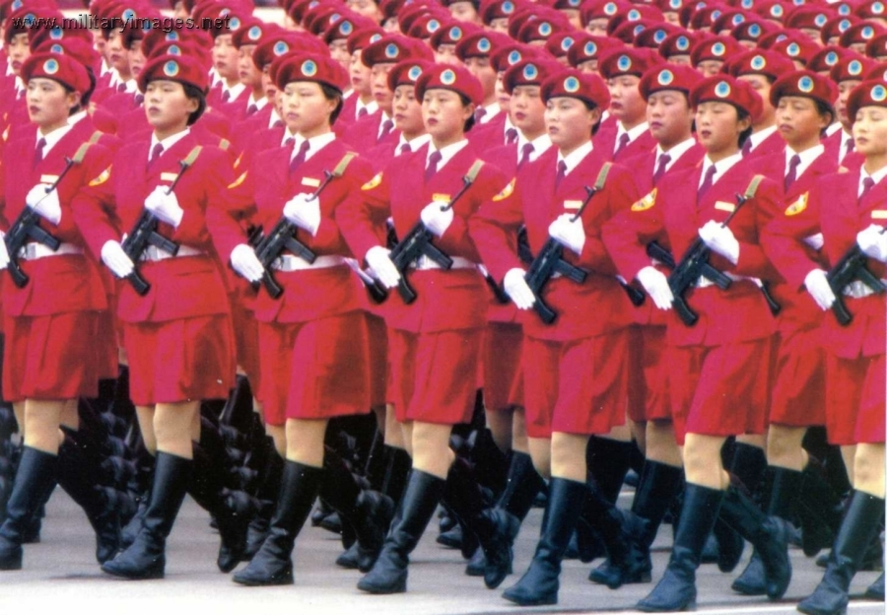
Communication
Té Oh ti zhié
Headquarters
Pyongyang, North Korea
Staff
200 angry girls

Slide 9
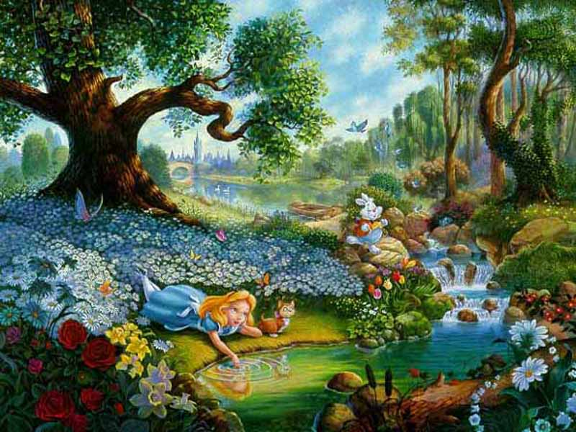
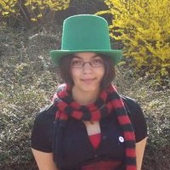
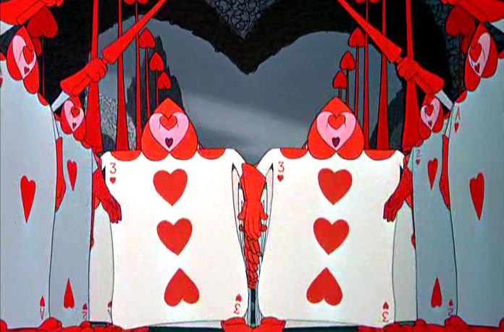
Commercial
Jessica Salvadoria Dalia
Headquarters
Wonderland
Staff
300 cards

Slide 10
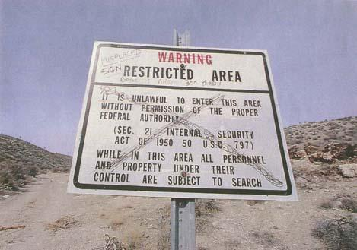
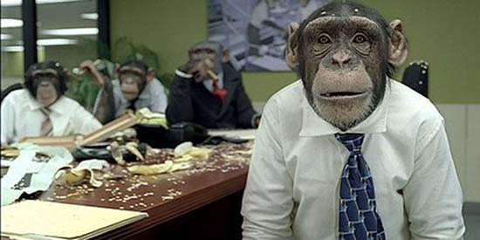
Research and development
Ferdinand von Zillerguilht
Headquarters
Nevada Desert – zone 51
Staff
9000 performing monkeys

Slide 11
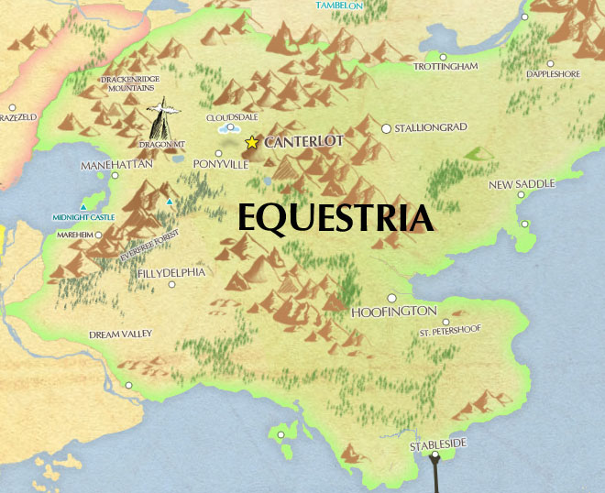
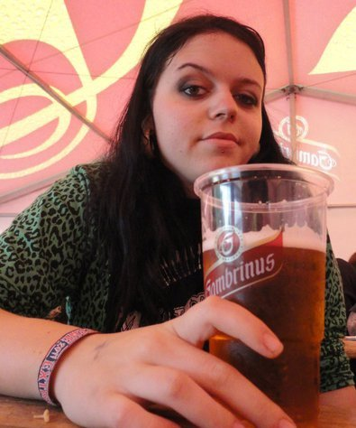
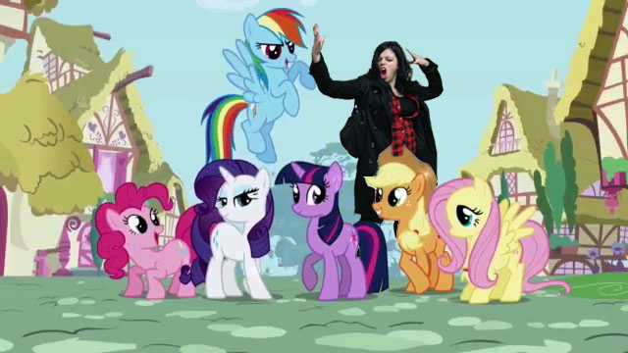
Joy Division
MArgaRINE Thatcher
Headquarters
Little Pony Land
Staff
666 cute ponies

Slide 12
marketing

Slide 13
Why can we meet market demand?
Low prices
Smile and joy division
Products certified and tested by animals
Products are waterproof.

Slide 14
TARGETS
from 7 to 77 years
&
pets

Slide 15
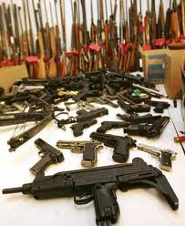
Major competitors

Slide 16
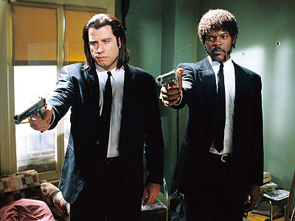
Sales Strategy
Door-to-door selling

Slide 17
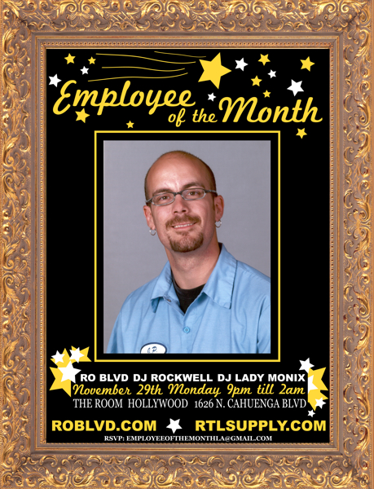
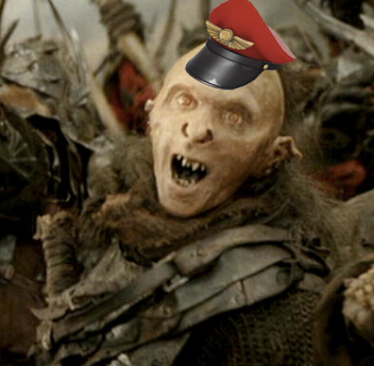
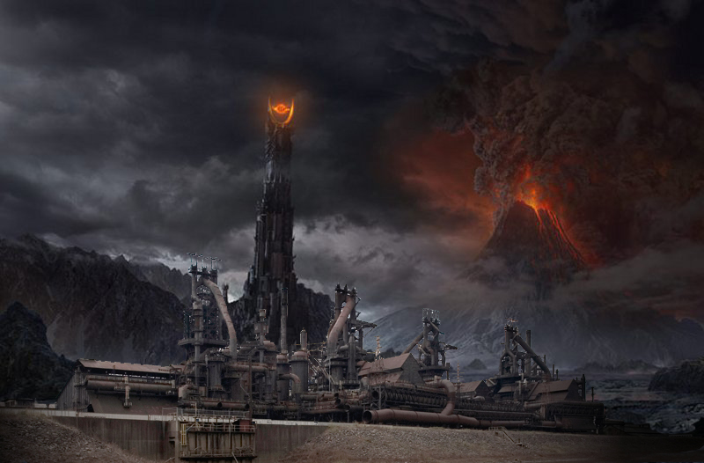
LOCATION
Our plants are based in the Mordor.

Slide 18
FINANCIAL PROFILE

Slide 19
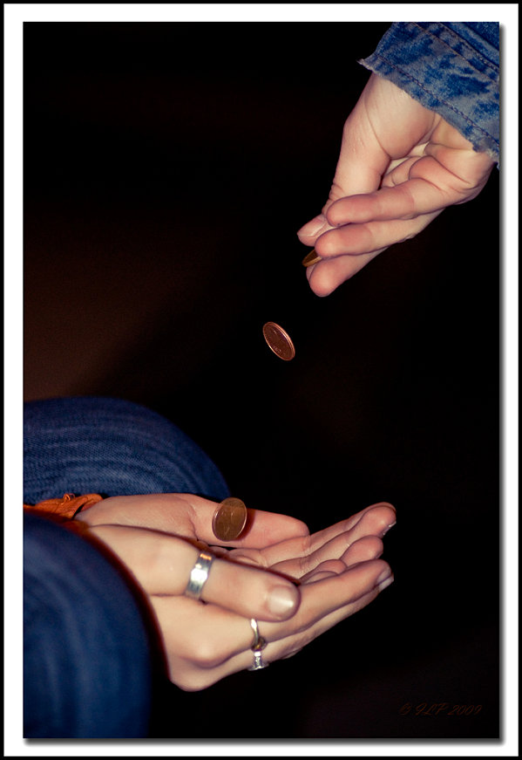
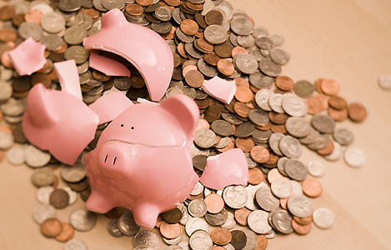
CAPITAL
We need approximately a capital of $15 000
We already own $315
and 65 cts.

Slide 20
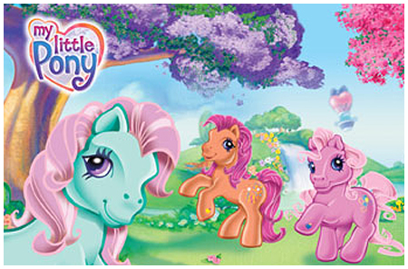
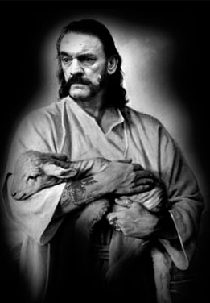
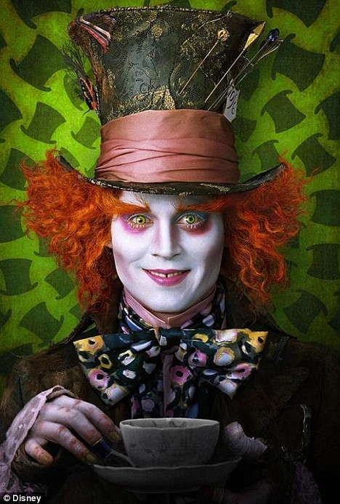
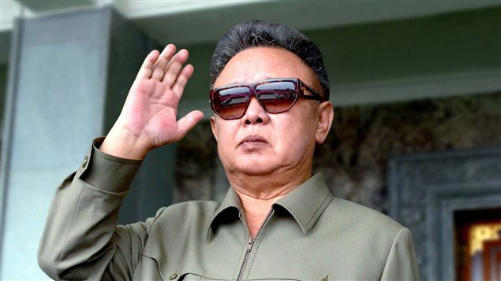
People who supports us
We have the financial support and the love of:
The little ponies,
Kim Jong-Il’s ghost,
Mad Hatter,
Lemmy Kilmister from Motörhead.

Slide 21
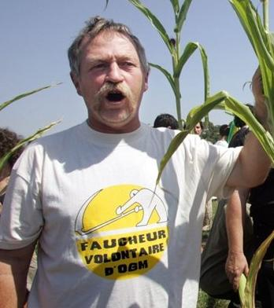
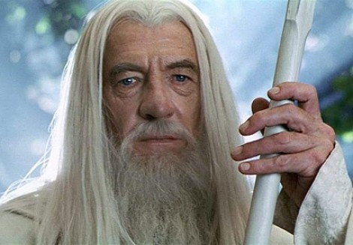
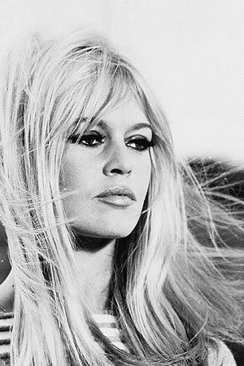
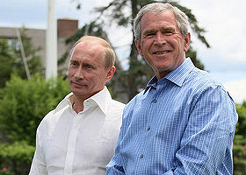
Our shareholders:

