Slide 1


Rôle des dysfonctions mitochondriales et lysosomales dans la maladie de Parkinson
Jean-Christophe (Chris) Rochet
UER Neurohistologie-Neuropathologie
Department of Medicinal Chemistry and Molecular Pharmacology
Purdue University

Slide 2
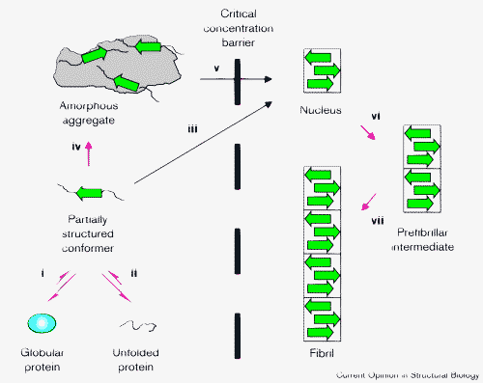
Protein misfolding leads to aggregation and amyloid fibril formation.
Rochet, J.-C. and Lansbury, P.T., Curr. Op. Struct. Biol. 2000

Slide 3
Various neurodegenerative diseases involve protein misfolding and aggregation.
        Disease Aggregated protein
        Alzheimer’s disease (AD) Amyloid-β peptide (Aβ), tau
        Parkinson’s disease (PD) α-synuclein
        Dementia with Lewy bodies (DLB) α-synuclein
        Multiple system atrophy (MSA) α-synuclein
        Huntington’s disease (HD) huntingtin
  Spinocerebellar Ataxia (SCA1) ataxin-1
        Amyotrophic lateral sclerosis (ALS) superoxide dismutase 1 (SOD1)
        Spongiform diseases (CJD, BSE) prion protein
        Frontotemporal dementia (FTD) tau

Slide 4



Parkinson’s disease (PD)
        ~5, 000,000 people affected worldwide

Slide 5
Symptoms of PD
        resting tremor (primarily on one side of body)
        rigidity (muscle stiffness)
        (3) bradykinesia (slow movement)
        (4) impaired balance, coordination
        (5) mask-like appearance
        (6) speech difficulties, cognitive deficits
http://www.pdf.org/AboutPD/symptoms.cfm

Slide 6
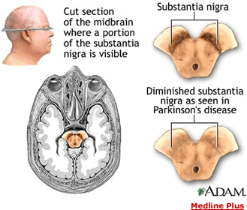
PD is characterized by a loss of dopaminergic neurons and the formation of Lewy bodies.
Surviving
neurons
often contain
Lewy body
inclusions
http://www.hcnr.med.harvard.edu/visitorInfo/parkinsons_f.php

Slide 7
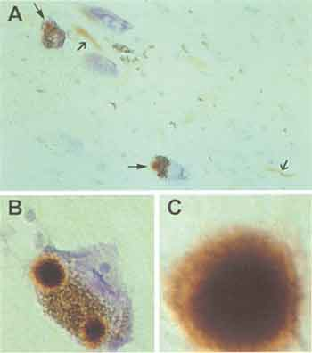
Surviving neurons in the brains of PD patients have dense, spherical protein deposits called Lewy bodies.
http://www.sfn.org/skins/main/images/brainbriefings/august2001_big.jpg

Slide 8
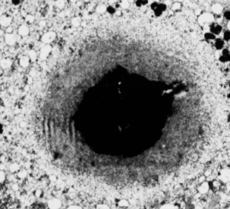
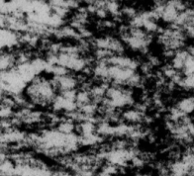
2nd clue: Lewy bodies in the brains of Parkinson’s patients consist primarily of fibrillar α-synuclein.
Fibrillar α-synuclein
Mutant forms of α-synuclein (A30P, E46K, A53T, triplication)
cause familial PD.
Exposure of rats to rotenone (a mitochondrial complex I inhibitor)
reproduces key features of PD, including α-synuclein aggregation.

Slide 9
Evidence suggests a role for α-synuclein in PD.
Lewy bodies characteristic of the PD brain consist primarily of fibrillar α-synuclein.
Mutations in the α-synuclein gene (triplication, duplication; missense mutations encoding A30P, E46K, A53T) have been linked to rare, hereditary forms of PD.
The expression of human α-synuclein in transgenic mice or flies produces a Parkinsonian phenotype.

Slide 10
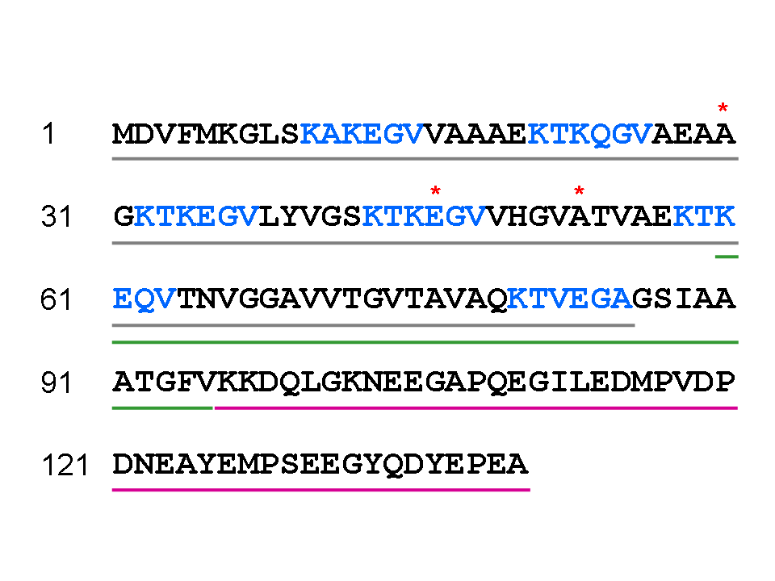
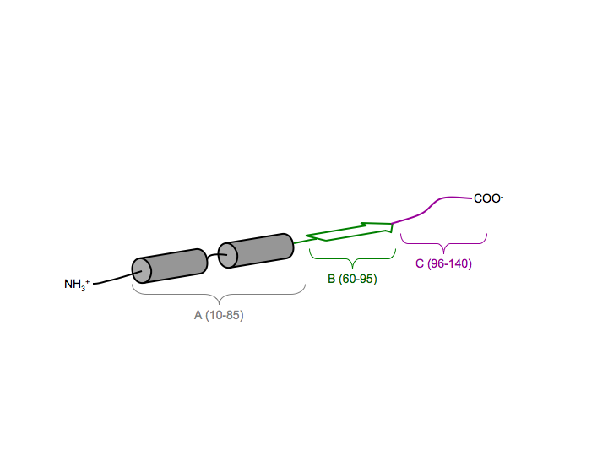
α-Synuclein is a natively unfolded protein that adopts different types of secondary structure.
lipid binding repeat
*WT and mutant α-synuclein form β-sheet-rich fibrils in vitro, similar to fibrils isolated from Lewy bodies.

Slide 11
Role of α-synuclein self-assembly
in PD pathogenesis
Are amyloid-like fibrils or protofibrils
the toxic species?

Slide 12
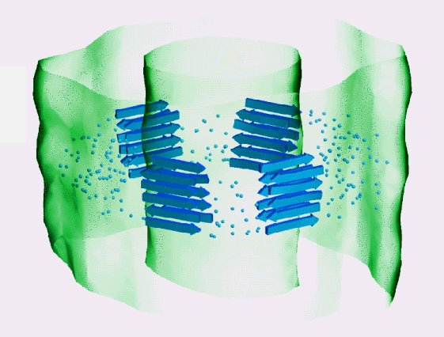
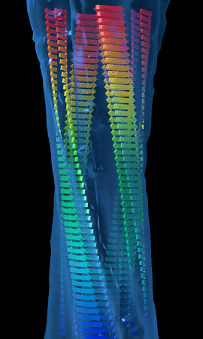
Amyloid fibrils consist of interwound
protofilaments, each of which has a cross-beta
structure (in this example: SH3 domain fibril).
Jimenez et al., EMBO J. 1999.

Slide 13
Each monomeric subunit adopts a
strand-loop-strand motif in fibrillar Aβ1-40.
Petkova, A.T. et al., Biochemistry 2006.

Slide 14
Each Aβ1-40 protofilament consists of four
extended, parallel β-sheet layers.
Petkova, A.T. et al., Biochemistry 2006.

Slide 15
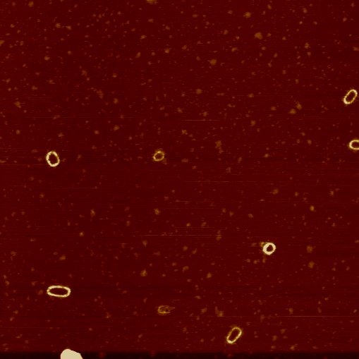
Oligomeric spheres can anneal to form
elongated or ‘annular’ protofibrils.
A53T, A30P > WT
A53T > WT > A30P
permeabilize membranes
stabilized by DA
elongated
protofibril
fibril
sphere
annular
protofibril
2 μm square

Slide 16
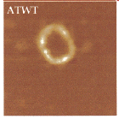
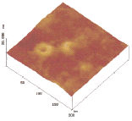
α-Synuclein ring-like protofibrils bind and
permeabilize phospholipid membranes.
Ding T. et al., Biochemistry 2002.

Slide 17
The ‘toxic protofibril’ model
?
Disease
?
?
Lewy body
Increasing stability

Slide 18
Histone deacetylase (HDAC) inhibitors promote the formation of large α-synuclein aggregates.
Bodner R.A. et al., PNAS 2006.

Slide 19
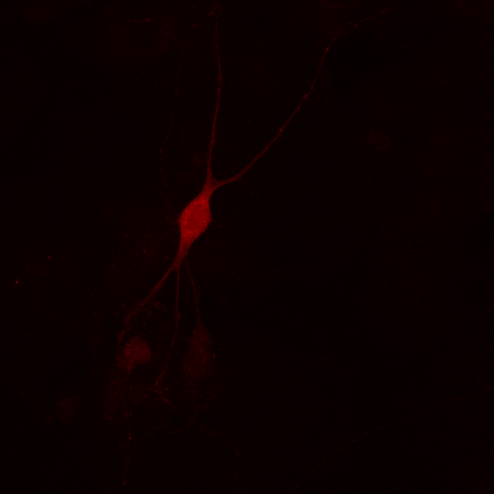
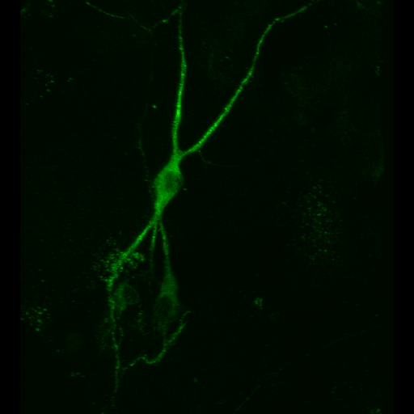
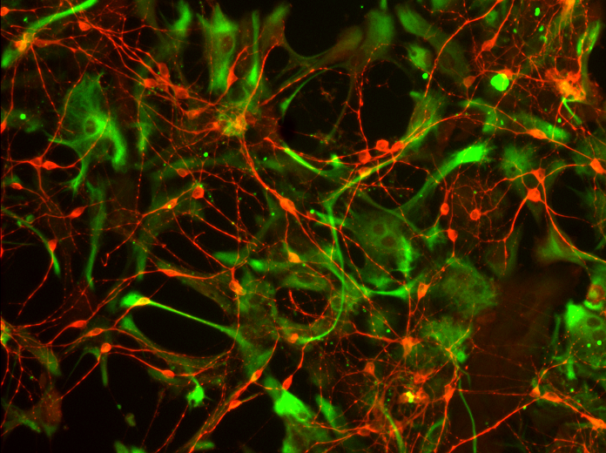
We use a primary cell-culture model to investigate the neurotoxicity of α-synuclein variants.
TH
MAP2
MAP2 + GFAP
Test whether PD-related stresses are selectively toxic to primary
dopaminergic neurons in mixed midbrain cultures …
Liu et al., J Neurochem 2008
Liu et al., FRBM 2008

Slide 20
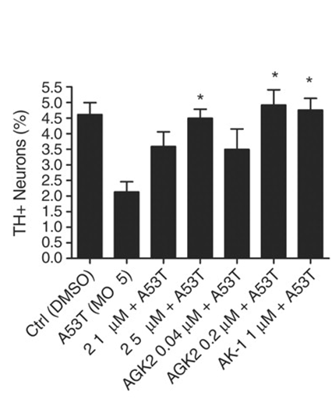
HDAC inhibitors protect dopaminergic cells from toxicity elicited by mutant α-synuclein.
Outeiro, T.F.,
Science 2007.

Slide 21
Role of mitochondrial dysfunction
in PD pathogenesis

Slide 22
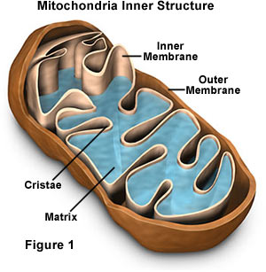
One clue: environmental poisons that harm mitochondria can cause PD.
Examples:
Pesticides (e.g. rotenone)
Herbicides (e.g. paraquat)
Metals (e.g. manganese)
MPTP (a heroin contaminant)

Slide 23
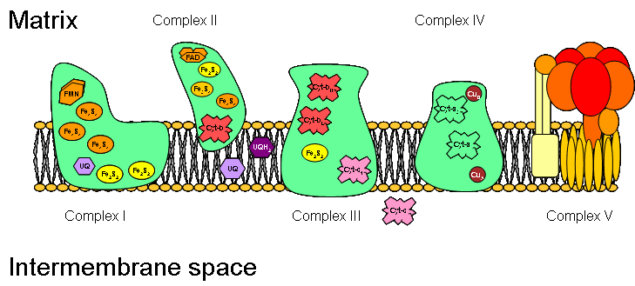
Rotenone inhibits mitochondrial complex I.
rotenone
http://images.google.com/imgres?imgurl=http://www.steve.gb.com/images/science/mitochondrial_electron_transport_chain.png&imgrefurl=http://www.steve.gb.com/science/oxidative_phosphorylation.html&h=329&w=729&sz=26&hl=en&start=6&tbnid=zGOQgvMUiDQkwM:&tbnh=64&tbnw=141&prev=/images%3Fq%3Dmitochondrial%2Bcomplex%2BI%26gbv%3D2%26svnum%3D10%26hl%3Den%26sa%3DG

Slide 24
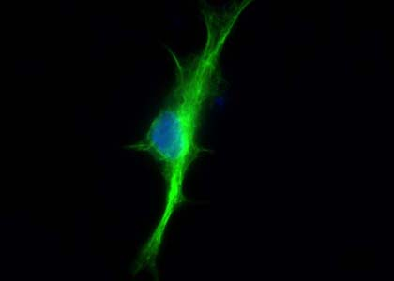
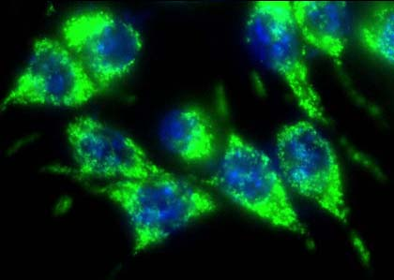
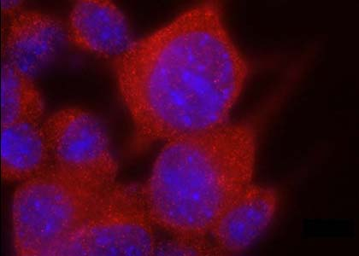
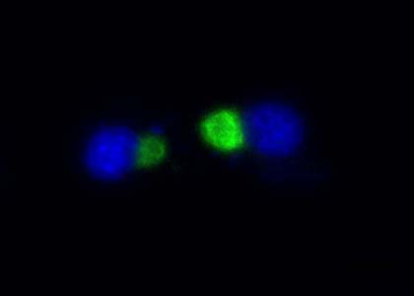
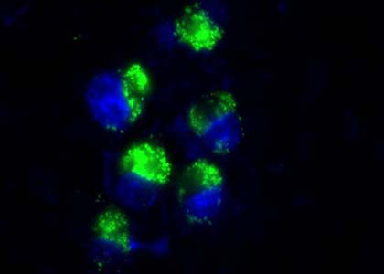
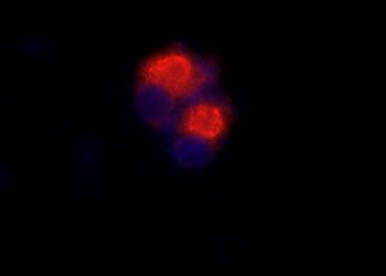
Rotenone induces protein inclusion formation in a neuronal cell line.
vimentin
(cytoskeletal protein)
Hsp70
(chaperone)
ubiquitin
(destruction ‘tag’)
- rotenone
+ rotenone

Slide 25
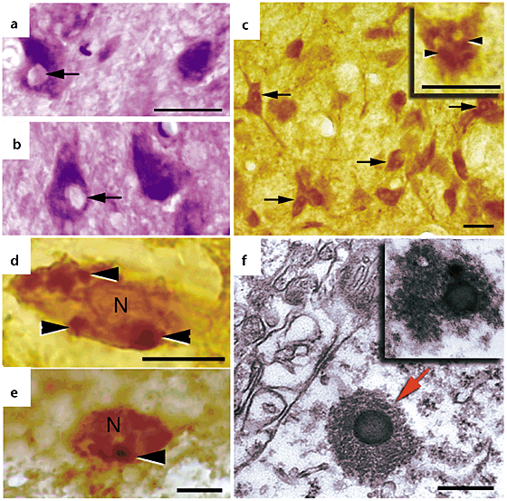
Exposure of rats to rotenone leads to a buildup of Lewy-like inclusions.
Betarbet R. et al., Nat. Neurosci. 2000

Slide 26
α-Synuclein aggregation is modulated by
oxidative modifications.
elongated
protofibril
fibril
sphere
oxidative stress,
post-translational
modifications
annular
protofibril

Slide 27
We developed an affinity method to isolate
(His)6-α-synuclein from a stably transfected
catecholaminergic cell line (PC12).
L
FT
W
E
L = initial lysate
FT = flow-through
W = wash
E = eluate

Slide 28
Rotenone treatment induces various C-terminal aSyn modifications.
116
125
127
129
133
136
MPVDPDNEAYEMPSEEGYQDY
M116, M127 sulfoxide:
- inhibit fibrillization; inhibitory effect rescued by metals
Y125, Y133, Y136 nitration:
- promote oligomerization
Y125, Y133, Y136 phosphorylation:
- inhibit fibrillization, may promote oligomerization?
S129 phosphorylation:
- promotes oligomerization or fibrillization?

Slide 29
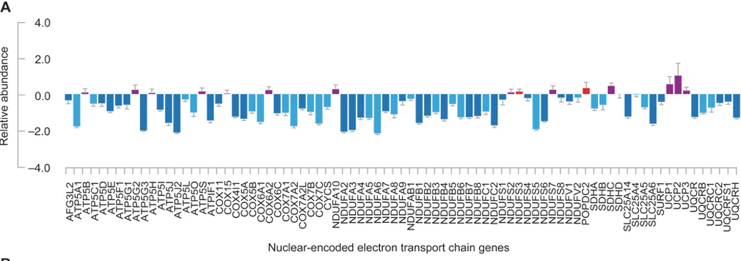
Nuclear genes encoding proteins of the electron transport chain are downregulated in PD dopaminergic neurons.
Zheng B. et al., Sci Transl Med 2010

Slide 30
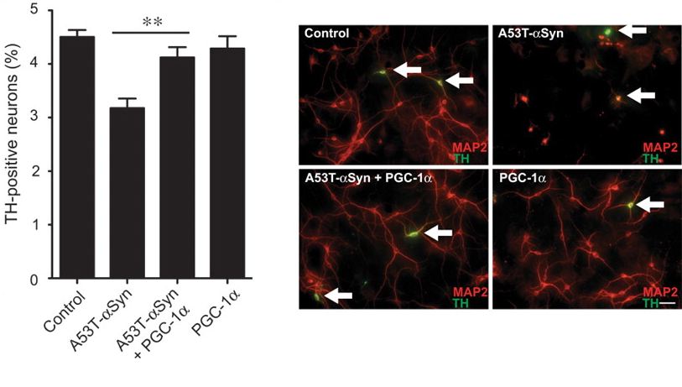
Over-expression of PGC1α, a regulator of genes encoding mitochondrial proteins, suppresses aSyn neurotoxicity.
Zheng B. et al., Sci Transl Med 2010

Slide 31
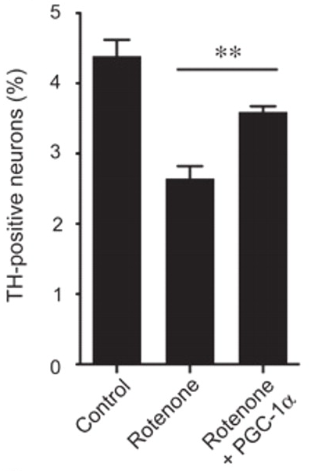
Over-expression of PGC1α suppresses rotenone neurotoxicity.
Zheng B. et al., Sci Transl Med 2010

Slide 32
Gene products involved in familial PD
Effects on
mitochondrial
function

Slide 33
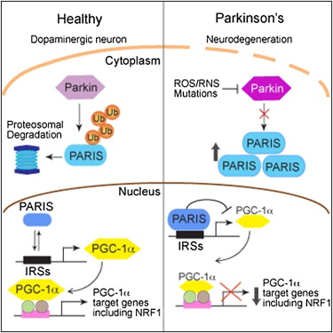
Parkin cleaves PARIS, a protein that down-regulates PGC1α.
Shin J.-H. et al., Cell 2011

Slide 34
Model showing neurotoxic/neuroprotective pathways
cytosol
mitochondria
nucleus
+
PGC1α
+
-
ROS
mitochondrial genes
-
DJ-1
proteasome
lysosome
DA
ROS
+
degraded
protein
autophagy
+
*
*
cell death
-
-
unmodified aSyn
oxidized
aSyn
aSyn aggregates
MsrA
molecular chaperones
(e.g. DJ-1)
Notes:
1

Slide 35
Role of autophagy in PD pathogenesis

Slide 36
Cellular responses to protein aggregation
Rochet, J.-C.,
2007

Slide 37
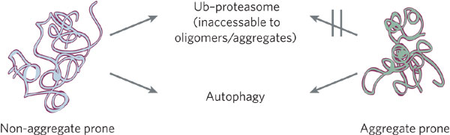
Macroautophagy is involved in clearing protein substrates (oligomers, aggregates) that are resistant to degradation by the ubiquitin-proteasome pathway.
Rubinsztein, D. C., Nature 2006

Slide 38
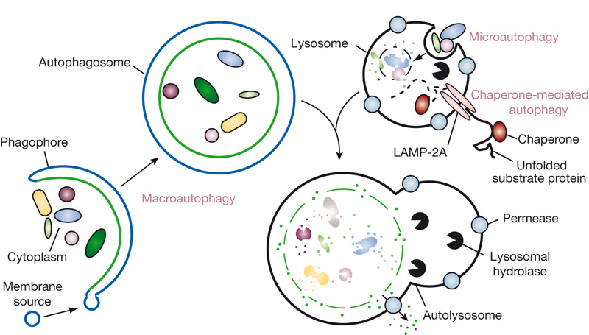
Macroautophagy involves the formation of autophagosomes, which then fuse with lysosomes.
Mizushima, N. et al., Nature 2008

Slide 39
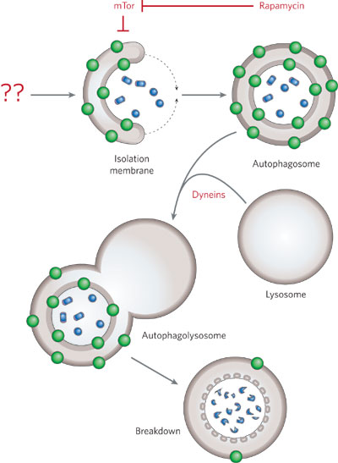
Macroautophagy is up-regulated by rapamycin; the protein LC3 is a marker of autophgosomes.
Rubinsztein, D. C., Nature 2006

Slide 40
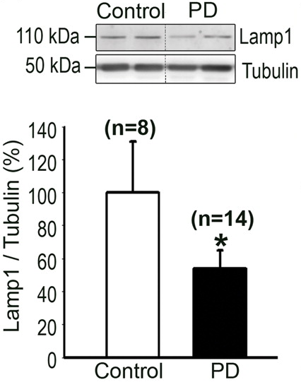
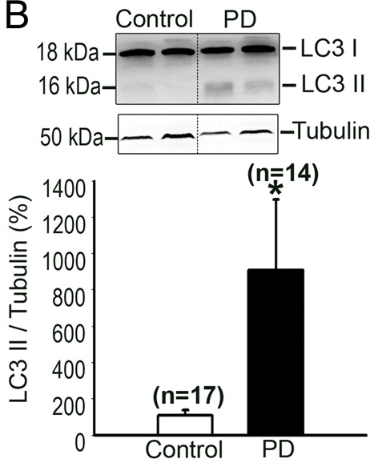
Lysosomes (Lamp 1) and autophagosomes
(LC3 II) are depleted and up-regulated (respectively) in PD brain.
Dehay, B. et al., J Neurosci 2010

Slide 41
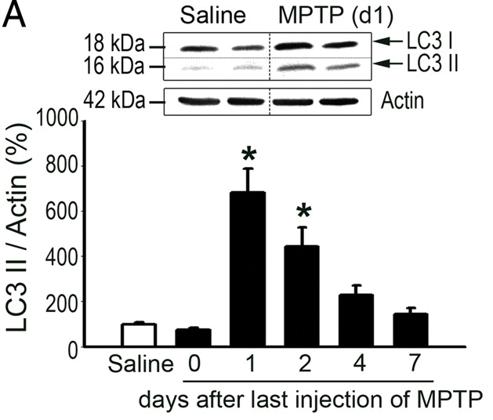
Autophagosomes (LC3 II) are up-regulated in the brains of mice treated with MPTP, a PD-related toxin.
Dehay, B. et al., J Neurosci 2010

Slide 42
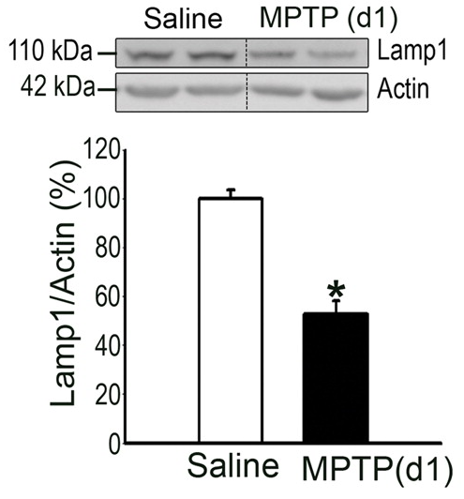
Lysosomes (Lamp1) are depleted in the brains of MPTP-treated mice.
Dehay, B. et al., J Neurosci 2010

Slide 43
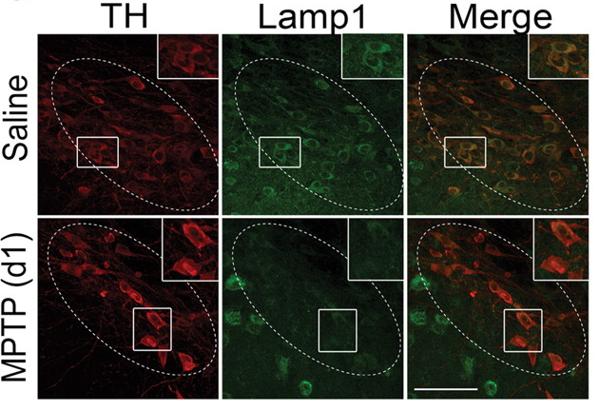
Lysosomes (Lamp1) are depleted in the brains of MPTP-treated mice.
Dehay, B. et al., J Neurosci 2010

Slide 44
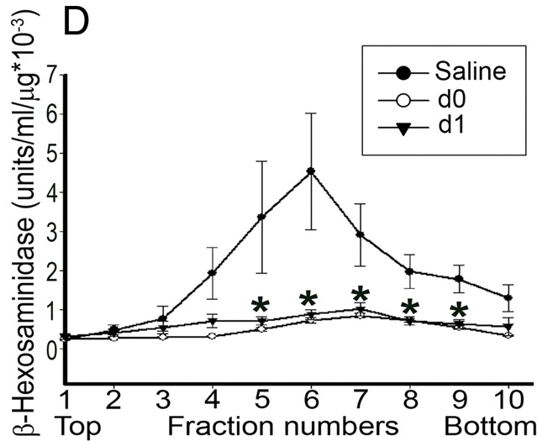
Lysosomes are depleted in the brains of MPTP-treated mice.
Dehay, B. et al., J Neurosci 2010

Slide 45
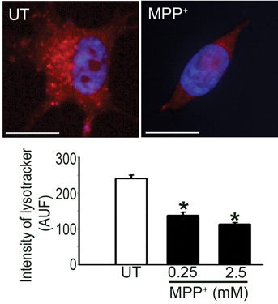
Lysosomes (lysotracker) are depleted in neuronal cells exposed to the PD-related toxin, MPP⁺.
Dehay, B. et al., J Neurosci 2010

Slide 46
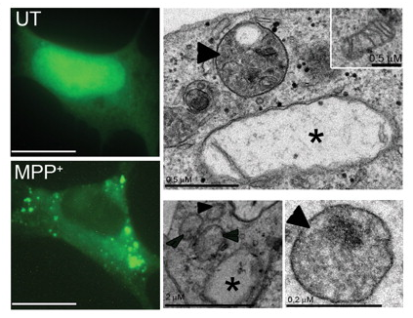
Autophagosomes (LC3 II) are up-regulated, and mitochondria are defective, in neuronal cells exposed to MPP⁺.
Dehay, B. et al., J Neurosci 2010

Slide 47
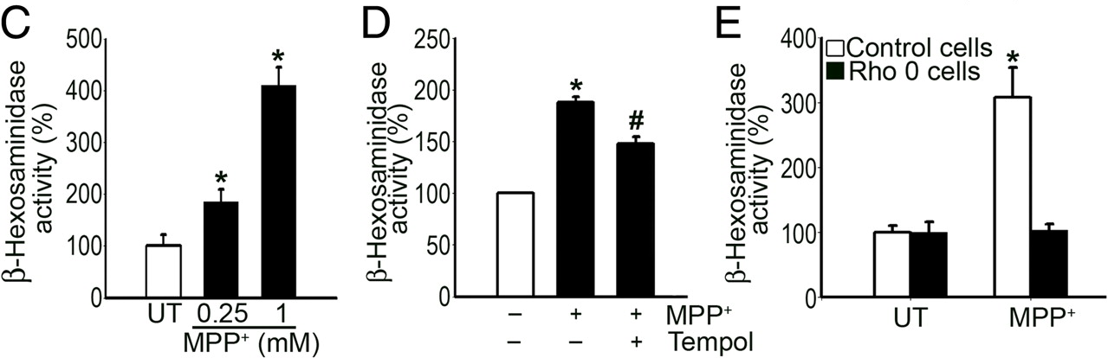
Lysosomal membrane leakage in neuronal cells exposed to MPP⁺ is a consequence of mitochondrial dysfunction and oxidative stress.
Dehay, B. et al., J Neurosci 2010

Slide 48
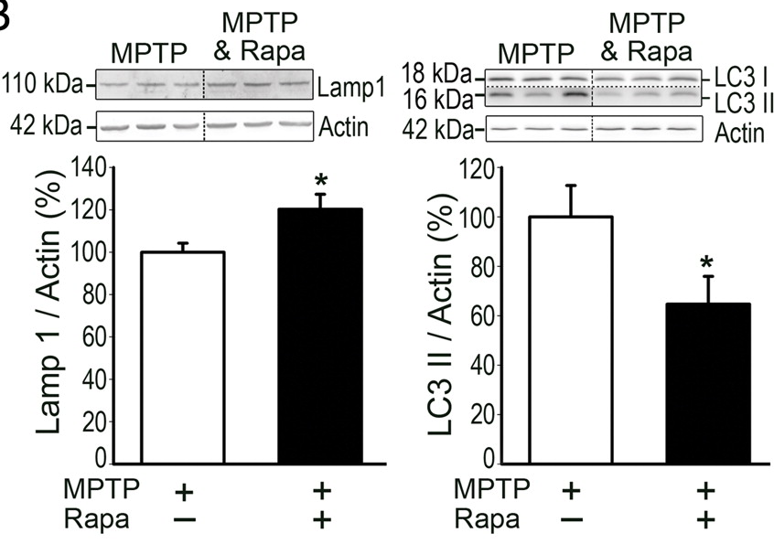
Rapamycin induces up-regulation of lysosomes (Lamp 1) and depletion of autophagosomes
(LC3 II) in the brains of MPTP-treated mice.
Dehay, B. et al., J Neurosci 2010

Slide 49
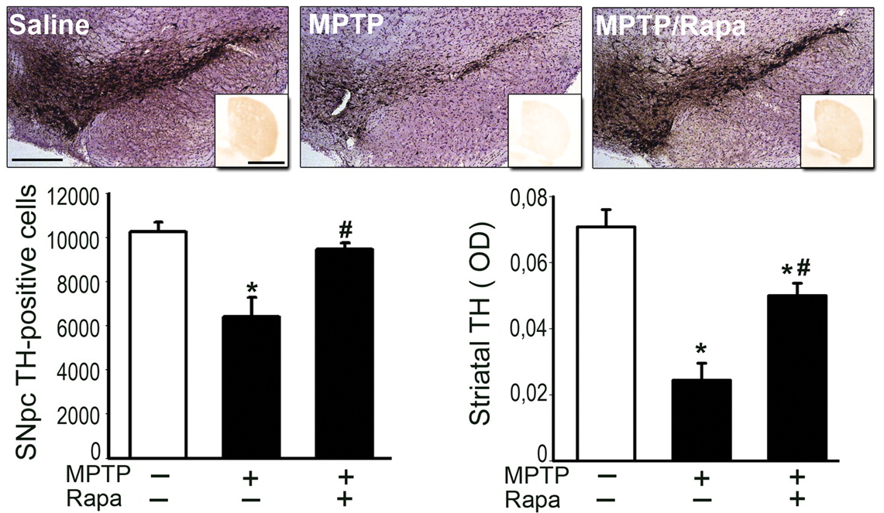
Rapamycin alleviates neurodegeneration in the brains of MPTP-treated mice.
Dehay, B. et al., J Neurosci 2010

Slide 50
Role of mitophagy in PD pathogenesis
Importance of the PINK1/parkin pathway

Slide 51
Gene products involved in familial PD
Effects on
mitochondrial
function

Slide 52
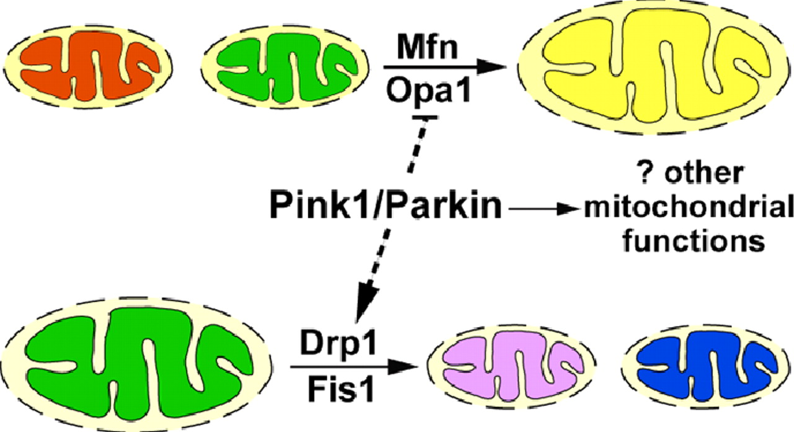
Pink1 and Parkin are involved in regulating the balance between mitochondrial fission and fusion.
Deng, H. et al., PNAS 2008

Slide 53
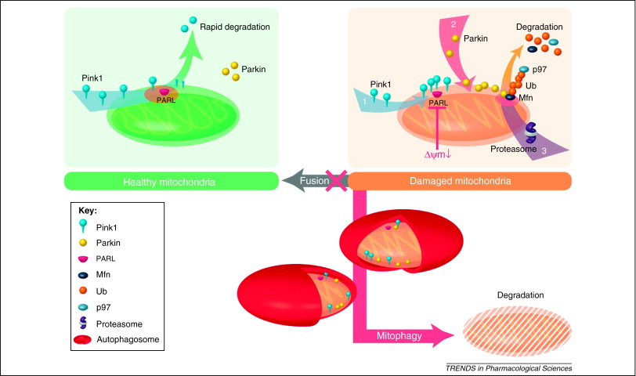
Pink1 and Parkin promote the removal of damaged mitochondria via mitophagy.
Kawajiri, S. et al., Trends Pharmacol Sci 2011

Slide 54
Neuroprotective effect of the mitochondrial protein DJ-1 in PD

Slide 55
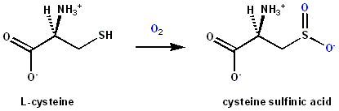
DJ-1 may be an important neuroprotective factor in the substantia nigra.
Mutations in the gene encoding DJ-1 have been linked to rare, hereditary forms of PD (14 kb deletion; homozygous missense mutations: M26I, E64D, E163K, L166P).
DJ-1 undergoes oxidation at cysteine 106 to the sulfinic acid.
DJ-1 adopts a homodimeric structure essential for its function.
*Sulfinic acid: -CH2-SO2H
*Sulfonic acid: -CH2-SO3H

Slide 56
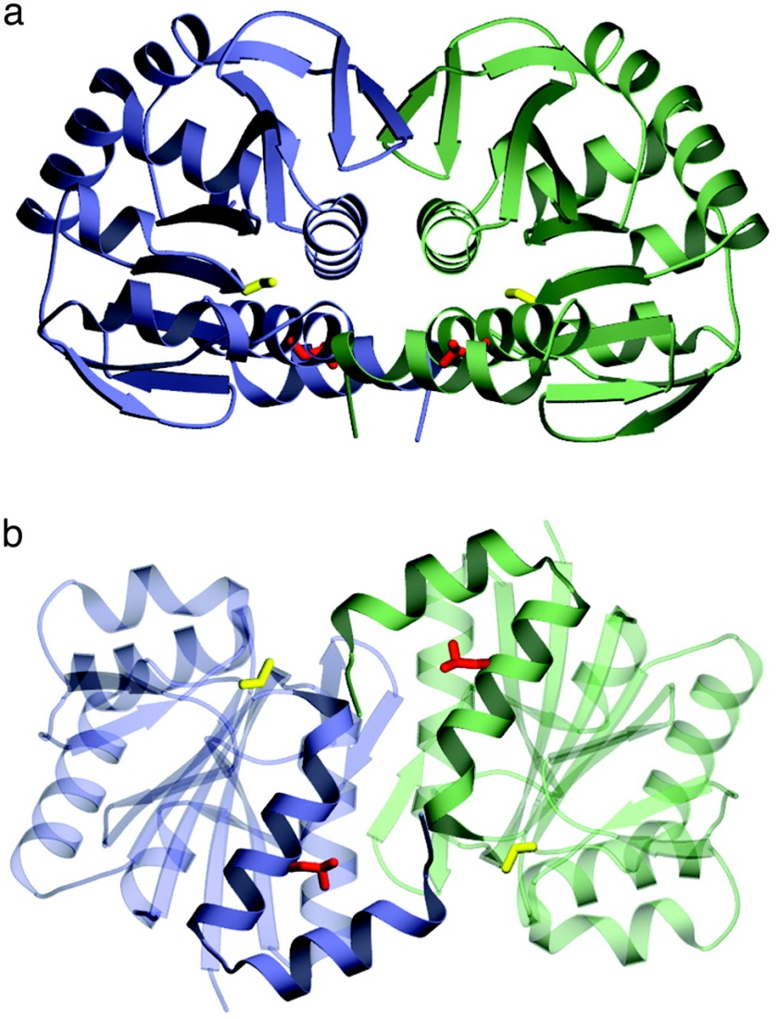
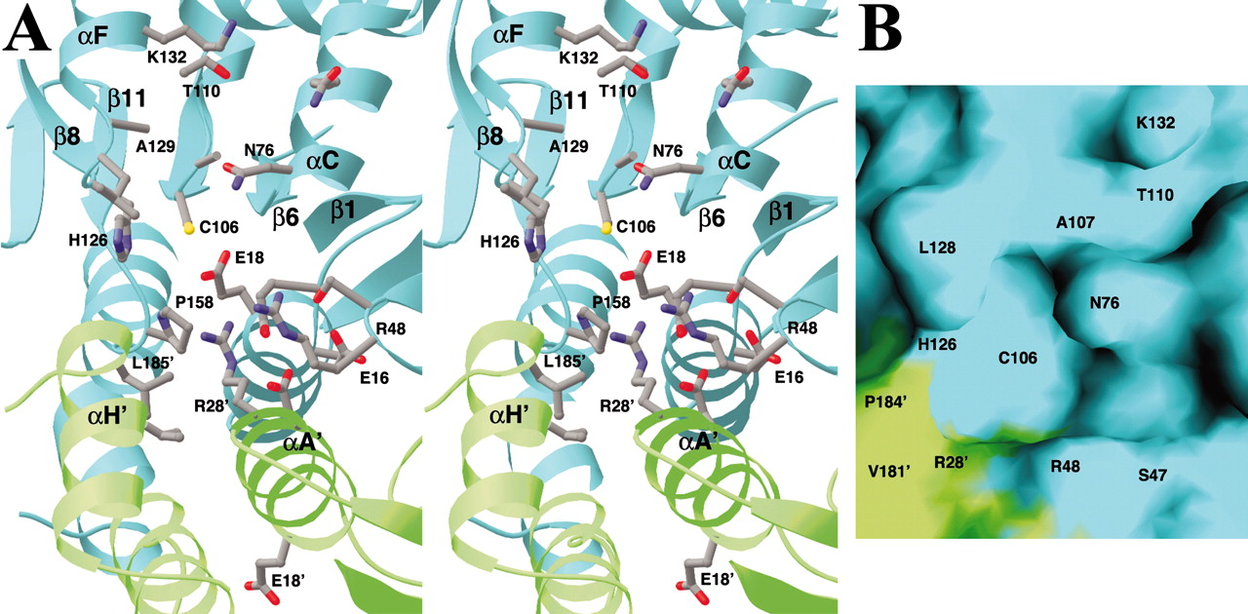
The crystal structure of DJ-1 indicates why a dimeric structure is essential.
Tao and Tong, 2003
Wilson, M. et al., 2003

Slide 57
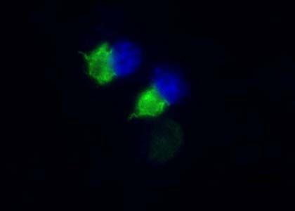
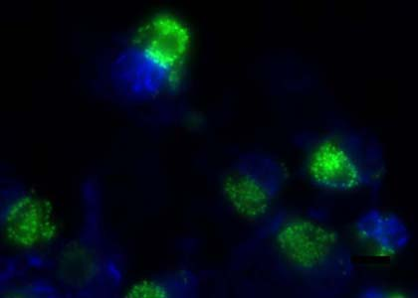




DJ-1 suppresses inclusion formation in cells treated with rotenone.
vimentin
Hsp70
ubiquitin
control
+ DJ-1
* All cells were treated rotenone.

Slide 58
Model showing neurotoxic/neuroprotective pathways
cytosol
mitochondria
nucleus
+
PGC1α
+
-
ROS
mitochondrial genes
-
DJ-1
proteasome
lysosome
DA
ROS
+
degraded
protein
autophagy
+
*
*
cell death
-
-
unmodified aSyn
oxidized
aSyn
aSyn aggregates
MsrA
molecular chaperones
(e.g. DJ-1)
Notes:
1

Slide 59
Conclusions
α-Synuclein aggregation is a characteristic feature of PD.
(2) α-Synuclein aggregation involves the formation of potentially toxic intermediates (oligomers and protofibrils).
α-Synuclein self-assembly is promoted by oxidative stress, a consequence of mitochondrial dysfunction.
Autophagy plays an important role in eliminating misfolded or aggregated α-synuclein .
Mitochondrial dysfunction and oxidative stress elicit lysosomal depletion, and thus reduced autophagy, in PD.
A decrease in mitophagy results in a build-up of defective mitochondria in PD.

Slide 60
Extras

Slide 61


Slide 62



Slide 63


