Slide 1
Welcome
Notes:
ljlkjl

Slide 2
Hotel

Slide 3
BathRoom
Kitchen
LivingRoom
BedRoom
.
Accomodation

Slide 4
BathRoom
Kitchen
LivingRoom
BedRoom
.
Accomodations

Slide 5
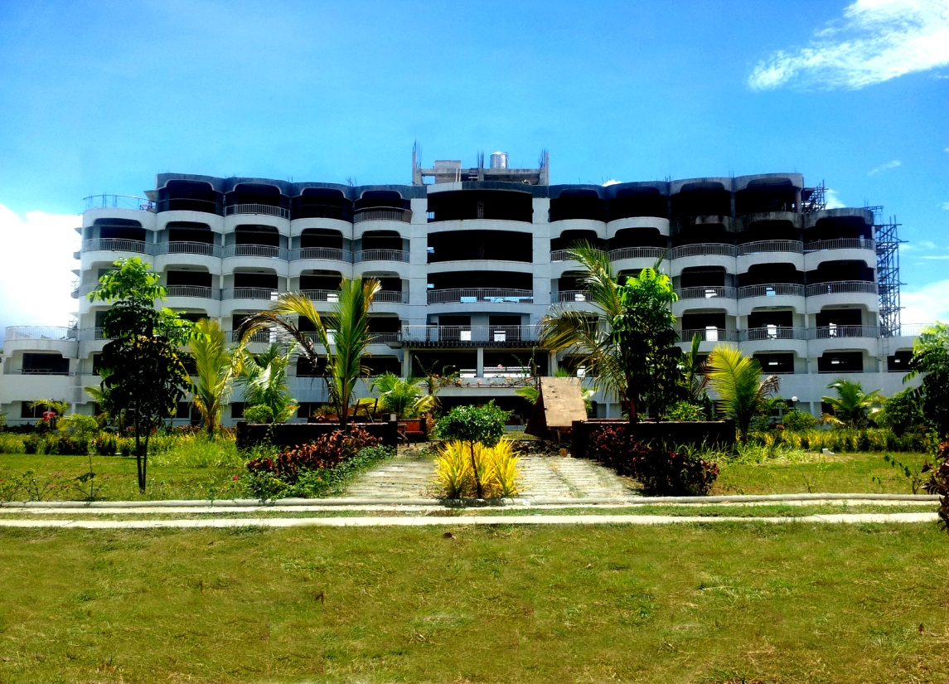
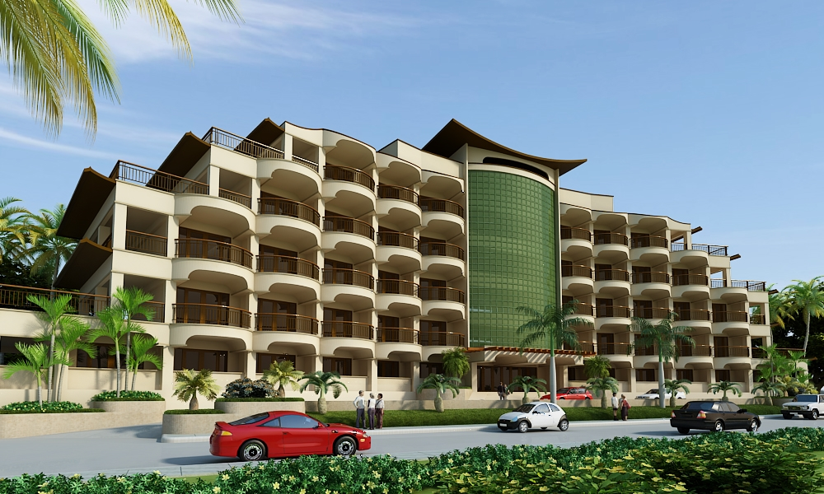
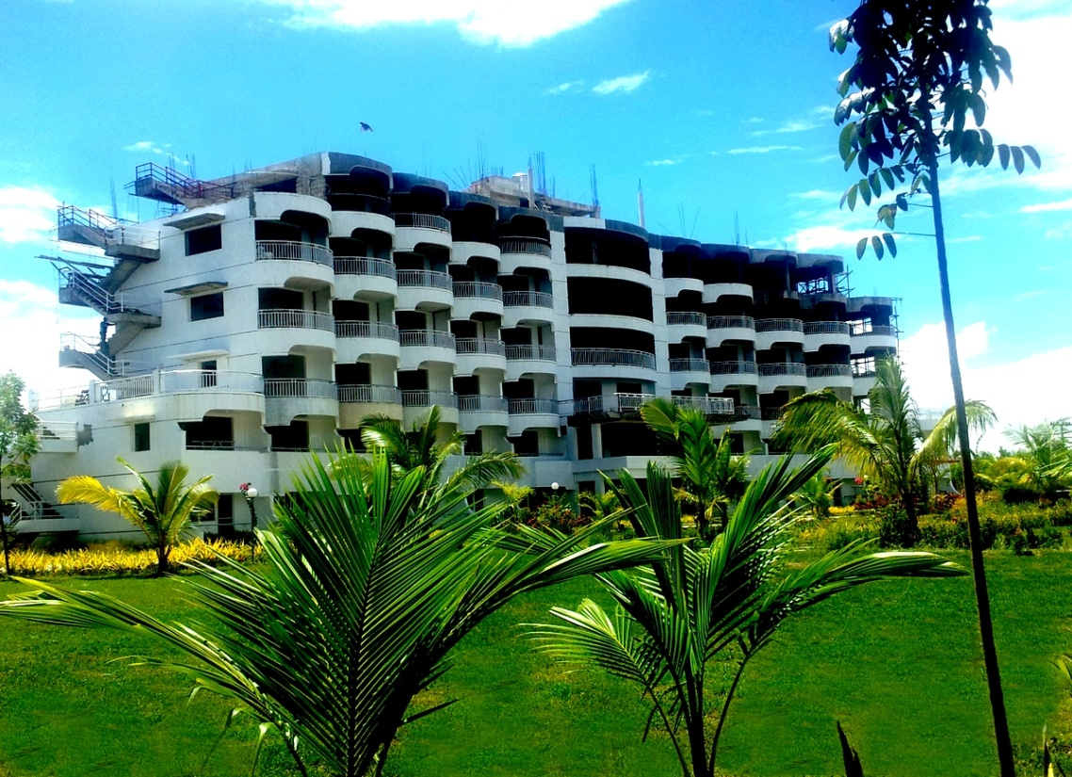
New
Proposed 6 storey Hometel

Slide 6
BathRoom
Kitchen
LivingRoom
BedRoom
.
Rooms
6 Storey Hometel

Slide 7
Amenities

Slide 8
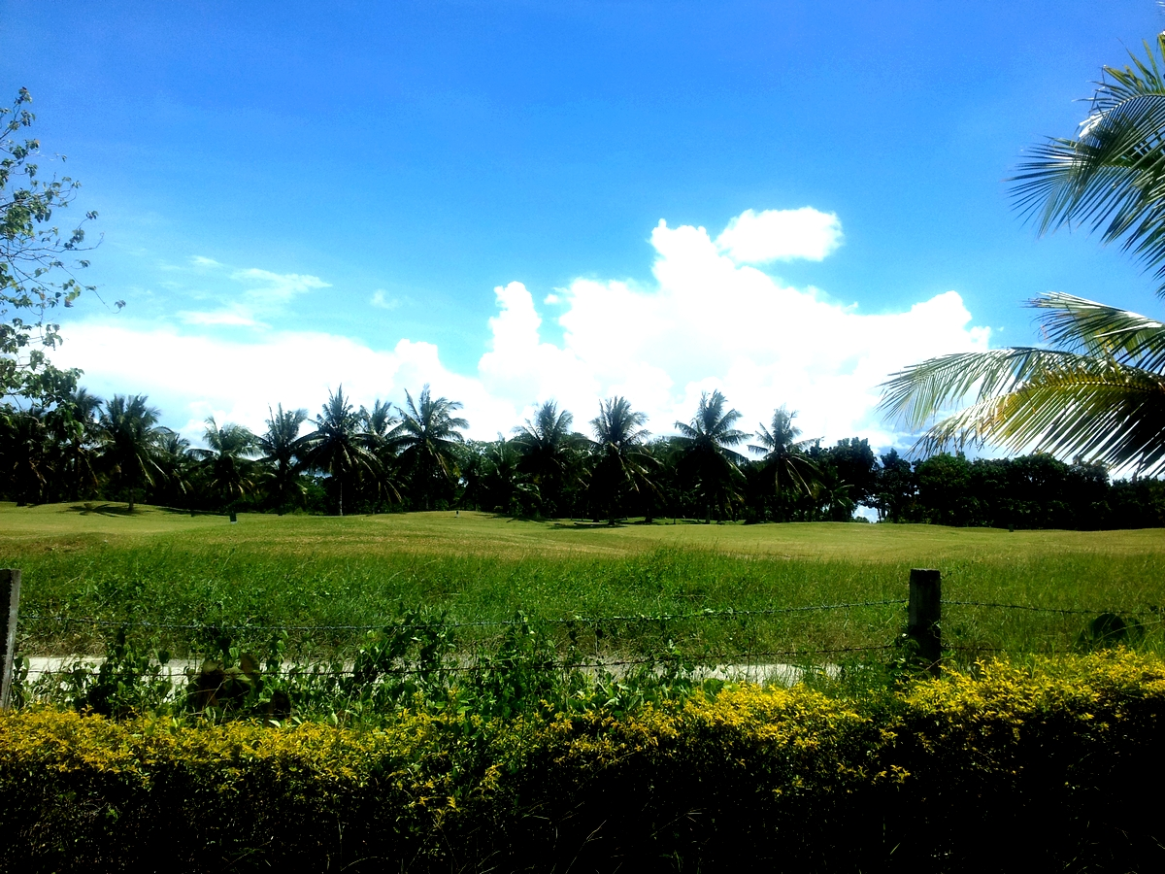
Golf
18 Holes

Slide 9
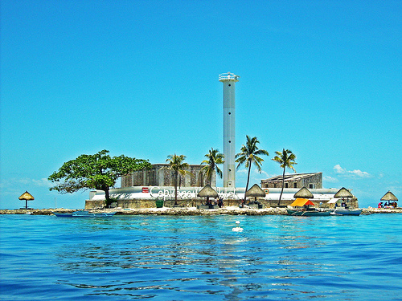
And Many Others Activities
Pumb Boat/Island Hopping :
Capitancillo
Malapascua

Slide 10
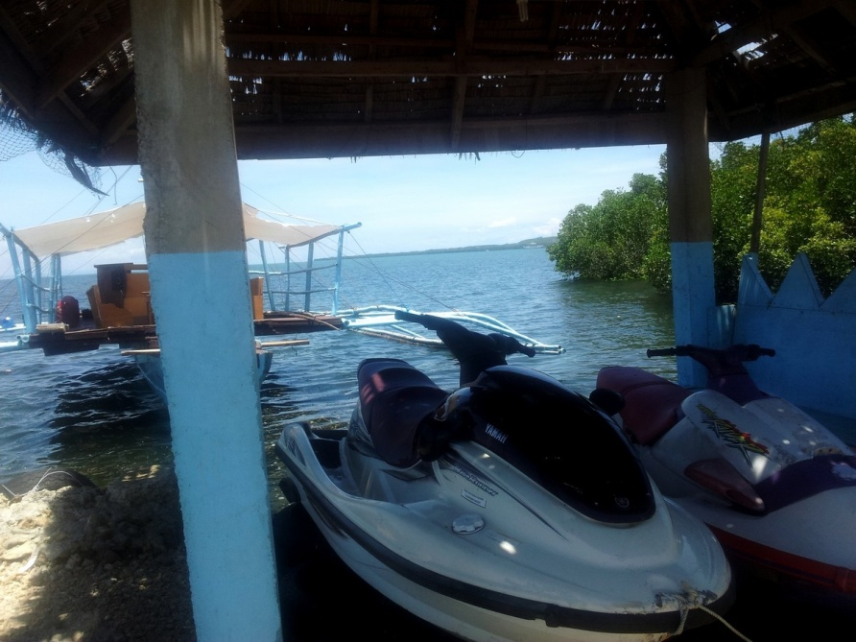
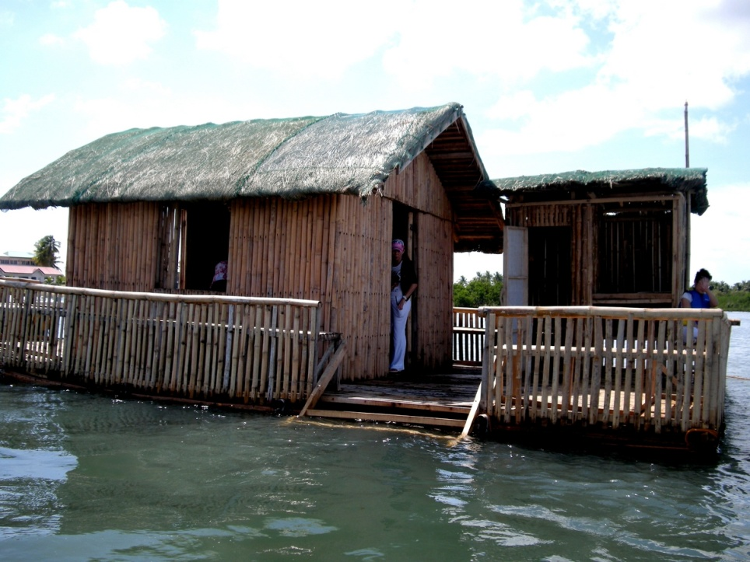
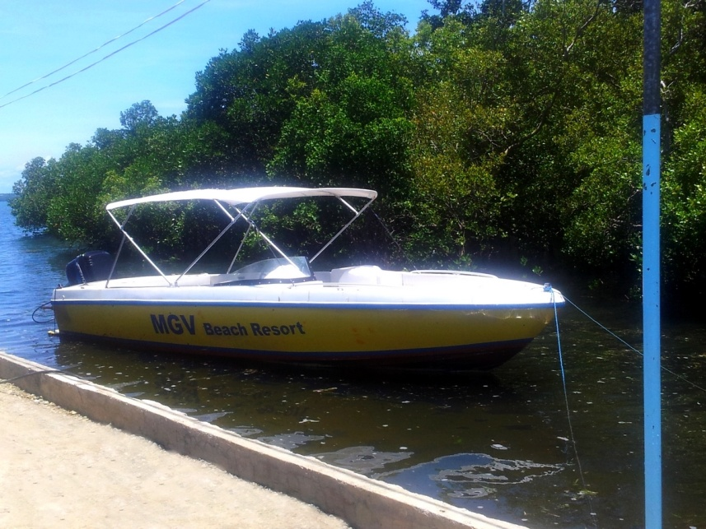
And Many Others Activities
Water sport :
Speed boat and Jetski
Floating mini restaurant

Slide 11
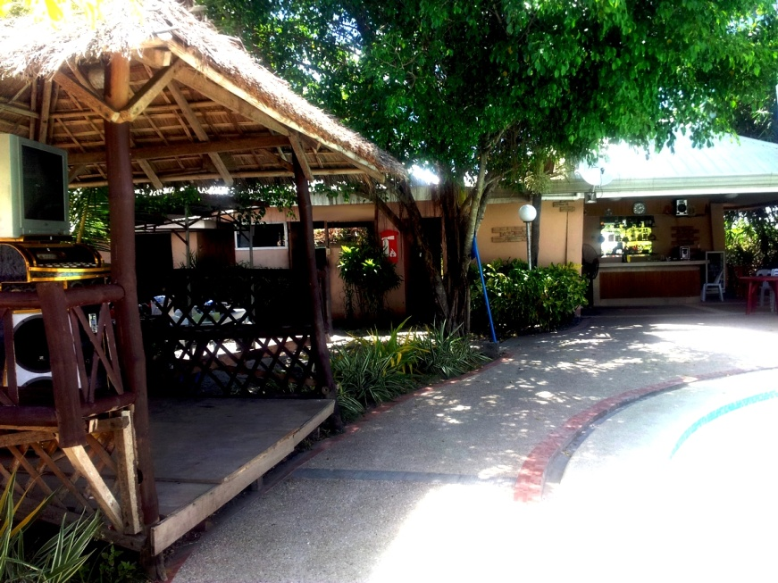
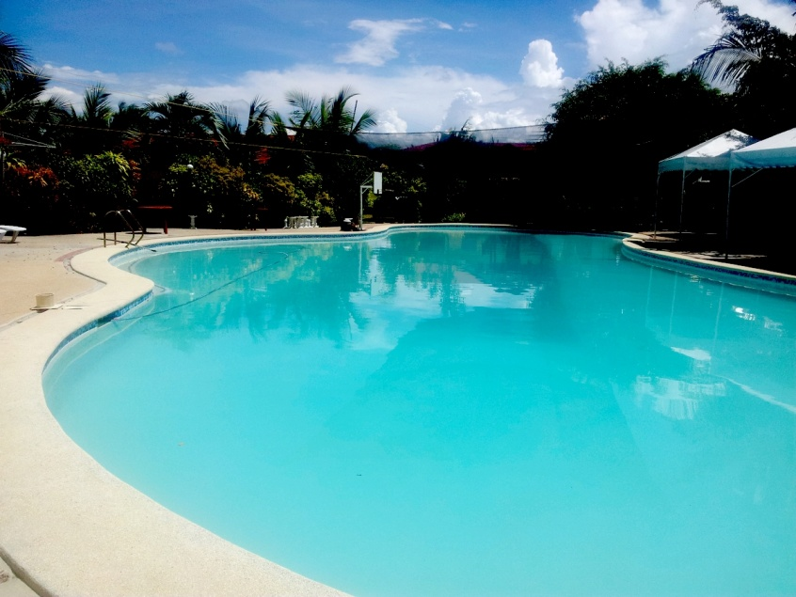
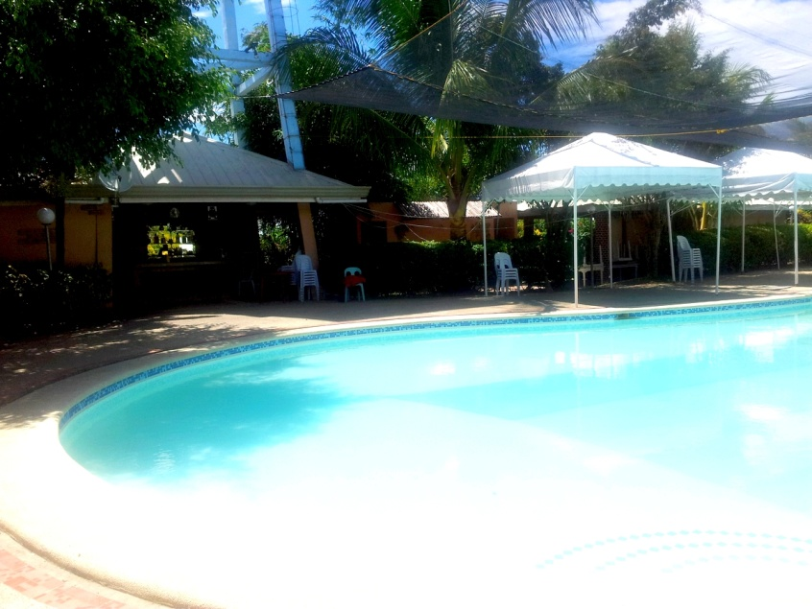
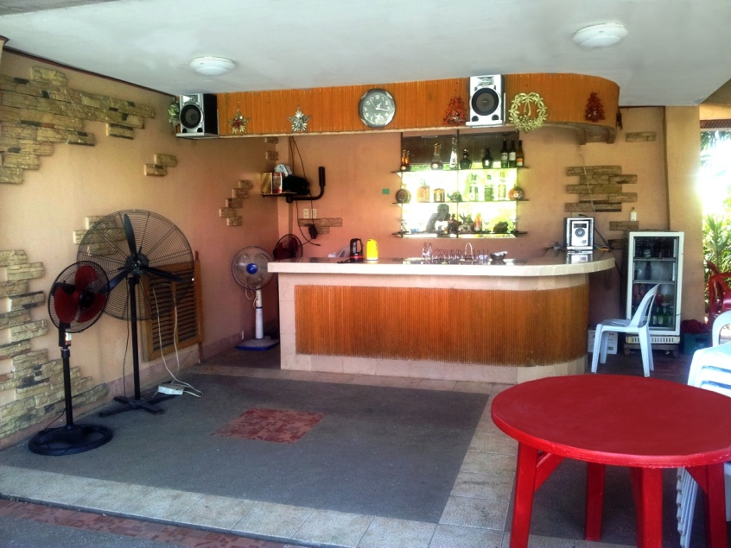
And Many Others Activities
Swimming Pool

Slide 12
And Many Others Activities
Casino and Games :
Billiard Hall
SPA/Massage Clinic
Wedding Accomodation

Slide 13
Restaurant
 Korean Food
 Philippin Food

Slide 14
Contact

Slide 15
Contact the Office
Movies and Website
Reservation and Queries Call: (032)-516-0900 (032)-513-0841 (032)-513-0842

