Slide 1
Background and rationale
What are the components of the adult hematopoietic stem cell “niche”? Osteoblasts (Calvi, 2003; Zhang 2003), osteoclasts (Kollet,2006), megakaryocytes, platelets, adipocytes, CAR cells (Sugiyama, 2006), Endothelial cells (Kiel, 2005; Ding 2012), perivascular cells (Ding, 2012).
One way to address this question is to build new niches out of the adult bone marrow.
How? Need to mobilize HSCs out of the bone marrow, to retain HSCs in the new site, and to provide a conducive microenvironment for HSCs properties maintenance.
Mobilization is done by many ways (G-csf…), retention and building a new microenvironment is not easy. For example injection of HSCs on different sites ( MI, regenerating liver, muscle…): they adopt hematopoietic fates (Balsam, 2004) and disappear after 7 days (Murry, 2004). HScs have been shown to reside next to Ecs in the spleen when after mobilization with G-csf (Kiel,2005): do sinusoids create a vascular niche that regulate HSC maintenance or are the HSCs on their way to the BM endosteum?
[Moreover, generally extramedullary hematopoiesis is induced under pathological hematopoiesis condition . We would like to build a new niche on top of the bone niche.]
Why VEGF? Clinical observations link high levels of VEGF to CASS (Cancer associated systemic syndrome) syndrome that includes extramedullary hematopoiesis
Circulating levels of VEGF have been shown to mobilize and induce extramedullary hematopoiesis (Rafii, 2001) but identity and quality of the niche were not questioned.
We have shown that VEGF induces mobilization and recruitment of hematopoietic cells through upregulation at perivascular sites of SDF. Importance of this chemokine for HSCs….

Slide 2
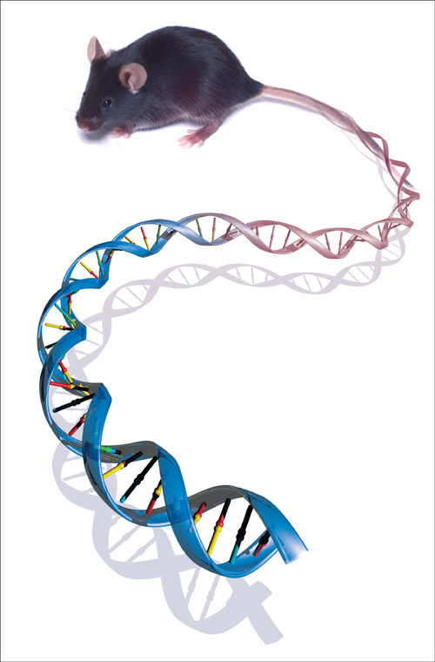
A Binary Transgenic System for Conditional and Reversible expression of VEGF in Selected Organs
Driver line
pLAP-tTA
Responder line
pTet-VEGF164
X
Double transgenic mice
Express VEGF in hepatocytes
when tetracyclin is omitted from drinking water
+ Tetracyclin
no Tetracyclin
birth
2 months
2 months
Hepatomegaly
Splenomegaly
Anemia, Red blood cells dysmorphia, Platelets defects

Slide 3
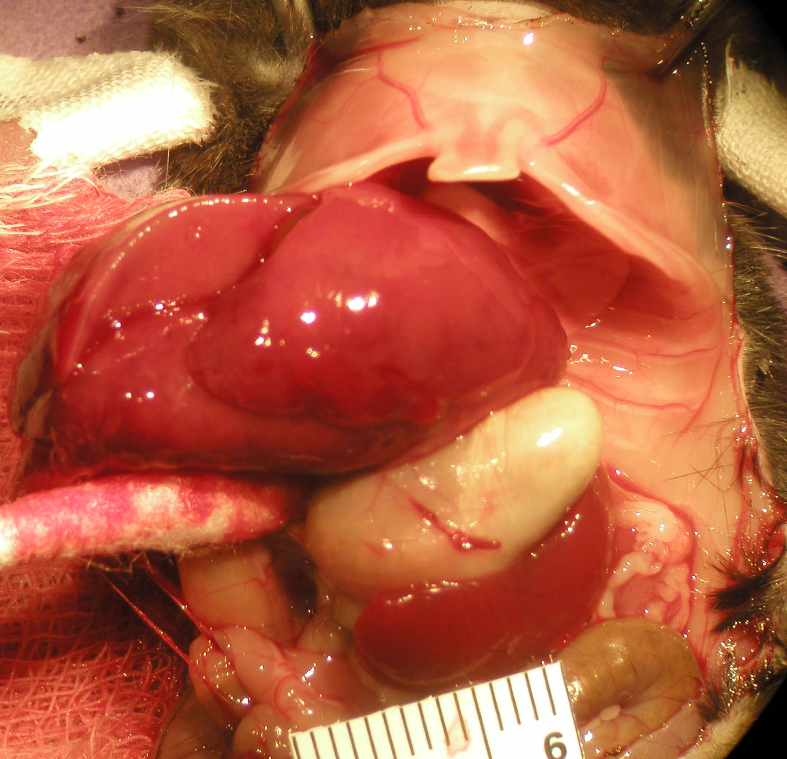
High levels of circulating VEGF induce Hepato- and splenomegaly
Enlarged Liver
Enlarged Spleen

Slide 4
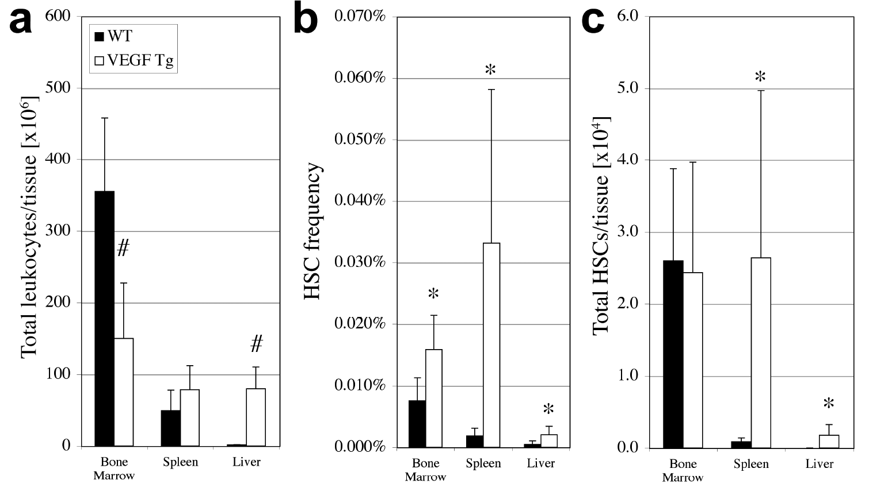
High levels of circulating VEGF (>1ng/ml) induces amplification of LT-HSCs and their “relocation “ in liver and spleen
1. Amplification of HSCs in extramedullary tissues: Analysis By SLAM markers
HSCs pool has been amplified, especially in spleen, same number in BM
Notes:
Same mouse, 3 different “niches”
Total number has doubled (at least)

Slide 5
What is the origin of the extramedullary hematopoiesis? Adult BM HSCs or activation of Liver and spleen HSCs?
Lethal irradiation
BM transplantation
Actin- GFP
Actin- B-gal
2months
Check chimerism
TG mice
We should protect liver and spleen
From irradiation
VEGF switched ON
3 weeks
Analysis of HSCs, CFU
Hematopoiesis is donor derived (see
Next slide for Liver)

Slide 6
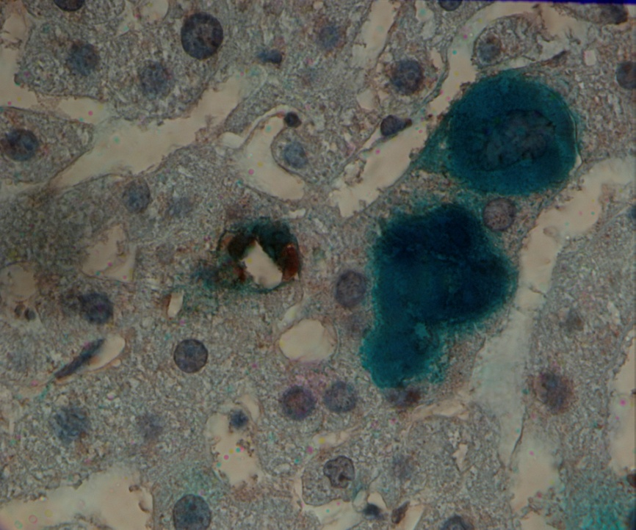
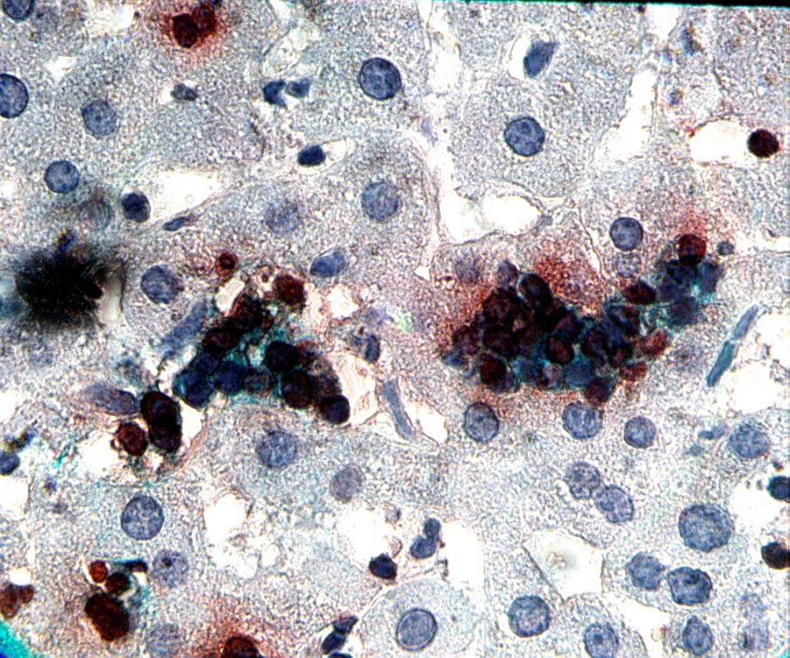
Liver hematopoiesis is of BM origin
Spleen hematopoiesis is of BM origin ? Only done once with GFP tagged BM, seems that
Lin- Sca1+cKit CD41- CD48- CD150+ HSCs are gfp positive

Slide 7
Are HSCs found in extramedullary sites functional ?
1. Reconstitution of lethally irradiated mice with mononuclear cells from TG livers
Mononuclear liver cells originating from VEGF switched ON mice contain hematopoietic cells that are endowed with long term engraftment potential.

Slide 8
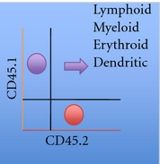
Competitive Repopulation Assay
1,000 cGy
300K cells from
LV ON
BM ON
SP ON
LV control
BM control
SP control
Wild type host
(Ly 5.1)
Donor
Ly 5.2)
Hematologic Recovery
and
(6 months)
(Wild-type Ly 5.1)
1:1 Ratio of
Bone Marrow Cells
Bone Marrow Chimera
10 mice each
(5 x 10⁶ cells)

Slide 9
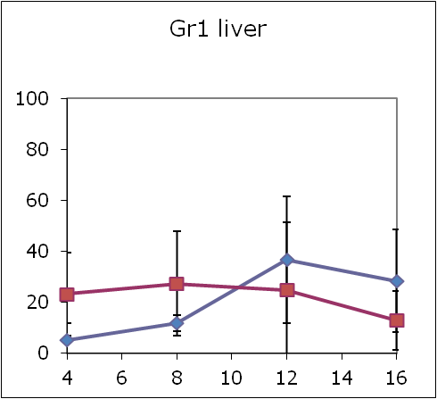
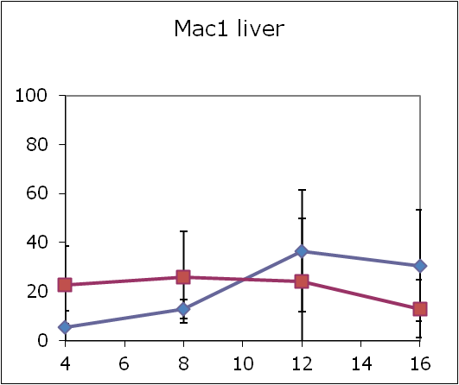
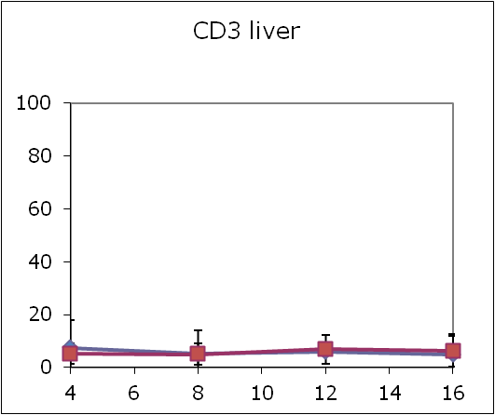
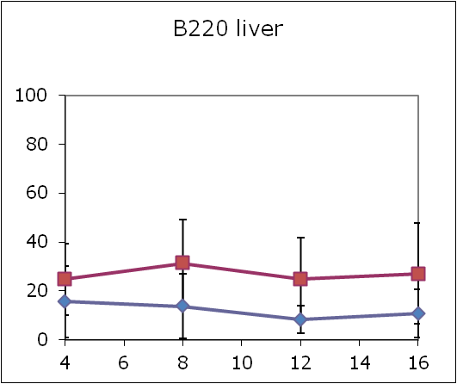
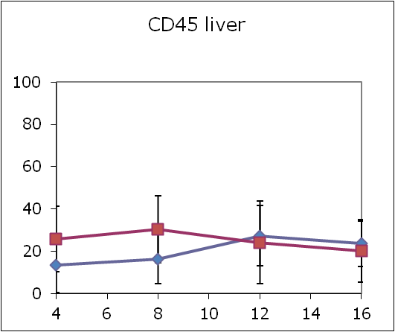
2. Competitive repopulation assay
Cells isolated from Liver
VEGF
WT
Notes:
Do we need to show the reconstitution assay (without competition)?

Slide 10
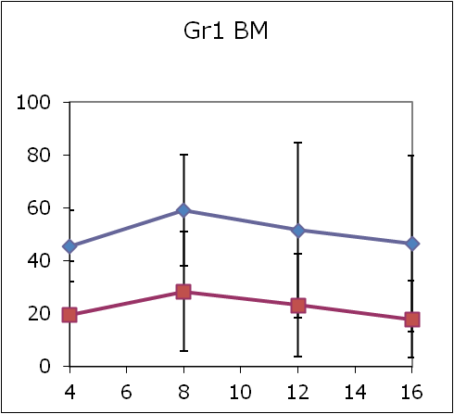
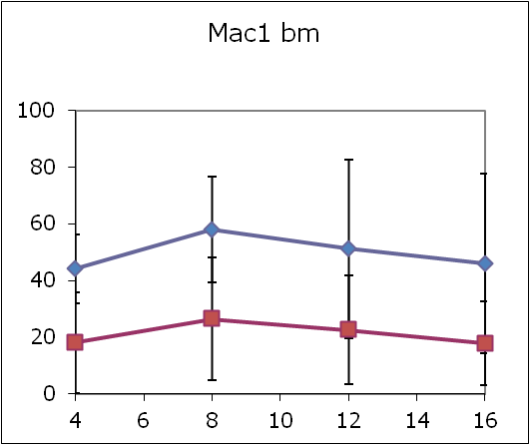
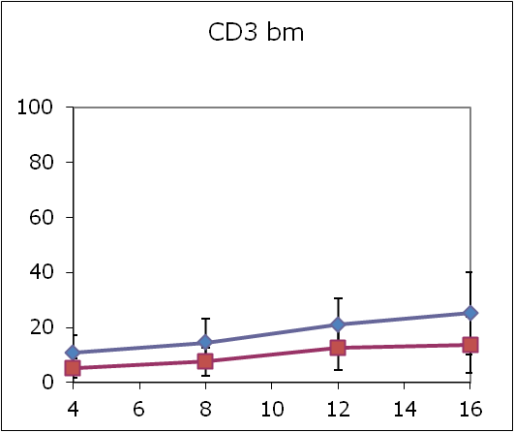
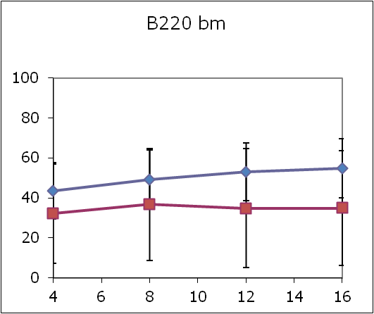
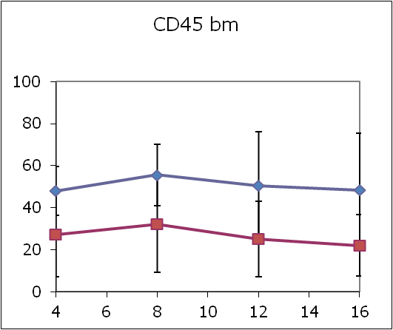
2. Amplification of HSCs in extramedullary tissues: By functional assay
Cells isolated from BM
VEGF
WT

Slide 11
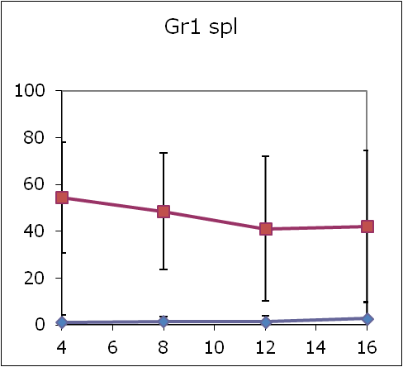
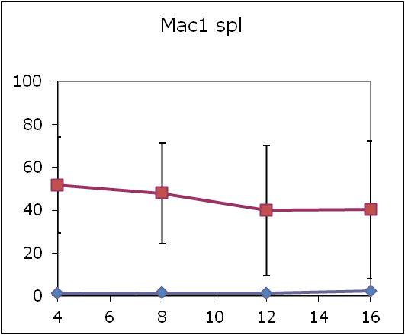
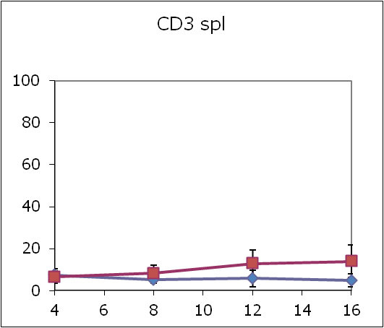
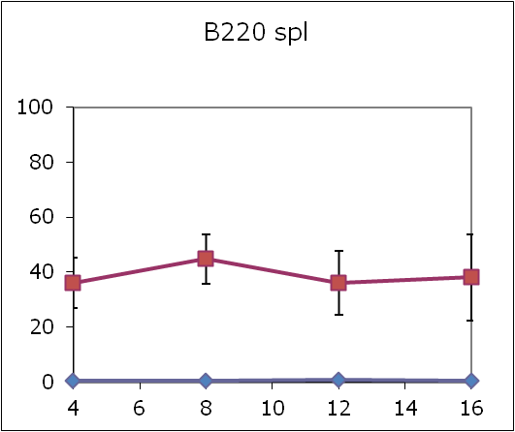
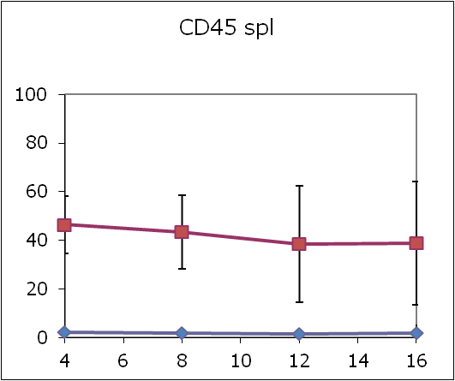
2. Amplification of HSCs in extramedullary tissues: By functional assay
Cells isolated from Spleen
VEGF
WT
in adult mice, spleen seems to be the only tissue that can provide a niche beside the Bone

Slide 12
Cycling status of HSCs in the different compartments
Use BrdU and Ki67 and PI?
Notes:
Important for 2 reasons: where takes place the amplification?
Could explain the reconstitution potential (cycling HSCs are less competitive)

Slide 13
What’s the outcome of VEGF induced EMH?
1. Blood analysis: represents the output from three different locations (BM, Liver and Spleen)
 | WBC c/ul |  | RBC c/ul |  | HGB g/dl |  | HCT |  | PLT
VEGF | 700 | 84.85281 | 576666.7 | 156950.1 | 0.4 | 0.1 | 2.6 | 0.6 | 161400
control | 1447.5 | 547.9887 | 1166000 | 104067.3 | 1.316667 | 0.231661 | 6.46 | 0.861974 | 76000
Reduced numbers of white blood cells (Less neutrophiles),
reduced number of red blood cells, anemia,
Reticulocytes number increases (not shown),
huge number of platelets (even at lower Levels of VEGF)

Slide 14
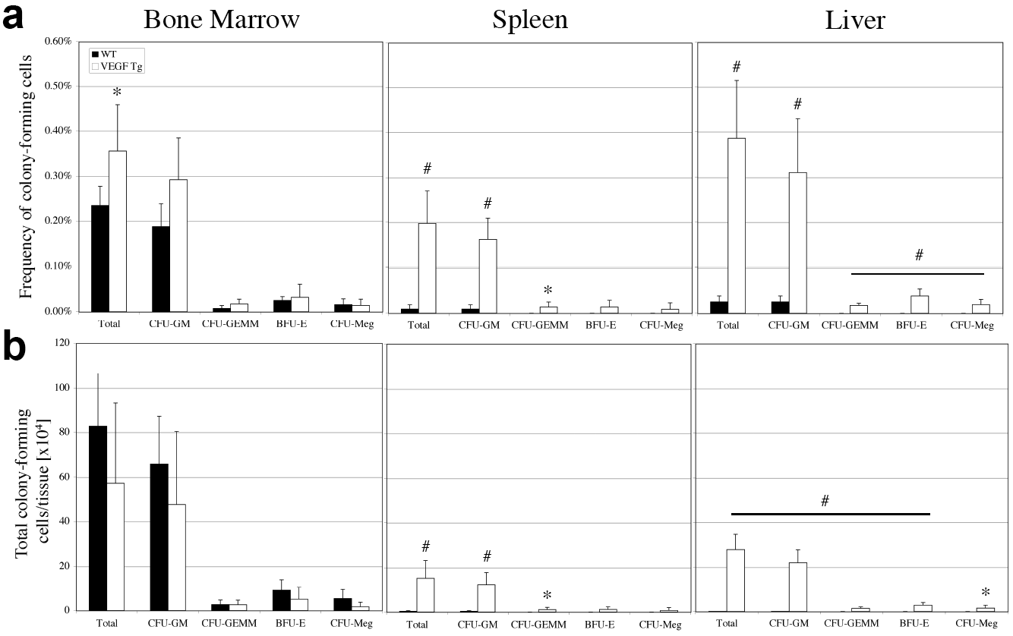
VEGF over-expression increases CFU-Cs in extramedullary tissues
Hindlimbs estimated to comprise 25% of total marrow; * indicates 0.01<p-value<0.05; # indicates p-value<0.01.
Notes:
Slide 31.

Slide 15
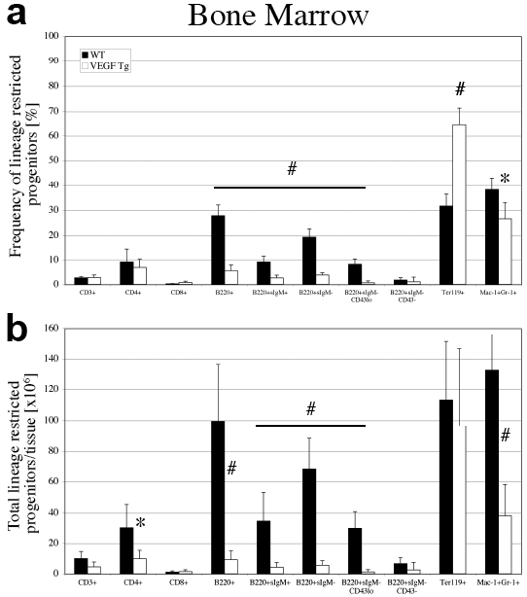
VEGF over-expression in liver leads to changes in bone marrow hematopoiesis
Notes:
Slide 31.

Slide 16
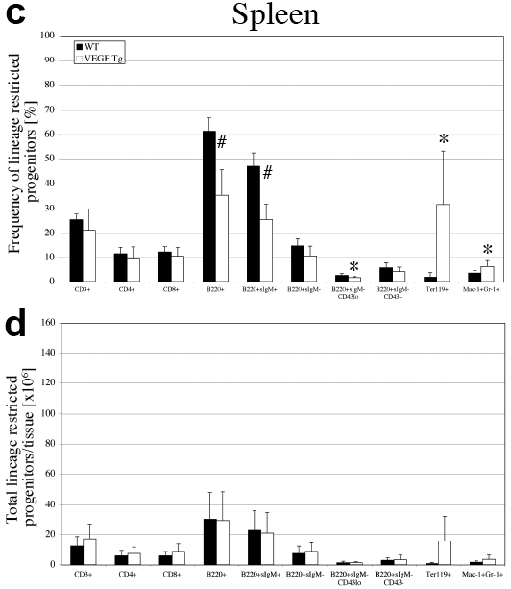
VEGF over-expression in liver leads to changes in spleen hematopoiesis
Notes:
Slide 31.

Slide 17
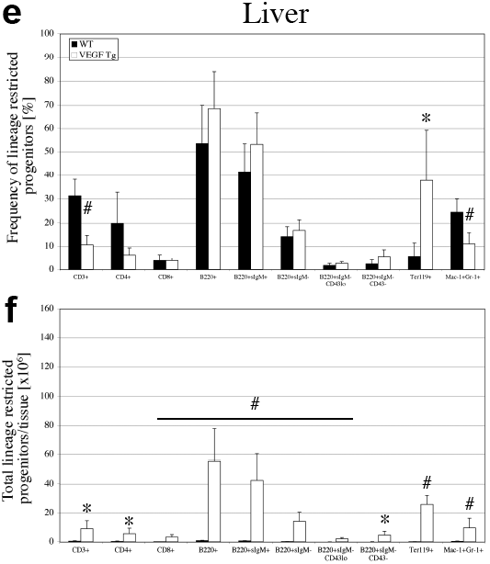
VEGF over-expression in liver leads to changes in liver hematopoiesis
Notes:
Slide 31.

Slide 18
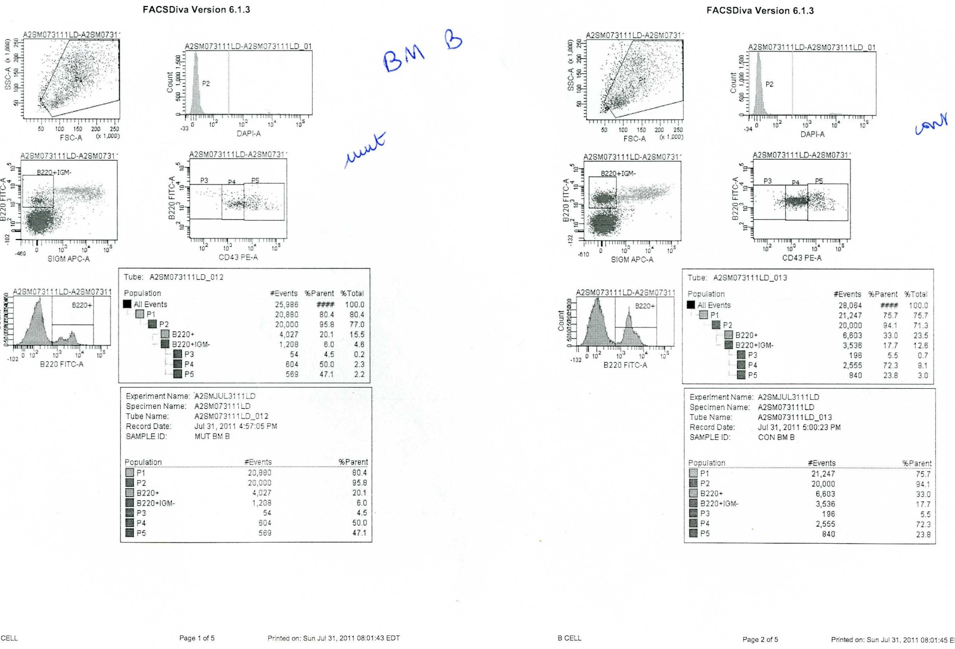
Hematopoiesis profile in BM
Mutant BM
1. B cells
WT BM

Slide 19
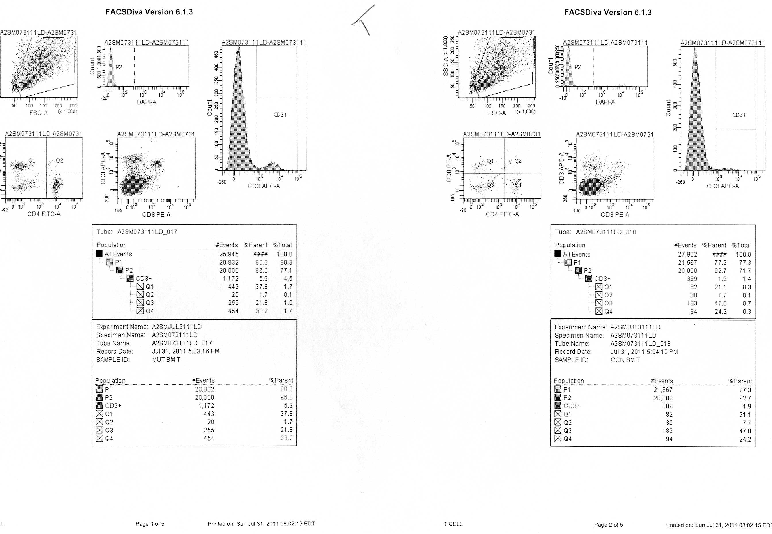
Mutant BM
2. T cells
WT BM

Slide 20
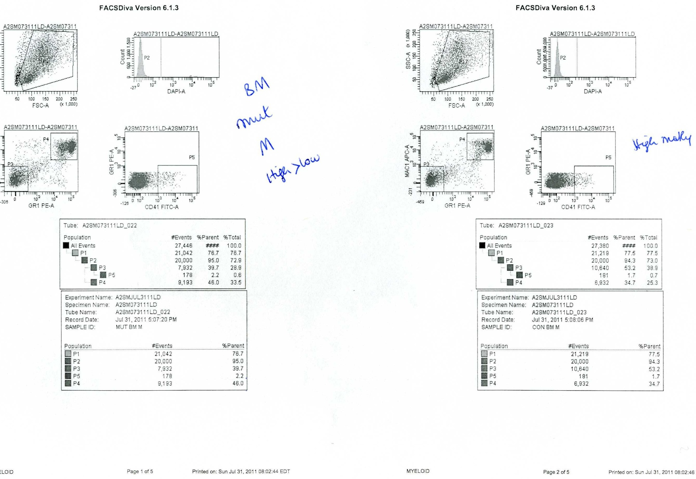
Mutant BM
3. Myeloid cells
Monocytes and megakaryocytes
WT BM

Slide 21
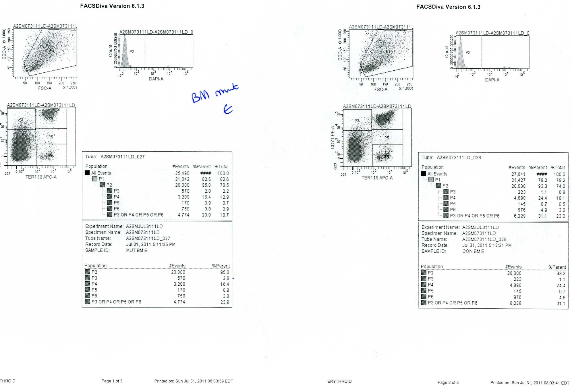
Mutant BM
4. Erythropoiesis
WT BM

Slide 22
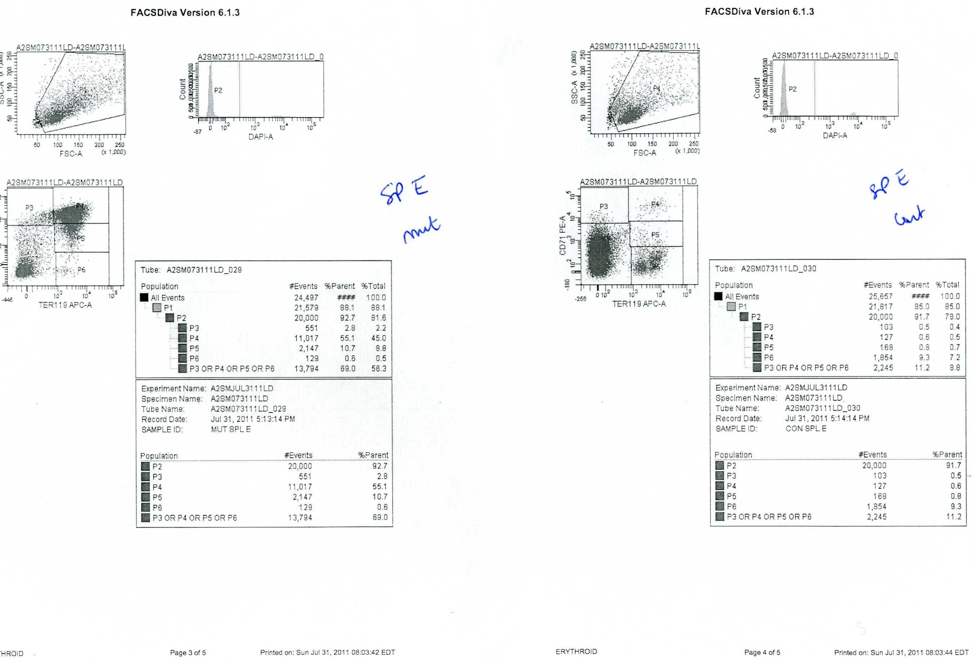
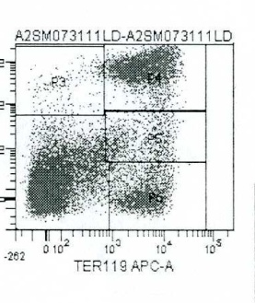
Erythropoiesis
Control BM
VEGF BM
VEGF Spleen
Control Spleen
Abnormal differentiation
VEGF Liver

Slide 23
Is on going VEGF needed for the maintenance of extramedullary hematopoiesis?
1. ON-OFF experiments
VEGF ON
VEGF OFF
3 weeks
3 weeks
HSCs presence analysis by FACS
HSCs detected only in BM and Spleen

Slide 24
Is on going VEGF needed for the maintenance of extramedullary hematopoiesis in the spleen?
2. Spleen transplant
Hematopoietic spleen transplanted
in WT recipient mice
VEGF ON
3 weeks
2 weeks
Analysis of spleen viability (H&E by pathologist)
Spleen HSCs FACS
Contribution to circulating hematopoietic cells
20% of cd45+ cells are of spleen origin
Only 1% is observed when spleen WT is transplanted
Notes:
Should stain lymph nodes for B cells contribution
Try hamatopoietic spleen transplant in irradiated mice?

Slide 25
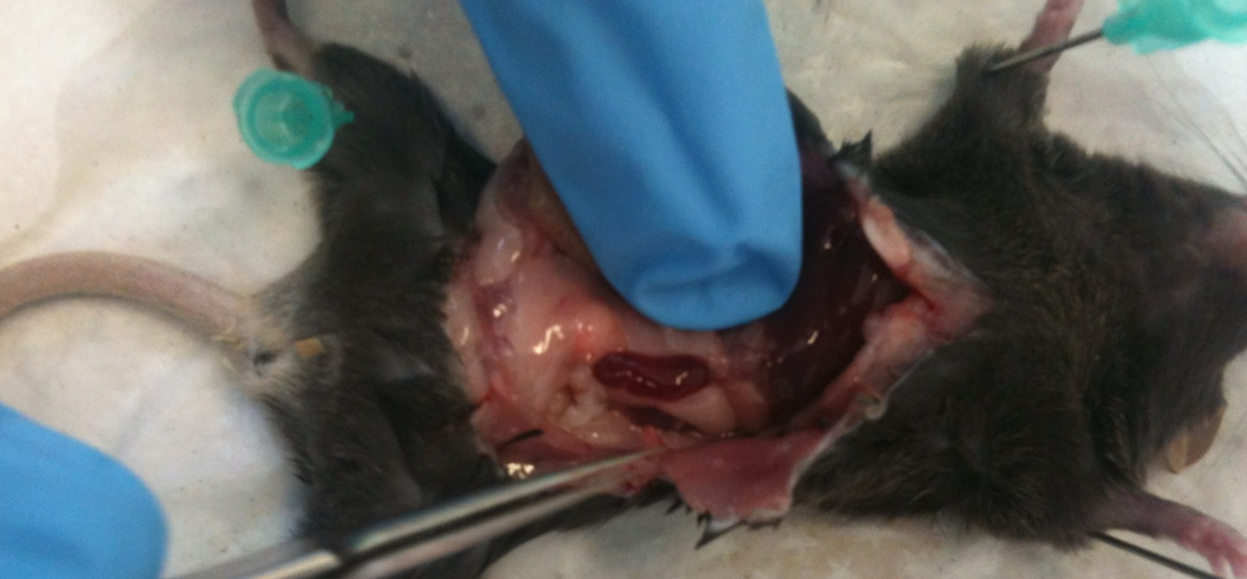
Spleen transplant
GFP tagged wt spleen transplanted in WT mouse
H&E spleen

Slide 26
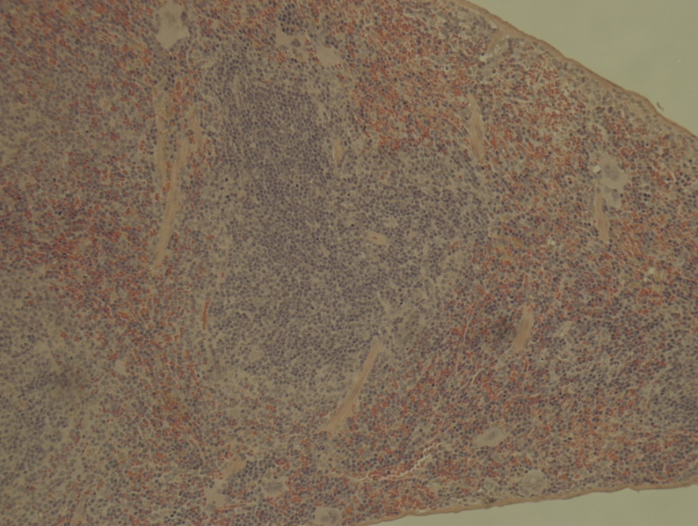
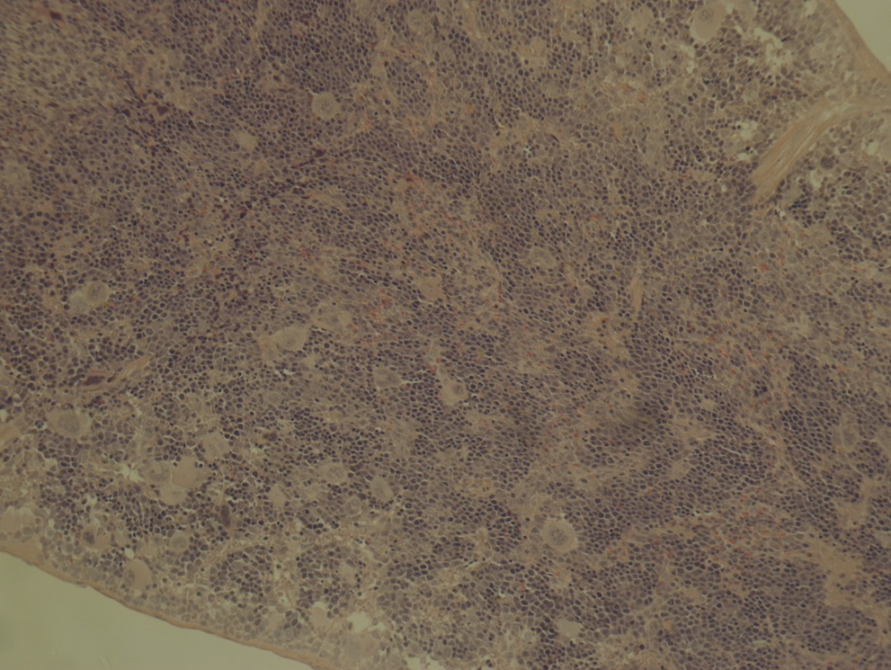
What happens in VEGF mice spleen?
WT
VEGF
H&E

Slide 27
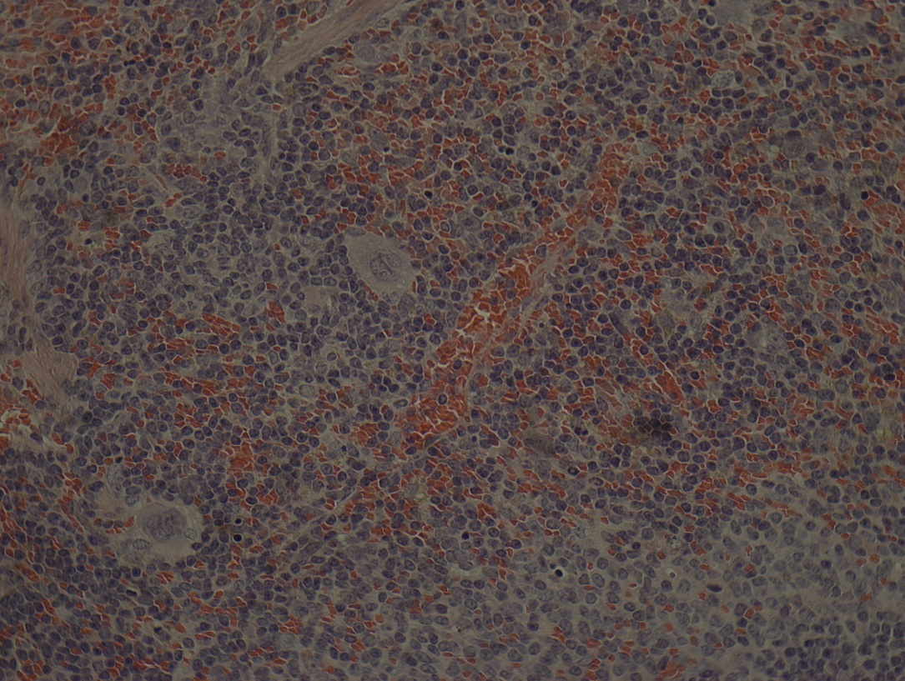
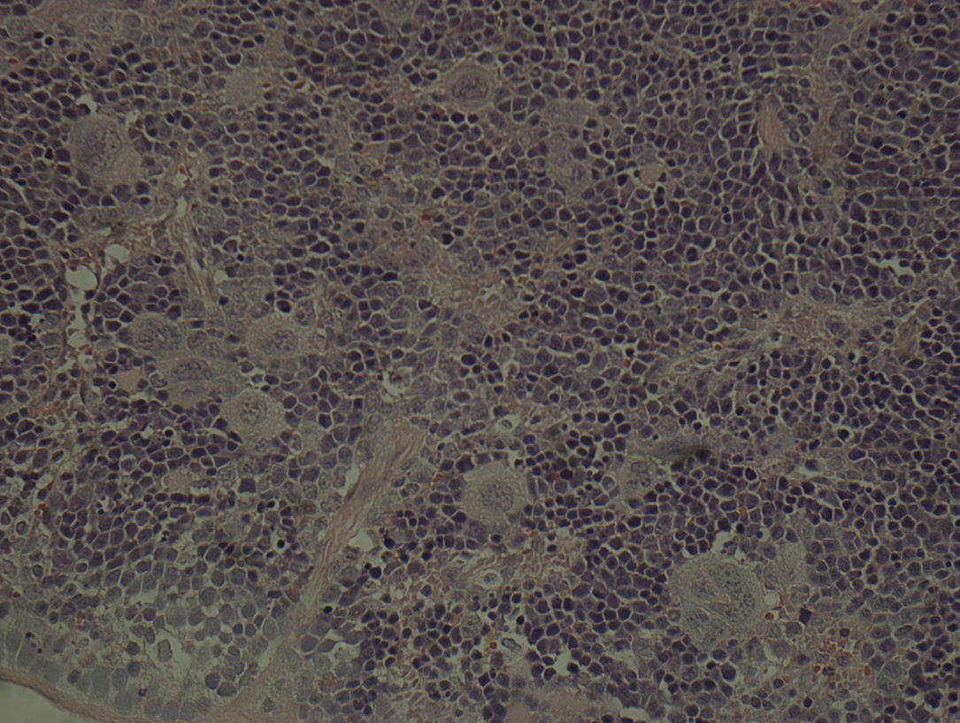
Increased number of Megakaryocytes
WT
VEGF

Slide 28
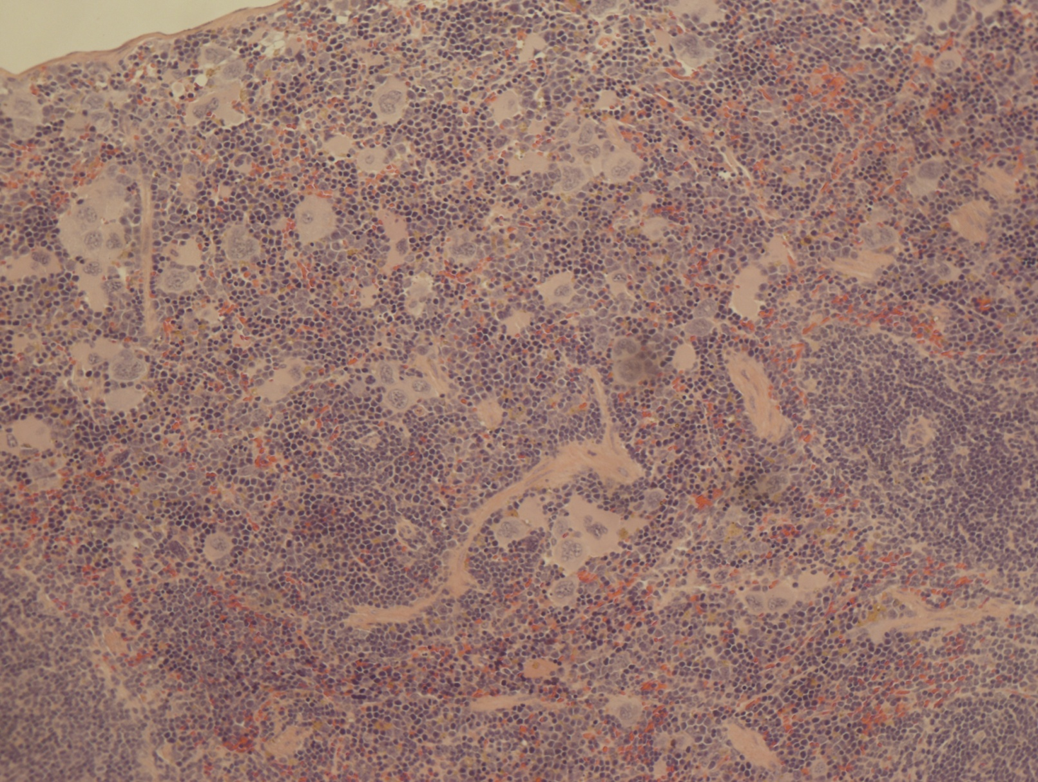
Even at low levels of VEGF (Heart switch)

Slide 29
SDF1 is important for the recruitment of HSCs to the liver and spleen
use of constant AMD3100 (minipumps for 30 days): no vascularization, no HSCs.
Other chemokines tested: Angiopoietin is increased in spleen (not in Lv)
SCF?

Slide 30
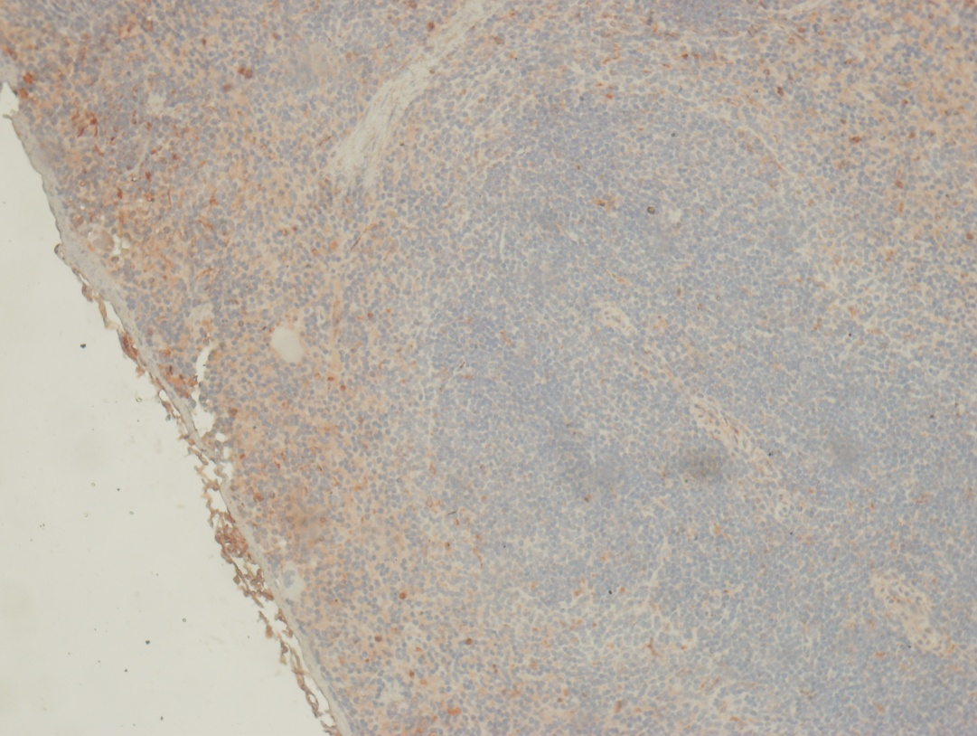
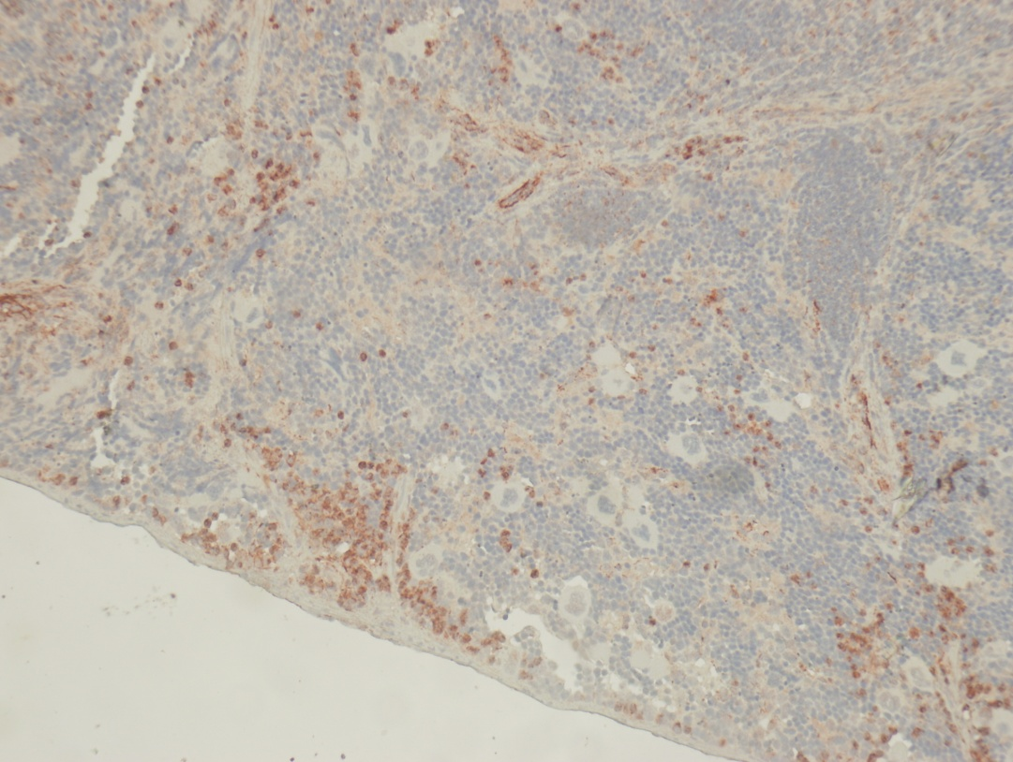
SDF is increased in VEGF spleens

Slide 31
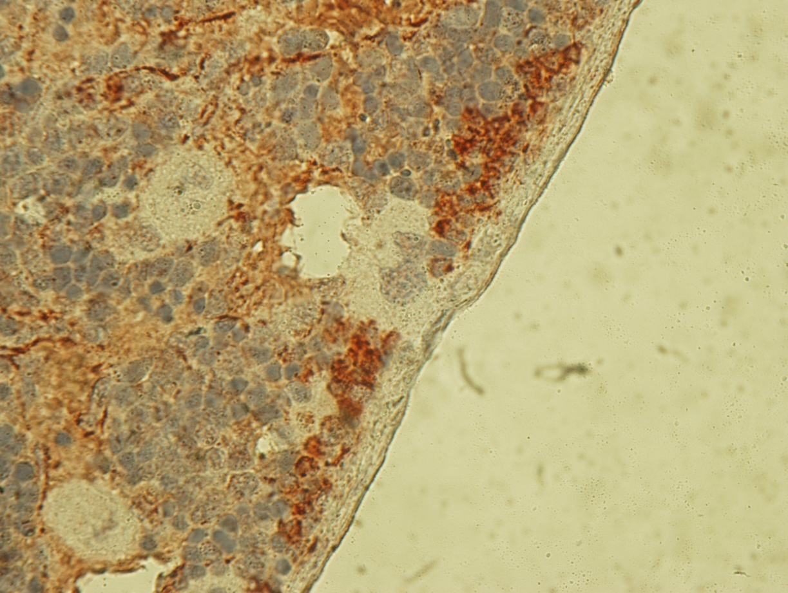
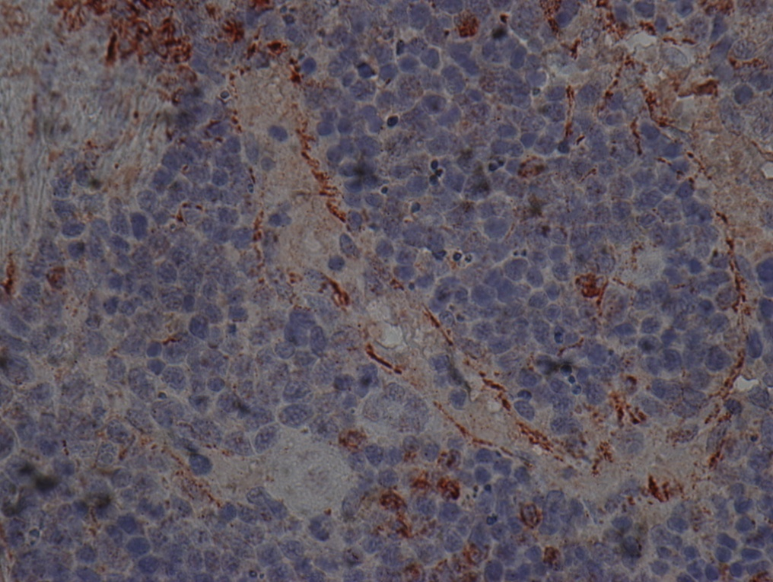
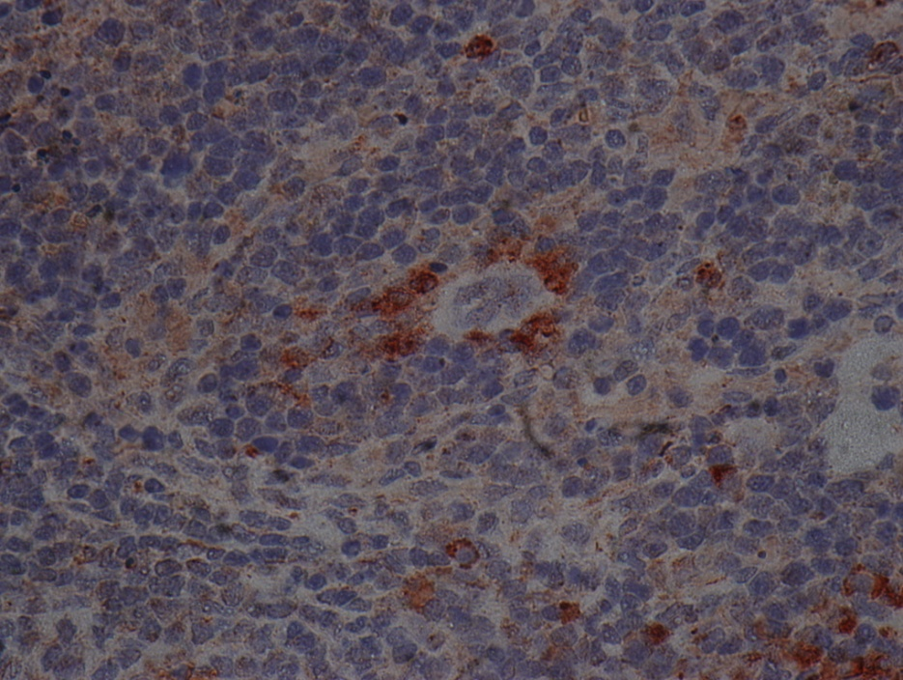

Slide 32
What is the new niche in the spleen?
No osteoblasts: vascular? Megakaryocytes? Perivascular (can we use scf-gfp mouse?)
SDF was shown to be important for recruitment/retention: staining spleen with SDF: Monocytes are positive, blood vessels, surrounding cells
should do double staining (sma, F4/80, Ecs marker)
Staining of HSCs to localize them
Can we inject HSCs (GFP+) and localize them or their progeny?
Proliferation of megakaryocytes in spleen (check presence in on-off experiment)
Notes:
What about the liver?

Slide 33
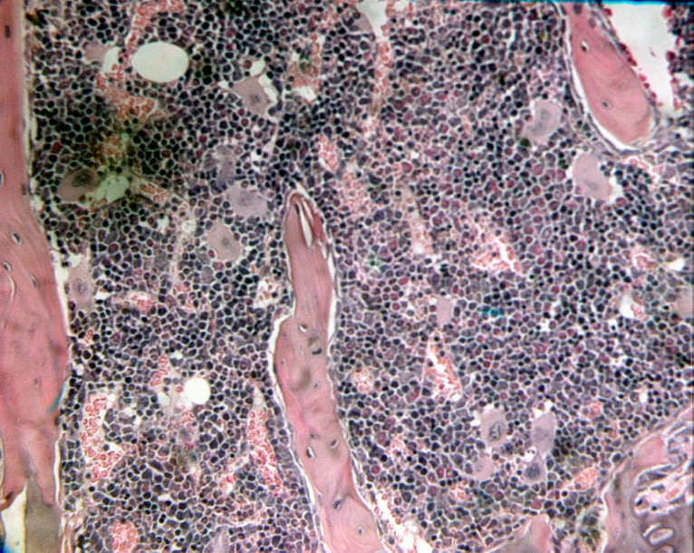
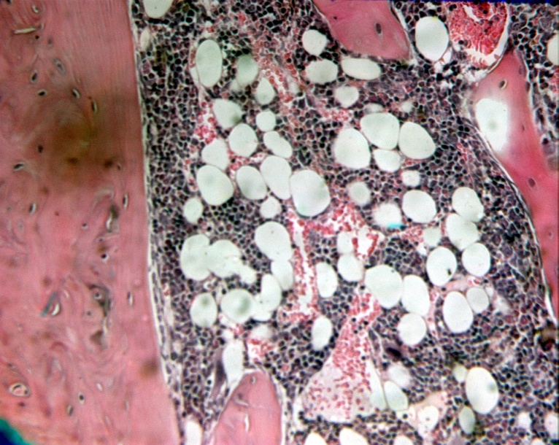
Effect of VEGF on the BM niche?
  Decrease cellularity : Adipose cells accumulation but no fibrosis
  Breakable bones
  Less Hematopoietic Progenitors
  Same number of Hematopoietic Stem Cells
  Hematopoiesis profile changes
OFF
ON

