Slide 1
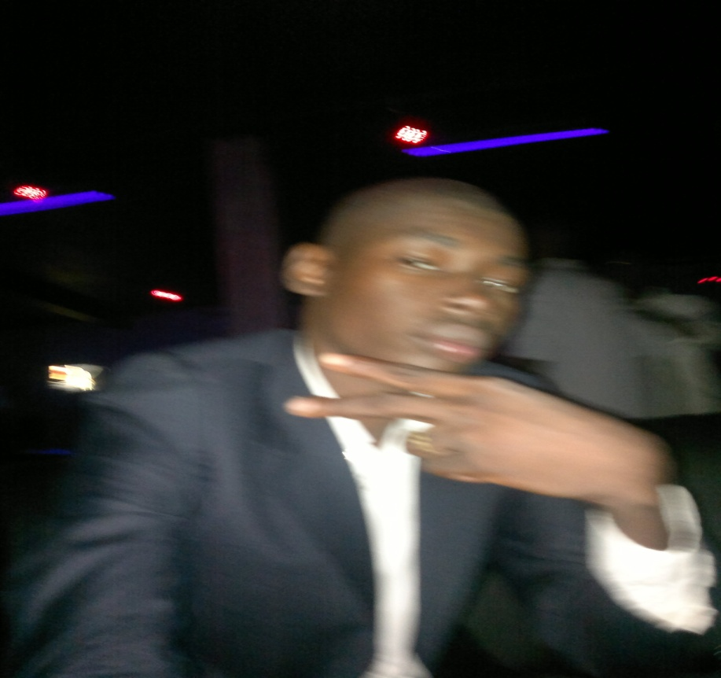
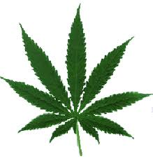
DRUGS USE AND ABUSE
4/20/2012
IUGB
BADI NATHANAEL

Slide 2
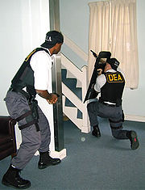
OUTLINE
Introduction
Key questions
The different kinds of drugs
Legalization of drugs
Abuse of drugs
Use of Drugs
Conclusion
Bibliography
Questions and comments

Slide 3
Key questions
What is drug ?
At what point does one speak of use or abuse of
drugs ?
Have to legalize actual illegal drugs ? If yes , how ?

Slide 4
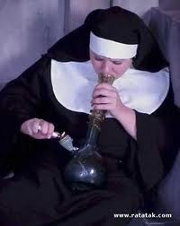
Introduction
We consider as a drug an often illegal and sometimes addictive substance that causes changes in behavior and perception and is taken for the effects. In that way, alcohol can be considered as the most popular drug. But since in many countries, it is not prohibited, so we will not consider it as a drug.

Slide 5
The different kinds of drugs
Cocaine come from Latin America.
LSD and ecstasy which are the new designed drugs from United states and Europe.
Heroin is from Pakistan, Taiwan, India and Afghanistan while the highly addictive drug which known as Mandrax which used to origined in India now they are manufactured in South Africa.

Slide 6
The different kinds of drugs

Slide 7
Legalization of drugs
Drug liberalization is the process of eliminating or reducing drug prohibition laws.
Drug relegalization
Drug legalization
Drug decriminalization

Slide 8
Legalization of drugs

Slide 9
Legalization of drugs
mandated labels with dosage and medical warnings
restrictions on advertising
age limitations
restrictions on amount purchased at one time
requirements on the form in which certain drugs would be supplied
ban on sale for intoxicated persons,
special user licenses to purchase particular drugs

Slide 10
Abuse of drugs
Why do some drug users become addicted, while others don’t?
Family history of addiction
Abuse, neglect, or other traumatic experiences in childhood
Mental disorders such as depression and anxiety
Early use of drugs
Method of administration—smoking or injecting a drug may increase its addictive potential

Slide 11
Abuse of drugs

Slide 12
Abuse of drugs

Slide 13
use of drugs
Mello Man is the perfect pill for relaxing and having a good time.

Slide 14
use of drugs
V8 is a powerful alternative to cocaine, that give you similar experience. It fuels your mind and your energy levels simply explode.

Slide 15
Why people sell drugs and have a big chance to be killed or jailed ?

Slide 16
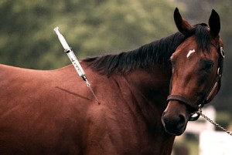
Please don’t put also the animals in this crazy behavior of human !!!!!!

Slide 17
Keep our Kids and our little brothers Safe !!!!

Slide 18
conclusion
For me the badests consequences of this phenomena are :
War because of drugs ( Columbia and Afghanistan )
More corruption

Slide 19
Bibliography
General knowledge
Wikipedia.com
www.buylegalsdrugs.net
http://www.google.fr/imghp?hl=fr&tab=ii
nature.com
http://www.justice.gov/dea/
Encarta 2011

Slide 21
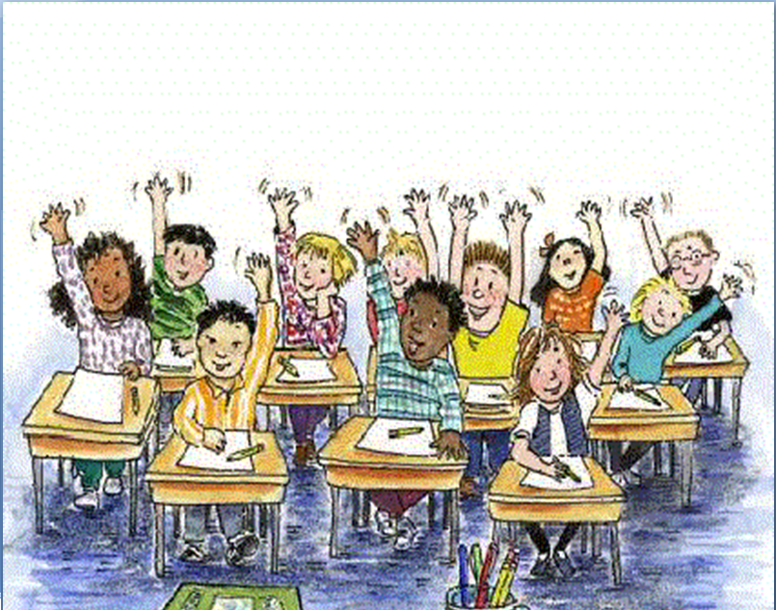
Questions and comments

