Slide 1
Julie is going to Cuba on holidays She’s preparing her travel. Look at the pictures and say what she’s already done and what she hasn’t done yet

Slide 2
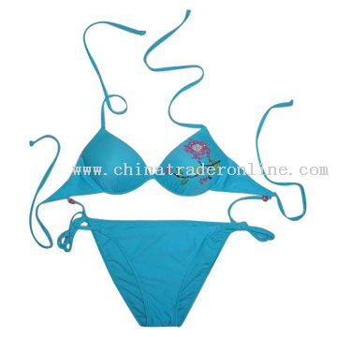
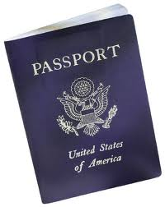
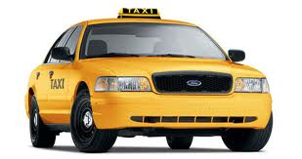

Slide 3
