Slide 1
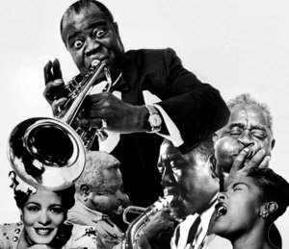
Music, characteristics and themes of Harlem Renaissance.

Slide 2
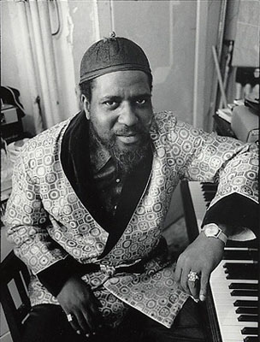
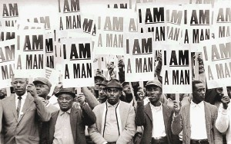
Gathering of rich and poor blacks.
During the Harlem Renaissance, the new way of playing piano helped the poor and rich blacks to get closer.

Slide 3
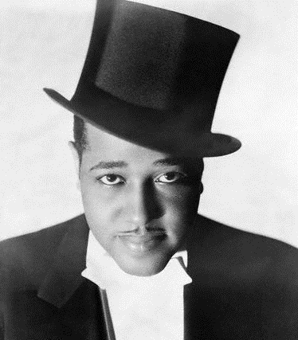
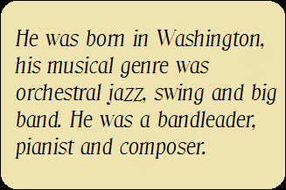
Duke Ellington
It is through this new way to play piano accompagnied by brass instruments that jazz was truly born, with several musicians such as Duke Ellington.

Slide 4
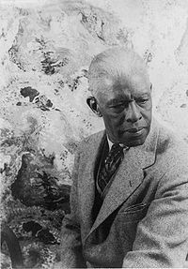
Roland Hayes
During this period, the whites were attracted by the musical style of black, and especially in the litterature, like novelists, dramatists. Even white composers used poems written by black people and were inspired by them, and put some pieces of jazz, like rhytms, melodies, in their concerts pieces. Progressively, African American began to be recognized internationnaly. The first was Roland Hayes, who was a brilllant singer.

Slide 5
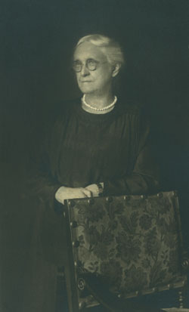
Charlotte Osgood Mason
It is thanks to the Harlem Renaissance that the blacks were able to advance their condition. This is due to the white americans such as Charlotte Osgood Mason who was coming from a wealthy family and who was a philantropist.
Born in 1855 in New-Jersey and died in 1956 in New-York.

Slide 6
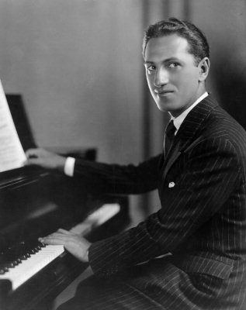
George Gershwin
There is also George Gershwin, an american and white opera composer and pianist. He is the example of whites who defied the racist attitudes and which helped the Afro-Americans to become famous.

Slide 7
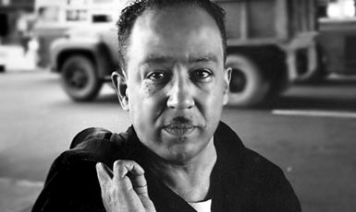
James Mercer Langston Hughes was an American poet, social activist, novelist, playwright, and columnist. He was one of the earliest innovators of the then-new literary art form jazz poetry. Hughes is best known for his work during the Harlem Renaissance. He famously wrote about the period that "Harlem was in vogue”.
These new trends have permitted to Blacks to publish their novels, newspapers and magazines. But it is mostly blacks who have succeeded in changing the habits. Indeed, we think especially Langston Hughes.

Slide 8
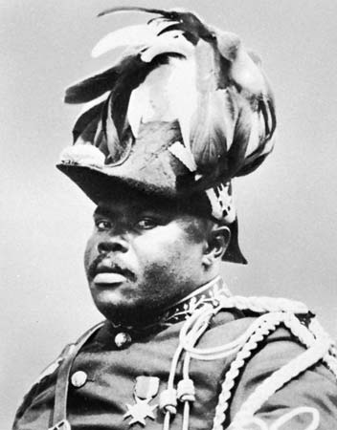
Marcus Garvey was born August 17, 1887 at St. Ann's Bay in Jamaica and died June 10, 1940 in London. He was a musician and activist.
This progress will lead to a black nationalism. One thinks especially UNIA (Universal Negro Improvement Association and African Communities League), a black nationalist fraternal organization founded by Marcus Garvey. The motto of the organization is "One God! One Aim! One Destiny!". After traveling through the United States beginning in March 1916, Garvey inaugurated the New York Division of the UNIA in 1917 with 13 members. After only three months, the organization's dues-paying membership reached 3500.
- The ideology of the UNIA is threefold: improving the lot of black people wherever they are, African independence, the return of American blacks in Africa.

Slide 9
R. Peirone / S. Laurenti.
We can therefore say that the Harlem Renaissance helped to change minds to allow black Americans to live like everyone else. Today the situation is much better, but discriminations still exist.

