Slide 1
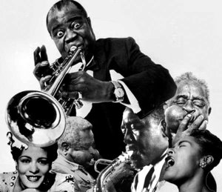
Music, characteristics and themes of Harlem Renaissance.

Slide 2
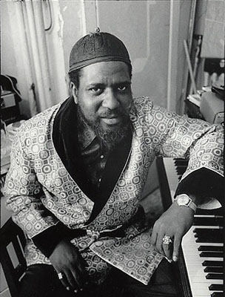
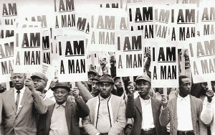
Gathering of rich and poor blacks.
During the Harlem Renaissance, the new way of playing piano helped the poor and rich blacks to get closer.

Slide 3
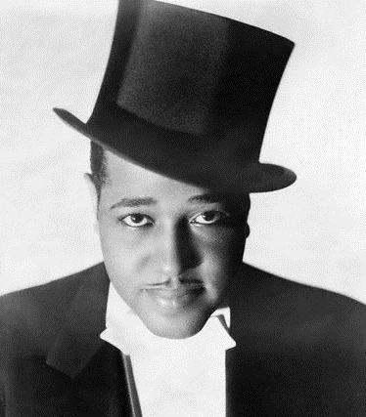
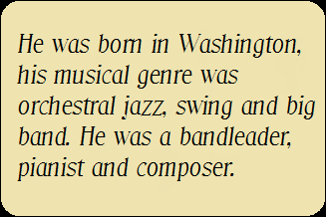
Duke Ellington
It is through this new way to play piano accompagnied by brass instruments that jazz was truly born, with several musicians such as Duke Ellington.

Slide 4
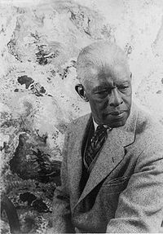
Roland Hayes
During this period, the whites were attracted by the musical style of black, and especially in the litterature, like novelists, dramatists. Even white composers used poems written by black people and were inspired by them, and put some pieces of jazz, like rhytms, melodies, in their concerts pieces. Progressively, African American began to be recognized internationnaly. The first was Roland Hayes, who was a brilllant singer.

Slide 5
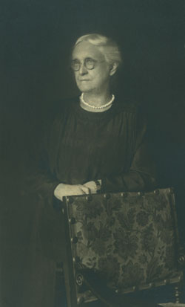
Charlotte Osgood Mason
It is thanks to the Harlem Renaissance that the blacks were able to advance their condition. This is due to the white americans such as Charlotte Osgood Mason who was coming from a wealthy family and who was a philantropist.
Born in 1855 in New-Jersey and died in 1956 in New-York.

Slide 6
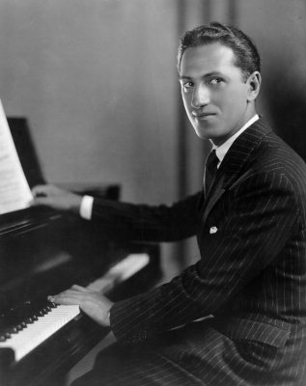
George Gershwin
There is also George Gershwin, an american and white opera composer and pianist. He is the example of whites who defied the racist attitudes and which helped the Afro-Americans to become famous.

Slide 7
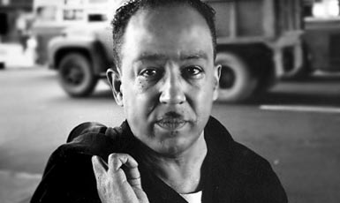
James Mercer Langston Hughes was an American poet, social activist, novelist, playwright, and columnist. He was one of the earliest innovators of the then-new literary art form jazz poetry. Hughes is best known for his work during the Harlem Renaissance. He famously wrote about the period that "Harlem was in vogue”.
These new trends have permitted to Blacks to publish their novels, newspapers and magazines. But it is mostly blacks who have succeeded in changing the habits. Indeed, we think especially Langston Hughes.

Slide 8
R. Peirone / S. Laurenti.
We can therefore say that the Harlem Renaissance helped to change minds to allow black Americans to live like everyone else. Today the situation is much better, but discriminations still exist.

