Slide 1
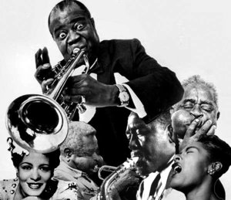
Music, characteristics and themes of Harlem Renaissance.

Slide 2
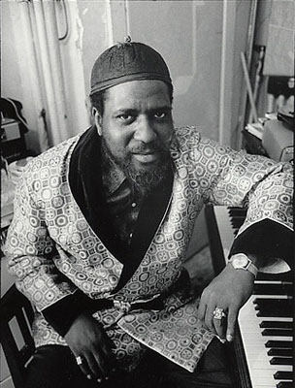
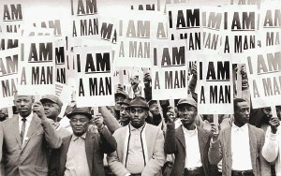
During the Harlem Renaissance , the new way of playing piano helped the poor and rich blacks to get closer.

Slide 3
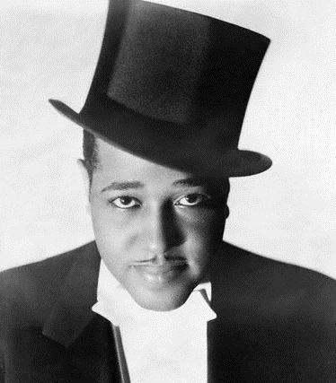
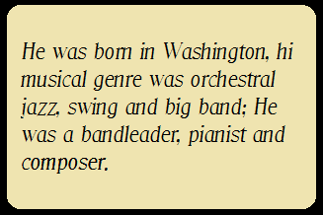
It is through this new way to play piano accompagnied by brass instruments that jazz was truly born, with several musicians such as Duke Ellington.

