Slide 1
The Atom

Slide 2
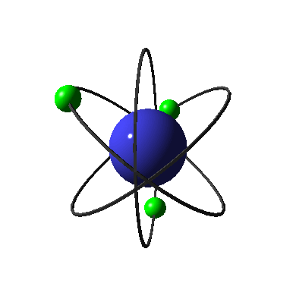
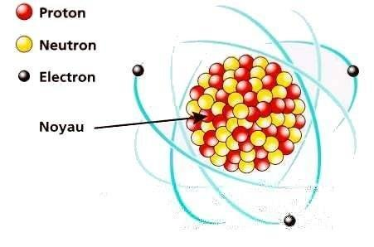
introduction
The atom is a basic unit of matter which is constitute of central nucleus and electron which turn around the nucleus. Atom is mainly made of vacuum. All the mass is inside the nucleus. the nucleus is 100,000 times smaller than the atom.

Slide 3
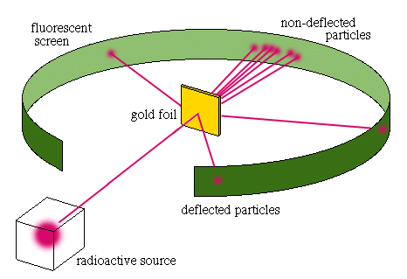
Rutherford experiment
The Rutherford experiment proved that the atom mostly consist of vacuum. experience consists in sending particles on a sheet of gold, we will observe that the particles will pass through the sheet and some will be deviated.

Slide 4
Electrical charges
The atom is electrically neutral like the neutrons but the electrons are negatively charged and the protons are positively charged. There are the same number of protons and electrons. The protons attract electrons.
The atomic number Z of an atom is the number of protons in this atom.A is the number of nucleons in the nucleus.
Ex : the magnesium atom : ²⁴₁₂Mg
24=number of nucleons
12=number of protons
N°Electrons=n°protons=12
N°neutrons=n° of nucleons-n°protons=24-12=12
^{A}_{Z}X

Slide 5
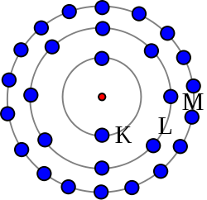
Electronic Structure
The electrons are not present around the atom, they move in an electron cloud. There are several shells called : K,L and M.
In K, there is a maximum of 2 electrons.
In L, there is a maximun and 19 electons in the shell M.
Ex : ²⁴₁₂Mg 12 electrons
K(2) L(8) M(2)
Inner Outter
Shell Shell
It was "the atom" presented by Thomas and Kevin

