Slide 1
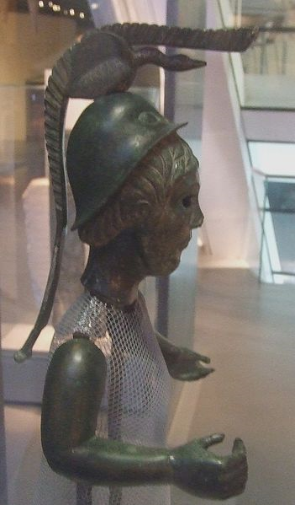
Celts
Nicolas B, Nicolas P, and Rémi R

Slide 2
Celtic’s empire ~ VIIIth century BC until IIIth century (out celtic nation)
1500-1800
(celtic nation)
6th century BC
275 BC

Slide 3
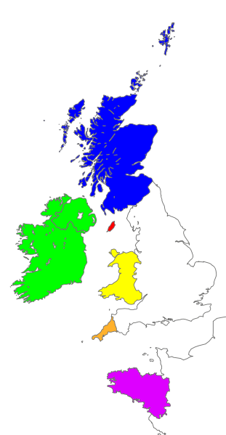
Celtic languages
The celts is diverse group in roman era, in europe, who spoke the Celtic languages.
The Celtic nations are territories in North-West Europe in which that area's own Celtic languages and cultural traits have survived :
Scotland
Ireland
Man
Wales
Cornwall
Brittany
(In Wales 21.7% of population are Native-competent speakers)

Slide 4
Celtic cross
This Celtic Cross is dating to approximately the ninth century and appearing mostly in Ireland.
Celtic cross may be a symbol of eternity and the endlessness of God's love. It can even represent a halo emanating from Christ.

Slide 5
The END

