Slide 1
Lesson one
Repeat the words
and
Look at the pictures

Slide 2
The team

Slide 3
The captain Haddock

Slide 4
Tintin

Slide 5
Professor Tournesol

Slide 6
Bianca Castafiore

Slide 7
Dupond and Dupont

Slide 8
Nestor

Slide 9
Are you a girl or

Slide 10
a boy

Slide 11
You come from France

Slide 12
You will go to England

Slide 13
to visit London

Slide 14
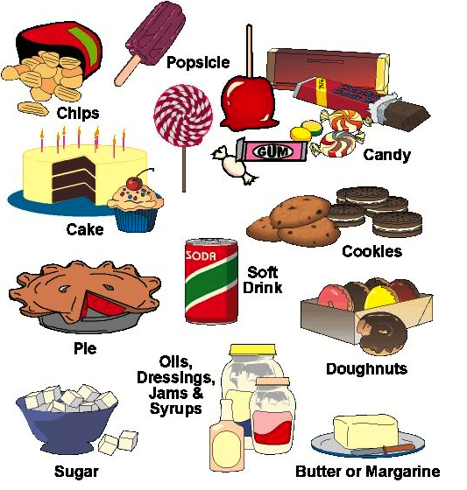
You must learn english

Slide 15
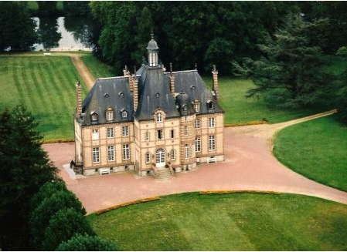
You learn english here

Slide 16
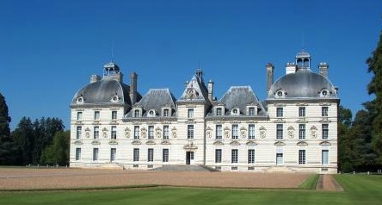
In Moulinsart

Slide 17
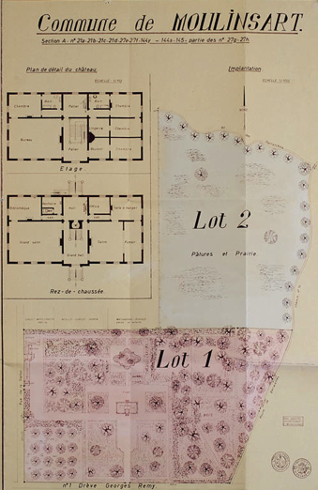
This is the map of the castle

Slide 18
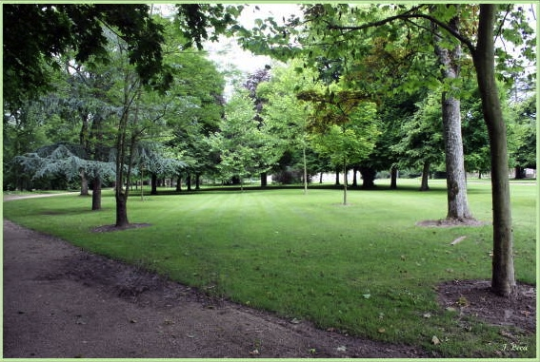
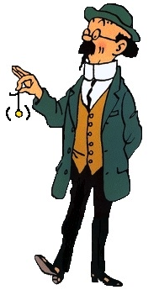
The garden with Professsor Tournesol

Slide 19
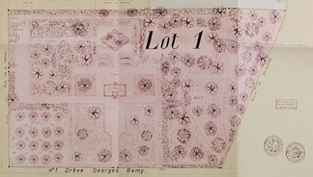
It is the garden where Tournesol ….

Slide 20
Is lost

Slide 21
directly

Slide 22
To the right

Slide 23
To the left

Slide 24
Where is the professor Tournesol

Slide 25
Les indices ….
Professor’s Tournesol hat
Shits of paper with formulas
One track of shoe
A plan of the park of Moulinsart

Slide 26
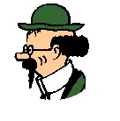
….

Slide 27
Good Good Good Good I know where it is

Slide 29
First exercice to learn vocabulary

Slide 30
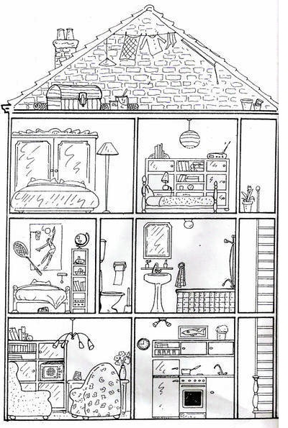
It is a house

Slide 31
The kitchen

Slide 32
The livingroom

Slide 33
The stairs

Slide 34
The room of the boy

Slide 35
The bathroom

Slide 36
The room of the girl

Slide 37
The room of the parents

Slide 38
The galetas on the top

Slide 39
Second exercice to learn vocabulary

Slide 40
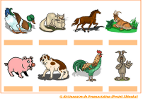
Put the good name below the good picture The duck - the rabbit- the pig - the dog- the horse - the cock- the goat- the cat.

Slide 41
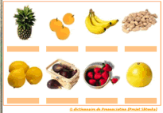
Put the good name below the good picture oranges – peanuts – ananas – lemons– strawberries – figs- apples - grapefruit

Slide 42
It is time to go to the classroom

Slide 43
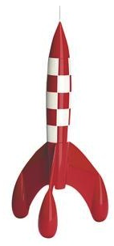
And after

